Slide 1
ETL Manager for Financial Instruments
Architecture and Design

Slide 2
Application Architecture
Vendor
Copy
SQL
App
Client
External
App
Bloomberg
Golden
Copy
ETL Manager
Middleware
Vendor
Copy
Reuters

Slide 3
Databases Design and Principles
Vendor Copy:
Components
Flat tables
Historical tables
Dictionaries
Mapping tables
Intermediate tables
Principles
No relations, all structures are flat
No transformations, data is stored as is
No normalization
“Processed” flag
Golden Copy:
Principles
Vendor Copy structures transformed into Golden Copy ones, normalized data

Slide 4
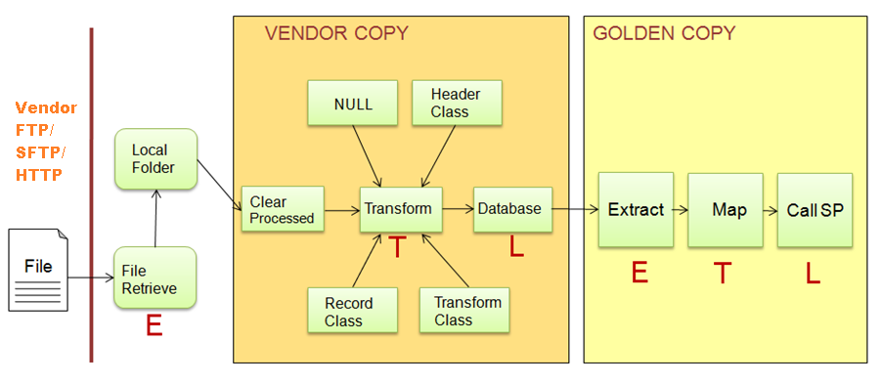
ETL Dataflow

Slide 5
ETL Manager Entities
Vendor/
Workflow Group/
Workflow
Transformation
Profile
Transformation
source/target record
file
db view
database
mappings
transfrom classes
Workflow

