Slide 1
📚
Star Publications
Desktop Publication Management System
C# 12 · WPF · Entity Framework Core 8 · MVVM · SQL Server
C# Final Project — System Demonstration

Slide 2
Project Objective & Overview
What was built and why
Objective
Project at a Glance
Build a fully functional, multi-subsystem Windows desktop application demonstrating professional software architecture, database integration, and modern UI design using the Microsoft .NET ecosystem.
Language:
C# 12 on .NET 8
UI Framework:
WPF — Windows Presentation Foundation
Three subsystems delivered:
• Sales Order Management — full CRUD with validation & composite-key detection
• Book Search — browse full catalogue, filter by title / genre / publisher / author
• Publisher Search — browse all publishers, view published titles & PR info
• General UX — persistent status bar, busy indicator, inline error messages
Pattern:
MVVM — zero code-behind in Views
ORM:
Entity Framework Core 8
Database:
SQL Server / LocalDB (pubs schema)
IDE:
Visual Studio 2022 (.slnx solution)
Views:
4 XAML Views (Main + 3 subsystems)
ViewModels:
5 (Main + 3 feature VMs + BaseViewModel)
Models:
7 EF Core model classes
DB Script:
setup_pubs.sql — idempotent seed script

Slide 3
MVVM Architecture
Strict separation of concerns across four layers
Views (XAML)
MainWindow · SalesOrderView · BookSearchView · PublisherSearchView Zero code-behind — bound exclusively to ViewModels via data binding
▼ Data Binding (INotifyPropertyChanged)
ViewModels
MainViewModel · SalesOrderViewModel · BookSearchViewModel · PublisherSearchViewModel BaseViewModel implements INotifyPropertyChanged + SetProperty helper
▼ EF Core Queries / RelayCommand
Data Layer (EF Core)
PubsDbContext · DbContextFactory · appsettings.json Fluent API configuration, navigation properties, LINQ queries
▼ ADO.NET / SQL connection
SQL Server / LocalDB
pubs schema: publishers · titles · authors · title_authors · stores · sales Composite PKs: sales(stor_id, ord_num, title_id) · titleauthor(au_id, title_id)
Workflow: User interacts with View → ViewModel executes RelayCommand → EF Core queries SQL Server → result bound back to View

Slide 4
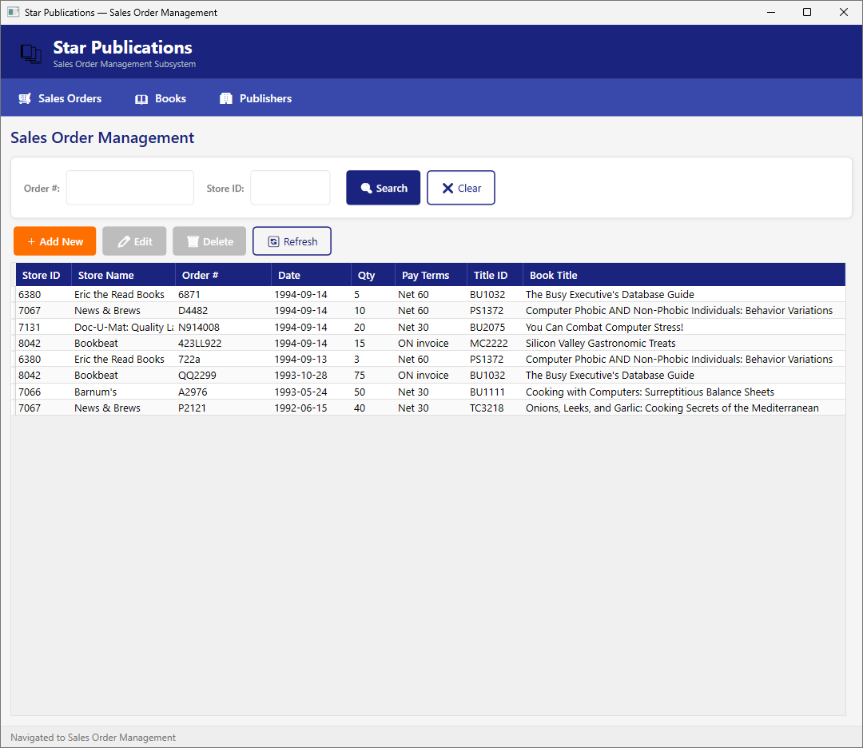
Sales Order Management
Full CRUD — View, Search, Add, Edit, Delete
Key capabilities:
• Loads all orders on startup — store name & book title via EF navigation properties
• Search by Order # or Store ID — partial substring matching
• Add New — inline slide-in form with required-field validation
• Edit — form pre-populated with selected row's data
• Delete — confirmation dialog before removal
• Composite-key duplicate detection: stor_id + ord_num + title_id
• Status bar reports count after every Load / Search / Save / Delete

Slide 5
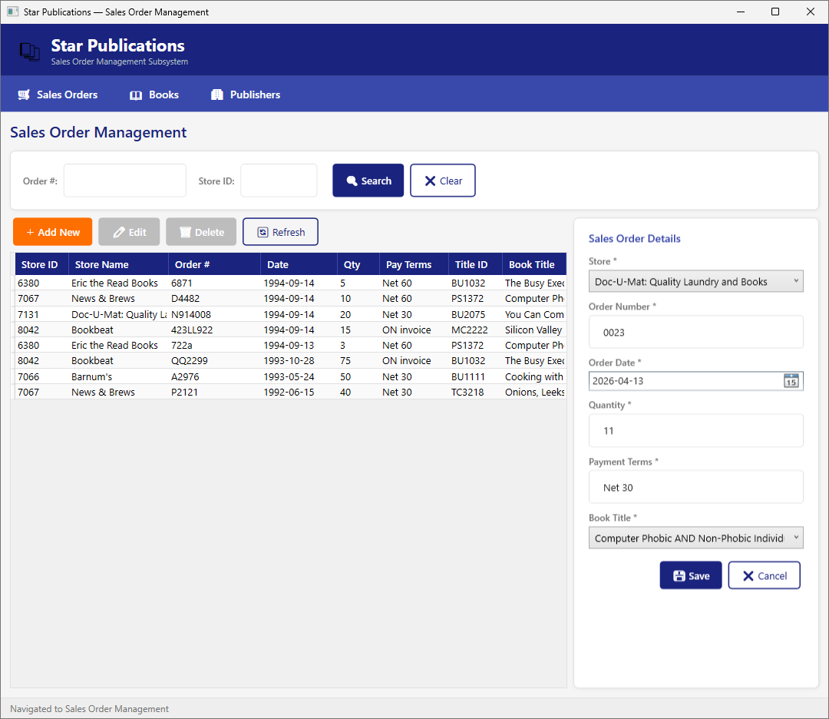
Adding a New Sales Order
Inline form with validation and composite-key duplicate detection
Add / Edit flow:
• Click Add New to open the inline slide-in form
• RelayCommand.canExecute disables Save until the form is valid
• Validation rules in SalesOrderViewModel.Validate():
· Store required
· Order # required, max 20 characters
· Quantity > 0
· Payment terms required
· Title required
• Duplicate check queries the DB before INSERT to prevent constraint violation
• TryExecute() wrapper manages IsLoading state & catches DB exceptions

Slide 6
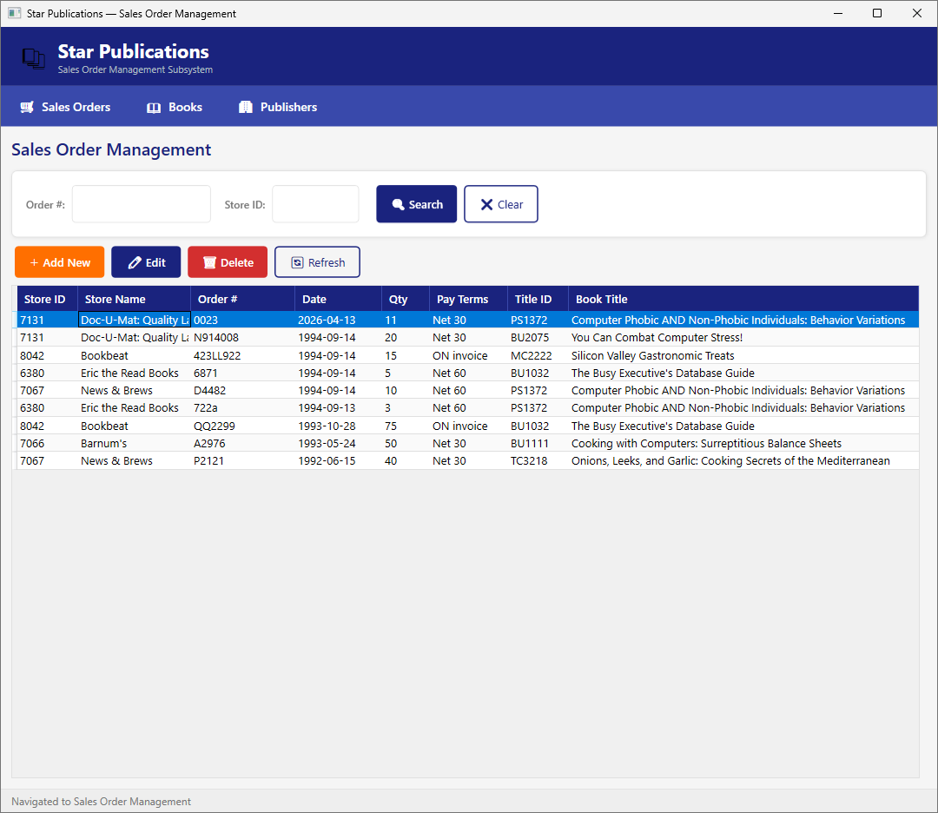
Order Saved — Grid Refreshes
New row highlighted at the top after a successful save
After saving:
• After Save, the form closes and LoadData() reloads the grid
• Newly added row appears highlighted (selected) at the top
• Status bar confirms 'Sales order added successfully'
• Edit follows the same flow — only date, qty, and pay terms are editable
• Cancel at any time discards changes and collapses the form

Slide 7
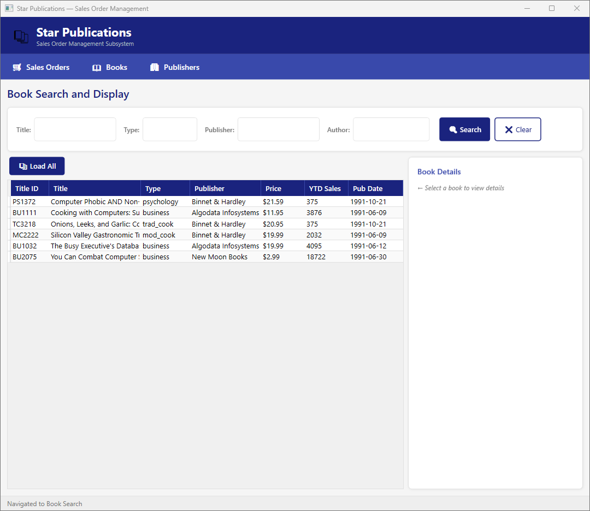
Book Search & Display
Browse the full catalogue and inspect title details
Key capabilities:
• Full catalogue loaded on startup via EF Core with publisher navigation
• Four independent search filters: Title · Type/Genre · Publisher · Author
• All filters are partial-match (SQL LIKE) — combinable in a single query
• Load All button resets filters and reloads the full list
• Selecting any row reveals the Book Details panel (right side):
· Lists all co-authors of the selected title
· Lists all stores where the title has been sold
• Status bar shows filter result count

Slide 8
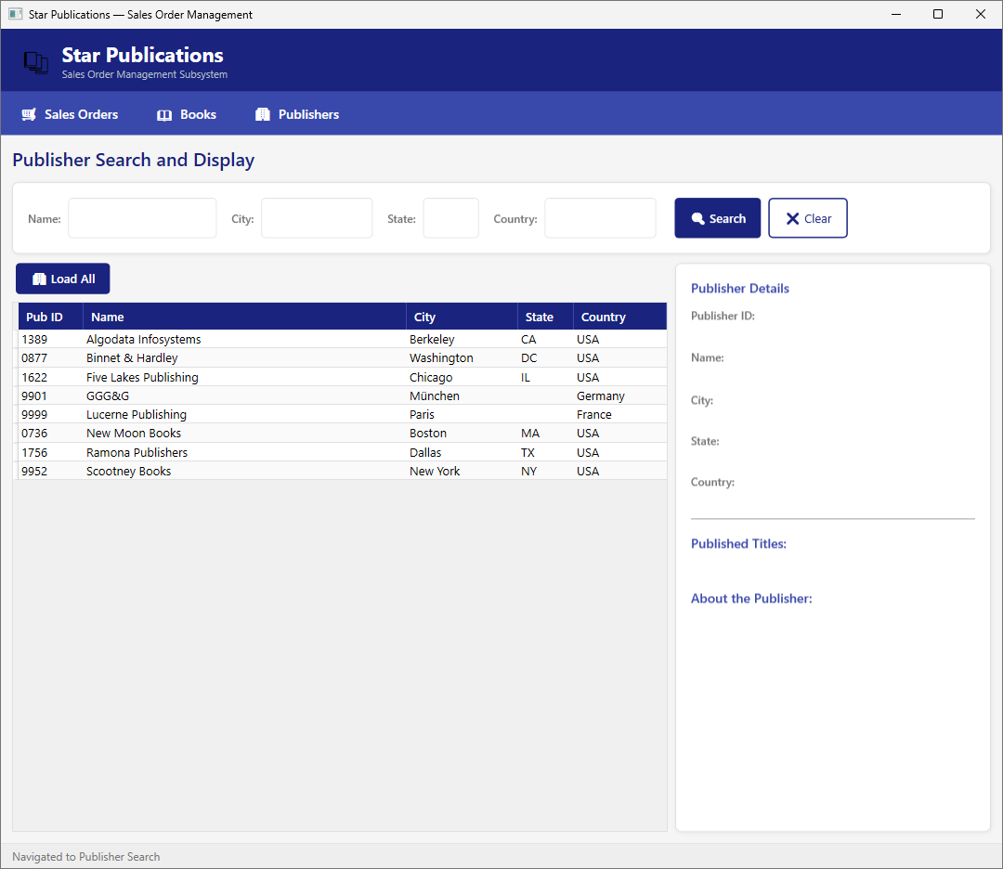
Publisher Search & Display
Browse publishers and view their catalogue and PR information
Key capabilities:
• All publishers listed on startup from the publishers table
• Search by Name · City · State · Country — partial match, combinable
• Load All resets all filters and reloads the complete list
• Selecting a publisher row populates the Publisher Details panel:
· Publisher ID, name, city, state, country
· Published Titles list with prices
· About the Publisher — PR description from pub_info table
• Status bar confirms navigation and search result count

Slide 9
Technology Stack
Tools and frameworks used to build Star Publications
C# 12 / .NET 8
WPF — Windows Presentation Foundation
Core language and runtime
Desktop UI; XAML templates, styles, value converters
Entity Framework Core 8
MVVM Pattern
ORM for SQL Server — Fluent API, nav properties, LINQ
Strict separation; Views are pure XAML, no code-behind
RelayCommand
Microsoft.Extensions.Configuration
Generic ICommand — wraps any method in one line for XAML binding
Loads appsettings.json connection string at runtime
SQL Server / LocalDB
Visual Studio 2022
Relational DB — classic pubs schema with seed data
IDE with .slnx solution format

Slide 10
Key Design Decisions
Architectural choices and their rationale
Why MVVM?
Views are purely XAML — zero code-behind. ViewModels can be unit-tested independently of the UI. Swapping or redesigning a View requires no logic changes.
Why a per-operation DbContext factory?
Avoids long-lived contexts. Each DB call creates a fresh PubsDbContext, preventing stale-entity tracking issues and connection-pool exhaustion.
Why composite primary keys on Sales & TitleAuthor?
Mirrors the real-world pubs schema constraints. Enforced at the database level and the application level — a duplicate check runs before every INSERT.
Why RelayCommand?
Eliminates boilerplate ICommand implementations. Any method — including canExecute predicates — is wrapped in a single line and bound directly in XAML.
Why does MainViewModel own the child ViewModels?
Provides centralized status-bar aggregation across all subsystems and enables single-window navigation without WPF frames, pages, or a navigation service.

Slide 11
10 – 15 Minute Demo Script
Live demonstration flow for the instructor session
1
2 min
Introduction
Introduce the project title, objective, and MVVM architecture diagram on the poster.
2
3 min
Sales Order Management
Load all orders → search by order number → add a new order → edit date/qty → delete with confirmation.
3
3 min
Book Search
Search by author name → select a book row → show the detail panel (authors & store availability).
4
2 min
Publisher Search
Search by city → select a publisher → detail panel shows titles with prices and PR description.
5
2 min
Code Walk-through
Show SalesOrderViewModel.cs: RelayCommand wiring, TryExecute() wrapper, DbContextFactory, Validate().
6
2–3 min
Q&A
Design decisions: MVVM rationale, per-operation DbContext, composite keys, single-window navigation.
Tip: Keep the poster beside you — refer to the architecture diagram and feature table as you speak.

