Slide 1

Project Kickoff Meeting
PROG3300 – Integrated Project
Simulated Incident Response Environment (S.I.R.E.)
ThePhoto by PhotoAuthor is licensed under CCYYSA.

Slide 2
Agenda
1. Welcome & Introductions
3. Objectives (SMART)
7. Timeline Discussion
8. Next Steps Discussion
2. Project Context
5. Architecture Discussion
4. Incident Response Scenarios
6. Risk Discussion

Slide 3

Welcome & Introductions

Slide 4
Welcome
Project Name:
S – Simulated
I – Incident
R – Response
E – Environment
Purpose:
The purpose of this kickoff meeting is to introduce the team and the project to the stakeholders and discuss the plans we have moving forward.
Team Name:
Nibble

Slide 5
Team Members of Nibble
Tom Burchell – Backend & Real-Time
Leon Wasiliew – Frontend & UX
John Hay – Scenario & QA
Kael Payette – PM & Testing

Slide 6
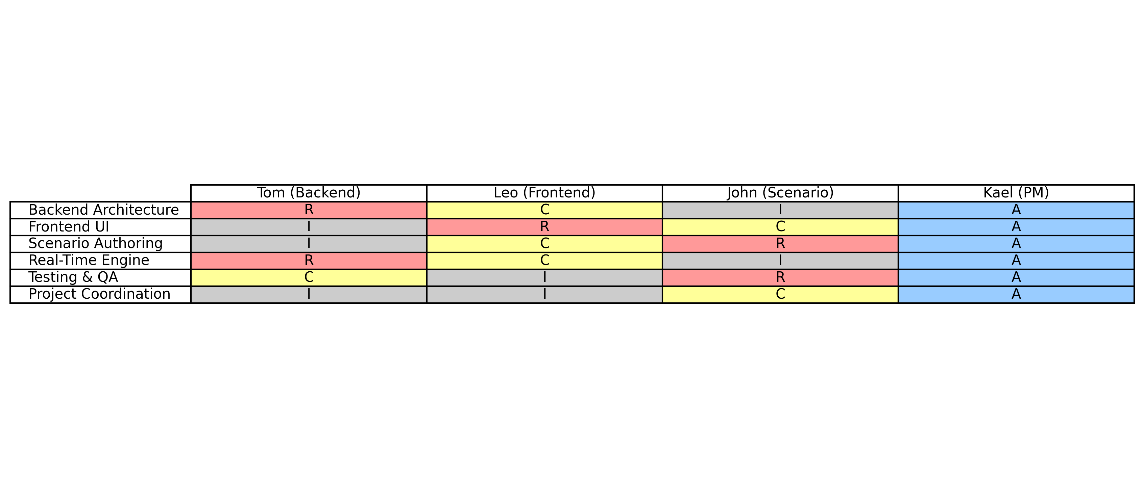
RACI
Color Legend:
R – Responsible (Red)
A – Accountable (Blue)
C – Consulted (Yellow)
I – Informed (Grey)

Slide 7
How We Will Collaborate
According to the Team Charter
Channels:
GitHub
Jira (Atlassian)
Microsoft Teams
Outlook/Gmail
Meetings:
The team will meet twice weekly (each 10 – 15 minutes) in person at the college to review previous, current, and next item actions.

Slide 8
Project Context

Slide 9
Why This Project Exists
Emergency preparedness training is essential
Traditional drills are costly and disruptive
Tabletop exercises lack realism and urgency
Organizations need an accessible way to train
SIRE fills this gap

Slide 10
SIRE Overview
Real-time emergency incident simulator
Four fully developed scenario types
Instructor-led with trainee event log updates

Slide 11
Project Scope
In Scope: JS Full Stack, Scenarios, Dashboard, Docs
Out of Scope: Mobile apps, Hardware sensors

Slide 12
Objectives (SMART)

Slide 13

SPECIFIC
Specific: Build a real‑time, instructor‑led incident simulator with four dynamic scenarios (out of eight) and trainee event‑log interaction.

Slide 14
MEASURABLE
Measurable: ≥10 concurrent users, <300ms latency, eight scenarios, full documentation, deployed demo.

Slide 15
ACHIEVABLE
Achievable: Uses a unified Node + Express + Socket.IO + React stack with zero-cost tooling.

Slide 16
RELEVANT
Relevant: Improves preparedness by providing accessible, repeatable emergency‑response training.

Slide 17
TIME-BOUND
Time‑Bound: Delivered within a defined 12‑week project schedule with milestone checkpoints.

Slide 18
Incident Response Scenarios

Slide 19
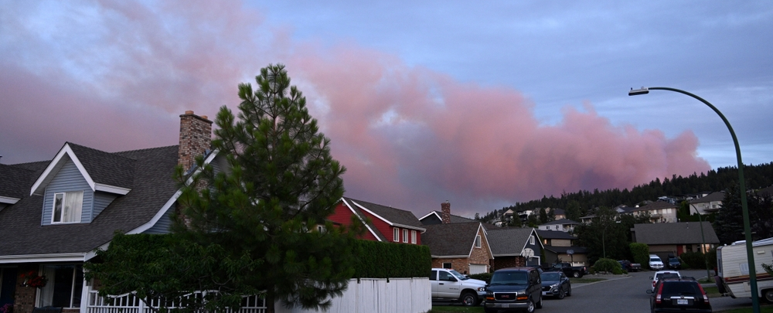
Scenario 1 – Fire Incident
ThePhoto by PhotoAuthor is licensed under CCYYSA.
Increasing wildfire seasons in Canada
Rural Nova Scotia communities are at higher risk
Residential fire incidents remain common
Fast-moving situations requiring rapid decisions

Slide 20
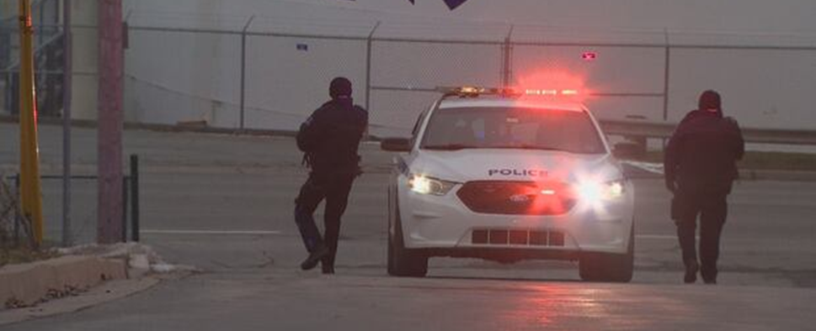
Scenario 2 – Active Threat
ThePhoto by PhotoAuthor is licensed under CCYYSA.
Rising active threat events across Canada
Schools and public spaces in Nova Scotia are vulnerable
High-risk, high-stress decision environments
Need for coordinated, practiced response paths

Slide 21
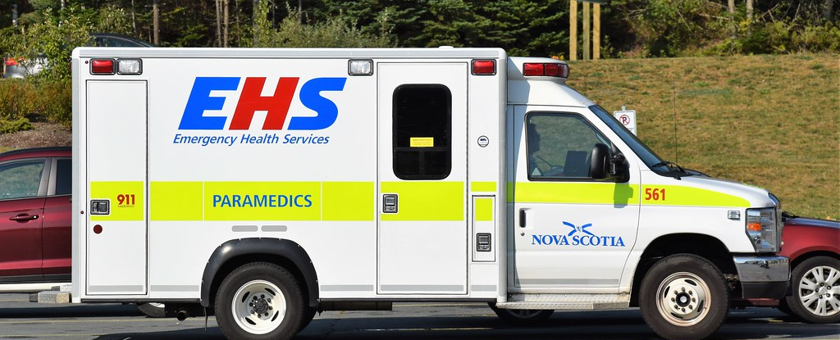
Scenario 3 – Medical Emergency
ThePhoto by PhotoAuthor is licensed under CCYYSA.
First-aid required by many Canadian employers
Limited interactive modules in Nova Scotia
Skills degrade without actual practice
Certifications cover a few emergency types

Slide 22
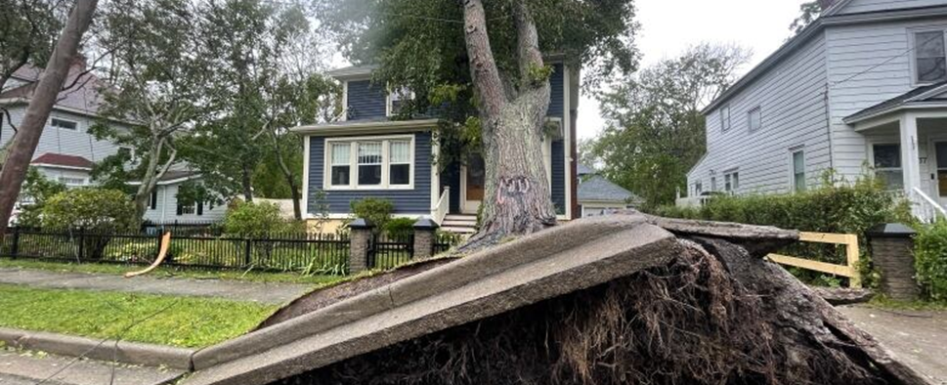
Scenario 4 – Structural Failure
ThePhoto by PhotoAuthor is licensed under CCYYSA.
Aging infrastructure across Canada
Weather damage is common in Nova Scotia
Homes and public buildings are vulnerable to failure
Minor issues escalating into major hazards

Slide 23
Architecture Discussion

Slide 24
ARCHITECTURE OVERVIEW
Key discussion points:
Review backend architecture:
Node.js + Express API.
Review real-time engine:
Socket.IO namespaces, events, and session flow.
Review frontend:
React components, admin dashboard, trainee UI.
Decision points:
Confirm API contract expectations.
Approve real-time event structure and escalation logic.
Validate that architecture meets performance targets.

Slide 25
Risk Discussion

Slide 26
Risks
Real-time drift
Scope creep
Dependency conflicts

Slide 27
Risk Review & Mitigations
Key discussion points:
Real-time sync drift → early Socket.IO prototyping.
Scope creep → MVP guardrails.
Dependency conflicts → pinned versions & lockfiles.
Timeline compression → parallel work where possible.
Decision points:
Approve risk mitigation strategies.
Identify any additional risks for tracking.

Slide 28
Timeline Discussion

Slide 29
Development Timeline
Week 5: DB Design, UI Design, Scenario Research & Scripting
Week 6: Backend & Frontend Implementation – S1
Week 7: Testing & Changes – S1
Week 8: Backend & Frontend Implementation – S2
Week 9: Testing & Changes – S2
Week 10: Backend & Frontend Implementation – S3
Week 11: Testing & Changes – S3
Week 12: Backend & Frontend Implementation – S4
Week 13: Testing & Changes – S4
Week 14: Final Testing & Project Summarization
Week 15: Final Presentation & Project Closure

Slide 30
Timeline Review & Dependency Highlights
Key discussion points:
Review 11-week development schedule and SCRUM sprints:
backend – frontend – scenario → testing & changes.
Identify dependencies (e.g., backend sockets must exist before frontend log UI).
Review Gantt chart to confirm sequencing & resource constraints.
Decision points:
Confirm timeline feasibility.
Approve dependency ordering and risk cushions.

Slide 31
Next Steps Discussion

Slide 32
Immediate Next Steps & Assignments
Key discussion points:
Confirm what must be completed in Development Week 5–6: requirements, repo, scaffolding.
Assign tasks:
Backend initialization, React scaffold, scenario draft.
Decision points:
Approve Development Week 5–6 tasks.
Confirm task owners and deadlines.

Slide 33
Q & A

