Slide 1
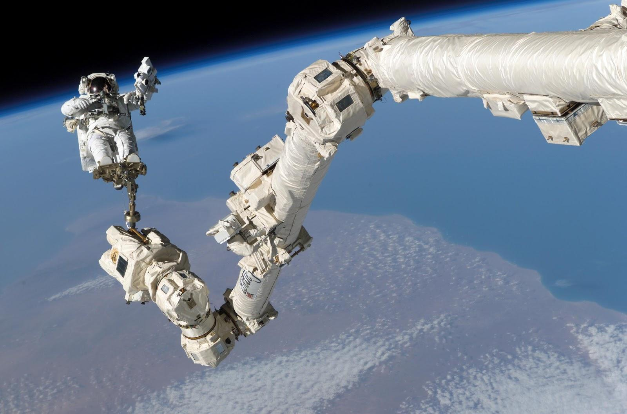
Session on Robotic Arm and Grippers
Date: 30th September, ‘14

Slide 2
What is Robotic arm?
A robotic arm is a type of mechanical arm which functions similar to a human arm; the arm may be the sum total of the mechanism or may be part of a more complex robot.
A system with multiple degrees of freedom that can perform various dexterous tasks like gripping, lifting and placing objects, etc.
Degrees of freedom??
Number of ways (rotation, translation about axes) in which the motion of the system can be actuated (motors, linear actuators etc.)
How many degrees of freedom are there in human hand? Describe them.

Slide 3
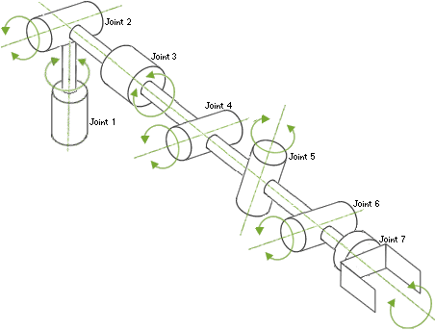
Degrees of freedom in Human hand

Slide 4
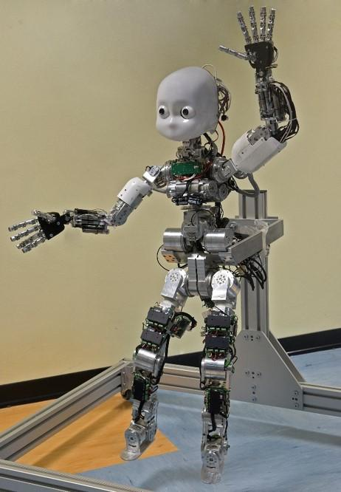
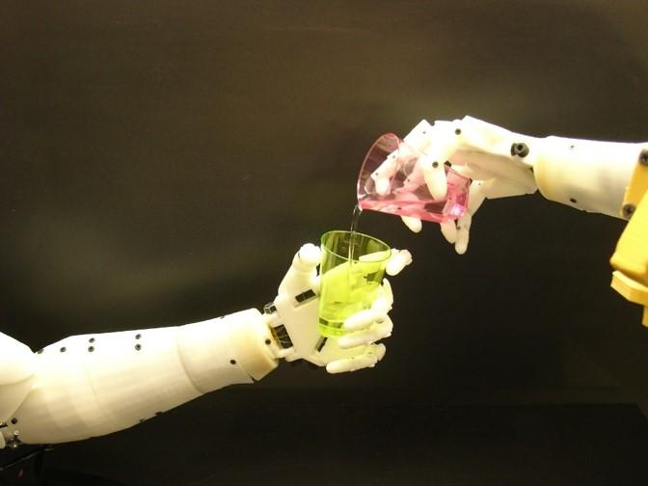
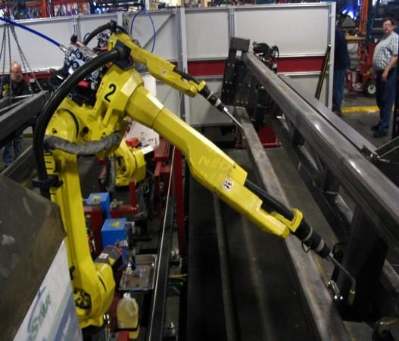
Deciding which DoFs are sufficient for given tasks?
Based on the tasks to be performed

Slide 5
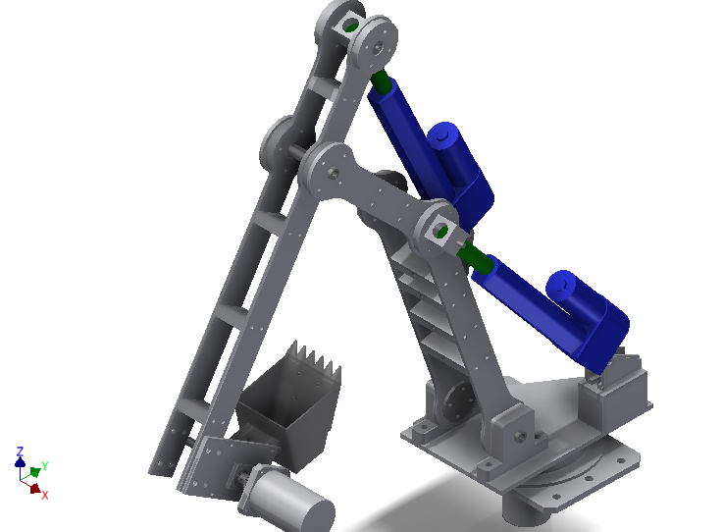
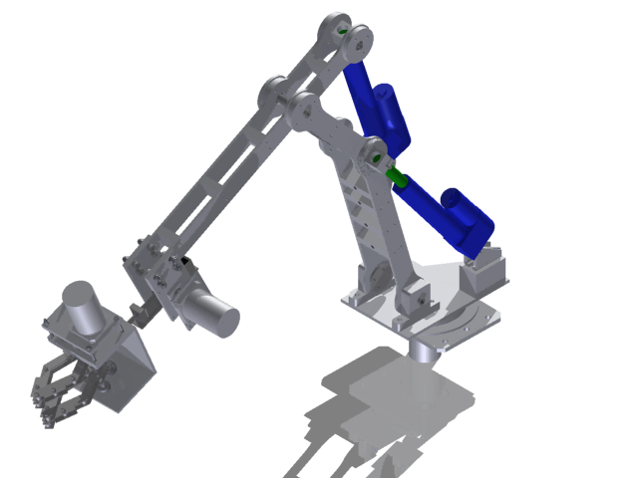
Parts of Robotic arm
Basic skeleton of arm containing upper arm(humerus) , lower arm(forearm) and the “End-effector”
End effector: The part which is to be attached at the end of upper arm which will perform tasks like gripping, digging, etc.

Slide 6
Our task for today
Design a universal gripper: a gripper which is expected to be able to handle varying shapes, sizes, fragility, smoothness, and irregularity of objects.
It is commonly understood that no one gripping mechanism or method is 100% suitable for handling every type of object. There are inherent advantages and disadvantages to each mechanism that make it more suitable for a particular type or nature of object than others. The task thus comes down to coming up with the most versatile gripper mechanism, or indeed, combination of mechanisms, that would be able to perform the necessary tasks.

Slide 7
Gripper Mechanisms:
Finger / Hand
Plates
Membrane / Belt usage - Wrap around mechanism
Roller
Suction / Vacuum
Magnetism
Adhesives
Scoops, Hooks, and Inflatable Bladders
Actuation Mechanisms:
Gears (Bevel, Rack and Pinion, Worm-Spur, etc.)
Linkages
Screws
Cam
Spring / String
Hydraulics
Rope / Pulley

Slide 8
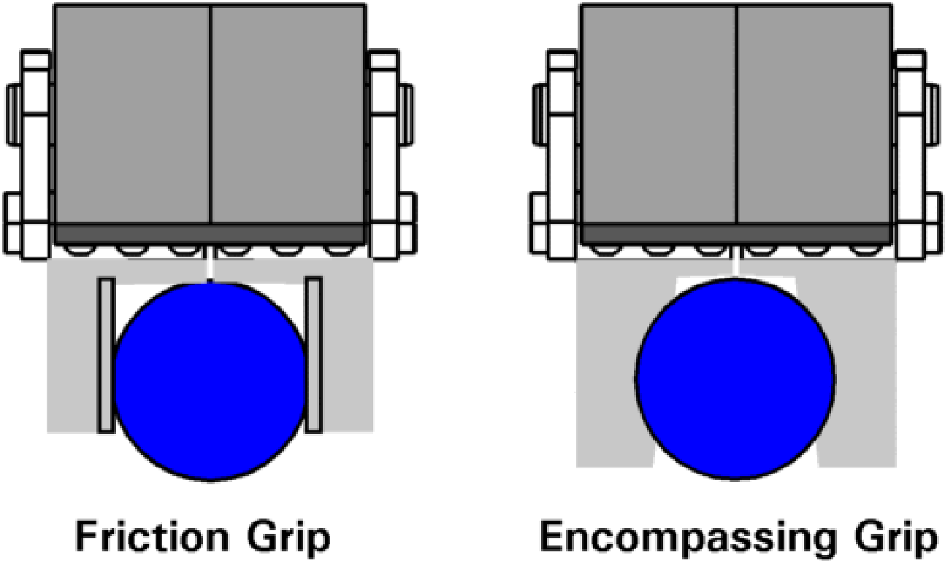
Classification of grippers
Based on the profile of grasping the object:
Encompassing Grip - The object is completely enclosed within the gripper.
Friction Grip - Where two opposing plates grip the object by means of friction.

Slide 9
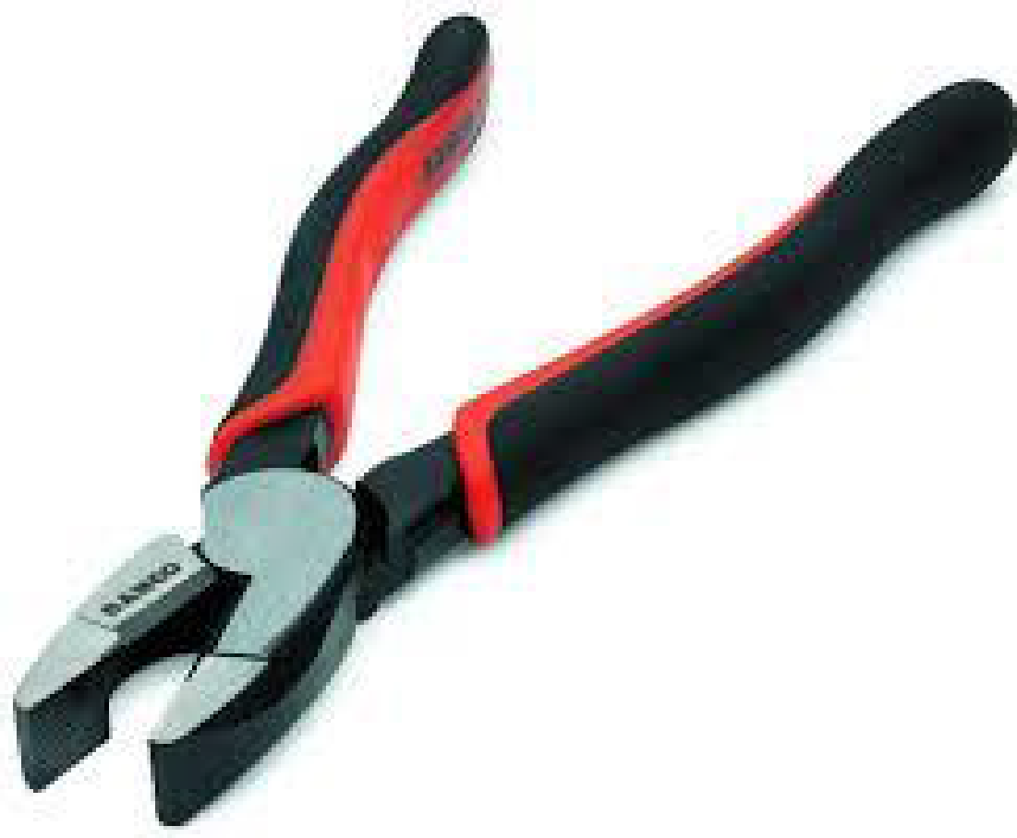
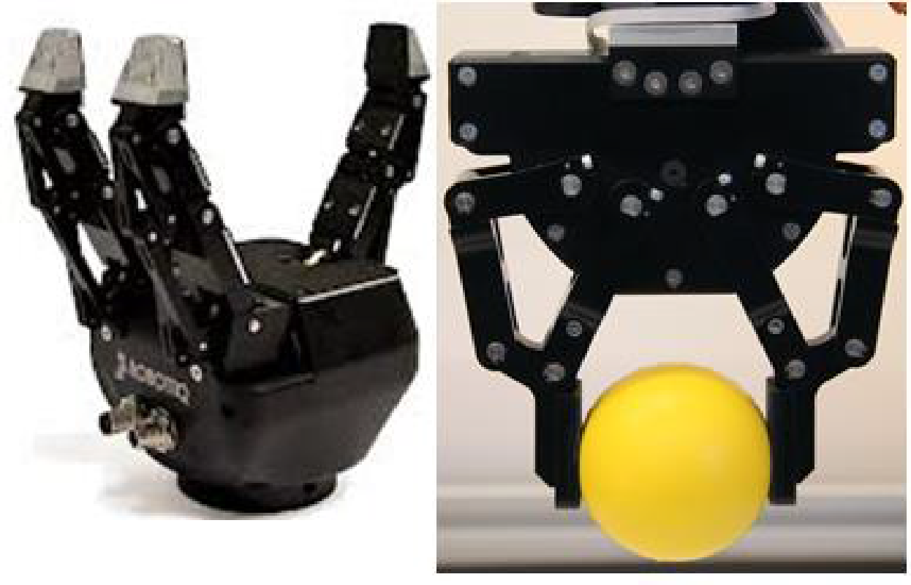
Based on the type of control:
Manual Control - Can be of several subtypes, including purely mechanical, electro-mechanical, direct input based, etc.
Automatic Control - Subtypes include sensor based, pre-programmed, etc. These involve mechanical, electronic and coding aspects.

Slide 10
Things to be considered whilst designing:
Is the object that we need to grasp have a varying area of cross-section, if so how can we efficiently design a gripper to grasp it.
The gripper can be designed with resilient pads to provide more grasping contacts in the work part. The replaceable fingers can also be employed for holding different work part sizes by its inter-changeability facility.
Consideration must be taken to the weight of a work part.
It must be capable of grasping the work parts constantly at its centre of mass.

Slide 11
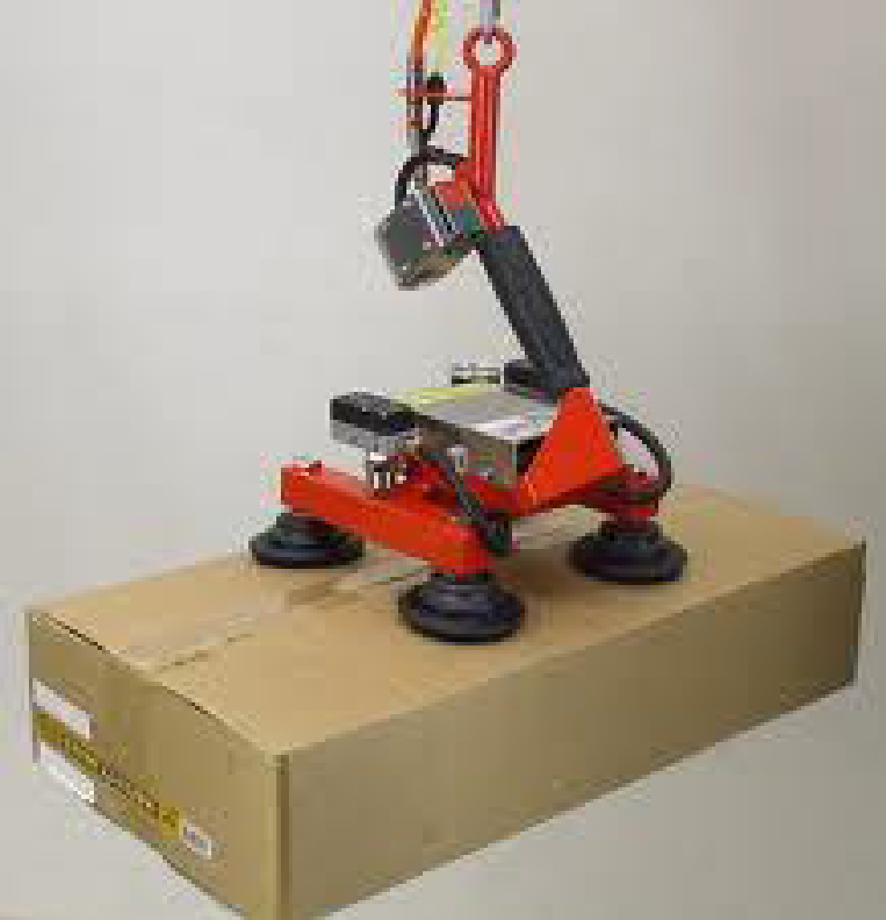
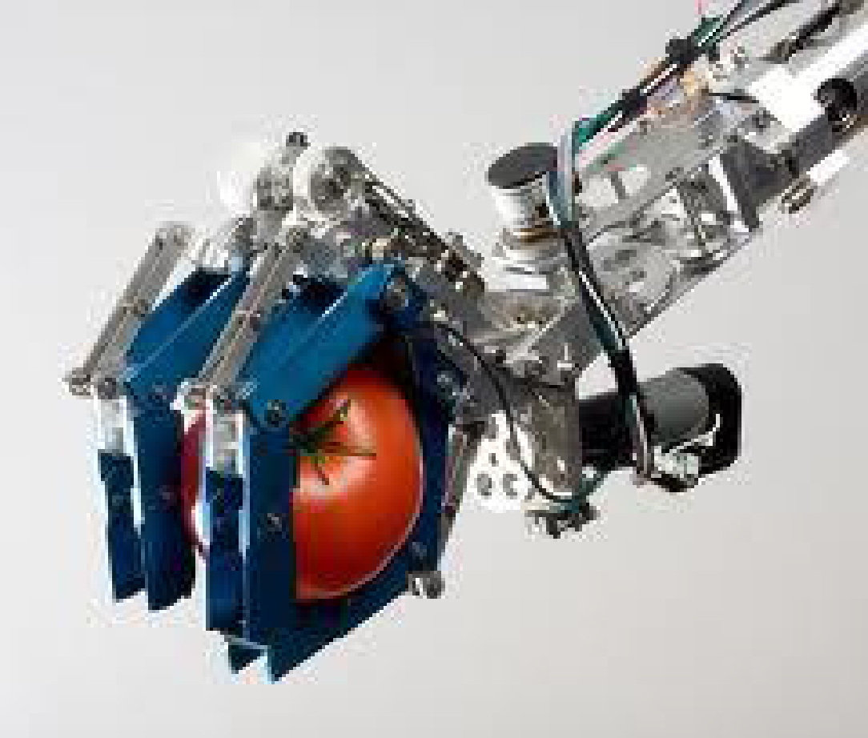
Analysis of mechanisms
Mechanism | Advantages | Disadvantages
Suction / Vacuum Mechanism | Suitable for flat, clean and smooth surfaces Potentially can create large gripping forces, thus is often used to lift the bot itself Can be used for minute objects | Unsuitable for porous materials Requires large power supply in active versions Requires continuous air pressure supply
Fingers / Hand Mechanism | Produces sufficient force (variable, according to need) High versatility and adaptability Less expensive | Large gripper footprint / clearance Actuation can potentially be complex

Slide 12
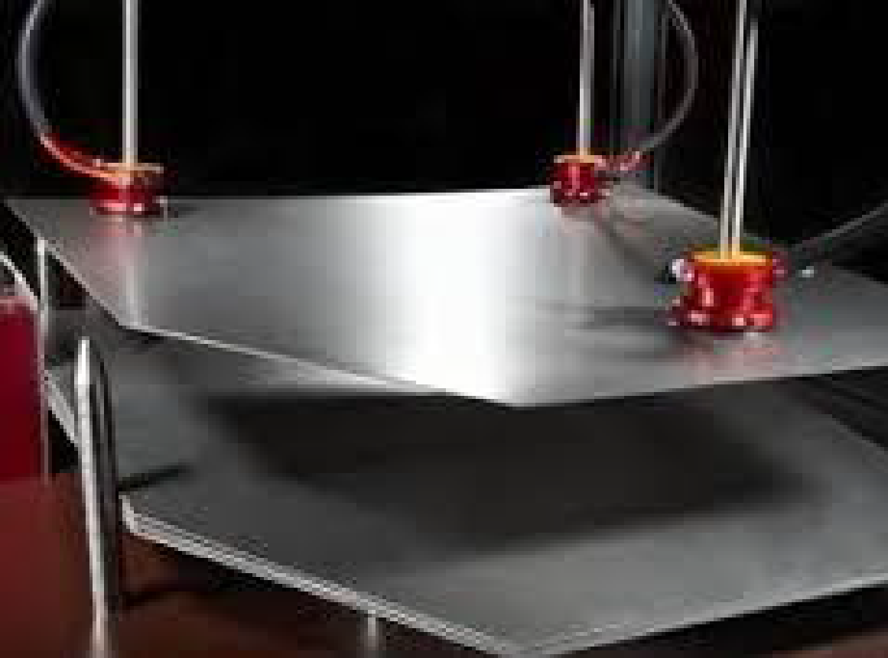
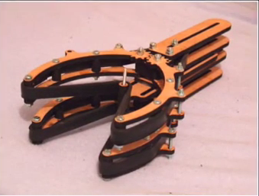
Mechanism | Advantages | Disadvantages
Magnetic Mechanism - (Either Electromagnetic / Permanent Magnets) | Suitable for magnetic materials Single surface gripping is possible Invariant with respect to type of object - Universal, and quick | Highly specific Chance of slipping during movement, or if lubrication is present
Roller Mechanism | Allows for misalignment of object during gripping | Slow action May not be suitable for irregular objects

Slide 13
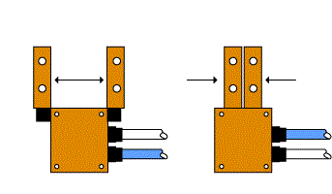
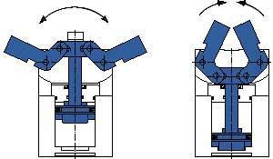
Mechanism | Advantages | Disadvantages
Parallel / Linear / Translational Mechanism | Less clearance required Accurate form of gripping | Possible loss of stability during tangential force application
Angular /Contour Mechanism | Grip specific to the surface, hence very useful for irregular objects | Difficult to implement, expensive and complex

Slide 14
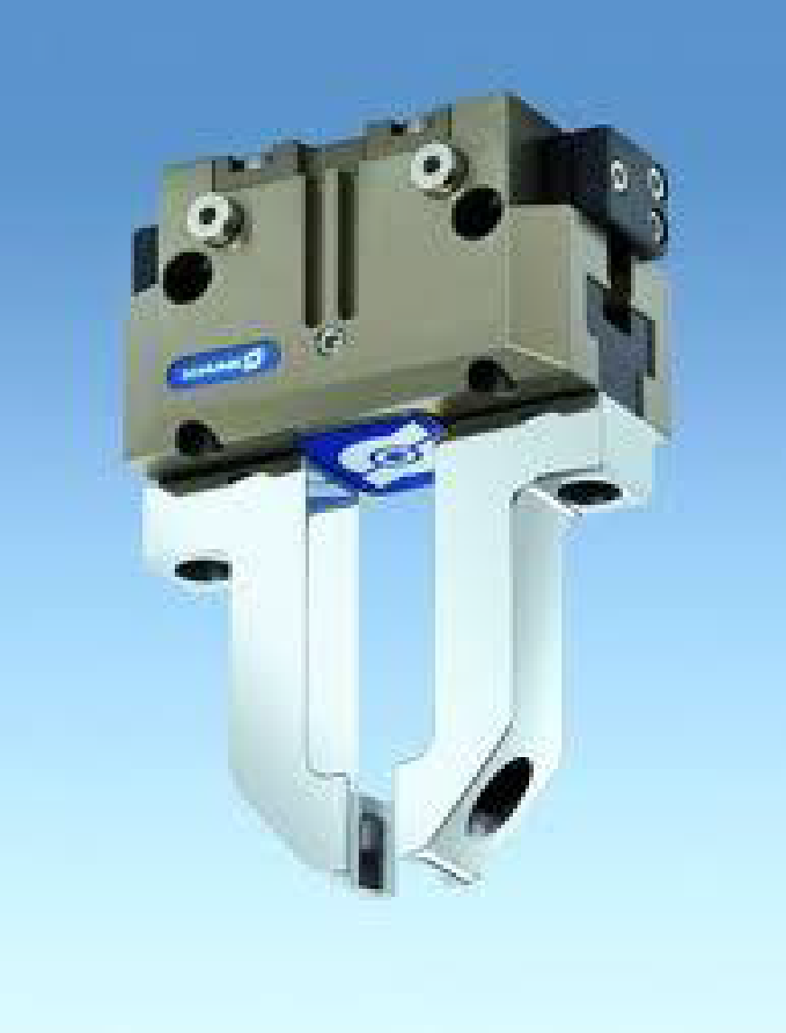
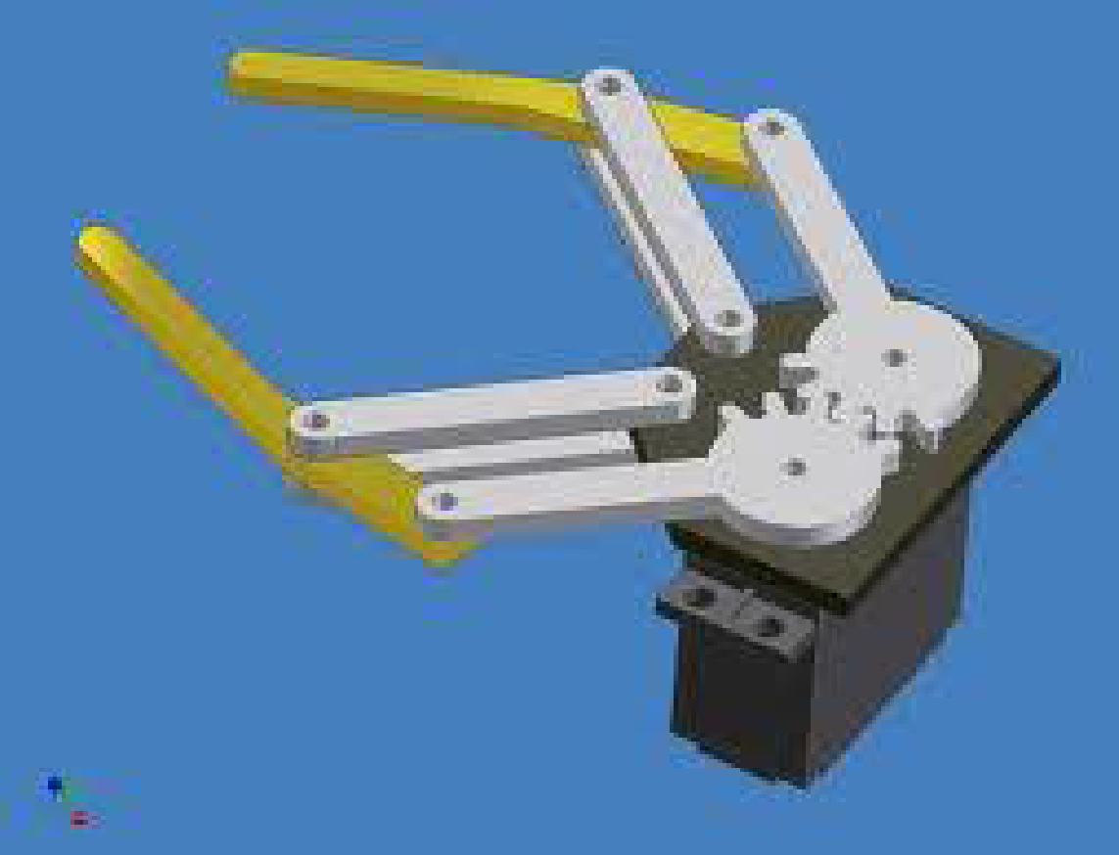
Mechanism | Advantages | Disadvantages
Pneumatic powered grippers | Smaller units, quicker assembly High cycle rate Easy maintenance | Maintaining constant air pressure so as to provide constant force is difficult
Hydraulic powered grippers | High strength and speed Mechanical simplicity Heavy payloads can be withstood | Large robots that take up space
Motor Actuation | High accuracy, repetitive power Less floor space, low cost, easy maintenance | Requires Electronic control system, may be complex

Slide 15
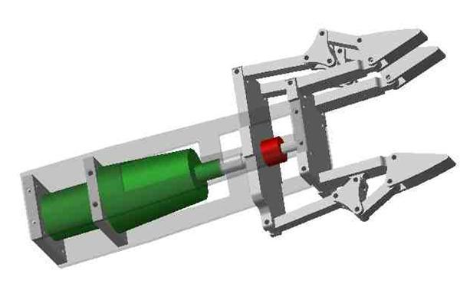
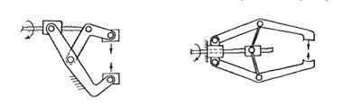
Motor actuated

Slide 16
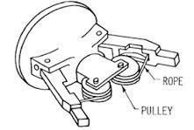
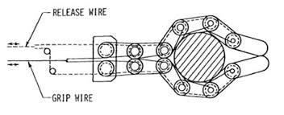
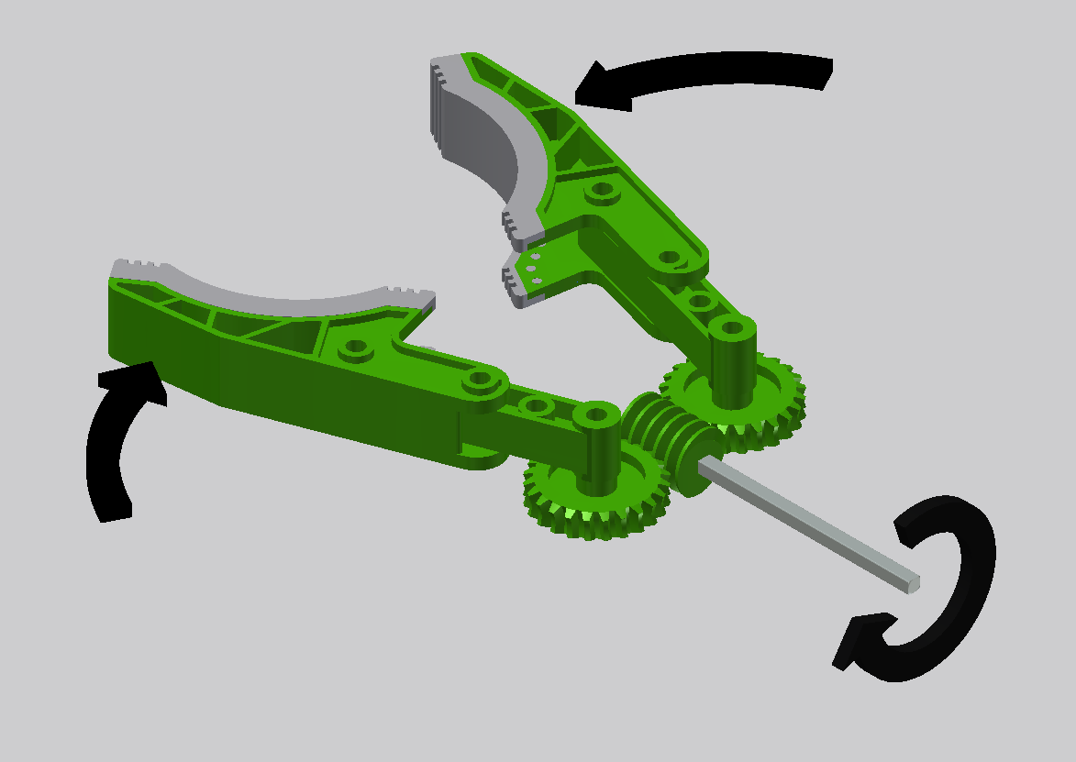
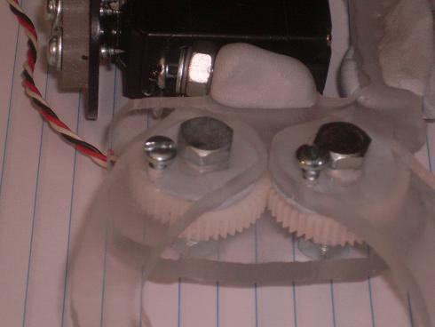
Motor actuated

Slide 17

A novel mechanism

Slide 18
Concept of Under-actuation
System that has a lower number of actuators than degrees of freedom is defined as an under-actuated system
Significance:
Typically actuated systems have a larger number of actuators, which means that the device increases in versatility, but this comes at the cost of size, complexity, cost and weight of the device.
Under-actuated devices can be more efficient, simpler and more reliable than their fully actuated alternatives.
Under-actuation is being used successfully in bionic assemblies like prosthetic limbs.

Slide 19
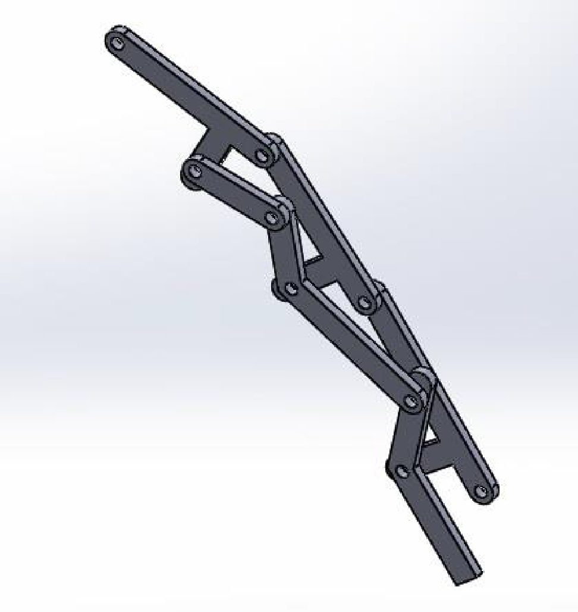

Linkage based under-actuated system

