Slide 1


01 · PROJECT OVERVIEW & PARTICIPANT DETAILS
UCIP
UCIP
Rank a city's districts by measured heat vulnerability, explains each score, names what to build there, and recommends solution based on Math.
STUDENT NAME
Anay Dhawan
SCHOOL
NES International School Mumbai
GRADE
11 (IBDP Year 1)
DOMAIN
PLANET
FOCUS AREA
Urban heat
Every ward in Mumbai, raised and coloured by its heat risk.
STUDY AREA
Mumbai’s 24 BMC wards
Sources: Live at ucip-eight.vercel.app. Code at github.com/AnayDhawan/UCIP. Every figure in this deck is computed by my own pipeline, from openly licensed data. Sources are given on the slide where each claim appears, and in full on slide 21. The opening observation, that named storms are taken more seriously than unnamed heat waves, is Eleni Myrivili's, UN Global Chief Heat Officer.
1 / 21
Notes:
[COLD OPEN. Do not introduce yourself yet. Stand still. Slower than feels natural. Let the first silence sit longer than is comfortable.] Right now, somewhere above this room, a family is living under a metal roof. [beat] This afternoon, the ground beneath that roof measured forty degrees. Three kilometres away, another rooftop measured twenty six. [slower] Same city. Same afternoon. Same sun. Fourteen degrees apart. [beat] We give hurricanes names. We do not give heat waves names, and so we do not take them seriously. [beat] Mumbai does not have a heat problem. It has twenty four of them, one for every ward, and it treats them as though it had one. [beat, then normal pace] My name is Anay Dhawan. I am in Grade eleven at NES International School. For the next fifteen minutes I want to walk you along a chain that runs from that roof to a hospital bed, and show you the one link in it a city can actually break.

Slide 2
01 · PROJECT OVERVIEW & PARTICIPANT DETAILS
UCIP
The problem, stated as one chain
01
More heat
Cities worldwide, especially those in India,
are heating immensely, making the
outdoors not such a pleasant place.
02
Discomfort, then illness
Discomfort for all, danger
for some, load on hospitals
03
Citizens suffer
Heat harms people without discriminating. Global warming is one of the greatest threats to not just Humanity, but also all other organisms living in Earth
04
So where do we act first?
Heat must not just be combatted with Air Conditioners, but more sustainable, long-term and more effective large-scale strategies that make the outdoors a more livable place to be in.
Over the next eighteen slides: First the chain, link by link. Then what already exists and why it stops short. Then the tool itself, how it decides, what it refuses to do, and what it changes for Mumbai.
Sources: The chain is my framing. Evidence for each link follows on slides 3 to 5.
2 / 21
Notes:
Here is the chain. It is short enough to hold in your head. [point to each link] More heat. Discomfort for everyone, illness for some, and a load on the hospitals. Citizens suffer. So a city has to decide where to act. [beat] The first three links are physics and biology. Nobody in this room can switch off the sun. [beat] But look at the fourth one. That link is not physics. It is a decision, made by a person, in a room, with a budget. And a decision is the only part of a chain you can change on a Monday morning. [beat] So that is the link I built for. Not measuring heat. That is done. Deciding where to act. That is not.

Slide 3
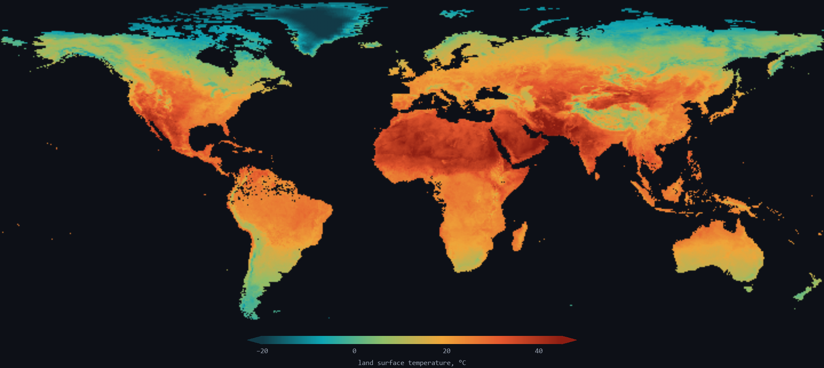
02 · PROBLEM UNDERSTANDING
UCIP
Link one: more heat, and it lands unevenly
01
More heat
Mumbai is heating,
and not evenly
02
Discomfort, then illness
discomfort for all, danger
for some, load on hospitals
03
Citizens suffer
hardest where people
can least cope
04
So where to act first?
one budget, twenty-four wards
13.7 °C
difference between the coolest and the hottest square kilometre of this city, measured on the same day, from the same satellite pass.
Indicator | Range across Mumbai | City average
How hot the ground gets | 26 °C to 40 °C | 32 °C
How green it is | almost bare to lush | patchy
Concrete and paving | 30 % to 97 % | 39 %
People per square kilometre | 16,000 to 115,000 | 47,270
Walk to the nearest hospital | next door to 6 km | 1,153 m
Take a city-wide average erases all of it. Every gap above is somewhere you could act.
Not only here. NASA's map of how much warmer each part of the world now runs. The world is on average 2-degrees Celcius hotter than pre-industrial revolution era.
Sources: Landsat 8/9 Collection 2 (USGS), ESA WorldCover v200, WorldPop 2020, OpenStreetMap, Datameet. Global anomaly map: NASA Goddard Scientific Visualization Studio, GISTEMP v4, 1880 to 2024. Ward figures computed by my own pipeline.
3 / 21
Notes:
Link one. More heat. [beat] And the important word in that sentence is not more. It is uneven. Ground temperature across Mumbai runs from twenty six degrees to forty. Concrete cover, from nothing to almost everything. Population, from sixteen people per square kilometre to a hundred and fifteen thousand. [beat] Now average all of it. Mumbai is thirty two degrees. That is true. It is also useless, because nobody lives in an average. [gesture right] And this is not a Mumbai quirk. That is NASA's map of where the world has warmed. Mumbai is simply where I could test it first.

Slide 4
02 · PROBLEM UNDERSTANDING
UCIP
Link two: heat is uncomfortable for everyone and dangerous for some
01
More heat
Mumbai is heating,
and not evenly
02
Discomfort, then illness
discomfort for all, danger
for some, load on hospitals
03
Citizens suffer
hardest where people
can least cope
04
So where to act first?
one budget, twenty four wards
● Homes that hold heat
● Older residents
● Far from help
● Out in it all day
Metal and asbestos roofs soak up heat all day and give it back all night. The body never gets the cool break it needs to recover.
The risk of dying in a heat wave rises steeply with age, and older people are the least able to move somewhere cooler.
Heat illness gets dangerous in hours. In this city, the distance to the nearest hospital ranges from next door to six kilometres.
Anyone waiting at a bus stop or on a platform takes the full exposure, with no cool room to go back to. From delivery partners to students to drivers and blue-collar workers.
Why this is a public health problem, not a private discomfort
And the people most at risk are the ones the city knows least about
Everyone is uncomfortable. But the illness lands in the same weeks, in the same wards, on the same hospitals, and it arrives where the ambulance has furthest to travel.
Informal neighbourhoods are, almost by definition, the least surveyed places in any city. Waiting for perfect local records means never acting at all.
That pair is the reason a city has to rank wards rather than treat itself as one place.
I built this from satellite images and public population data, which cover every ward equally, and made it state plainly which of its own numbers are estimates.
Sources: Reid et al. 2009, Environ Health Perspect, doi 10.1289/ehp.0900683 (age and isolation as heat-vulnerability factors). Hospital locations: OpenStreetMap. Ward distances computed by my own pipeline.
4 / 21
Notes:
Link two. Heat is uncomfortable for every person in this room. [beat] For four groups it stops being discomfort and becomes danger. People under metal roofs that soak heat up all day and give it back all night, so the body never recovers. Older residents. People far from help. Anyone who waits outside all day. [beat] And that is what makes it public health, not private discomfort. The illness lands in the same weeks, in the same wards, on the same hospitals, and it arrives where the ambulance has furthest to travel. [beat] Now the hard part. The people most at risk live exactly where the city knows least about them.

Slide 5
02 · PROBLEM UNDERSTANDING
UCIP
Links three and four: people suffer, and someone has to choose
01
More heat
Mumbai is heating,
and not evenly
02
Discomfort, then illness
discomfort for all, danger
for some, load on hospitals
03
Citizens suffer
hardest where people
can least cope
04
So where to act first?
one budget, twenty-four wards
● Heat kills quietly, and India cannot agree how many
● So why has nobody chosen?
Three government bodies counted heat deaths for the same twenty years and published 20,615, 17,767 and 10,545. Spread over a season instead of one dramatic day, heat rarely gets counted as an emergency, or counted well.
Because choosing is harder than measuring.
This city's climate plan already names heat as a priority. It is a serious document. But it sets goals for the whole city and stops there.
It never answers the question a person with one budget actually faces: which ward gets cooled first, and how do I prove that was the right one?
That is not missing data. It is a missing decision.
~1,190
lives estimated saved every year in Ahmedabad after India's first heat action plan. This proves deliberate heat action works. What it does not do is say which part of a city to treat first: it is a forecast-triggered warning system.
Break the chain here, and everything upstream still happens, but far fewer people get hurt.
Sources: Heat deaths in India 2000 to 2020, three official counts: NCRB 20,615, NDMA 17,767, IMD 10,545 (Gadgil and Narang, Down To Earth, 10 April 2025). Ahmedabad: Knowlton et al. 2014, IJERPH, doi 10.3390/ijerph110403473. Mumbai Climate Action Plan 2022 (BMC, WRI India, C40).
5 / 21
Notes:
Links three and four. People suffer, and somebody has to choose. [beat] Heat kills quietly, and here is how badly that shows. Three government bodies counted India's heat deaths over the same twenty years and published twenty thousand, seventeen thousand, and ten thousand. Nobody is lying. It simply is not counted. [beat] So does acting save anyone? Ahmedabad's heat action plan is credited with roughly eleven hundred and ninety lives a year. It proves acting works. But it is forecast-triggered, so it says when to act, never where. [beat] Nobody has answered where, because choosing is harder than measuring. That is not missing data. It is a missing decision.

Slide 6
03 · RESEARCH & INSIGHTS
UCIP
Output of my initial run
Every number in this deck came out of my initial UCIP run, thus the data can be arguable.
12
32 °C
541
24
satellite passes
combined
typical ground
temperature
squares of the city
scored separately
wards covered,
the whole city
Dataset | Published by | What it provides
Satellite heat and greenery | US Geological Survey | How hot the ground is, how green
Satellite land cover | European Space Agency | Concrete, water, grass, trees
Population estimates | WorldPop | How many people, and how many are older
Community map data | OpenStreetMap | Where the hospitals are
Municipal boundaries | Datameet, open data | Ward outlines, informal settlements
Every one of these is free and public on the Github repository at https://github.com/anaydhawan/ucip
Sources: Landsat 8/9 Collection 2 (USGS), ESA WorldCover v200, WorldPop 2020, OpenStreetMap (ODbL), Datameet. Composited in Google Earth Engine. Every figure on this slide is computed by my own pipeline.
6 / 21
Notes:
So I had a choice. I could take somebody's published heat map and put a nice interface on it. Plenty of projects do. [beat] I did not. Every number here came out of a pipeline I ran. Twelve satellite passes, cloud and shadow removed. And look at what is underneath. Satellite images from the US Geological Survey and the European Space Agency. Population from WorldPop. Hospitals from OpenStreetMap. Boundaries from open municipal data. Every one free and public. Hold on to that. It matters at the end.

Slide 7
03 · RESEARCH & INSIGHTS
UCIP
What the science says, including the finding I did not want
● A few trees will not do it
● Pale roofs work, reliably
● Trees in the wrong place do harm
Cooling only really begins once an area is roughly two fifths covered by tree canopy. Below that, planting a handful of trees looks good and changes almost nothing.
Ziter and colleagues, 2019
Painting a dark roof a reflective colour measurably drops the peak temperature underneath. It is cheap, it is fast, and it works on exactly the roofs that trap the most heat.
Santamouris, 2014
Some open land is naturally grassland, not forest. Planting trees there damages the ecosystem that is already doing a job. Good intentions, real damage.
Bastin 2019 and Veldman 2019
Why the third finding changed the design
Almost every green-city tool answers heat with the same three words: plant more trees. Two teams of scientists arguing in the journal Science established that this is wrong often enough to matter. So this tool does not recommend planting until it has checked whether trees belong there, and when the answer is no, it says no and suggests pale roofs instead. I will show that running shortly.
Sources: Ziter et al. 2019, PNAS, doi 10.1073/pnas.1817561116. Santamouris 2014, Solar Energy, doi 10.1016/j.solener.2012.07.003. Bastin et al. 2019, Science, doi 10.1126/science.aax0848 and Veldman et al. 2019, Science, doi 10.1126/science.aay7976.
7 / 21
Notes:
Three findings shaped this tool. Two of them I expected. [beat] First, a few trees will not do it. Cooling only really begins once an area is about two fifths covered in canopy. Below that, planting a handful of trees looks good in a photograph and changes almost nothing. Second, pale reflective roofs work, cheaply and reliably. [beat] And then there is the third, which I did not want to be true. Some open land is naturally grassland, and planting trees there damages an ecosystem already doing a job. [beat] Almost every green-city tool answers heat with the same three words. Plant more trees. After reading that, I could not.

Slide 8
03 · RESEARCH & INSIGHTS
UCIP
Five serious efforts already exist. None of them combines all five jobs.
Every one of these is better resourced than I am. This is what each one sets out to do, not a scorecard of how well it does it.
Tool | Ranks every ward | Explains why | Names an intervention | Refuses unsuitable ones | Handles budget
Mumbai Climate Action Plan 2022 | city scale | no | yes | no | no
RAND India heat risk study 2017 | 640 districts | partly | no | no | no
IIT Bombay Mumbai heat mapping | yes | partly | no | no | no
C40 global cooling toolbox | no | no | yes | no | partly
Ahmedabad heat action plan | no | no | yes | no | no
UCIP | 24 wards | yes | yes | yes | Planned as a future goal
Each one is built for at most two of these five jobs. UCIP currently does four.
640
districts nationally explored in
the closest study
The fifth, spending a fixed budget well, is designed but not built. It appears on the last slide as a plan, and is not claimed here as a feature.
Sources: Mumbai Climate Action Plan 2022 (BMC, WRI India, C40); Azhar et al. 2017, doi 10.3390/ijerph14040357; Mehrotra, Bardhan and Ramamritham 2018, doi 10.1177/0975425318783548; C40 and Ramboll, Urban Cooling Toolbox 2021; Knowlton et al. 2014. Each row reflects what that tool's own publications claim to do, read and tabulated by me.
8 / 21
Notes:
Now the obvious question. Surely somebody has already built this. [beat] Five serious efforts exist, every one better resourced than I am. Mumbai's own climate plan names heat, at city scale. The RAND study is peer reviewed, but covers six hundred and forty districts, so all of Mumbai is one dot. IIT Bombay's mapping is rigorous and local, and it diagnoses: where it is hot, then stops. C40's toolbox is generic, with no Mumbai data underneath. Ahmedabad tells you when, not where. [beat] None of that is a criticism. Each was built for a different job. What nobody has done is put all five jobs in one tool.

Slide 9
04 · PROPOSED SOLUTION
UCIP
The solution, in four steps: score, explain, suggest, check
01
Score
Every ward gets
one heat risk number,
0 to 100
02
Explain
Show which factors
pushed that number up,
and by how much
03
Suggest
Turn the score into a
specific thing to build,
with the research behind it
04
Check
Refuse the suggestion
if it would damage
what is already there
Who it is built for
City officials: a ranked list they can defend in a meeting, where every position can be traced back to the thing that caused it.
Residents: a plain answer to why their ward ranks where it does, and what is being suggested for it.
Researchers and NGOs: the full method, the data sources, and a written list of what the tool cannot do.
Sources: The four steps are my design. Each one is evidenced on the slides that follow.
9 / 21
Notes:
So here is the whole thing, in four words. [beat] Score. Explain. Suggest. Check. [beat] Score gives every ward one number out of a hundred. Explain shows which factors pushed it up. Suggest turns that into a specific thing you could build. [beat] And check is the step almost nobody has. It refuses its own suggestion if building it would damage what is already there. Remember that fourth one. It is the part of this I would defend hardest. [beat] Three people use it. Officials who have to defend a decision. Residents who deserve a plain answer. And researchers, who get the method and a written list of what it cannot do.

Slide 10
04 · PROPOSED SOLUTION
UCIP
The seven things that go into the score
Indicator | Direction | Why it is included
How hot the ground gets | raises risk | The hazard itself.
How green it is | lowers risk | Plants cool the air around them.
How crowded it is | raises risk | More people exposed in the same space.
Share of older residents | raises risk | Heat deaths climb steeply with age.
Share of informal housing | raises risk | Roofs that trap heat, little relief indoors.
Distance to a hospital | raises risk | Heat illness is dangerous within hours.
Concrete and paving | raises risk | Hard surfaces store heat and release it at night.
I did not invent this list.
Everything is put on the same scale first.
These are the factors published heat risk studies already use. Greenery is the only one where more of it means less risk.
Degrees, people and metres are different units. They get converted to a common scale so no factor wins simply because its numbers are bigger.
Sources: Indicator set and the direction of each one follow Reid et al. 2009, doi 10.1289/ehp.0900683, and Azhar et al. 2017, doi 10.3390/ijerph14040357. Values computed by my own pipeline.
10 / 21
Notes:
Seven factors go in. How hot the ground gets. How green it is, the one where more means safer. How crowded. How many older residents. How much informal housing. How far the nearest hospital is. And how much concrete, because hard surfaces hold heat into the night. [beat] Now, the question I would be asking if I were sitting where you are. Where does he get to put his thumb on the scale? Two places. The first is deciding which way each factor points, and I did not decide that, the published research did. The second is how much each counts. Next slide.

Slide 11

04 · PROPOSED SOLUTION
UCIP
How much should each factor count?
The easy way, and why I did not take it
● To be exact about what I did choose
Most risk scores let the author pick the weights. Pick numbers that feel about right, publish, and nobody can check you.
I chose the seven factors and which direction each one points, both taken from published studies. What I did not choose is how much each one counts. That is the part the data sets, and it is the part that is usually hidden.
58%
of the variation between wards comes down to one underlying pattern. Strong enough that I let that pattern set the weights, instead of setting them by hand.
● The safety catch
Below a set threshold the program stops trusting that pattern and counts every factor equally instead. It did not need to here, and the site says so.
The weights the data produced
Concrete and paving
18%
How crowded
17%
Ground temperature
17%
How green
15%
The website reads these numbers straight from the program's own output.
Distance to hospital
15%
Informal housing
11%
Older residents
8%
Sources: Weighting method follows Reid et al. 2009, doi 10.1289/ehp.0900683. Weights, explained variance and the fallback state are read from data/hvi_pca_log.json, computed by my own pipeline.
11 / 21
Notes:
This is where most risk scores quietly cheat. The author picks how much each factor counts, publishes, and nobody can check them. [beat] So let me be exact about what I chose. I chose the seven factors and which direction each points, both from published studies. I did not choose how much each counts. The program finds the strongest pattern across the seven and lets that set the weights. Here that one pattern explains fifty eight percent of the variation between wards. [beat] Concrete counts most. Older residents least. Not the order I expected, but I did not get a vote. And if the pattern had been weak, the program counts everything equally instead.

Slide 12
04 · PROPOSED SOLUTION
UCIP
From a score to something you can actually build
Intervention | When it is suggested | Priority
Plant native trees and green corridors | Hot, bare, and trees belong there | 1
Pale roofs and reflective paving | Hot and bare, but trees do NOT belong | 1
Cooling centres, placed deliberately | Many older residents, far from a hospital | 1
Rain gardens and soak-away paving | Lots of concrete, close to water | 2
Pocket parks | Very crowded, almost no open space | 3
81
suggestions generated,
covering every ward
38%
of the city where planting trees
would be the wrong answer
5
kinds of intervention, each with
its own research behind it
● The check, in plain words
Trees are allowed only if the ground is not already built on, not water or wetland,
not naturally grassland, and not almost entirely paved over.
Fail any one of those and the suggestion switches to pale roofs instead.
The first two rows are the same situation with opposite answers. What decides between them is the check.
Sources: Planting gate: Bastin et al. 2019 and Veldman et al. 2019, Science. Cooling evidence: Ziter et al. 2019, PNAS, and Santamouris 2014, Solar Energy. Rule output: data/nbs_recommendations.json, computed by my own pipeline.
12 / 21
Notes:
A score on its own is still only a diagnosis. So it feeds a set of rules, each naming a thing to build and how urgent it is. [beat] Look at the top two rows. They contradict each other on purpose. They fire in the same situation, a hot bare ward, and give opposite answers. What decides between them is the check. Trees are allowed only if the ground is not already built on, not water, not naturally grassland, and not almost entirely paved. [beat] And here is the number that surprised me most. That check rules out planting across thirty eight percent of Mumbai.

Slide 13
05 · PROTOTYPE / SOLUTION DESIGN
UCIP
How the prototype works, end to end
01
Free public data
Satellite images,
population estimates,
maps
04
Website
A map anyone can
open and click,
no login
02
Processing
steps that clean it,
score it, and apply
the rules
03
Stored online
Data stored in Supabase
connected to the frontend
05
Publishing
Data and findings all
over the web and open-sourced.
24
541
81
13
11
wards scored
squares measured
suggestions made
processing steps
research papers used
Sources: Google Earth Engine, Supabase Postgres, Next.js and Leaflet. Basemap tiles: CARTO and OpenStreetMap contributors. The offline test was run by me on 2026-07-24. Live at ucip-eight.vercel.app. Code at github.com/AnayDhawan/UCIP.
13 / 21
Notes:
How the prototype actually works. Free public data comes in. Thirteen steps clean it, score it and apply the rules. Results are stored twice, and a website draws the map. [beat] Now one decision, and it is not a feature. Every demo has one thing that can kill it, and it is the wifi. So the results are written as plain files on the site itself, and the site never calls out while you are using it. [beat] And I tested that rather than assuming it. I cut both data providers off at the network level and walked the whole thing. Nothing broke.

Slide 14
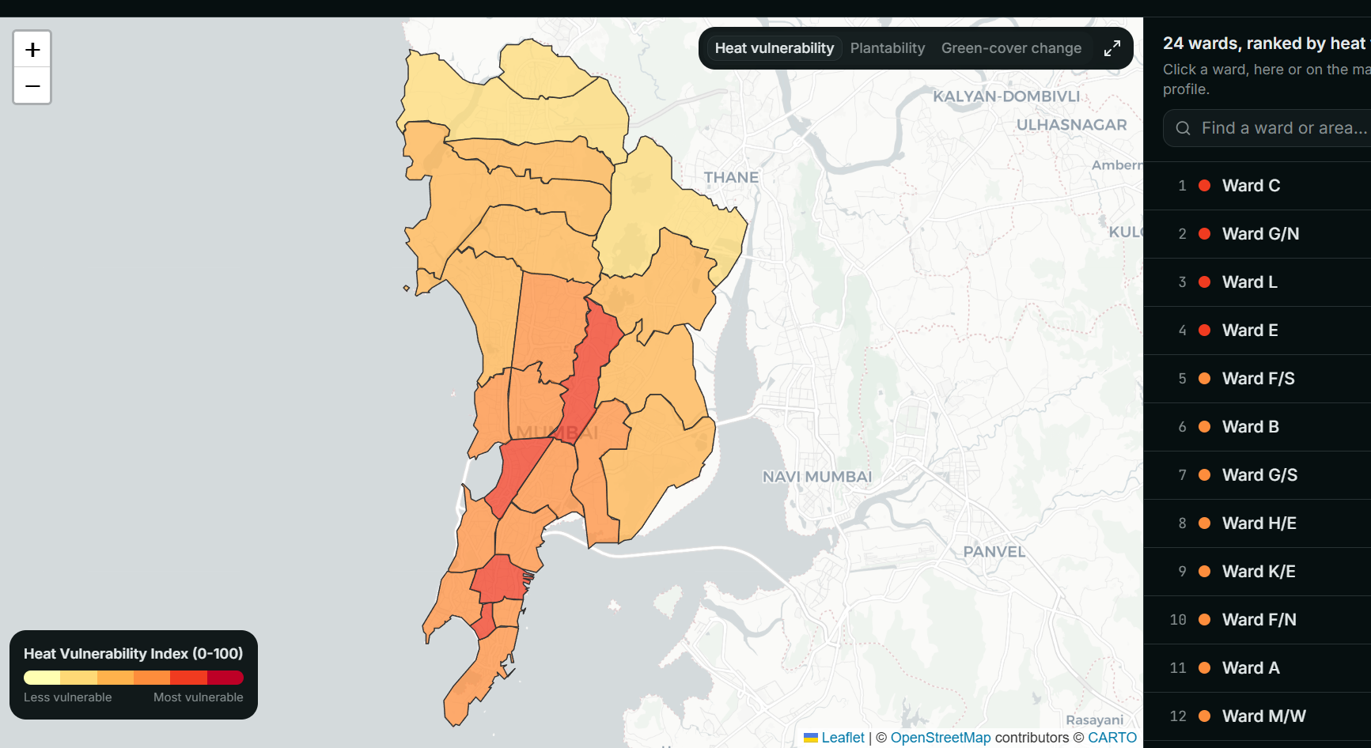
05 · PROTOTYPE / SOLUTION DESIGN
UCIP
The map: every ward in Mumbai, ranked by measured risk
The five highest ranked wards
1
Ward C
Marine Lines, Kalbadevi
74
2
Ward G/N
Dadar, Mahim, Dharavi
70
3
Ward L
Kurla
66
4
Ward E
Byculla, Mazgaon
65
5
Ward F/S
Parel, Lalbaug, Sewri
65
You can search by the name people actually use. Type Dharavi and it finds the right ward. Every ward has its own web link you can send to someone.
ucip-eight.vercel.app
Darker means more at risk. The list beside it is the same information, ranked.
Sources: Ward boundaries: Datameet BMC_Wards. Basemap: CARTO and OpenStreetMap contributors. Ranking read from data/wards_hvi.geojson, computed by my own pipeline.
14 / 21
Notes:
So here it is. Every ward, coloured by risk, with the same information ranked beside it, and a key that stays on screen, because a coloured map nobody can read is decoration, not help. And I want to be precise about one thing. [beat] I did not choose this order. I did not put Dharavi near the top because Dharavi is the famous answer. The ward containing Dharavi came second on its own. And two small things. You can search by the name people actually use. And every ward has its own link, so an official sends a colleague one place, not a screenshot.

Slide 15
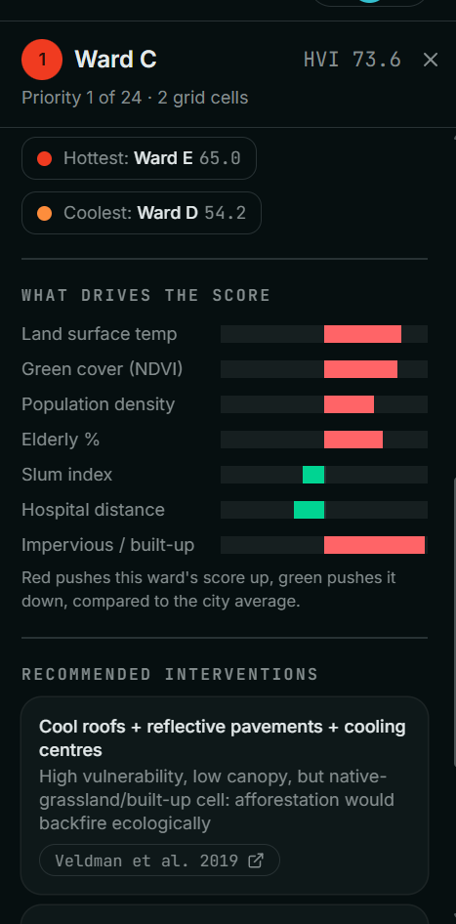
05 · PROTOTYPE / SOLUTION DESIGN
UCIP
Click one ward, and it explains itself
● Written in plain English
"This ward runs about 3 degrees hotter than the city average." Those sentences are assembled from the ward's own measurements. There is no AI writing them, so they cannot make something up.
● The bars are the reason
Each bar shows how much one factor pushed this ward's score up or down. Red pushed it up. Green pulled it down. Add them together and you get the score itself.
Nothing here is a black box.
You are not being shown a guess about how the score was made. You are being shown the arithmetic that made it.
Every number here is looked up, not generated.
Sources: Screenshot of the live site. The contribution bars are computed from the same weights and standardised values as the score itself, computed by my own pipeline.
15 / 21
Notes:
Now click the one at the top. [beat] First, three sentences of plain English, assembled from that ward's own measurements. There is no AI writing them, which means they cannot make anything up. [beat] Then these bars, which are the heart of it. Each shows how much one factor pushed this ward up or down. Red pushed it up. Green pulled it down. [beat] And here is the part I care about. Add those bars together and you get the score itself. You are being shown the arithmetic, not an explanation of it.

Slide 16
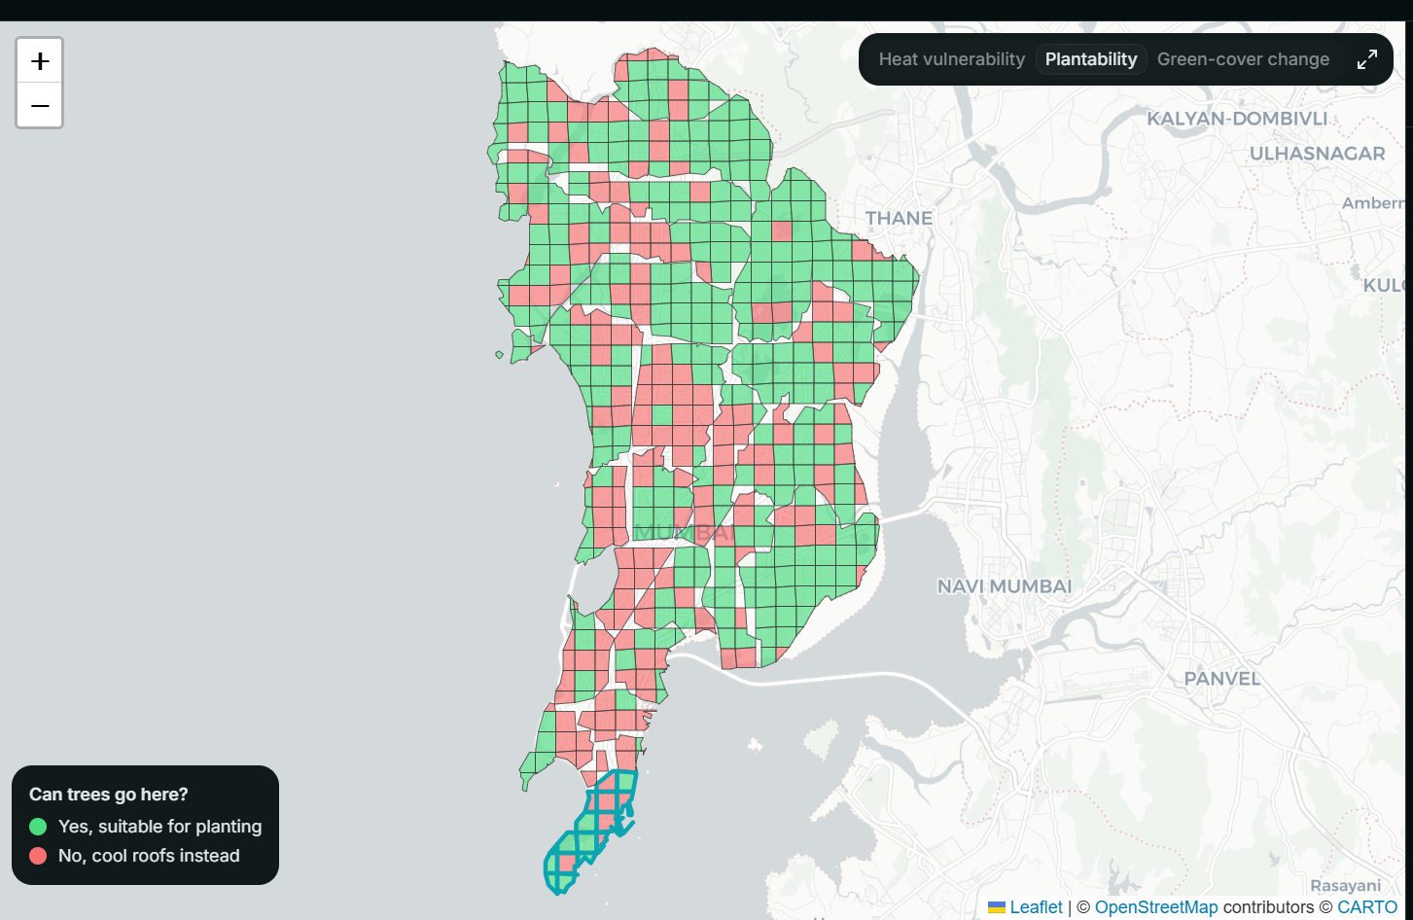
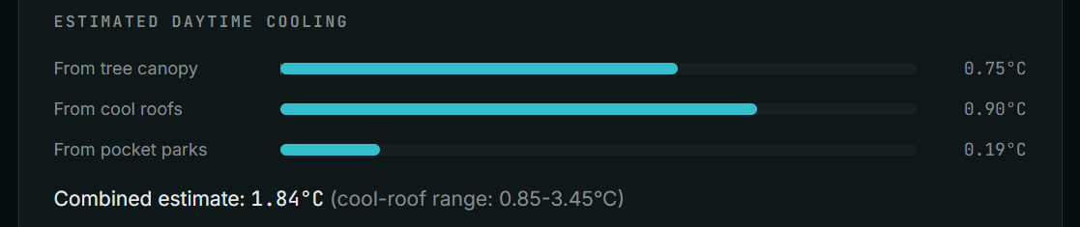
05 · PROTOTYPE / SOLUTION DESIGN
UCIP
The check, running on real data: where this tool refuses to plant
● Two opposite answers, one place
▸ Pale roofs and reflective paving
"planting here would do ecological harm"
▸ Plant native trees and green corridors
"this part genuinely suits restoration"
Same ward. Different squares. Each one
linked to the paper it came from.
Most tools cannot produce that pair.
A tool whose only answer is plant more trees has no way of ever saying no. Saying no is the point.
Green squares: trees belong here. Red squares: they do not, so pale roofs instead. One ward, both answers.
Move a slider, and the estimated cooling updates.
Sources: Land cover: ESA WorldCover v200, classes 30 (grassland) and 50 (built up). Refusal rule follows Bastin et al. 2019 and Veldman et al. 2019, Science. Cooling estimates: Ziter et al. 2019, Santamouris 2014, Bowler et al. 2010.
16 / 21
Notes:
If you remember one slide from today, make it this one. [beat, then click to the tree layer] Green squares mean trees belong there. Red squares mean they do not. [beat] Now look at the panel on the right. This is one ward, holding two opposite answers at the same time. The first card says pale roofs, because planting there would do ecological harm. Directly below it, the second says plant native trees, because that part genuinely suits it. [slower] Same ward. Opposite advice. Different squares. Both cited. [beat] A tool whose only answer is plant more trees has no way of ever saying no. Saying no is the point.

Slide 17
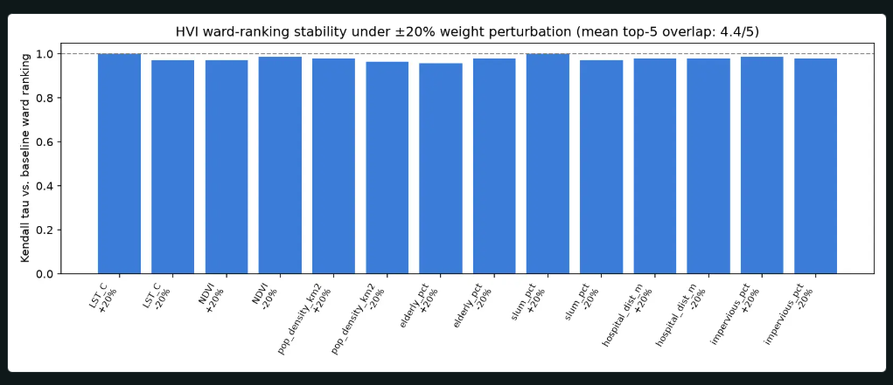
05 · PROTOTYPE / SOLUTION DESIGN
UCIP
Does the answer hold up if you push it?
almost
unchanged
the ranking stayed nearly identical every time I changed the weights.
4 of 5
the same wards stayed in the top five, on average, across every run.
● Where it is not perfect
All 14 test runs. Every bar sits near the top, meaning the order barely moved.
It is four out of five, not five out of five. In 2 of the 14 runs, the fifth place swapped.
That is not the method wobbling. Those two wards score 64.84 and 64.82. They are effectively tied, and any nudge flips a tie.
I would rather show you that than round it away.
How I tested it
Change how much each factor counts by a fifth, up and down, one at a time, then redo the whole ranking from scratch. 14 runs.
Sources: 14 runs, each weight moved plus and minus 20 percent in turn. Rank correlation and top-five overlap read from data/sensitivity.json, computed by my own pipeline.
17 / 21
Notes:
Now the question I was most afraid of. [beat] What if those weights are simply wrong? So I ran that attack before you could. I moved every factor's weight by a fifth, up and down, one at a time, and redid the whole ranking. Fourteen times. The order barely moved. [beat] On average, four of the same five stayed in the top five. And I want to stop on that, because four out of five is not five, and I could have quietly rounded it. In two runs the fifth place swapped. That is not the method wobbling. Those two wards are tied to two decimal places, and any nudge flips a tie.

Slide 18
06 · IMPACT & FUTURE SCOPE
UCIP
What this tool does not know
▸ Satellites measure the ground, not the air.
What the satellite records is how hot the surface is, which is related to, but not the same as, the temperature a person standing there actually feels.
▸ The cooling numbers were measured in another country.
The figures for how much trees and pale roofs cool things down come from studies elsewhere, because nobody has run that experiment in Mumbai yet. That is a borrowed assumption, not a local measurement.
▸ Some of the population data is an estimate.
The figures on informal housing and older residents are modelled from satellite and map data, not counted door to door. They are good enough to rank with, and not good enough to quote as fact.
▸ The slider tool gives a rough estimate.
It adds up published figures. It is not a weather model, and it does not simulate what would really happen to your street.
▸ The tree check works at street-block scale.
It is reliable for saying this area is grassland. It is not precise enough to tell you where to put one particular tree.
Sources: Land surface temperature against air temperature: a standard limitation of thermal remote sensing. Cooling coefficients are transferred from Ziter et al. 2019, Santamouris 2014 and Bowler et al. 2010, not measured in Mumbai. Population estimates: WorldPop 2020. The same list is published on the site's methodology page.
18 / 21
Notes:
Now let me spend a minute arguing against my own project. [beat] Satellites measure the ground, not the air, so what I record is related to what a person feels, but is not the same. The cooling figures are borrowed from studies abroad. Some population data is modelled, not counted. [beat] Why put this on a slide at a competition? Because tools that oversell certainty get believed, then get caught, and then nobody trusts the next one. I would rather be the tool you can check than the tool you have to trust.

Slide 19
06 · IMPACT & FUTURE SCOPE
UCIP
The impact: who this helps, and what it changes
● Mumbai
● Any other city
● Anyone working on this
It turns something already known, that the city is hot, into something you can act on: this ward first, for this reason, build this. Someone with a fixed budget gets a starting order they can defend, instead of a hunch they cannot.
Every input is free and public. Moving this to another city needs a different map of its boundaries, not a different method and not a purchase.
The code is public and free to reuse. The idea worth copying is not the map. It is that a heat tool should sometimes refuse to give the popular answer.
What changes in practice
An official opens one link, sees every ward ranked by measured need, and can show a committee exactly what drove the order, factor by factor.
A resident types the name of their own neighbourhood, sees its score and what is suggested for it, and can read what the tool admits it does not know.
Sources: All eight datasets behind this work are openly licensed; the full list is on slide 21. Live at ucip-eight.vercel.app. Code at github.com/AnayDhawan/UCIP.
19 / 21
Notes:
So what actually changes? [beat] For Mumbai, something already known becomes something you can act on. This ward first, for this reason, build this. Someone with a fixed budget gets an order they can defend in a room, instead of a hunch they cannot. [beat] For any other city, and this is the part I care most about, remember what I asked you to hold on to. Every input is free and public. Moving this needs a different boundary file. It does not need a different method, and it does not need money.

Slide 20

06 · IMPACT & FUTURE SCOPE
UCIP
What comes next
▸ Look at the city in finer detail.
● Being straight about this list
Halving the size of each measured square would make the smallest wards far more reliable. It is a one-line change.
Ideated by myself, Code and API architecture by myself, feature and raw UI planning by myself. Rest of the work such as working with the codebase, research on factors affecting heat, measuring heat, etc, and webpage copy majorly handled by Claude Code.
▸ Measure the cooling here, instead of borrowing it.
Put sensors on real roofs in this city and replace the borrowed figures with local ones. This is the limitation I would most like to close.
▸ Add the budget.
Work out how to get the most risk reduction per rupee across wards. This is the fifth column that was empty earlier. It is designed, and it does not exist yet.
▸ Use real counts when they become available.
Replace the estimated population figures with proper local records if and when those open up.
▸ Make it easy to move to another city.
Package it so the next city only has to supply its own boundaries.
ucip-eight.vercel.app
github.com/AnayDhawan/UCIP
I cannot cool that roof. I can tell you, with evidence, which one to cool first.
Sources: The roadmap is mine. Live at ucip-eight.vercel.app. Code at github.com/AnayDhawan/UCIP. Limitation being closed by item two: cooling coefficients from Ziter et al. 2019 and Santamouris 2014 are transferred, not local.
20 / 21
Notes:
Three things next. Finer detail, a one-line change that fixes a weakness I showed you. Measure the cooling in Mumbai instead of borrowing it, the limitation I would most like to close. And build the budget layer, that fifth empty column, which does not exist yet, which is exactly why it is on this slide and nowhere earlier. [beat, slow right down] I began by telling you about a family under a metal roof at forty degrees. [beat] I cannot cool that roof. Nobody in this room can switch off the sun. [beat] But I can now tell you, with evidence you are free to go and check tonight, that theirs is the roof to cool first. Which ward. Why. And what to build. [beat] Thank you.

Slide 21
06 · IMPACT & FUTURE SCOPE
UCIP
Every source behind this deck
Not presented. This page exists so any claim in the deck can be traced without asking me.
Research papers (11)
Data sources (8), all openly licensed
Authors | Venue | DOI
Reid et al. 2009 | Environ. Health Perspect. 117(11):1730-1736 | 10.1289/ehp.0900683
Knowlton et al. 2014 | IJERPH 11(4):3473-3492 | 10.3390/ijerph110403473
Azhar et al. 2017 (RAND India HVI) | IJERPH 14(4):357 | 10.3390/ijerph14040357
Bastin et al. 2019 | Science 365(6448):76-79 | 10.1126/science.aax0848
Veldman et al. 2019 | Science 366(6463):eaay7976 | 10.1126/science.aay7976
Friedlingstein et al. 2019 | Science 366(6463):eaay8060 | 10.1126/science.aay8060
Lewis et al. 2019 | Science 366(6463):eaaz0388 | 10.1126/science.aaz0388
Ziter et al. 2019 | PNAS 116(15):7575-7580 | 10.1073/pnas.1817561116
Li, Bou-Zeid & Oppenheimer 2014 | Environ. Res. Lett. 9(5):055002 | 10.1088/1748-9326/9/5/055002
Santamouris 2014 | Solar Energy 103:682-703 | 10.1016/j.solener.2012.07.003
Bowler et al. 2010 | Landscape and Urban Planning 97:147-155 | 10.1016/j.landurbplan.2010.05.006
Dataset | Used for
Landsat 8/9 Collection 2 (USGS) | Land surface temperature and NDVI composites
WorldPop age-sex rasters | Population density and elderly-share estimates
ESA WorldCover v200 | Land cover, impervious surface, plantability screening
Google Earth Engine | Satellite data access and zonal statistics
OpenStreetMap contributors | Hospital locations (ODbL)
Datameet Municipal Spatial Data | BMC ward boundaries and slum-cluster polygons
CARTO / OpenStreetMap | Basemap tiles on the dashboard
Natural Earth 1:10m physical | Regional coastline behind the landing-page model (public domain)
Also cited in this deck
Global temperature anomaly imagery: NASA Goddard Space Flight Center, Scientific Visualization Studio, GISTEMP v4 (slide 3). India heat mortality, three official counts: Gadgil and Narang, Down To Earth, 10 April 2025 (slide 5). Mumbai Climate Action Plan 2022, BMC with WRI India and C40 (slides 5 and 8). Mehrotra, Bardhan and Ramamritham 2018, doi 10.1177/0975425318783548 (slide 8). C40 and Ramboll, Urban Cooling Toolbox 2021 (slide 8).
Sources: Read at build time from the same citation module the live site renders, so this list cannot drift from the one published online.
21 / 21
Notes:
[APPENDIX. Not presented and not timed. Open this only if a judge asks where something came from. Built from the same citation module the live site renders.]

