Slide 1
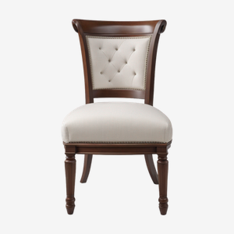
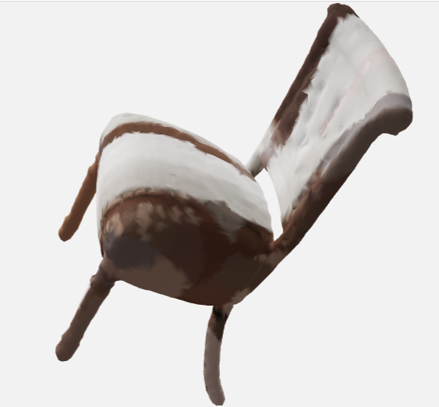
Image-to-3D Mesh Agent
Intelligent 3D Reconstruction from Single and Multiple Images
Anshuman Rai (2400290120055)
Core ML Pipeline, Agent Orchestration & Analytics
Anany Sharma (2400290120043)
Preprocessing, Interactive Interfaces, Rendering & Evaluation
Guide: Prof. Kirti Sharma
KIET Deemed to be University
Input photo (cut-out, from the preview sheet)
Mesh viewer capture from one run, unedited
Real outputs, not illustrations. Backend, IoU and log for this run were not recorded, so no score is claimed.
Source notebook: Image_to_3D_Agent_Colab.ipynb (Colab, T4 GPU target)
Notes:
Good morning. Our project is an Image-to-3D Mesh Agent: it turns one photo, or two to four views of an object, into a 3D mesh. It does this by orchestrating pretrained models, not by training a new one. I am Anshuman Rai; I built the core pipeline, agent orchestration and analytics. Anany Sharma built preprocessing, the interfaces, rendering and evaluation. Our guide is Prof. Kirti Sharma. The two images on the right are real captures from one run of our notebook, shown as they came out. We will be candid about what they show.
VIVA - 2D image vs 3D mesh: an image is a grid of pixels from one viewpoint; a mesh is vertices and faces describing the surface, viewable from any angle.

Slide 2
Problem and Motivation
CONCEPT
A single photograph carries limited depth information and no view of hidden surfaces
Manual 3D modelling needs specialist skills and time
Multiple views add geometric cues, but still need a reconstruction step
Our approach: an automated inference pipeline that orchestrates pretrained 3D-generation models
2D input
One photo, or 2-4 views
Reconstruction
Pretrained generative model, selected and scored by the agent
3D mesh
GLB / OBJ / STL
Notes:
Turning a photo into a usable 3D asset is hard. A photo holds one viewpoint, so depth and the hidden side must be inferred. Manual modelling takes specialist skills and time. Extra views add geometric cues but still need a reconstruction step. Our project explores an automated inference pipeline built on pretrained 3D-generation models. We do not claim this removes manual modelling in every scenario.
VIVA - why is single-image reconstruction difficult? Many different 3D shapes produce the same photo, so the model has to guess the hidden surfaces. Why pretrained models? Training 3D generators needs large datasets and heavy compute that are beyond a student project.

Slide 3
Objectives and Proposed Solution
IMPLEMENTED
1
Accept one or more images of an object
2
Standardise the image and inspect its quality
3
Select an available pretrained model backend
4
Generate and compare candidate 3D meshes
5
Process the selected mesh and project available image colours
6
Provide downloadable outputs and an evaluation report
The agent = an orchestration layer linking preprocessing, generative backends, candidate scoring, mesh processing and export. It orchestrates existing models; it does not train one.
Notes:
We set six objectives, and the notebook has code for each: accept one or more images; standardise them and check quality; choose an available pretrained backend; generate and compare candidate meshes; clean the chosen mesh and project colours from the photo; and give downloadable outputs and an evaluation report. The agent is the orchestration layer that connects these steps. Our engineering contribution is that layer, not a new 3D model.
VIVA - role of the orchestration layer? It decides the backend order from the number of views, generates and scores candidates, falls back when a result is weak, and handles memory and time limits.

Slide 4
System Architecture
IMPLEMENTED
Input
Image upload (1 image or 2-4 views)
Repo sample images (cell 6)
Preprocessing
EXIF fix
Background removal
Crop and centre
Quality analysis
View assignment
Agent orchestration
Single or multi-view
Backend chain
N seeds per backend
Time budget + OOM back-off
Select best
3D generation
Hunyuan3D-2mv (2-4 views)
Hunyuan3D-2mini
TripoSR (if installed)
Evaluation + postprocess
Mesh clean + decimate
Silhouette IoU (24 poses)
Orient + colour projection
Output
GLB, OBJ, STL
Preview PNG
JSON report
ZIP bundle
OPT: Gradio UI, batch CSV
Dashed = optional, outside the core Colab flow. Generation and evaluation repeat per seed and backend.
Notes:
This diagram follows the notebook, cell by cell. Inputs come from an upload or the sample images in the Hunyuan repo. Preprocessing fixes EXIF orientation, removes the background, crops and centres, analyses quality and assigns views. The orchestration layer plans the backend order, generates candidates, applies the time budget and out-of-memory back-off, and picks the best. The three backends are conditional: they exist only if they imported and loaded. Evaluation scores silhouettes and cleans the mesh; after selection we orient it and project colour. Outputs are GLB, OBJ, STL, a preview, a JSON report and a ZIP. The Gradio interface and batch CSV are optional extras. There are no servers, databases or cloud APIs in this design.

Slide 5
Input Modes and Preprocessing
IMPLEMENTED
Image
Background removal
Foreground mask
Crop and centre
512x512 RGBA
Quality analysis
Input modes
What helps the result
Warnings raised by the code
Single view: one image is used as 'front'
Multi-view: 2-4 images as front, left, back, right
Views are picked from filename keywords, else upload order
Plain background
Whole object visible
Sharp, adequately sized photo
3/4 front angle; extra views add cues
Under 256 px
Blurry (Laplacian variance < 30)
Mask < 10% or > 92% of frame
Fragmented mask (main blob < 90%)
Fallback segmentation (corner-colour threshold) is a simple heuristic and can fail on busy or low-contrast backgrounds.
Notes:
The notebook accepts one image, or two to four views labelled front, left, back and right; labels come from filenames, otherwise upload order. Preprocessing runs rembg for background removal, with a simpler fallback that thresholds against the corner colour and keeps the largest blob. The object is cropped, scaled with an 8 percent margin and centred on a 512 by 512 transparent canvas. The analysis step warns about low resolution, blur, a tiny or oversized mask, and a fragmented mask. Why this matters: the generative models then receive a more standardised input. The fallback segmentation is not claimed to work on arbitrary images; busy backgrounds, low contrast and cropped objects can all hurt.
VIVA - why different models for single and multi-view? Hunyuan3D-2mv is the multi-view model; mini and TripoSR take one image.

Slide 6
Intelligent Agent Orchestration
IMPLEMENTED
Load backend
Best IoU >= 0.85?
Analyse and plan chain
Generate seed k
Clean + silhouette IoU
Pick best, finish
No: skip backend, try the next
CUDA OOM: octree x0.75, chunks /2 (up to 3 tries)
No: next backend, if time <= 900 s (soft)
No candidate from any backend: RuntimeError
Single-view: 3 seeds per Hunyuan backend; multi-view: 2; TripoSR: 1
Below threshold: best candidate kept, warning added to report
Fallback improves resilience in principle; it does not guarantee a result when every backend fails. The time budget is only checked between backends.
Notes:
Why an agent rather than one model call? Inputs differ, models may be missing, and a single generation can be poor. The flow: analyse and plan the backend chain; load a backend, skipping it if loading fails; generate a candidate for each seed; if CUDA runs out of memory, shrink the octree grid by 25 percent and halve the chunk size, up to three tries; clean the mesh and score its silhouette. If the best IoU reaches 0.85 the agent stops; otherwise it moves to the next backend, provided the 900 second soft time budget allows. If everything fails it raises an error. Fallback improves resilience in principle but cannot guarantee output.
VIVA - what if the GPU runs out of memory? The agent frees memory and retries with a coarser grid and smaller chunks; later seeds keep the lighter settings.

Slide 7
Selecting the 3D Generation Backend
UNVERIFIED
Backend | Intended role in this notebook | Important qualification
Hunyuan3D-2mini | Primary single-image route; second choice in multi-view runs (front view) | Checkpoint loading and generation require runtime verification
Hunyuan3D-2mv | Multi-view route (2-4 views, tried first) | Needs successful install and compatible checkpoints
TripoSR | Potential last fallback, front view only | Needs its dependencies, including a CUDA build of torchmcubes; auto-disabled if setup fails
1 view: Hunyuan3D-2mini > TripoSR
2-4 views: Hunyuan3D-2mv > mini > TripoSR
Each step exists only if that backend imported and loaded. Qualitative description, not a benchmark ranking.
Notes:
Routing is conditional. plan_chain builds the list from the number of views and from which backends actually imported. One view: Hunyuan3D-2mini, then TripoSR. Two to four views: Hunyuan3D-2mv first, then mini on the front view, then TripoSR on the front view. This table is qualitative. We are not ranking the models; no benchmark was run, and we make no claim that one is more accurate or faster. The orchestrator is useful because models support different inputs, a fallback helps when the preferred one is unavailable, and several candidates allow selection instead of accepting the first output.
VIVA - why route differently? Because multi-view cues need a multi-view model, and the single-view models ignore extra images.

Slide 8
Pretrained Model Inference Pipeline
UNVERIFIED
Pretrained weights (Hugging Face)
Image conditioning
3D shape generation (5 steps turbo / ~30)
Mesh extraction (octree 320)
Candidate mesh (trimesh)
Runtime requirements
Scope
Google Colab with a GPU runtime (T4 targeted)
Model-weight downloads (~5 GB per notebook comment), optional Drive cache
Dependency install (~5-8 min first time)
One model on the GPU at a time (T4 ~15 GB)
Inference-only: no training, no fine-tuning
Hunyuan3D shape model only; no texture model is used (colour comes from projection)
Full GPU workflow timing and memory not yet measured
Notes:
This is inference only. The notebook loads pretrained weights from the Hugging Face hub and calls them; nothing is trained or fine-tuned. For Hunyuan3D the flow is: load the flow-matching diffusion-transformer pipeline, condition it on the preprocessed image, generate a shape with 5 steps in turbo mode or about 30 otherwise, extract a mesh with marching cubes at an octree resolution of 320, and return a trimesh. Runtime needs: Google Colab, a GPU, a weights download of roughly 5 GB per the notebook comment, about 5 to 8 minutes of installs, and enough VRAM; the notebook keeps one model on the GPU at a time. T4 is the target. We have not established timing on it.
VIVA - why not train from scratch? Cost and data. We contribute orchestration and evaluation around existing models.

Slide 9
Candidate Generation and Selection
IMPLEMENTED
Candidate A (seed 0)
Silhouette IoU per candidate
Input image(s)
Candidate B (seed 1)
Rank by mean IoU
Selected mesh
Candidate C (seed 2)
Config values: N_SEEDS_SINGLE = 3, N_SEEDS_MULTI = 2, TripoSR = 1. These are code settings, not empirically tuned.
Ranking uses silhouette agreement only, so the top score is not necessarily the most accurate full 3D object.
Notes:
Generative models are stochastic, so different random seeds give different meshes. The agent generates several candidates, scores each one's silhouette against the input mask, and keeps the highest. In code, single-view runs use 3 seeds, multi-view runs use 2, and TripoSR contributes one. These are configuration values, not optimised ones. Candidates from different backends are pooled when a fallback happens. A higher score only means the outline agrees better; it does not mean the whole object is right.
VIVA - why different seeds? Each seed samples a different plausible shape, so we get a choice. Selection raises the odds of a good match; it does not guarantee a correct reconstruction.

Slide 10
Silhouette IoU: Evaluation Method
IMPLEMENTED
How the code computes it
Limitations
Masks cropped and resized to 128x128 (scale and position invariant)
Best of 24 camera poses (6 directions x 4 rotations)
Multi-view: distinct directions per view, mean IoU
Stop threshold 0.85 is a code setting, not a validated standard
Best-of-24 pose search makes scores optimistic
Orthographic render vs perspective photo
Hidden side of a single view is unconstrained
No check of depth, topology, texture or meaning
Target (photo)
Render (mesh)
Overlap = intersection; both shapes together = union
IoU = Area(Intersection) / Area(Union)
Notes:
IoU is intersection over union of two binary silhouettes: the input photo's mask and the mesh's rendered outline. In the diagram, violet is the target and cyan is the render; the overlap is the intersection. The notebook normalises both masks to 128 by 128 by cropping to the bounding box, so scale and position are ignored. Because the mesh pose is unknown it tries 24 axis-aligned camera poses and keeps the best; for multi-view it assigns distinct directions to each view and averages. Limits: best-of-24 selection and orthographic rendering against a perspective photo make the score optimistic; hidden surfaces, depth, topology, texture and semantics are not measured. The 0.85 threshold is an implementation parameter, not a validated standard.
VIVA - what does IoU measure, and why is it not full 3D accuracy? It measures outline overlap from one projection only; two different 3D shapes can share a silhouette.

Slide 11
Mesh Cleanup and Optimisation
IMPLEMENTED
1 Remove degenerate faces and unused vertices
2 Filter small disconnected parts (< 3% of largest)
3 Fill holes, fix normals (best effort)
4 Decimate to <= 80,000 faces, keep colours
5 Centre and scale to unit size
6 Orient to the input view
7 Project colours from the photo
Steps 1-5 run per candidate; steps 6-7 run once on the selected mesh. Schematic only: no real before/after meshes are shown.
The 80,000-face limit (MAX_FACES) is a configured target, not a guarantee, and does not make a mesh suitable for every production use.
Notes:
After each candidate is generated, clean_mesh drops degenerate faces and unused vertices, removes floating fragments smaller than 3 percent of the largest component, fills holes and fixes normals where it can, decimates to at most 80,000 faces with a quadric method, and centres and scales the mesh to unit size. After a candidate is selected we orient it so the input camera looks down the negative Z axis, and project colours. Repair is best effort. The 80,000-face cap is a configured target to keep files manageable; we do not claim every mesh meets it or is production-ready. The schematic is not a before-and-after of real meshes.
VIVA - mesh cleanup vs mesh generation? Generation creates the raw surface; cleanup repairs and simplifies it afterward.

Slide 12
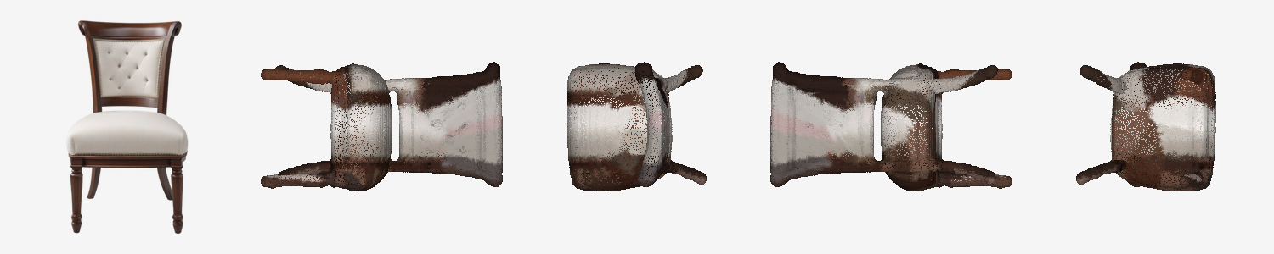
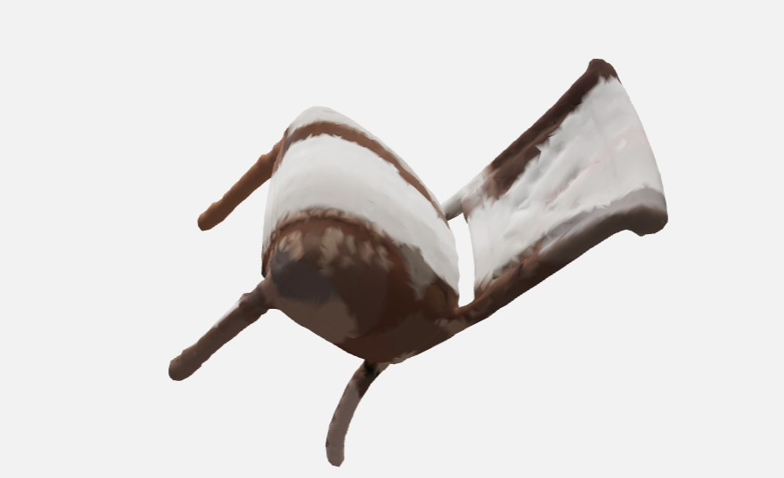
Colour Projection and 3D Preview
ONE RUN OBSERVED
Preview sheet from one run: cut-out input, then four orbit views drawn by the notebook's point-splat renderer (dotted look). Unedited.
Visible vertices take photo colour; hidden ones are filled approximately
Not a physically accurate material
In this one run: colour is blotchy and the mesh looks tilted versus the upright input; orientation and colour projection need work
Interactive viewer captures, same mesh
Notes:
Colour projection paints each vertex that the photo's camera can see directly from the photo. Hidden vertices keep the model's own colour if it has one, otherwise take the nearest visible vertex's colour. So unseen surfaces get approximate colour, and this is not a physically accurate material. The strip shows the preview sheet from one run: the cut-out input, then four orbit views. The dotted look comes from our software point-splat preview renderer, not necessarily from the mesh. The two captures are the interactive viewer for the same mesh. In this single example the colour is blotchy and the mesh looks tilted relative to the upright input, so orientation recovery and colour projection need work. We show this as it came out, not as a validated result.

Slide 13
Output Formats and Deliverables
DEFINED IN CODE
Output | Typical purpose | Note for this notebook
GLB | Compact asset format for viewers and the web | Carries geometry and vertex colours
OBJ | Widely supported interchange format | Written from a colourless copy (geometry only)
STL | Geometry-only; common in 3D printing | No colour or material information
PNG preview | Quick visual check | Input cut-out + 4 orbit views
JSON report | Structured run information | Backend, seed, IoU, faces, warnings, time
CSV table | Batch evaluation results | evaluation.csv from cell 8
ZIP bundle | One-click download of all outputs | Cell 9
Formats are defined in code; a given run may not produce all of them.
Notes:
The notebook is written to export these files. GLB holds geometry and the vertex colours. OBJ and STL are written from a colourless copy of the mesh in the code, so they carry geometry only. STL is a geometry-oriented format common in 3D printing. The PNG is the preview sheet, and the JSON report records the backend, seed, per-view IoU, face counts, candidates, warnings and time. The batch function writes evaluation.csv and cell 9 zips everything. These describe the code; we do not claim every file has been produced on every run.
VIVA - why export GLB, OBJ and STL? Different tools expect different formats: GLB for viewers and web, OBJ for interchange, STL for printing.

Slide 14
Interfaces and Demonstration Workflow
UNVERIFIED
Google Colab (core)
Optional Gradio interface
Choose one image, 2-4 views, or a repo sample
Run the agent
Read image-quality warnings
Review selected candidate and IoU
Inspect preview sheet and 3D viewer
Download GLB / OBJ / STL / report (ZIP)
Front image required; left, back, right optional
Button: Generate 3D model
3D viewer, preview sheet, run summary
Downloads: GLB, OBJ, STL, JSON report
Gradio is launched with share=True, a public link. Avoid sensitive images; this is not a secure deployment. The interface has not been demonstrated at runtime.
Notes:
There are two paths. In Colab you pick a source, run the agent, read any quality warnings, review the selected candidate and its score, view the preview and the interactive 3D model, and download files. The optional Gradio app needs a front image, accepts left, back and right views, and returns a 3D viewer, the preview and downloads. Important: the code launches Gradio with share equals True, which creates a public link, so avoid sensitive images and do not treat it as a secure deployment. Because the Gradio runtime has not been demonstrated, this is the designed flow rather than a verified one.

Slide 15
Batch Evaluation and Reporting
UNVERIFIED
Test folder
loose images or per-object folders
run_agent per object
single- or multi-view; failures logged
evaluation.csv
object, mode, backend, IoU, faces, seconds, warnings
Mean IoU by mode
printed summary
Helps assess reliability across different objects
Uses silhouette IoU and run metadata only
Does not compare against ground-truth 3D models
No verified evaluation dataset yet. No dataset size, mean IoU, success rate or runtime is claimed.
Notes:
The batch function walks a test folder. A loose image is a single-view test; a sub-folder of up to four views is a multi-view test. For each object it runs the agent, catches failures as FAILED rows, and writes a CSV with the object, mode, backend, silhouette IoU, face count, seconds and warnings, plus mean IoU by mode. This helps judge reliability across objects. But it uses silhouette IoU and run metadata only, so it does not establish 3D accuracy against ground-truth models. No evaluation dataset has been documented yet, so we report no dataset size, mean score, success rate or average runtime.
VIVA - how would you evaluate with ground-truth 3D models? Compare against reference meshes using Chamfer distance and F-score after alignment, which this notebook does not yet do.

Slide 16
Implementation Status and Validation
ONE RUN OBSERVED
Component | Status
Preprocessing and image analysis | Implemented; synthetic-data testing reported in notebook
Agent loop and fallback | Implemented; tested with fake backends (component level)
Pretrained model integration | Source present; one output set observed, run log not recorded
3D generation and export | One mesh and preview observed (chair); other files unverified
Silhouette scoring | Implemented; metric limits apply
Gradio interface | In notebook; runtime not demonstrated
Batch evaluation | Function present; no results yet
Current limitations
Quality depends on photo and backend
Hidden surfaces cannot be observed from one view
IoU is not a full 3D accuracy measure
Cleanup and colour are best effort
GPU memory, dependencies and downloads can break a run
Saved notebook copy shows only a no-GPU error in cell 1
Notes:
This table separates what exists from what is verified. Preprocessing, analysis, pose recovery, scoring, colour projection, the agent loop with fake backends, and out-of-memory back-off were tested on synthetic data according to the notebook; that is component-level evidence, not end-to-end proof. We have one set of real outputs, the chair run, which shows a mesh and preview were produced at least once, but the backend, score and log for that run were not recorded. The saved notebook copy itself shows only a no-GPU error in cell 1. Limitations: reconstruction quality depends on the photo and backend; a single view cannot see hidden surfaces; IoU is a silhouette metric; cleanup and colour are best effort; GPU memory, dependencies and downloads can break a run.
VIVA - what is tested and what is not? Component logic on synthetic data and one observed output set; not a documented test set, timing, or ground-truth accuracy.

Slide 17
Future Work and Conclusion
CONCEPT
Future work (not yet done)
Conclusion
An automated pipeline combining pretrained 3D generation, conditional backend selection, candidate scoring, mesh cleanup and export.
The engineering contribution is the orchestration and evaluation workflow around existing models, not a new 3D foundation model.
Run the full notebook on a GPU; save outputs and error logs
Test a documented single- and multi-view image set
Compare backends under controlled conditions
Evaluate single- vs multi-view input
Add ground-truth 3D metrics (e.g. Chamfer, F-score) if references exist
Record memory, runtime, failure rate, mesh complexity
Improve segmentation, orientation and colour projection
Validate mesh integrity in downstream tools
Notes:
The items on the left are future work, not completed. The priorities: run the full notebook on a compatible GPU and save logs; test a documented set of single and multi-view images; compare backends under controlled conditions; evaluate single against multi-view; add ground-truth metrics if reference models exist; record memory, runtime, failure rate and mesh complexity; and improve segmentation, orientation and colour projection. In conclusion, the project proposes an automated pipeline that combines pretrained 3D generation, conditional backend selection, candidate scoring, mesh cleanup and export. Our contribution is the orchestration and evaluation around existing models, not a new 3D foundation model.
VIVA - what would you improve next? First, verified end-to-end runs with logs; then orientation recovery and colour projection, which the observed run shows are weak.

Slide 18
References and Questions
[1] Z. Zhao et al., "Hunyuan3D 2.0: Scaling diffusion models for high resolution textured 3D assets generation," arXiv:2501.12202, 2025.
[2] D. Tochilkin et al., "TripoSR: Fast 3D object reconstruction from a single image," arXiv:2403.02151, 2024.
[3] Tencent-Hunyuan, "Hunyuan3D-2," GitHub. github.com/Tencent-Hunyuan/Hunyuan3D-2; models tencent/Hunyuan3D-2mini, -2mv (Hugging Face).
[4] VAST-AI-Research, "TripoSR," GitHub. github.com/VAST-AI-Research/TripoSR; model stabilityai/TripoSR (Hugging Face).
[5] A. Paszke et al., "PyTorch: An imperative style, high-performance deep learning library," NeurIPS 32, 2019.
[6] A. Abid et al., "Gradio: Hassle-free sharing and testing of ML models in the wild," arXiv:1906.02569, 2019.
[7] Trimesh (github.com/mikedh/trimesh); rembg (github.com/danielgatis/rembg), software documentation.
[8] P. Jaccard, "The distribution of the flora in the alpine zone," New Phytologist, vol. 11, no. 2, pp. 37-50, 1912.
Questions?
Thank you. Anshuman Rai and Anany Sharma, guided by Prof. Kirti Sharma.
Licences: check each model card before redistribution or commercial use.
Notes:
These are the sources we verified: the Hunyuan3D 2.0 paper and the TripoSR paper on arXiv, the official code repositories the notebook clones, and the main libraries. The Hunyuan3D-2mini and 2mv checkpoints are cited through the repository and model cards. Before any redistribution or commercial use, check each licence; the notebook notes that Hunyuan3D-2 uses the Tencent Hunyuan Community License with region restrictions and that TripoSR is MIT. Thank you; we are happy to take questions.

