Slide 1

Project Title -AIRBNB HOTEL BOOKING ANALYSIS
[NAME: Ananya T Y ]

Slide 2

PROBLEM STATEMENT
The hospitality industry is shifting with online platforms like Airbnb.
Airbnb connects hosts and guests via a commission-based model, without owning properties.
This project analyzes the NYC Airbnb dataset to extract insights on:
Listing availability
Pricing strategies
Customer satisfaction
Findings provide value for travelers, hosts, Airbnb, and researcher

Slide 3
Dataset Overview Source: Airbnb dataset (Excel file) Key features: Room Type, Neighbourhood Group, Price, Reviews, Hosts Records: ~number of rows after cleaning Data Cleaning Normalized column names Converted price & service fee to numeric Filled missing values (e.g., reviews = 0, unknown names) Removed duplicates

Slide 4

WHO ARE THE END USERS?
Travelers → find best property options
Hosts → optimize pricing & performance
Airbnb Platform → monitor market trends
Researchers/Analysts → study housing & tourism patterns

Slide 5

Technology Used
Python: Pandas, NumPy, Matplotlib, Seaborn
Google Colab / Jupyter Notebook for analysis
Excel dataset as input
Data Visualization libraries for insights

Slide 6
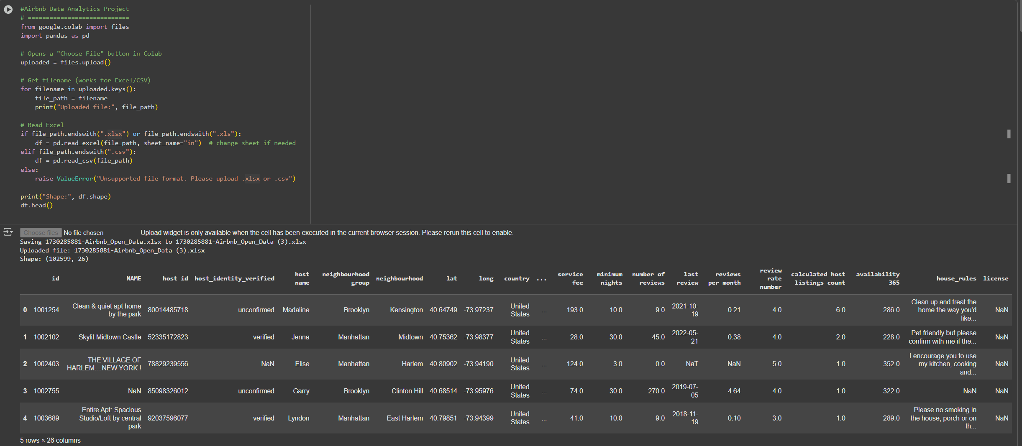
RESULTS
Demo Link: https://colab.research.google.com/drive/1ZyxK4RzrdWuQ_7a39dsRJ1k7d53MWKAu#scrollTo=ce_jl3u4NNU4

Slide 7
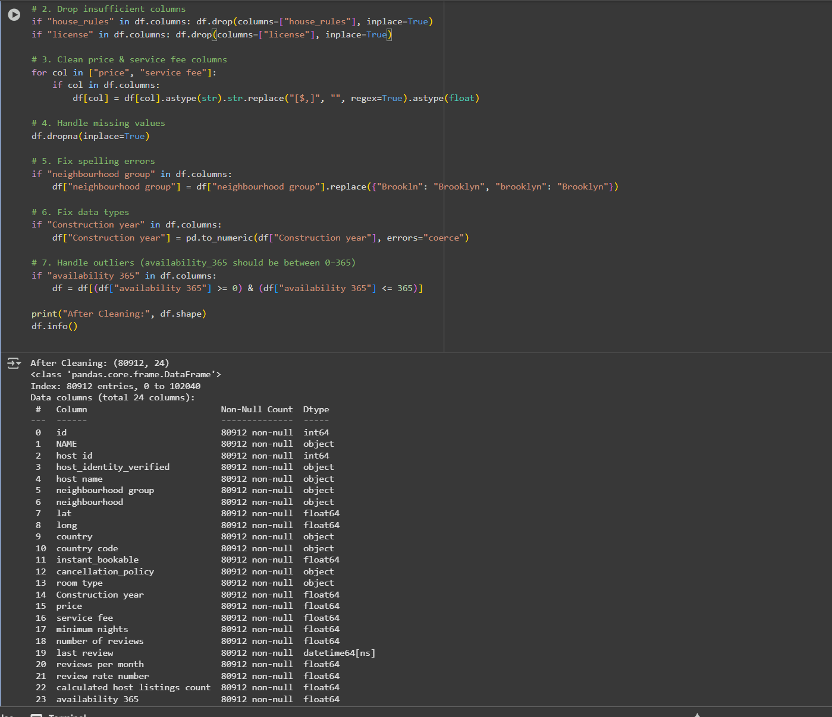
RESULTS

Slide 8
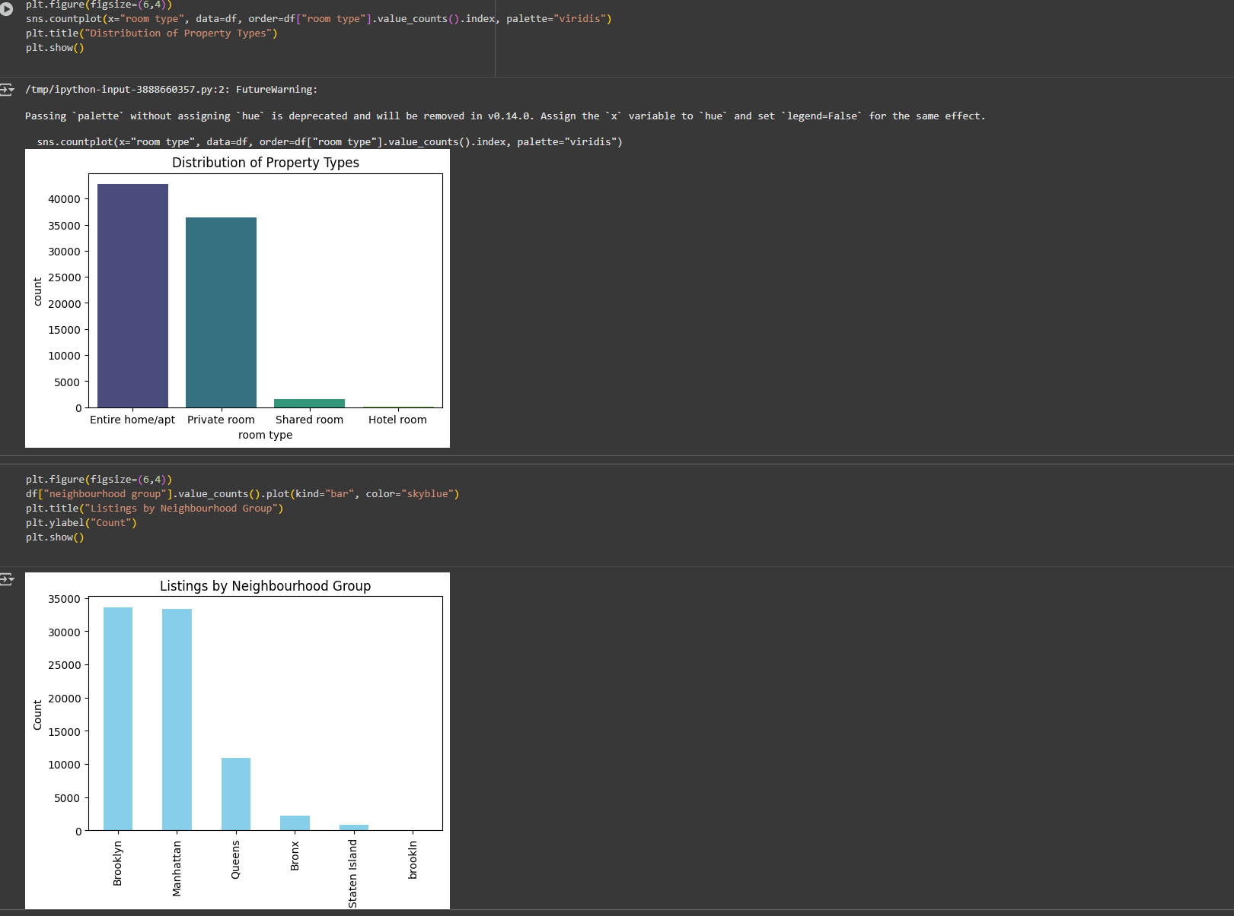
RESULTS

Slide 9
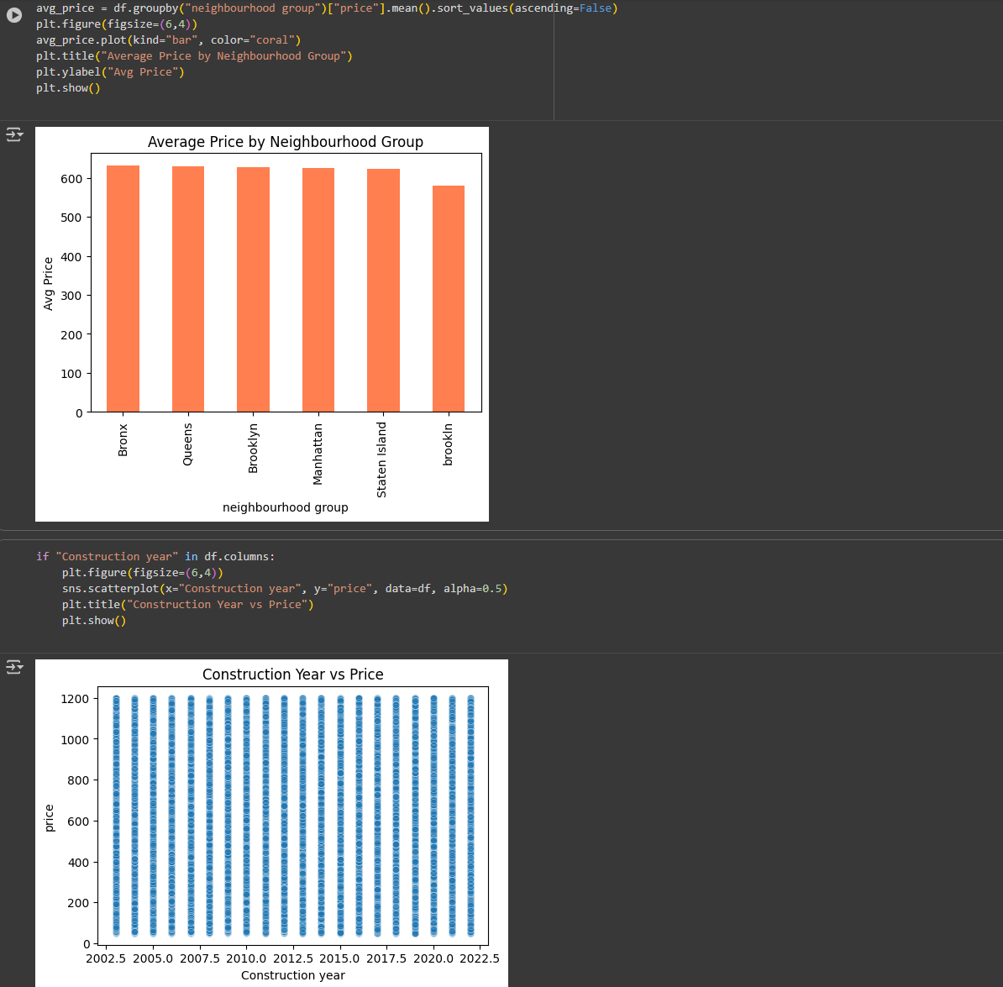
RESULTS

Slide 10
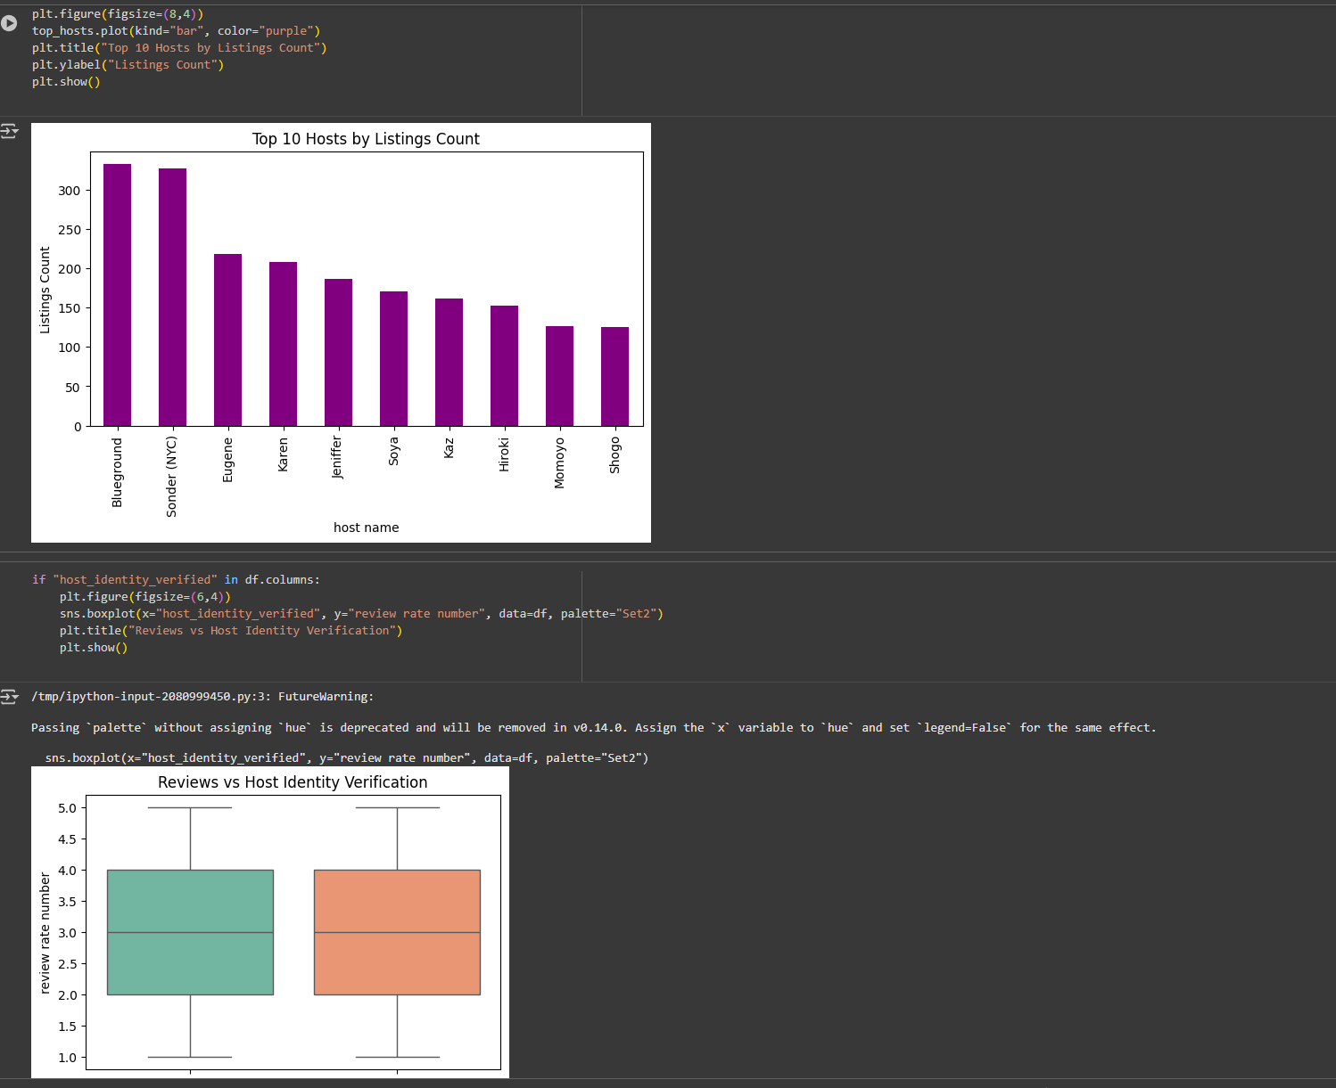
RESULTS

Slide 11
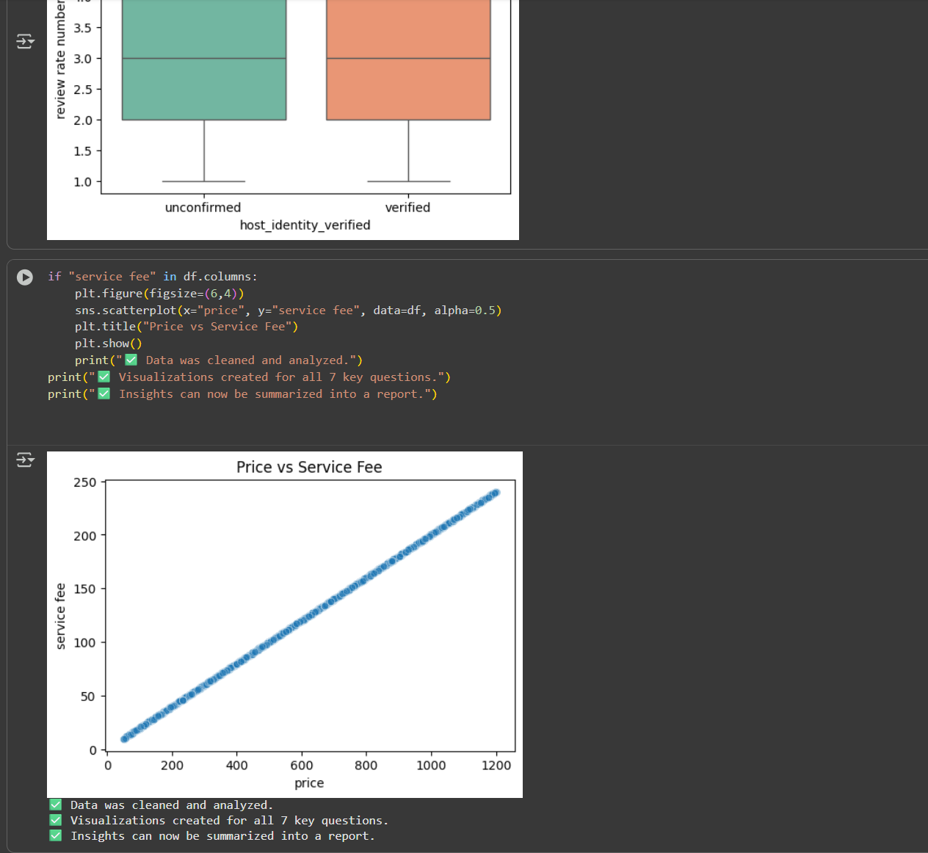
RESULTS

Slide 12
Thank you
.
.

