Slide 1
MyGov
Contribute towards a better city

Slide 2
Issues
Potholes
Littered Garbage
Stagnant Water
etc

Slide 3
Solution
Let the people be included in a good governance.
Just take a picture of the problem and send it to the govt.
The govt will solve the problems according to the number of complaints(freq).

Slide 4
Working

Slide 5
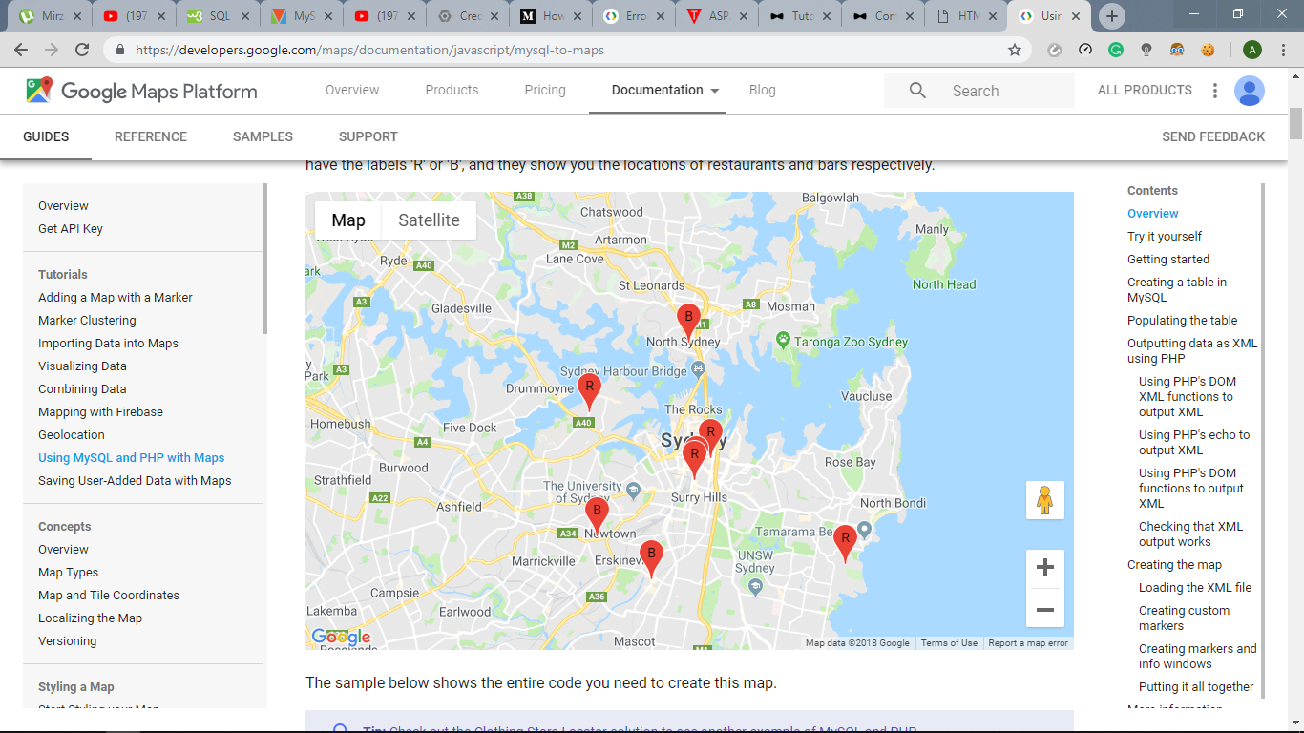

Slide 6
Future To Do’s
Area wise sorting using markers in google map on admin panel.
Progress updates on the complaint.
Make Mobile application for the same for easier complaint lodging.
Can tie up with local cctv cameras and set up camers on public vehicles.
Using Image Processing to filter out fake complaints.
Implement on all major cities.

Slide 7
Thank you
Team Magnum

