Slide 1
Agentic AI Health Symptom Checker
IBM HACKATHON PROJECT
Presented By:
Student Name- Situ Saw
College Name- Kanpur Institute of Technology
Department - Computer Science ( AI & ML )

Slide 2
OUTLINE
Problem Statement
Technology used
Wow Factors
End users
Result (Output Image)
Conclusion
Git-hub Link
Future Scope
IBM Certifications

Slide 3
Problem Statement
An Agentic AI Health Symptom Checker helps users understand their health conditions by analyzing symptoms and providing probable causes, preventive advice, and care recommendations. It retrieves verified medical data, symptom databases, and guidelines from trusted sources like WHO, government health portals, and medical journals. Users can input symptoms in natural language such as “I have a sore throat and fever,” and the agent provides possible conditions, urgency level, home remedies, and when to consult a doctor. It supports multi-language interaction and avoids self-diagnosis risks by offering educational and referral-based suggestions. This AI-driven assistant promotes early detection, reduces misinformation, and empowers users to take informed health actions.

Slide 4
Technology used
IBM cloud lite services
Natural Language Processing (NLP)
Retrieval Augmented Generation (RAG)
IBM Granite Model

Slide 5
Ibm cloud services used
IBM Cloud Watsonx AI Studio
IBM Cloud Watsonx AI runtime
IBM Cloud Agent Lab
IBM Granite foundation model

Slide 6
Wow factors
This agent will significantly reduce research time, improve the quality of literature reviews, help early-stage researchers find direction, and foster interdisciplinary collaboration by making knowledge more accessible and actionable.
Unique features:
Semantic search across research papers, journals, and datasets
Auto-summarization of selected papers
Citation and reference analysis to trace influence
Recommendation of research papers based on a user’s current topic
Trend analysis over time for specific keywords or domains.
Collaboration mapping: suggests potential co-authors or institutions based on similar research interests

Slide 7
end users
Academic Researchers
Research Institutions and Universities
Industry R&D Teams
Educators
Normal Public

Slide 8
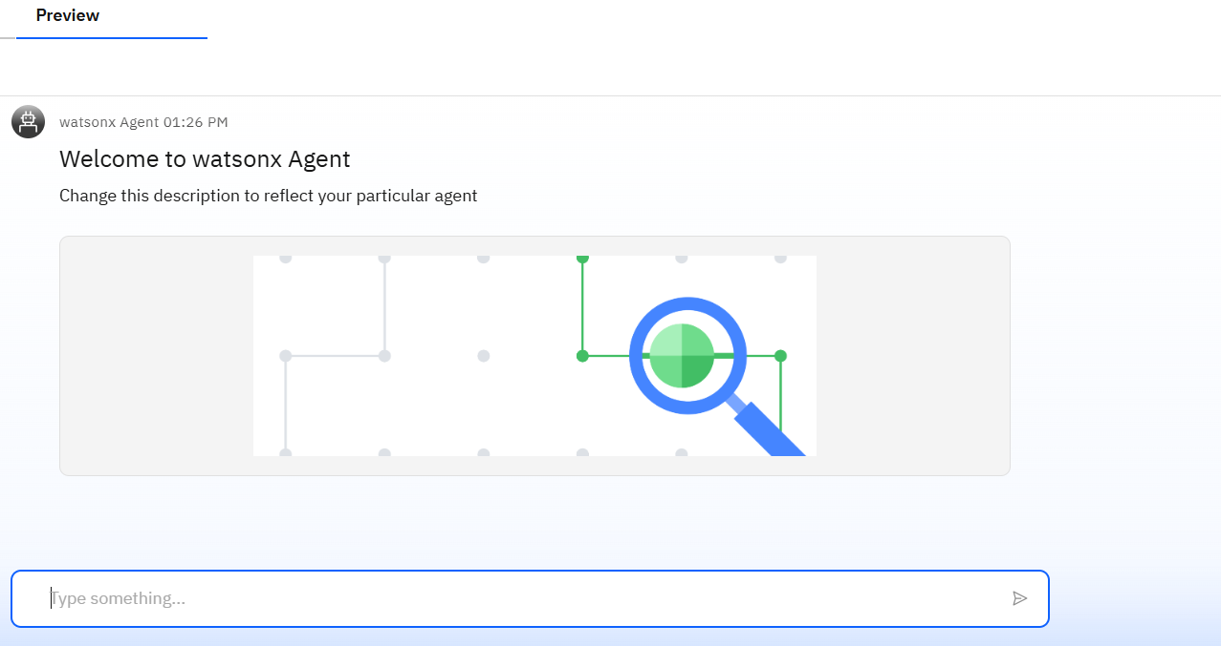
Result

Slide 9
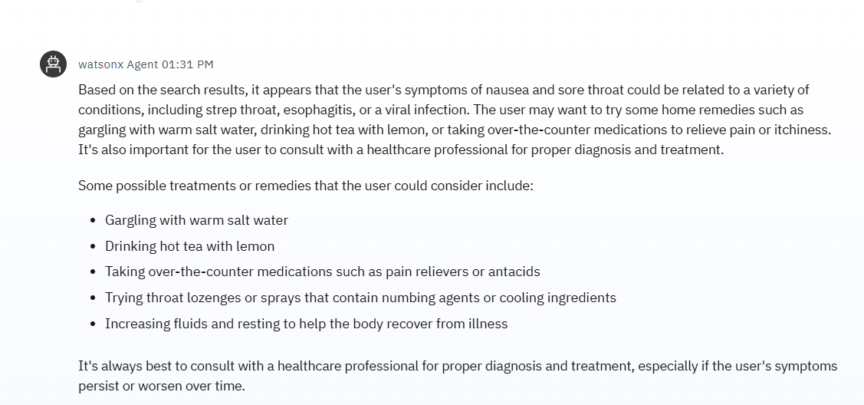
Result

Slide 10
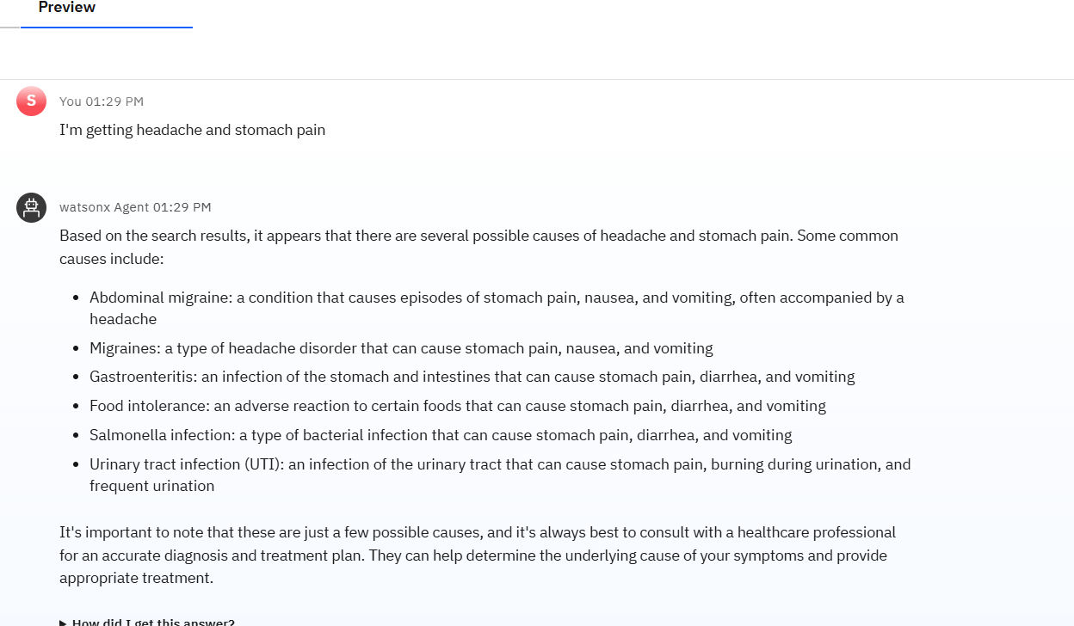
Result

Slide 11
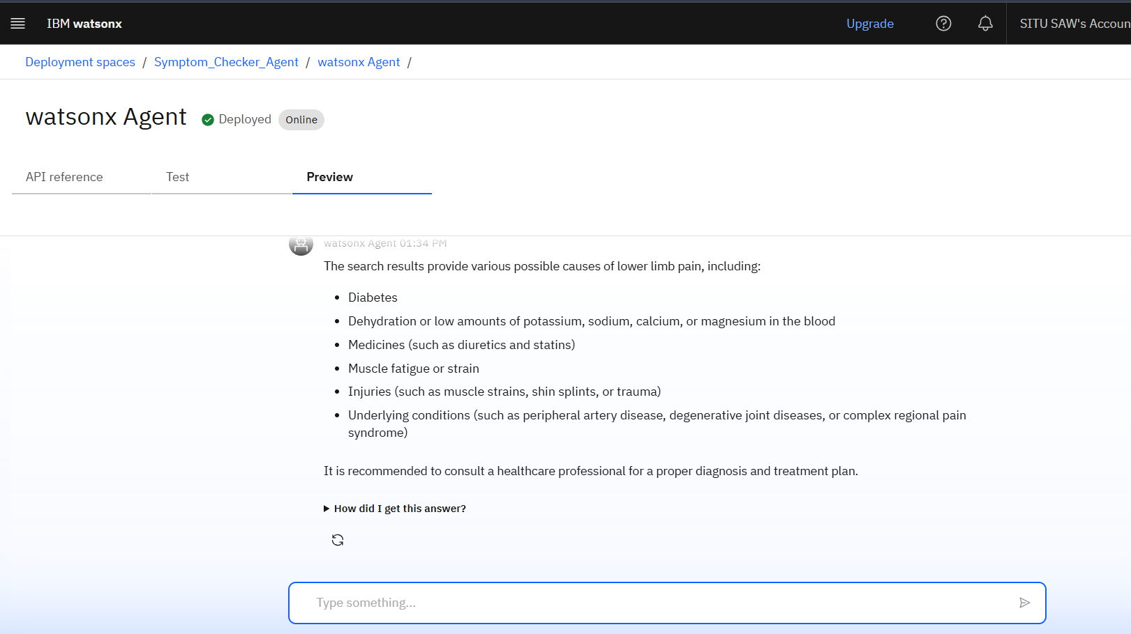
Result
DEPLOYED AI AGENT

Slide 12
Conclusion
The agent can generate results, suggest solutions and remedies.
It saves time by automating repetitive tasks like viewing past reports of patients and data extraction.
Research Agents enhance efficiency, accuracy, and innovation in both academic, industrial R&D and in medical field.

Slide 13
Future scope
Multilingual Research Support
Voice-Activated Research Assistant
Real-Time Collaboration Features in Medical Industry
Research Gap and Novel Topic Identification
Integration with Publishing Platforms
AI-Assisted Medical Diagnosis

Slide 14
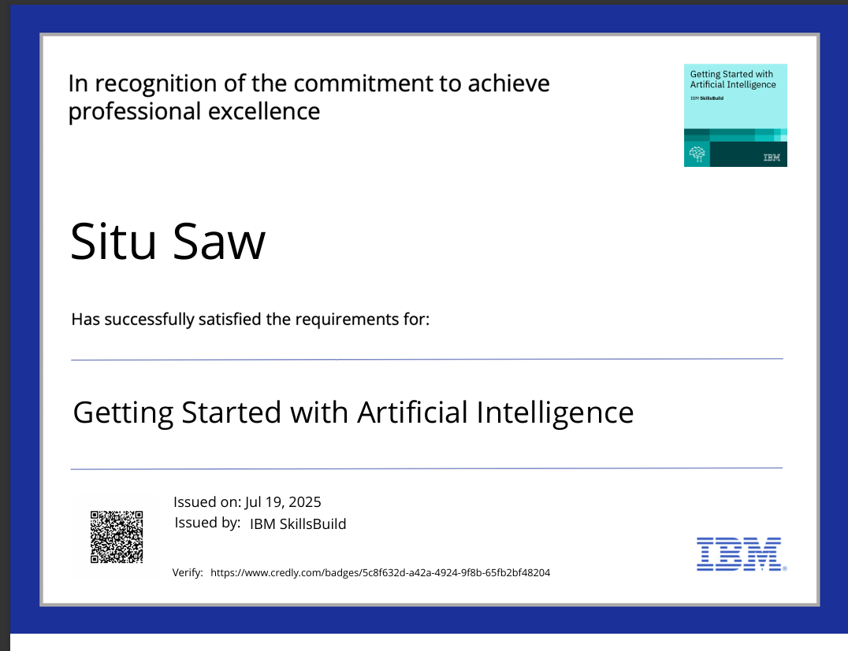
IBM Certifications

Slide 15

IBM Certifications

Slide 16
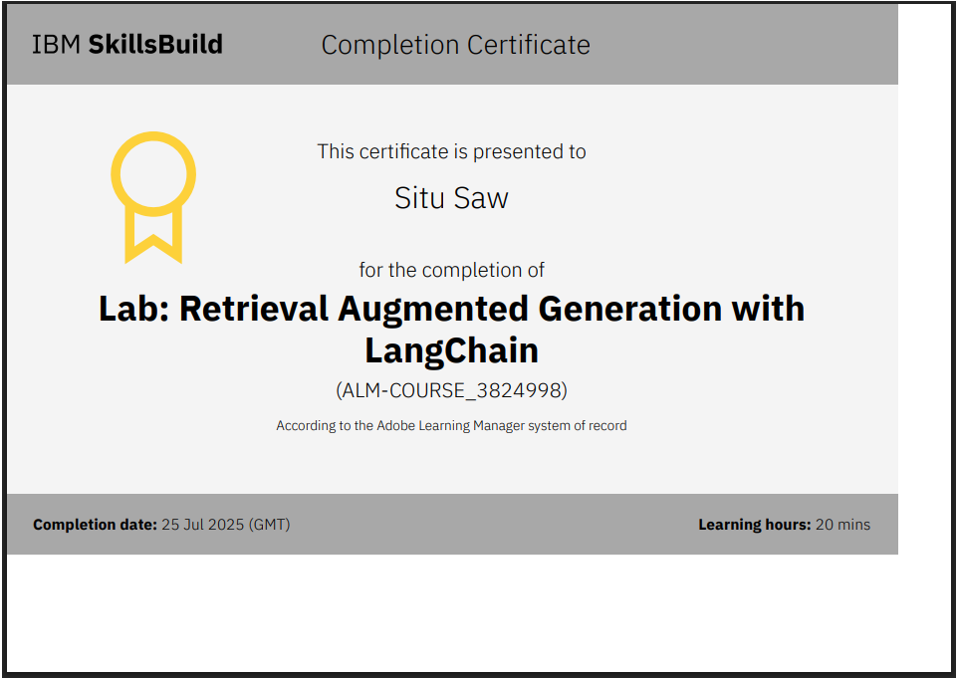
IBM Certifications

Slide 17
GitHub Link
https://github.com/Anbhavsaw/Symptom_Checker-AI-Agent/tree/main

Slide 18
THANK YOU

