Slide 1

Dormitory Management System
Project Management Complete Report
Complete Project Management Closed-Loop from Problem Analysis to Solution
Project Team Member
Project Date
Course
余升斌 冯宏臻 陈乐怡 郑珺文 汤雨潭 张锐
January 2026 - May 2026
Software Engineering Project Management
Core Value
Establish a complete project management closed-loop from requirement traceability, work breakdown, quality control to risk management
GitHub: github.com/Anblackin/DMMUST
27 Pages Complete Report

Slide 2























Problem Background & Pain Points
Three Core Pain Points of Traditional Dormitory Management
Pain Point 1: Manual processes cumbersome, leading to low efficiency 40% efficiency drop
Traditional dorm management relies on manual processes for check-in, room changes, and visitor logs, which are time-consuming and error-prone. Fragmented data and repetitive inputs lack automation support.
Manual Forms
Repetitive Entry
Time-consuming
Pain Point 2: Decisions lack real-time data support Decision accuracy down 35%
Administrators struggle to view real-time data on building capacity, room occupancy, and student behavior trends. Decisions rely heavily on experience, lacking data-driven scientific bases.
Data Missing
Poor Visualization
Experience Reliant
Pain Point 3: Dorm allocation lacks compatibility metrics Satisfaction down 28%
Dormitory allocations typically lack quantifiable support for living habits, daily routines, and compatibility. Subsequent conflict resolution costs are high, and student satisfaction is hard to guarantee.
Low Matching
Fairness Issues
Cohabitation Conflicts
Solution Goal: Establish a unified, visual, traceable, and explainable matching dormitory management system, transforming from "experience-driven" to "data-driven".

Slide 3
Vision Statement
To transform traditional dormitory management into a digital, data-driven, and intelligent management system
Current Situation
Manual Operations
Paper-based records
Vision
Data Blindness
No real-time dashboard
Conflict Management
Subjective allocation
Expected Value
Reduce manual workload and record errors.
Provide real-time visibility of occupancy, repairs, and student records.
Support more informed roommate allocation and better student living experience.

Slide 4



Scope of Project
Overview
Product Scope
A web-based dormitory management prototype covering role-based access, room/student management, repair tracking, occupancy dashboard, and AI-assisted roommate matching.
Project Scope
The project work includes requirements collection, scope definition, RTM construction, WBS creation, Scrum-based planning, metrics collection, software estimation, testing, GitHub/Leangoo tracking, and final demo preparation.
Scope Boundaries
Exclusions: no payment system, no smart-lock/hardware integration, no full production deployment.
Constraints: limited course timeline, limited team resources, prototype-level AI matching.
Acceptance: working prototype, RTM, WBS, metrics, estimation models, GitHub/Leangoo records, and demo completed.

Slide 5

Problem Decomposition
Phase1
Phase2
Phase3
Authentication
Occupancy Dashboard
Personality Questionnaire
JWT-based secure login system with strict role-based access control (RBAC) for SuperAdmin, Dormitory Admin, and Students.
Real-time room occupancy rates and capacity monitoring at a glance.
Student preference survey module covering 16 personality dimensions.
Student Records
Distribution Charts
Roommate Matching
Comprehensive profile management including enrollment data, and digital workflows for check-in/check-out processes.
Interactive visualizations for gender, department, and major breakdowns via ECharts.
Collaborative filtering algorithm & compatibility scoring engine.
Anomaly Alerts
Facility Management
Work-Order Analytics
Hierarchical 3-level structure management: Building → Floor → Room. Full CRUD operations for campus infrastructure.
Repair efficiency metrics, resolution times, and trend analysis.
Proactive notifications for empty beds and frequent repair flagging.
Repair System
Digital repair reporting channel, work order creation, real-time status tracking, and resolution history logging.
Process To Be Used:
Requirements collection→Scope definition→RTM&WBS→Scrum-based development→Testing and demonstration→Metrics and estimation

Slide 6








W5HH Project Overview
Six-Dimensional Project Management Analysis Framework
Why - Reasons?
What - Scope?
When - Timeline?
Improve dorm management efficiency and data-driven decisions, resolving traditional low efficiency, scattered info, and lack of data support.
Build dorm management Web prototype covering management/behavior/stats/visitors, plus questionnaire & matching expansion.
Mid-term prototype completion; Post mid-term expansion (management docs, estimation, risk, and matching features).
40% Efficiency Increase
10+ Core Features
4-Month Cycle
Who - Team?
Where - Location?
How - Approach?
Collaboration across frontend, backend, test/deployment, docs/PM roles within a 6-member agile team.
Code hosted on GitHub, process managed via Leangoo/Kanban, demonstrated locally or on course server.
Technical: Vue 2.7 + Koa 2.x + MySQL. Management: Scrum small-step iteration with RTM & WBS.
6-Member Team
GitHub + Kanban
Agile Development
Project Management Approach: Utilize Scrum iterations, ensure requirements tracking with RTM, breakdown tasks via WBS, and track progress using GitHub commits and Kanban boards to achieve a complete project management closed-loop.

Slide 7
Scrum Process
Agile Framework for Smart Dormitory Management System
Roles
Product Backlog
Product Owner
prioritizes requirements and product backlog.
Scrum Master
coordinates sprint meetings, tracks blockers, and protects sprint scope.
Development Team
frontend, backend, database, UI, and AI.
● Authentication & RBAC
● Room / student mgmt
● Repair workflow
● Occupancy dashboard
● Questionnaire system
● Roommate matching
● Anomaly alerts
● Testing & demo prep
Sprint Plan
Scrum Ceremonies
Sprint 1 — Digital Core
Backend APIs, JWT auth, CRUD, repair workflow.
Sprint 2 — Data Visualization
Dashboard UI, ECharts, stats APIs, analytics.
Sprint 3 — AI Intelligence
Questionnaire, matching algorithm, anomaly detection.
Sprint Planning — select backlog tasks.
Daily Scrum — progress and blocker check.
Sprint Demo — show completed functions.
Retrospective — review and improve.

Slide 8






















Scrum Iteration Rhythm (3 Sprints)
Iterative Development Process and Outputs
Sprint 1: Digital Core
Completed
Login/Permissions
User Management
Building/Floor/Room Models
CRUD & Database
Sprint 2: Visualization
Completed
Management Overview
Dorm Details
Behavior Trend Charts
Student Info
Sprint 3: Expansion
In Progress
Questionnaire Matching
RMMM
EVM
Presentation Materials
Iteration Value: Through three sprints, the project progressively builds the core framework, visualizes data, and finally completes intelligent matching and management closure, ensuring steady value delivery at each stage.

Slide 9





Requirements Management RTM Overview
Requirements Traceability Matrix: 10 Requirements Full Coverage
Req ID
Description
Source Role
Implementation Module
Acceptance Criteria
Status
R1
User registration/login
Student/Admin
user_router, JWT, login page
Login success & returns role info
Completed
R2
Role-based permission control
Admin
asyncRoutes, permission store
Different roles see respective menus
Completed
R3
Super admin manages admin accounts
Super Admin
admin-manage, user API
Can add admins & show in table
Completed
R4
Building/floor management
Super Admin
building-manage, building API
Can create buildings, view managers
Completed
R5
Admin views students/rooms
Admin
floor-manage, room/user-info
Can query by building/floor/room/student
Completed
R6
Submit wake-up/return/cleaning records
Student
getup/back/clean record pages
Records can be added and displayed
Completed
R7
Statistical visualization
Admin/Student
dashboard, line chart, prob API
Show trend charts, probabilities & stats
Completed
R8
Dorm evaluation
Admin
evaluate API, dorm details page
Can submit scores and feedback
Completed
R9
Visitor registration
Super Admin
visitor-manage, visitor API
Can add visitors and view list
Completed
R10
Future questionnaire/matching expansion
Admin
questionnaire / matching modules
Design completed and reviewed
In Progress
Requirements Coverage
Completed Requirements
Pending Requirements
100%
9 / 10
1

Slide 10
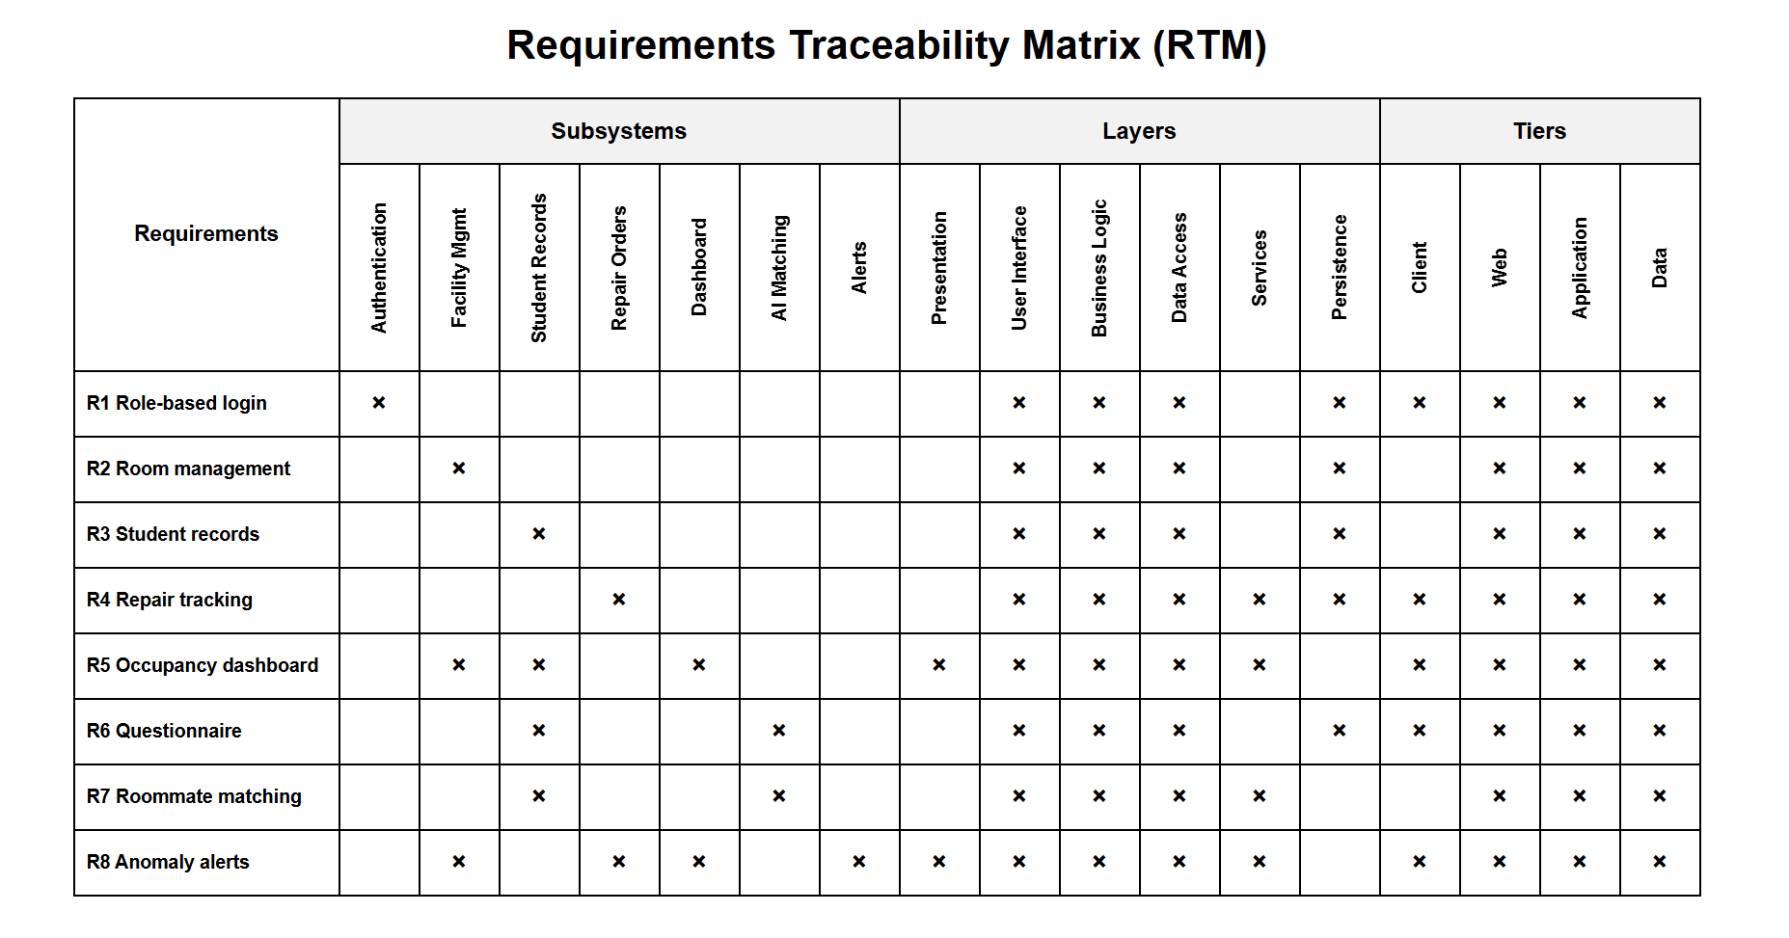
Requirements Management RTM

Slide 11
















RTM Traceability Chain Examples
Complete Traceability Chain from Requirement Source to Acceptance
Requirement R6: Students submit wake-up/return/cleaning records
Accepted
Student
getup/back/clean pages
record API
Create and read back
Acceptance Criteria: Records can be created and displayed correctly, data accuracy 100%
Requirement R2: Role-based permission control for pages and features
Accepted
Policy
asyncRoutes/permission store
Token check
Role-based menus
Acceptance Criteria: Different roles only see their respective menus, permission control 100% accurate
Traceability Value: Every requirement can be traced to specific roles, pages, APIs, and acceptance actions, ensuring no requirements are lost, implementation is traceable, and testing is verifiable, forming a complete project management closed loop.

Slide 12








WBS Work Breakdown Structure (Six Modules)
Project Work Breakdown and Module Relationship Diagram
1. Project Initiation & Scope
2. System Design
Requirements collection, problem analysis, vision/scope definition, stakeholder identification, RTM establishment
Tech stack confirmed, DB ER design, role/permission design, API design, UI style design
Requirements
Scope Mgmt
RTM
Architecture
Database
3. Core Development
4. Project Management & Control
Login/auth, role control, building/floor/room mgmt, student info, behavior records, dorm evaluation, visitor registration, statistical visualization
Scrum planning, GitHub commits & branch management, Leangoo Kanban, periodic checks & risk tracking
10+ Features
Vue+Koa
Scrum
GitHub
5. Quality & Verification
6. Post Mid-term Expansion
FTR (Formal Technical Review), functional testing, defect tracking & fixing, quality metrics (DRE, defect density)
Questionnaire model design, matching algorithm design, student questionnaire/matching pages, admin config/results pages
Work Breakdown Principle: Documents/management/dev/test integrated structure ensures clear inputs/outputs and acceptance criteria for traceability.

Slide 13
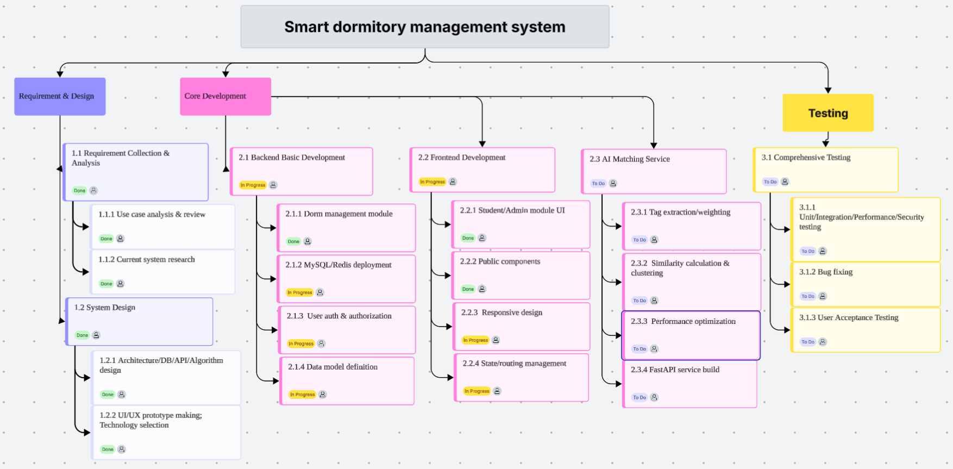
WBS

Slide 14






Scale Estimation: Function Point Derivation (FP=87)
Detailed Calculation Process of Function Points
Type
Identified Items
Complexity
Quantity
Weight
Subtotal
EI
Login, Register, Edit Profile, Add Admin, Add Building, Assign Cleaner/Admin, Submit Evaluation, Submit Behavior Record
Low
8
3
24
EO
Management Overview Stats, Floor Stats, Dorm Details Output, Student Details Output, Behavior Trend Chart, Visitor List Output
Low
6
4
24
EQ
Student Query, Admin Query, Room Query, Record Query
Low
4
3
12
ILF
Accommodation Resource Logic File, User and Behavior Logic File
Average
2
10
20
EIF
Department-Major Basic Dictionary
Average
1
7
7
UFP (Unadjusted)
VAF (Adjustment)
Final FP Target
87
≈ 1.00
87
24 + 24 + 12 + 20 + 7
0.65 + 0.01 × 35
UFP × VAF

Slide 15
Set of Size-oriented metrics
Errors per KLOC: 5
Defects per KLOC: 5
$per LOC: 1 yuan
Pages of Documentation per KLOC: 1
Errors per person-month: 2
LOC per person-month: 1000
$ per Page of documentation: 1 yuan

Slide 16

Estimation Models
Purpose:
Estimate the effort, time, and cost required to complete the smart dormitory management system.
Inputs
Primary
Rationale
Primary
Estimated size: 20 KLOC
Function Points: 87 FP
Productivity: 600
Duration: 4 months
Complexity factor: 0.16
Project scope based on RTM and WBS
The project has a defined scope, RTM and WBS, so effort can be estimated from functional requirements and estimated size.
FP-oriented estimation is suitable because the project requirements can be mapped to function points.
The Software Equation provides a second effort estimate based on LOC, productivity, skills factor and duration.
COCOMO II is included as a supporting empirical model for effort, cost and schedule estimation.
Models Used
FP-oriented estimation model
E = -12.88 + 0.405 × FP
Software Equation
E = [LOC × B^0.333 / P]^3 × (1/t^4)
COCOMO II model
PM = A × Size^E × ∏EMᵢ

Slide 17



Effort Estimation: Regression vs Putnam
Dual Model Estimation Comparison
Regression Model
Primary
Putnam Model
Reference
E = -12.88 + 0.405 × FP
E = [LOC × B^0.333 / P]^3 × (1/t^4)
E = -12.88 + 0.405 × 87 = 22.355 PM
E = [20000 × 0.5437 / 600]^3 × (1/256)
≈ 22.36 Person-Months
≈ 23.2 Person-Months
Function Points (FP)
87
Lines of Code (LOC)
20,000
Regression Coefficient
0.405
Technology Factor (B)
0.16
Constant Term
-12.88
Productivity (P)
600 LOC/PM
Estimation Accuracy
±15%
Development Time (t)
4 Months
Conclusion: Total effort is approximately 22-23 person-months. The estimates from both models align closely. The 20 KLOC figure used in the Putnam model represents the target product size assumption for the prototype.

Slide 18

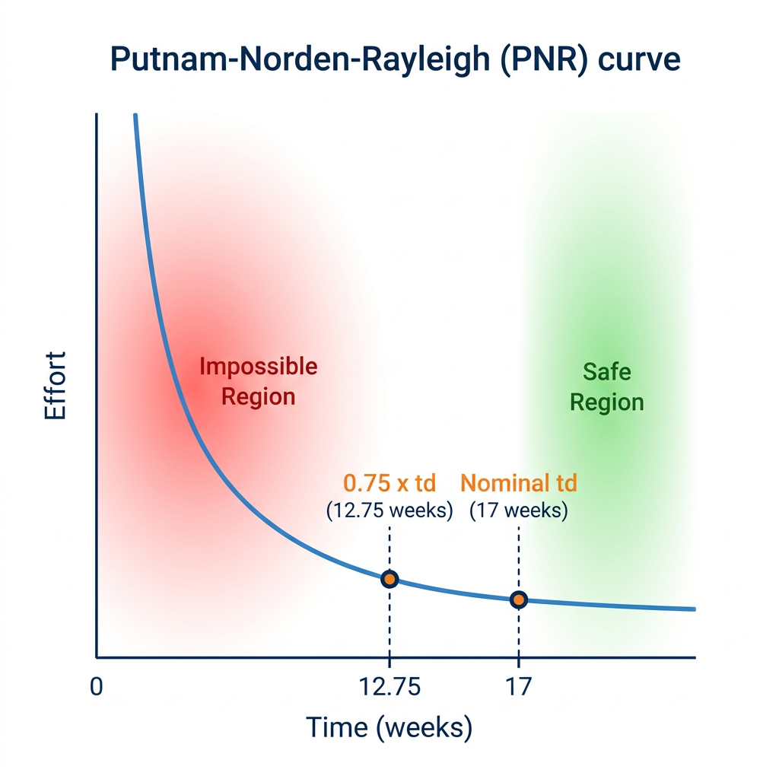
PNR Curve: Schedule Compression Feasibility Analysis
Putnam-Norden-Rayleigh (PNR) Curve
Core Formula:
Ea = m × (td⁴ / ta⁴)
Project Parameters:
Nominal delivery time (td): 17 weeks
Compression lower limit (0.75 × td): 12.75 weeks
Current plan: 17 weeks → Safe Region
Key Insight:
If schedule is compressed below 12.75 weeks,
effort escalates nonlinearly (4th power),
entering the "Impossible Region" —
failure risk increases sharply.

Slide 19









Quality Management: Framework & Metrics
Quality Management Three Dimensions: Do Right, Clarify, Stabilize
Do Right
Clarify
Stabilize
Requirements correctly realized
Documents clearly reviewed
Defects stably removed
Do Right (Correctness)
Clarify (Clarity)
Stabilize (Stability)
RTM ensures requirements realized
FTR ensures document clarity
DRE ensures defect removal
RTM Coverage
≥90%
Traceability
10/10
FTR Pass Rate
≥95%
Review Items
28
DRE Target
≥85%
Defect Density
≤5/KLOC
Actual: 100% (10/10)
All reqs traceable
Actual: 96.4% (27/28)
27 passed, 1 pending
Actual: 92.3%
DRE = E/(E+D)
= 60/(60+5)
Actual: 4.4/KLOC
38 defects/8.7 KLOC
Completion
100%
Acceptance
95%
Pending Fixes
2
Completeness
98%
All funcs complete
19/20 items passed
Doc format standard
Structurally complete
Severe Defects
0
99%
System Stability
No high-risk vulns
Runs stably, no crash
10/10 reqs traced, 100% function completion
27/28 review items passed, standard docs
Defect density 4.4/KLOC, DRE exceeds target

Slide 20
FTR Execution Plan: Review Nodes, Objects & Roles
Review | Review Object | Participants
FTR-1 | Core API interfaces Database Schema RBAC logic | Review Lead(李逸群) Backend Dev A(刘沁若) Backend Dev B(叶一诺) DBA(屈紫晨)
FTR-2 | Dashboard UI ECharts charts Statistics API | Review Lead(李逸群) Frontend Dev A(仇泽程) Frontend Dev B(屈紫晨) Backend Dev B(叶一诺)
FTR-3 | Questionnaire module Roommate matching algorithm Full integration flow | Review Lead(李逸群) Frontend Dev A(仇泽程) Backend Dev A(刘沁若) AI Engineer(周凡皓)
Review Principle
"Review the product, not the producer."
All defects are recorded and tracked to closure.
Meeting duration: ≤ 2 hours per session.
Materials distributed 1–2 days in advance for independent preparation.

Slide 21
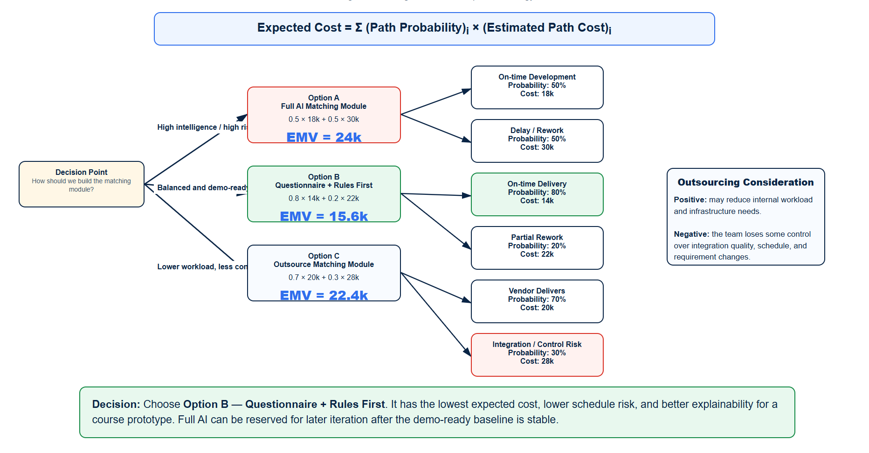
Decision Tree

Slide 22












Transition: From Prototype to Questionnaire & Matching Expansion
Goal: Ensure usability and explainability first, then iterate intelligence
Principles: Configurable weights, auditable logs, reproducible results
Mid-term: Foundation Building
Post Mid-term: Expansion & Enhancement
Ultimate Goal
Core dorm management functions completed including login/management/records/stats/evaluation
Achieve intelligent dormitory allocation, improve management efficiency and student satisfaction
Add questionnaire system, matching algorithm, risk management, EVM analysis
Completed
In Progress
Target

Slide 23















Post Mid-term New Feature Scope
From Prototype to Questionnaire & Matching Expansion: New Feature Module Definition
Student-side New Features
Admin-side New Features
Data Objects
5 New Tables Required:
Questionnaire filling
Matching configuration
questionnaire_template
Students can fill dorm preference/schedule questionnaire.
Admin configures matching weights and parameters.
questionnaire_answer
Result review
Matching result view
View, filter, and manually adjust pairing results.
match_config
View recommended dorm/roommates after allocation.
match_result
Run/Re-run
Execute matching algorithm and re-run capability.
match_log

Slide 24



RTM Supplement (R11-R16)
Post Mid-term New Requirements Traceability: 6 Expansion Features Full Coverage
Req ID
Description
Source Role
Implementation Module
Acceptance Criteria
Status
R11
Students fill dorm preference/schedule questionnaire
Student
student/questionnaire
Save and edit
Completed
R12
Admin configures matching weights
Admin
admin/match-config
Configurable and effective
Completed
R13
System generates matching results
Management req.
matching engine
Room allocation suggestions
Completed
R14
Student views matching results
Student
student/match-result
Display recommended dorm/roommates
Completed
R15
Admin reviews and adjusts pairing
Admin
admin/match-result
View/filter/adjust
Completed
R16
System logs matching runs
Audit req.
match_log
Parameters/time/outcomes traceable
In Progress
Requirements Coverage
Completed Requirements
Pending Requirements
100%
5 / 6
1

Slide 25










Evaluation Document: Prototype Status Evaluation
Comprehensive Prototype Evaluation: Completeness, Consistency, Demonstrability & Gaps
1) Completeness Assessment Complete
Core modules: login/roles/admin/buildings/students/records/stats/evaluation/visitors all core functions completed
2) Consistency Assessment Good
Clear module boundaries around user/building/floor/room/record/evaluate/visitor entities
3) Demonstrability Strong
UI screenshots/DB schema/backend start proof available
4) Gaps Identified Attention needed
Automated test evidence insufficient, matching not yet implemented

Slide 26




Evaluation Document: Expansion Feature Design Evaluation
Multi-dimensional Analysis
Feasibility & Maintainability
Good
Testability & Business Value
Excellent
Feasibility
★★★★☆
4.2/5
Testability
★★★★☆
4.3/5
Maintainability
★★★★☆
4.0/5
Explainability
★★★★★
4.8/5
Code Complexity
Medium
Business Value
High
Technical Debt
Low
Demo-ready
Yes

Slide 27


Risk Management RMMM (with Mitigation/Monitoring)
6 Major Risks: Identification, Assessment & Mitigation Strategies
ID | Risk Description | P | I | Exposure | Mitigation Strategy | Monitoring Signal
RK1 | Poor questionnaire design distorts results | 0.6 | 4 | 2.4 | Small-sample review; fallback to rules | Students don't understand questions
RK2 | Algorithm complexity causes delay | 0.5 | 5 | 2.5 | Rules-first approach; narrow scope | Task delay / API not integrated
RK3 | Insufficient historical data for validation | 0.7 | 3 | 2.1 | Generate synthetic datasets | Test data coverage insufficient
RK4 | DB changes impact existing stability | 0.4 | 4 | 1.6 | Pre-migration backups & integration tests | Errors in existing pages
RK5 | Time compression desynchronizes docs & code | 0.7 | 4 | 2.8 | Sync RTM/WBS each iteration | PPT and code inconsistent
RK6 | Uneven workload creates bottlenecks | 0.5 | 4 | 2.0 | Dual-ownership on key modules | Task pile-up for specific members
Risk Priority Management: Risks are prioritized by Exposure (Probability × Impact). Highest priority risks RK5 (2.8) and RK2 (2.5) require active mitigation and continuous monitoring throughout the project lifecycle.

Slide 28
Risk Management RMMM (with Mitigation/Monitoring)
Example of Risk Information Sheet – Top Priority Risks
RK5 |  | RK2
Risk Name | Schedule compression causing misalignment between documentation, code, and PPT |  | Roommate matching algorithm development delay
Probability | High (0.7) ｜ Impact Major (4) ｜ Exposure 2.8 |  | Medium (0.5) ｜ Impact Very High (5) ｜ Exposure 2.5
Owner | Project Manager (PM) |  | AI Engineer
Description | During AI-phase crunch, the team may skip updating RTM, WBS, and Leangoo to save time. At final defense (May 3), the presentation slides may show features or plans that do not match the live demo, suggesting poor project management. |  | The collaborative filtering algorithm involves sparse matrix handling and cold-start issues, which may cause development to stall. If the core matching API is not ready by the middle of Sprint 3, the frontend-backend integration will be blocked, and the AI matching feature may not be demonstrable on Apr 28
Mitigation | • Enforce RTM & Leangoo update at the end of every Sprint • Freeze code after Apr 28; only allow PPT revisions afterward |  | Build a rule-based baseline first to ensure a working demo always exists Develop collaborative filtering on a separate branch so it never blocks the main workflow
Monitoring Signal | • ≥3 Leangoo cards remain in “In Progress” after Sprint Review • PPT screenshots differ from the actual running application |  | By the end of Week 2 of Sprint 3, the core matching API still returns 500 errors or empty results in unit tests.
Contingency Plan | In the final wrap-up window (Apr 29–30), all members cross-check PPT against the live demo. Any feature gap that cannot be fixed in time is honestly marked as “Planned for V2” in the slides, with oral clarification during the defense |  | Fallback to a “hard-rule scoring engine”: assign points for same major, compatible sleep schedule, same college, etc. The AI intelligence label is softened but the complete matching flow is preserved for the final demo.

Slide 29





Task Set T1-T9
Post Mid-term Core Tasks: 9 Key Tasks & Descriptions
Task ID
Task Name
Priority
Description
T1
Requirements clarification & dimensions
High Priority
Define questionnaire dimensions/preference types/schedule habits key fields
T2
Database schema design
High Priority
Design tables for questionnaire_template/answer/match_config/result/log
T3
Student questionnaire page
High Priority
Frontend page for students to fill preferences
T4
Admin configuration page
Medium Priority
Admin interface to configure matching weights
T5
Matching algorithm development
High Priority
Implement rules-based matching algorithm core logic
T6
Result display page
Medium Priority
Student and admin result viewing pages
T7
Integration testing
High Priority
Frontend-backend integration and end-to-end testing
T8
Testing & bug fixes
High Priority
Functional testing and defect resolution
T9
Docs & presentation updates
Medium Priority
Update RTM/WBS/presentation materials
High Priority Tasks
Medium Priority Tasks
Total Core Tasks
6
3
9

Slide 30

Task Network & Critical Path
Task Dependencies & 16-day Critical Path Analysis
Task List (Duration)
Task Network
■ Critical Tasks ■ General Tasks
A. Requirements clarification
2 days
B (2d)
D (3d)
B. Questionnaire design
2 days
C. Database expansion
2 days
A
F (4d)
G (2d)
H (3d)
I (2d)
J
D. Student questionnaire page
3 days
E. Admin config page
3 days
C (2d)
F. Matching algorithm
4 days
E (3d)
G. Result pages
2 days
H. Integration testing
3 days
I. Bug fixes
2 days
Network:
A → {B,C}; {B,C} → {D,F}; C → E; F → G; {D,E,G} → H → I → J
J. Docs update
1 day
Critical Path:
A → B/C → F → G → H → I → J
Total Duration: 16 days

Slide 31





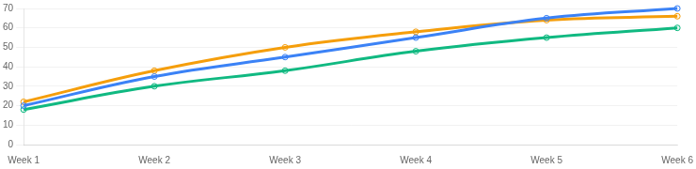
Earned Value Analysis (EVM)
Project Performance Metrics Analysis & Cost-Schedule Control
Planned Value PV
Earned Value EV
Actual Cost AC
70
60
66
Planned work value
Actual completed work value
Actual cost spent
EVM Trend Chart
PV
EV
AC
Key Metrics
CPI (Cost Perf. Index)
CV = -6
0.91
Cost efficiency low
SPI (Schedule Perf. Index)
SV = -10
0.86
Schedule delayed
EAC (Estimate at Completion)
Target = 100
110
+10% budget overrun
Analysis & Action: CPI<1 indicates low cost efficiency, likely due to rework/collaboration overhead. SPI<1 indicates schedule delay, likely due to algorithm/integration slower than expected. Forecast: EAC≈110 means ~10% budget overrun. Action: protect critical path, control non-critical polish.

Slide 32






















Management Decisions & Priorities
Management Decisions Based on EVM Analysis
Decision 1: Prioritize Algorithm Chain (Critical Path) High Priority
Based on EVM analysis with CPI≈0.91 and SPI≈0.86 indicating low cost efficiency and schedule delay, root cause is algorithm chain slower than expected. Action: allocate best resources to matching algorithm development, ensure timely completion of critical path tasks.
Resource Reallocation
Schedule Recovery
Algorithm Focus
Decision 2: Control Scope & Cosmetic Requests Medium Priority
Avoid scope creep, reject non-essential feature requests and UI polish. Freeze feature scope, focus on core functionality, defer optimizations to post-delivery to ensure primary objectives are met within constraints.
Scope Control
Limit Polish
Defer Non-critical
Decision 3: Establish Version Freeze & Rollback Strategy High Priority
Set version freeze checkpoints at key milestones, prepare rollback procedures for DB changes, and maintain backup branches for stable versions to mitigate risks during the integration of new expansion modules.
Version Freeze
Rollback Plans
Stable Backups
Strategic Insight: EVM metrics serve not just as performance trackers but as early warning systems. Immediate course correction prioritizing the critical path ensures project viability despite initial schedule setbacks.

Slide 33






Post Mid-term Achievements & Next Steps
From Prototype to Expansion: Post Mid-term Phase Achievements & Future Directions
Post Mid-term Core Achievements
Next Steps & Roadmap
Questionnaire model design complete
Matching algorithm design complete
Risk management system established
Task network & critical path analysis complete
1
Immediate
Implement questionnaire/matching modules, conduct validation and demo preparation
Key accomplishments: Successfully completed RMMM risk identification with 6 major risks and mitigation strategies, Completed task network planning with 16-day critical path identified, EVM analysis reveals project status (CPI≈0.91, SPI≈0.86) with actionable decisions
2
Mid-term
Iterate based on feedback, optimize algorithm performance
Long-term Roadmap
Long-term: Rules-first approach, intelligent enhancements, continuous explainability

Slide 34







Team Division & Responsibility Matrix
Team Member Roles & Responsibility Allocation (RACI Matrix)
Scope Mgt / Frontend Arch
Estimation & Schedule / Backend
Risk Mgt / Frontend A
Project scope & frontend tech architecture
Effort estimation & backend dev
Risk identification & frontend mod A
Requirements collection & analysis
Function point & effort estimation
RMMM risk documentation
Frontend architecture design
Backend API development
Frontend module A development
Page prototype development
Database design & optimization
Risk monitoring & mitigation
Quality Mgt / Frontend B
EVM & Decisions / Test & Deploy
Summary / Docs Integration
Quality assurance & frontend mod B
EVM analysis & testing/deployment
Docs & presentation materials
FTR technical reviews
EVM analysis & forecasting
RTM/WBS documentation
Quality metrics tracking
Integration & system testing
Presentation materials prep
Frontend module B development
Deployment & env management
Cross-team coordination
RACI Legend: R = Responsible (executes the task), A = Accountable (final decision maker), C = Consulted (provides input), I = Informed (kept up-to-date). This matrix clearly defines responsibility allocation for each task, ensuring efficient and orderly team collaboration.

Slide 35

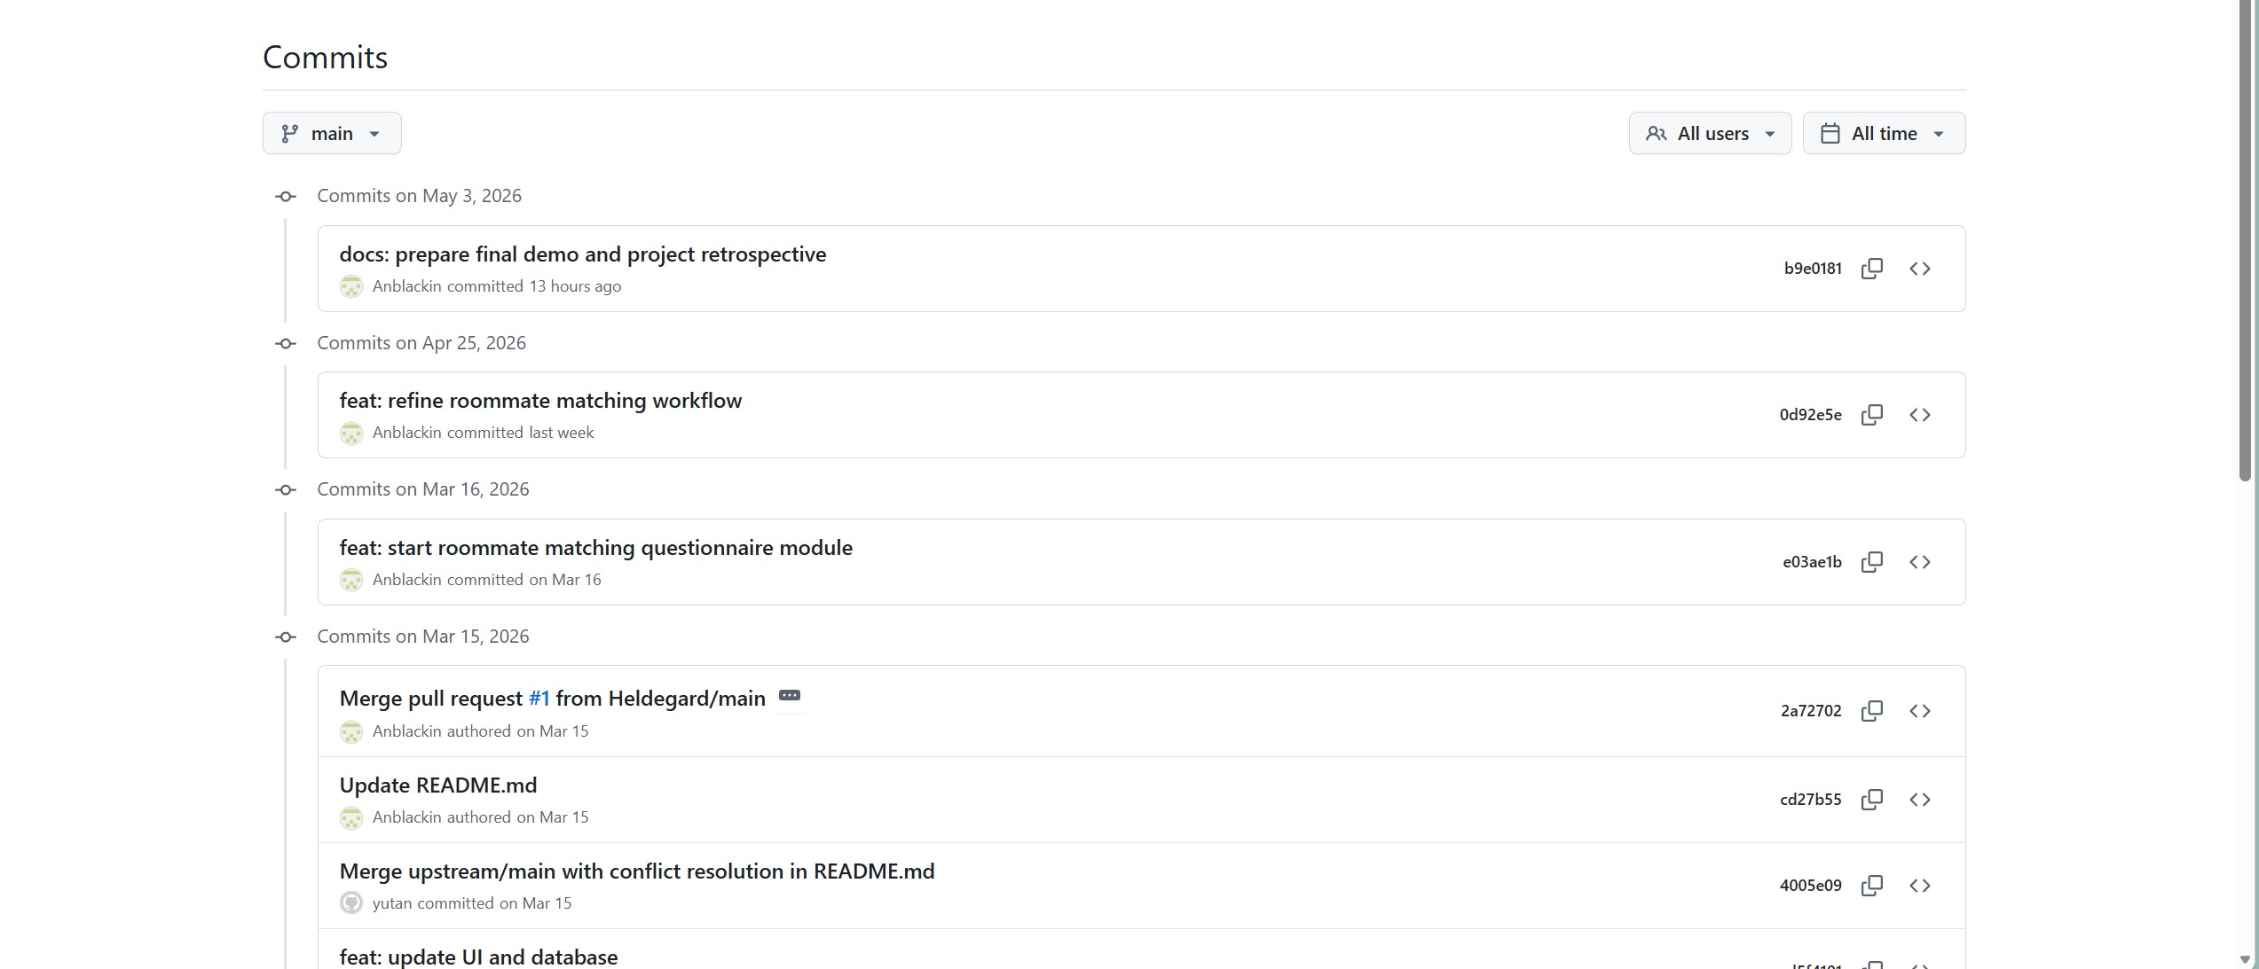
GitHub Commit (https://github.com/Anblackin/DMMUST)

Slide 36
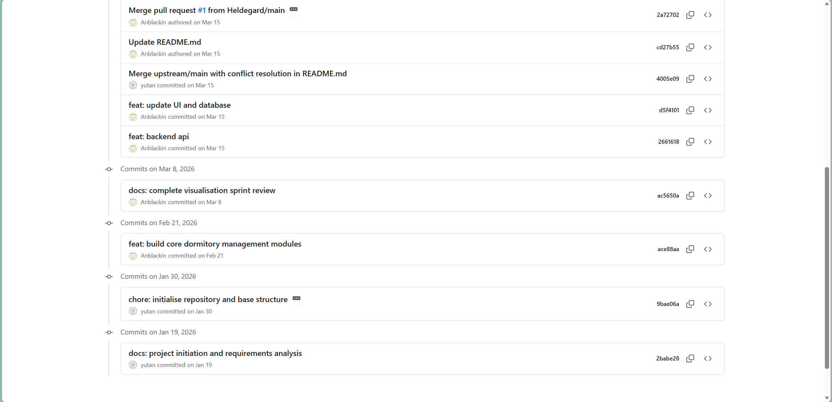
GitHub Commit (https://github.com/Anblackin/DMMUST)

Slide 37

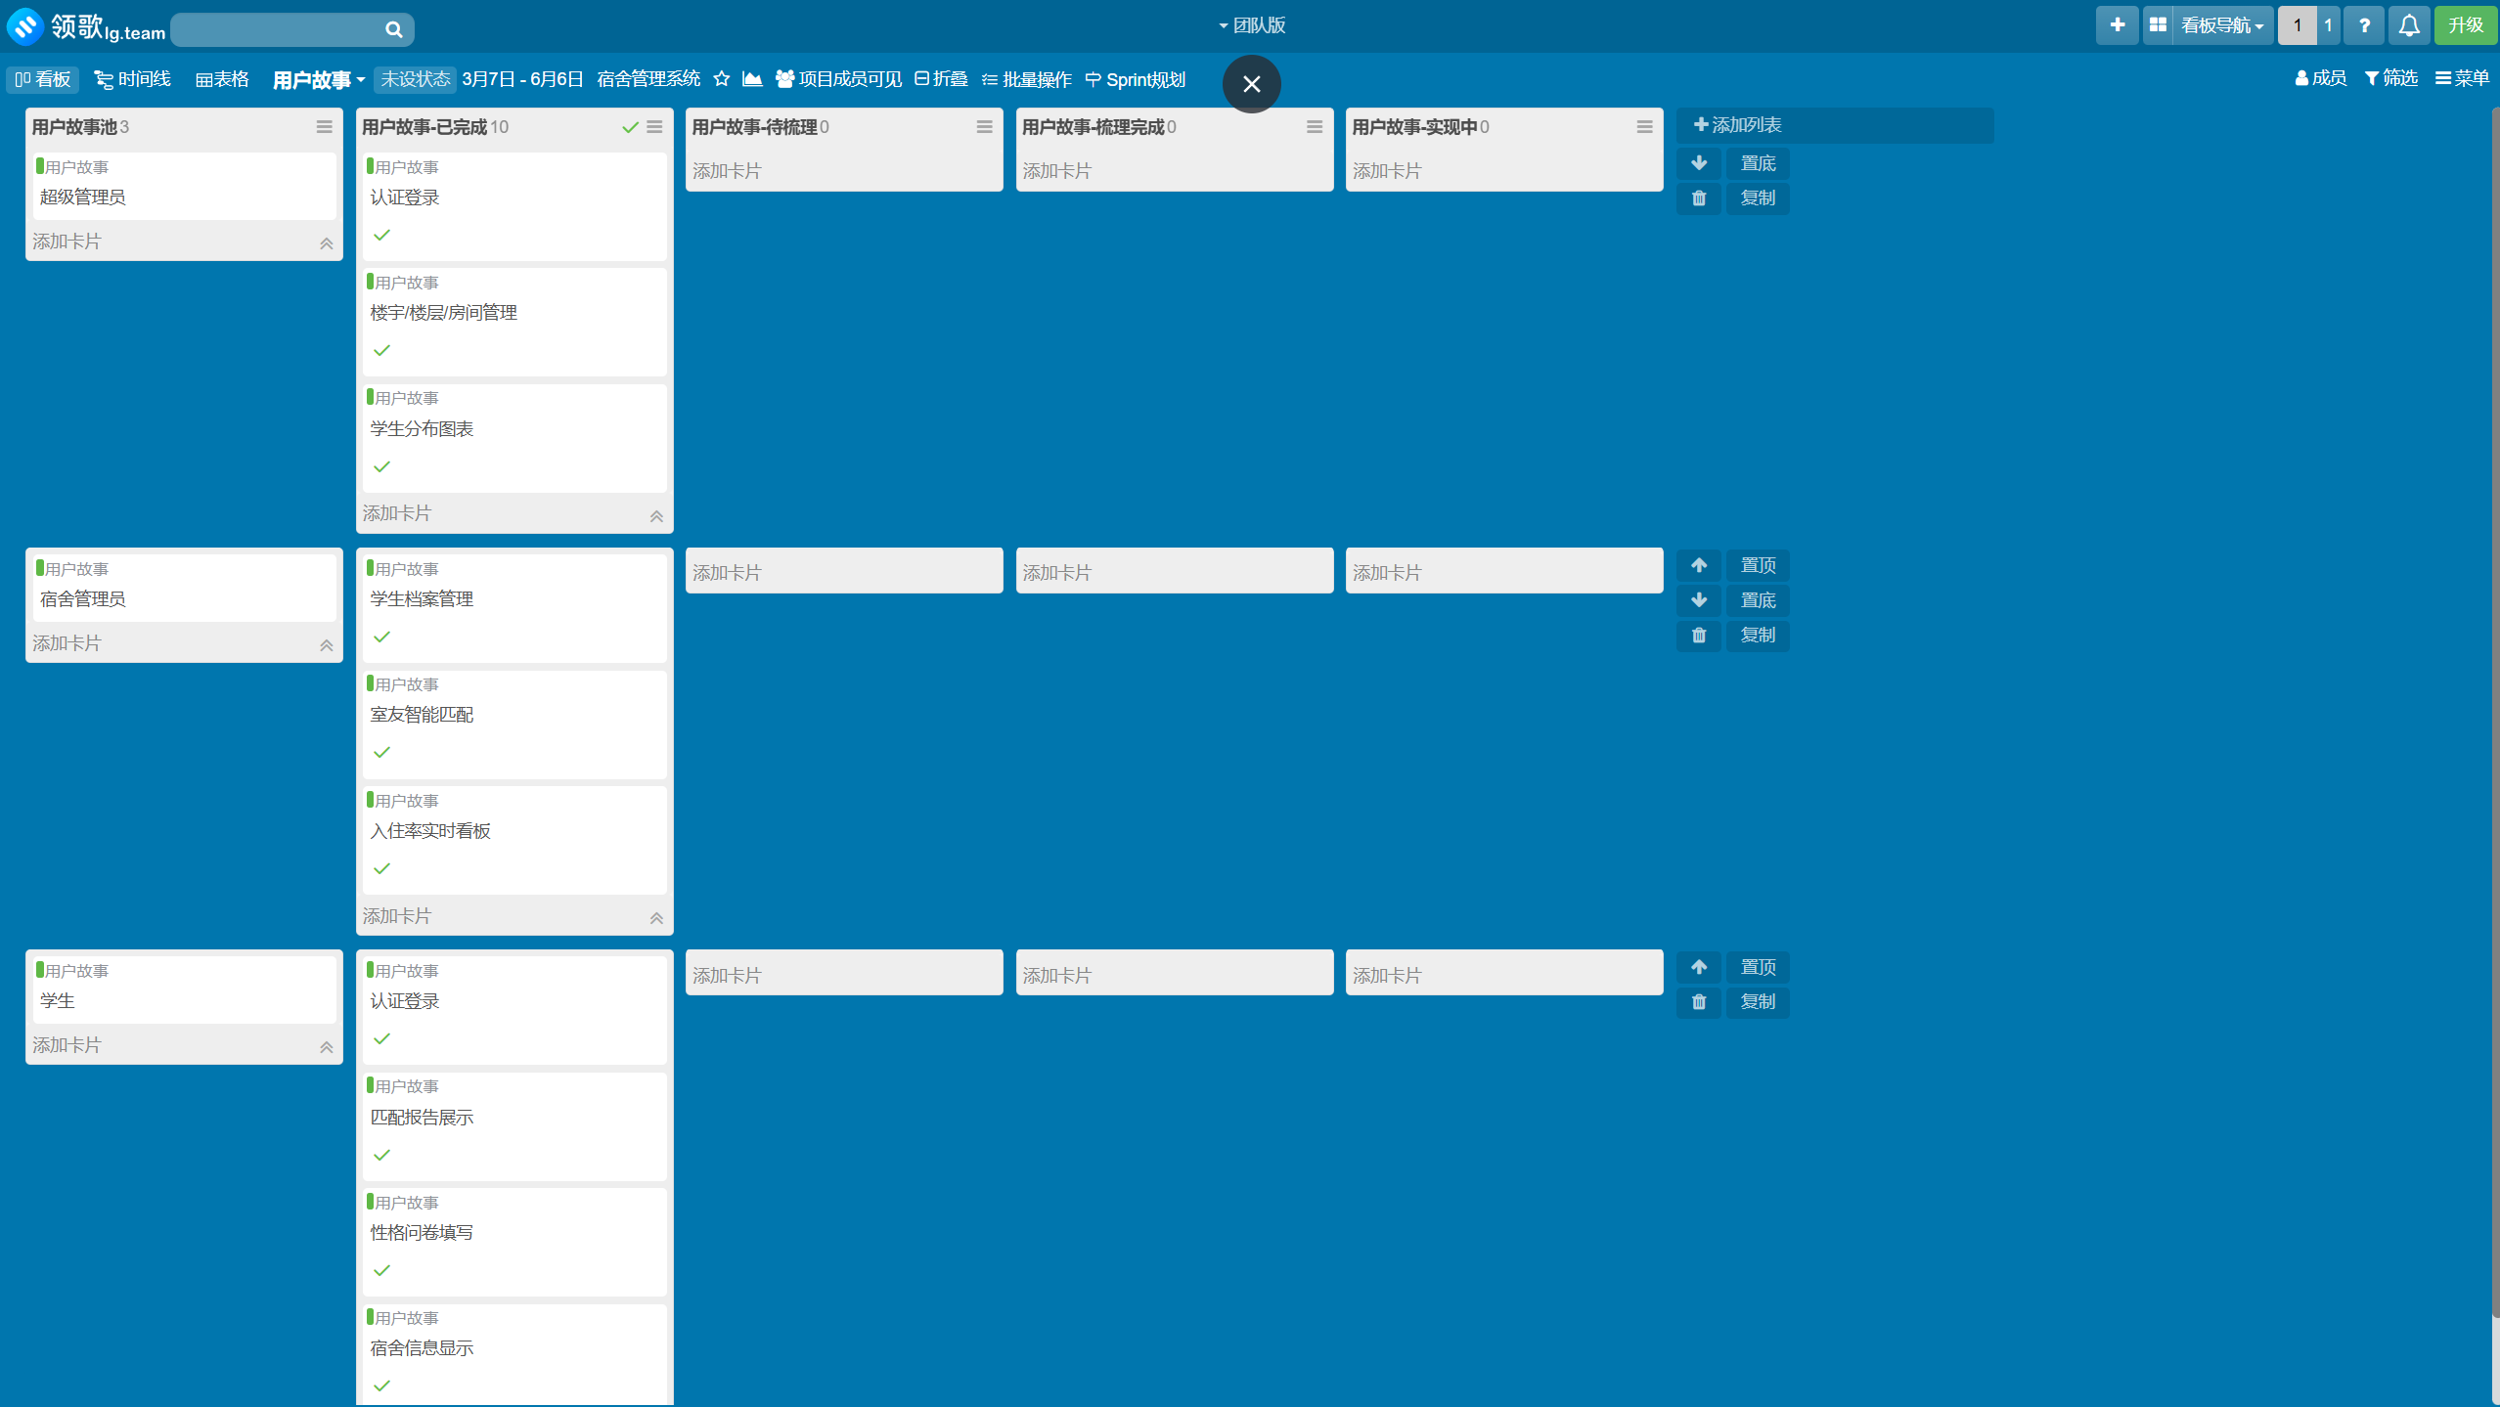
Leangoo

Slide 38
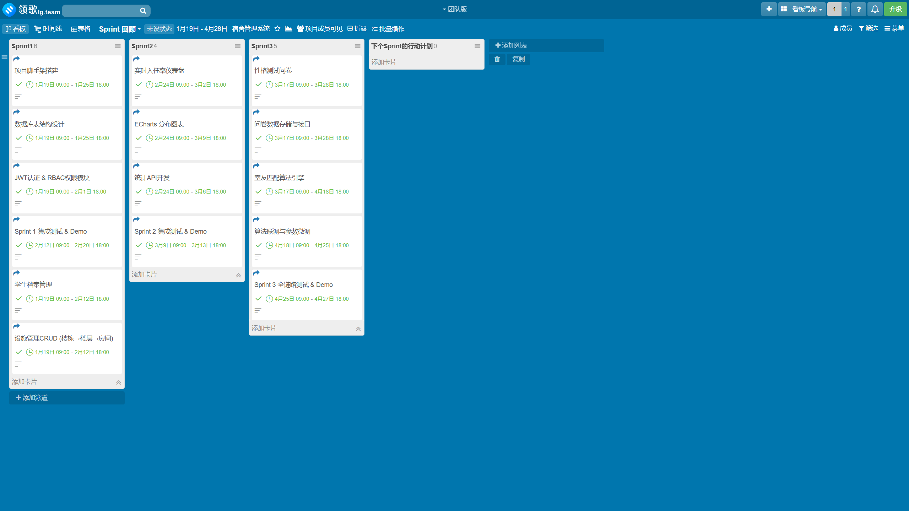
Leangoo

Slide 39
Demo

Slide 40




Q&A / Acknowledgments
Thank You for Your Time
Thank you to the review panel and instructors for your guidance and suggestions. Questions and feedback are welcome.
Questions & Feedback Welcome
In this dormitory management system project, our team built a complete closed-loop from requirements analysis to system implementation, from project management to risk control, demonstrating comprehensive application of software engineering and project management methodologies. We look forward to your valuable feedback and guidance.
Requirements Traceable
Quality Assured
Risks Controlled
Schedule Tracked

