Slide 1

Fresher Learning Program
Selenium – Day 1

Slide 2
What is Functional Automation Testing?
Automation testing is to automate the execution of manually designed test cases without any human intervention.
The purpose of automated testing is to execute manual functional tests quickly and in a cost-effective manner.
Why do we Automate?
Effective Smoke (or Build Verification) Testing
Whenever a new software build or release is received, a test (generally referred to as “smoke test” or “shakedown test”) is run to verify if the build is testable for a bigger testing effort and major application functionalities are working correctly.

Slide 3
Why do we Automate?
2. Increased Repeatability
At times it becomes impossible to reproduce a defect which was found during manual testing. Key reason for this could be that the tester forgot which combinations of test steps led to the error message; hence, he is unable to reproduce the defect.
3.Testers can Focus on Advanced Issues
As tests are automated, automated scripts can be base-lined and re-run for regression testing. Regression tests generally yield fewer new defects as opposed to testing newly developed features. So, functional testers can focus on analysing and testing newer or more complex areas.
4. Higher Functional Test Coverage
With automated testing a large number of data combinations can be tested which might not be practically feasible with manual testing. We use the term ‘Data driven testing’ which means validating numerous test data combinations using one automated script.
Notes:
Gherkin’s grammar is defined in the Treetop grammar that is part of the Cucumber codebase. The grammar exists in different flavours for many spoken languages (60 at the time of writing), so that your team can use the keywords in your own language.

Slide 4
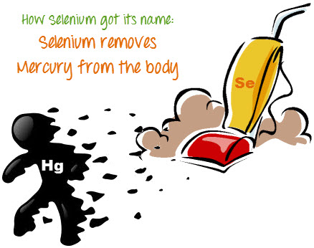
Introduction to Selenium
Selenium is an Open Source tool for automating browser-based applications. Selenium is a set of different software tools, each with a different approach to support test automation.
It has capabilities to operate across different browsers and operating systems.
Selenium is not just a single tool but a set of tools that helps testers to automate web-based applications more efficiently.
Selenium is a well-known antidote for Mercury poisoning, Jason (developed JavaScript Test Runner) suggested that name
Notes:
Gherkin’s grammar is defined in the Treetop grammar that is part of the Cucumber codebase. The grammar exists in different flavours for many spoken languages (60 at the time of writing), so that your team can use the keywords in your own language.

Slide 5
Selenium Tools
Tool | Description
Selenium IDE | Selenium Integrated Development Environment (IDE) is a Firefox plugin that lets testers to record their actions as they follow the workflow that they need to test.
Selenium RC | Selenium Remote Control (RC) was the flagship testing framework that allowed more than simple browser actions and linear execution. It makes use of the full power of programming languages such as Java, C#, PHP, Python, Ruby, and PERL to create more complex tests.
Selenium WebDriver | Selenium WebDriver is the successor to Selenium RC which sends commands directly to the browser and retrieves results.
Selenium Grid | Selenium Grid is a tool used to run parallel tests across different machines and different browsers simultaneously which results in minimized execution time.
Notes:
Gherkin’s grammar is defined in the Treetop grammar that is part of the Cucumber codebase. The grammar exists in different flavours for many spoken languages (60 at the time of writing), so that your team can use the keywords in your own language.

Slide 6
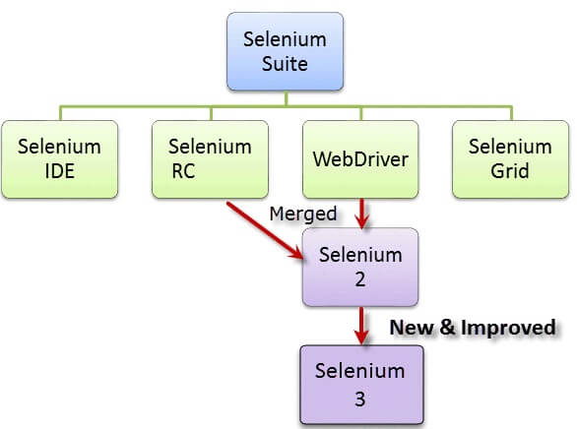
Selenium Tools
Notes:
Gherkin’s grammar is defined in the Treetop grammar that is part of the Cucumber codebase. The grammar exists in different flavours for many spoken languages (60 at the time of writing), so that your team can use the keywords in your own language.

Slide 7
Selenium IDE
Selenium Integrated Development Environment (IDE) is the simplest framework in the Selenium suite and is the easiest one to learn.
It is a Firefox plugin that you can install as easily as you can with other plugins.
Feature:
Easy record and playback
Intelligent field selection will use IDs, names, or XPath as needed
Autocomplete for all common Selenium commands
Debug and set breakpoints
Option to automatically assert the title of every page
All in one project file, containing all test cases and suites
Notes:
Gherkin’s grammar is defined in the Treetop grammar that is part of the Cucumber codebase. The grammar exists in different flavours for many spoken languages (60 at the time of writing), so that your team can use the keywords in your own language.

Slide 8
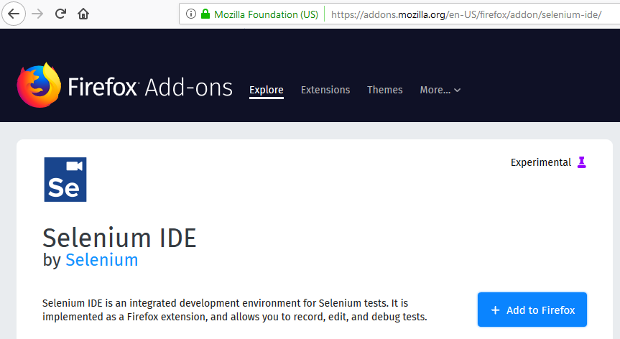
How to install Selenium IDE
Launch Mozilla Firefox Browser.
URL:https://addons.mozilla.org/en-us/firefox/addon/selenium-ide/
in your browser. Selenium IDE Add-ons page will get open then Click on Add to Firefox button as shown in image bellow.
Wait until Firefox completes the download and then click "Install.“
Wait until the installation is completed. In the pop-up window, click "Restart Now.“
After Firefox has restarted, launch Selenium IDE.
Notes:
Gherkin’s grammar is defined in the Treetop grammar that is part of the Cucumber codebase. The grammar exists in different flavours for many spoken languages (60 at the time of writing), so that your team can use the keywords in your own language.

Slide 9
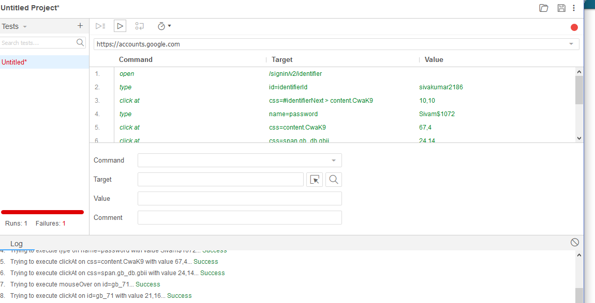
Record and Execute Selenium IDE
Notes:
Gherkin’s grammar is defined in the Treetop grammar that is part of the Cucumber codebase. The grammar exists in different flavours for many spoken languages (60 at the time of writing), so that your team can use the keywords in your own language.

Slide 10


Record and Execute Selenium IDE
Run all test
Run 1 test
Run current Command
Set Execution Speed
Recording and Stopping
Notes:
Gherkin’s grammar is defined in the Treetop grammar that is part of the Cucumber codebase. The grammar exists in different flavours for many spoken languages (60 at the time of writing), so that your team can use the keywords in your own language.

Slide 11
Record and Execute Selenium IDE
The Command selectbox has a list of all the commands that are needed to create a test. You can type into it to use the auto complete functionality or use it as a dropdown. 
The Target textbox allows you to input the location of the element that you want to work against. 
The Find button, once the target box is populated, can be clicked to highlight the element on the page. 
The Value textbox is where you place the value that needs to change. For example, if you want your test to type in an input box on the web page, you would put what you want it to type in the value box.
Notes:
Gherkin’s grammar is defined in the Treetop grammar that is part of the Cucumber codebase. The grammar exists in different flavours for many spoken languages (60 at the time of writing), so that your team can use the keywords in your own language.

Slide 12
Record and Execute Selenium IDE
Selenese Commands
Actions - Perform action
Accessors - Store the output
Assertions - Verify the specifics
Assert Vs Verify
Assert, the test will stop at that point and not run any subsequent checks.
In contrast, verify commands will not terminate the test. If your test uses only verify commands you are guaranteed the test will run.
Limitation:
It will not support iteration and conditional statement
Selenium IDE doesn't support error handling
Notes:
Gherkin’s grammar is defined in the Treetop grammar that is part of the Cucumber codebase. The grammar exists in different flavours for many spoken languages (60 at the time of writing), so that your team can use the keywords in your own language.

Slide 13
Chropath ( Overview & Features )

Slide 14
Chropath - Overview
What is Chropath
Development tool to edit, inspect and generate XPath and CSS selectors
Easy to write, edit, extract, and evaluate XPath and CSS queries on any webpage
Saves at least 40–50% manual effort in automation script writing
Used as an XPath/CSS helper, XPath/CSS editor, XPath/CSS viewer or XPath/CSS validator.

Slide 15
Chropath - Features
Can be opened as side bar in the dev tools panel
To get the absolute XPath and CSS selector of the element or selected node
Generation of unique XPath and CSS elector
Verification of XPath/ CSS selectors allows you to view the matching nodes in their sequential occurrence.
If the matching element is not in the visible area of web page, it will automatically scroll to the area on mouse hovering over the matching node
While verifying XPath, if you enter the XPath expression pattern incorrectly or incompletely it gets highlighted in red.

Slide 16

Listened much…
Feeling tired…
Need break…???
Lets Conclude and continue in next session

Slide 17


