Slide 1

Fresher Learning Program
Selenium – Day 2

Slide 2
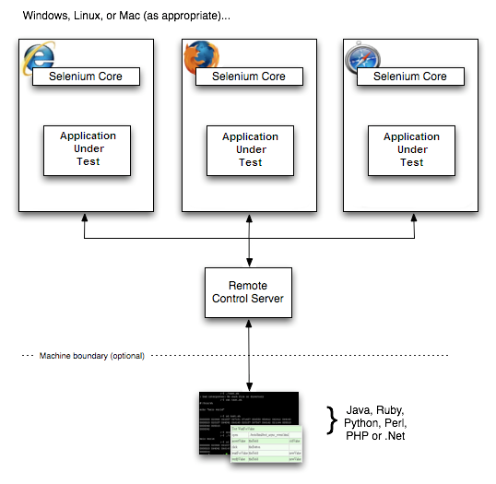
Selenium RC
The Selenium Server which launches and kills browsers, interprets and runs the Selenese commands passed from the test program, and acts as an HTTP proxy, intercepting and verifying HTTP messages passed between the browser and the AUT.
Client libraries which provide the interface between each programming language and the Selenium RC Server.
Notes:
Gherkin’s grammar is defined in the Treetop grammar that is part of the Cucumber codebase. The grammar exists in different flavours for many spoken languages (60 at the time of writing), so that your team can use the keywords in your own language.

Slide 3
Selenium RC
Launch a separate application called Selenium Remote Control (RC) Server before you can start testing.
The Selenium RC Server acts as a "middleman" between your Selenium commands and your browser.
While testing Selenium RC Server "injects" a Javascript program called Selenium Core into the browser.
Once injected, Selenium Core will start receiving instructions relayed by the RC Server from your test program.
When the instructions are received, Selenium Core will execute them as Javascript commands.
The browser will obey the instructions of Selenium Core and will relay its response to the RC Server.
The RC Server will receive the response of the browser and then display the results to you.
Notes:
Gherkin’s grammar is defined in the Treetop grammar that is part of the Cucumber codebase. The grammar exists in different flavours for many spoken languages (60 at the time of writing), so that your team can use the keywords in your own language.

Slide 4
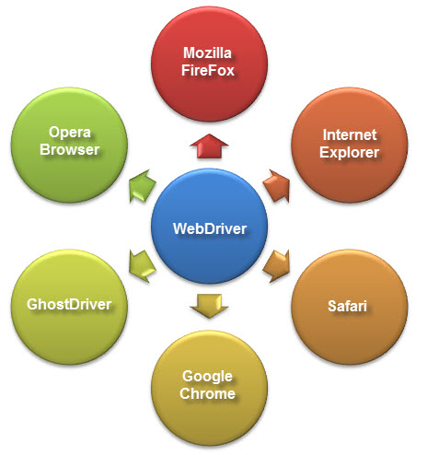
Selenium WebDriver
WebDriver is a web automation framework that allows you to execute your tests against different browsers.
Notes:
Gherkin’s grammar is defined in the Treetop grammar that is part of the Cucumber codebase. The grammar exists in different flavours for many spoken languages (60 at the time of writing), so that your team can use the keywords in your own language.

Slide 5
Selenium WebDriver
WebDriver also enables you to use a programming language in creating your test scripts.
Following programming languages are supported by WebDriver
Java
.NET
PHP
Python
Perl
Ruby
Difference between Selenium RC and Web driver
They both allow you to use a programming language in designing your test scripts.
They both allow you to run your tests against different browsers.
So how do they differ?
Notes:
Gherkin’s grammar is defined in the Treetop grammar that is part of the Cucumber codebase. The grammar exists in different flavours for many spoken languages (60 at the time of writing), so that your team can use the keywords in your own language.

Slide 6
Selenium WebDriver
Architecture - WebDriver's architecture is simpler than Selenium RC's.
WebDriver is faster than Selenium RC since it speaks directly to the browser uses the browser's own engine to control it.
WebDriver interacts with page elements in a more realistic way.
WebDriver's API is simpler than Selenium RC's. It does not contain redundant and confusing commands.
WebDriver can support the headless Html Unit browser
Limitations:
It cannot readily support new browsers, but Selenium RC can.
It does not have a built-in command for automatic generation of test results.
Notes:
Gherkin’s grammar is defined in the Treetop grammar that is part of the Cucumber codebase. The grammar exists in different flavours for many spoken languages (60 at the time of writing), so that your team can use the keywords in your own language.

Slide 7
Pre-requisite of Selenium WebDriver
Java Development Kit (JDK):
http://www.oracle.com/technetwork/java/javase/downloads/index.html
Eclipse IDE :
http://www.eclipse.org/downloads/
Java Client Driver :
http://seleniumhq.org/download/
Notes:
Gherkin’s grammar is defined in the Treetop grammar that is part of the Cucumber codebase. The grammar exists in different flavours for many spoken languages (60 at the time of writing), so that your team can use the keywords in your own language.

Slide 8
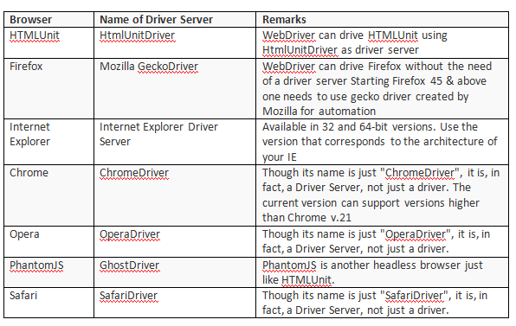
Selenium WebDriver – Driver details
Notes:
Gherkin’s grammar is defined in the Treetop grammar that is part of the Cucumber codebase. The grammar exists in different flavours for many spoken languages (60 at the time of writing), so that your team can use the keywords in your own language.

Slide 9
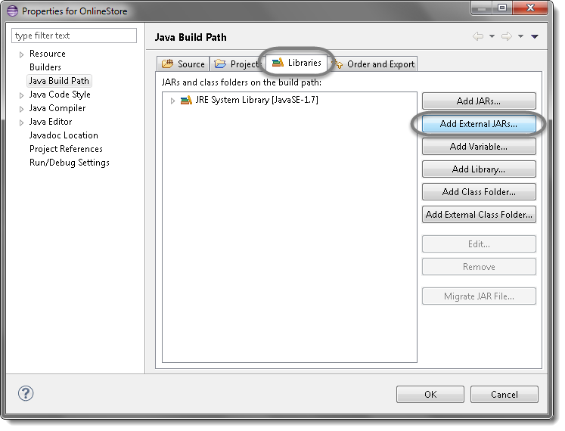
Selenium WebDriver – Installation
Launch the Eclipse IDE & Create a Workspace
Create a new Project
Create a new Package
Create a new Class
Add External Jars to Java build path
Right click on your project > Select Properties > Java build path. Then navigate to Libraries tab and click Add External JARs.
Notes:
Gherkin’s grammar is defined in the Treetop grammar that is part of the Cucumber codebase. The grammar exists in different flavours for many spoken languages (60 at the time of writing), so that your team can use the keywords in your own language.

Slide 10
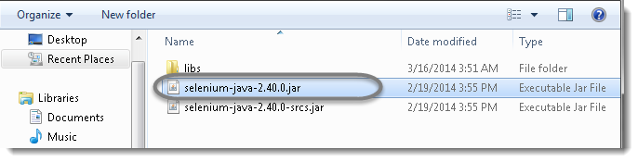
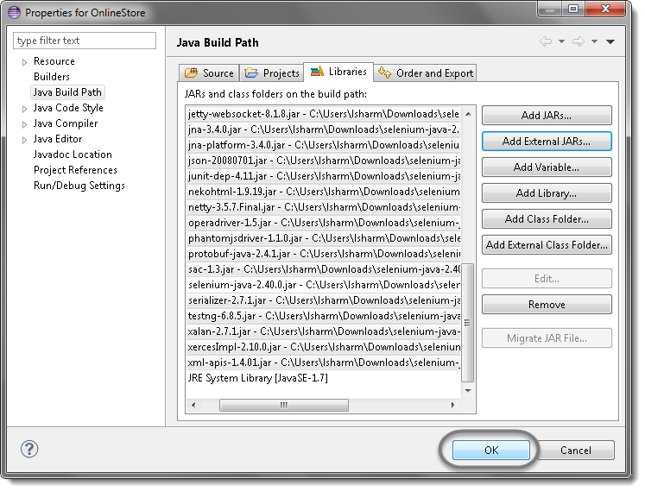
Selenium WebDriver – Installation
Add Selenium Java jar, you may add the source file too.
Click OK. That’s all about configuration of WebDriver with eclipse. Now you are ready. to write your test script in eclipse and run it in WebDriver.
Notes:
Gherkin’s grammar is defined in the Treetop grammar that is part of the Cucumber codebase. The grammar exists in different flavours for many spoken languages (60 at the time of writing), so that your team can use the keywords in your own language.

Slide 11
Selenium WebDriver – Write your first code
Instantiating objects and variables
WebDriver driver=new FirefoxDriver();
Importing Packages
org.openqa.selenium.*- contains the WebDriver class needed to instantiate a new browser loaded with a specific driver
org.openqa.selenium.firefox.FirefoxDriver - contains the FirefoxDriver class needed to instantiate a Firefox-specific driver onto the browser instantiated by the WebDriver class
Launching a Browser Session
WebDriver's get() method is used to launch a new browser session and directs it to the URL that you specify as its parameter.
driver.get(https://google.com);
Notes:
Gherkin’s grammar is defined in the Treetop grammar that is part of the Cucumber codebase. The grammar exists in different flavours for many spoken languages (60 at the time of writing), so that your team can use the keywords in your own language.

Slide 12
Selenium WebDriver – Write your first code
Get the Actual Page Title
String actualTitle= driver.getTitle();
Compare the Expected and Actual Values
This portion of the code simply uses a basic Java if-else structure to compare the actual title with the expected one.
//example
If(actualTitle.contentEquals(expectedTitle))
{
System.out.println(“Execution passed”);
}
else
{
System.out.println(“Execution failed”);
}
Terminating a Browser Session
driver.close();
Notes:
Gherkin’s grammar is defined in the Treetop grammar that is part of the Cucumber codebase. The grammar exists in different flavours for many spoken languages (60 at the time of writing), so that your team can use the keywords in your own language.

Slide 13
Selenium WebDriver – Get Commands
Methods | Comments
get() | It automatically opens a new browser window and fetches the page that you specify inside its parentheses. It is the counterpart of Selenium IDE's "open" command. The parameter must be a String object
getTitle() | Needs no parameters Fetches the title of the current page Leading and trailing white spaces are trimmed Returns a null string if the page has no title
getPageSource() | Needs no parameters Returns the source code of the page as a String value
getCurrentUrl() | Needs no parameters Fetches the string representing the current URL that the browser is looking at
getText() | Fetches the inner text of the element that you specify
Notes:
Gherkin’s grammar is defined in the Treetop grammar that is part of the Cucumber codebase. The grammar exists in different flavours for many spoken languages (60 at the time of writing), so that your team can use the keywords in your own language.

Slide 14
Selenium WebDriver – Driver Commands
Navigate Commands
Methods | Comments
navigate().to() | It automatically opens a new browser window and fetches the page that you specify inside its parentheses. It does exactly the same thing as the get() method.
navigate().refresh() | Needs no parameters. It refreshes the current page.
navigate().back() | Needs no parameters Takes you back by one page on the browser's history.
navigate().forward() | Needs no parameters Takes you forward by one page on the browser's history.
Closing and Quitting Browsers
close() - It closes only the browser window that WebDriver is currently controlling.
quit(): It closes all windows that WebDriver has opened.
Notes:
Gherkin’s grammar is defined in the Treetop grammar that is part of the Cucumber codebase. The grammar exists in different flavours for many spoken languages (60 at the time of writing), so that your team can use the keywords in your own language.

Slide 15
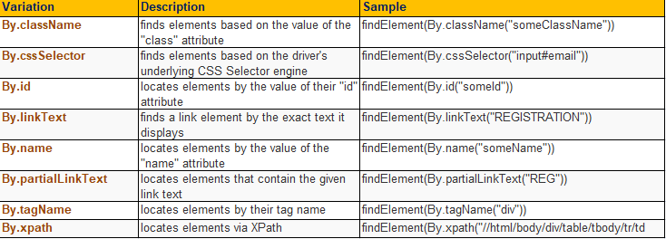
Locating GUI Elements
Locating elements in WebDriver is done by using the "findElement(By.locator())" method.
Notes:
Gherkin’s grammar is defined in the Treetop grammar that is part of the Cucumber codebase. The grammar exists in different flavours for many spoken languages (60 at the time of writing), so that your team can use the keywords in your own language.

Slide 16
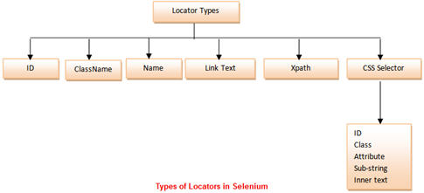
Locating GUI Elements
Notes:
Gherkin’s grammar is defined in the Treetop grammar that is part of the Cucumber codebase. The grammar exists in different flavours for many spoken languages (60 at the time of writing), so that your team can use the keywords in your own language.

Slide 17
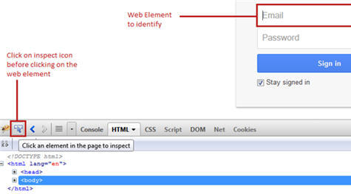
Finding the locators in Firefox
Finding an ID of a web element using Firebug
Step 1: Launch the web browser (Firefox) and navigate to “https://accounts.google.com/”.
Step 2: Open firebug (either by pressing F12 or via tools).
Step 3: Click on the inspect icon to identify the web element.
Notes:
Gherkin’s grammar is defined in the Treetop grammar that is part of the Cucumber codebase. The grammar exists in different flavours for many spoken languages (60 at the time of writing), so that your team can use the keywords in your own language.

Slide 18
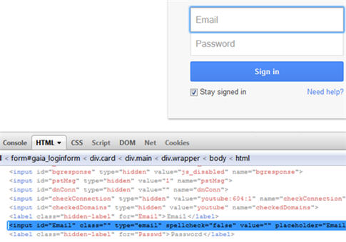
Finding the locators in Firefox
Step 4: Hover on the web element (Email textbox in our case) on which we desire to perform some action. In the firebug section, one can see the corresponding HTML tags being highlighted.
Step 5: Now we need to verify if the ID identified is able to find the element uniquely and flawlessly.
Syntax: id = id of the element
In our case, the id is “Email”.
Notes:
Gherkin’s grammar is defined in the Treetop grammar that is part of the Cucumber codebase. The grammar exists in different flavours for many spoken languages (60 at the time of writing), so that your team can use the keywords in your own language.

Slide 19

Listened much…
Feeling tired…
Need break…???
Lets Conclude and continue in next session

Slide 20


Slide 21

1.Selenium IDE
- Record and Playback – Sign-In and Sign out mail.
- Add assert to any text.
2. Test Gmail login functionality with incorrect username and incorrect password.
3. Selenium Web Driver
Launch the chrome browser and navigate to https://login.salesforce.com/?
locale=in url.
Enter username, Password and click on “LogIn” button”.
Capture the Error message by using getText method.
4. Above experiment for Firefox and headless browser.
Notes:
Gherkin’s grammar is defined in the Treetop grammar that is part of the Cucumber codebase. The grammar exists in different flavours for many spoken languages (60 at the time of writing), so that your team can use the keywords in your own language.

Slide 22
5. Launch google page and click on “Gmail” and “SingIn” link. (using link Text or Partial link Text).
6. Launch IRCTC page and identify textbox, buttons using class Name, enter incorrect username & password, capture error message.
Notes:
Gherkin’s grammar is defined in the Treetop grammar that is part of the Cucumber codebase. The grammar exists in different flavours for many spoken languages (60 at the time of writing), so that your team can use the keywords in your own language.

