Slide 1

Fresher Learning Program
Selenium - Day 3

Slide 2
Introduction to WebElement, findElement(), findElements()
Selenium Web Driver encapsulates a simple form element as an object of WebElement.
Web Driver provides the following two methods to find the elements. findElement() – finds a single web element and returns as a WebElement object.
(If the specified locator is not matching with any of the element then findElement() method will throw ‘NoSuchElementException’.)
findElements() – returns a list of WebElement objects matching the locator criteria.
Entering Values in Input Boxes: To enter text into the Text Fields and Password Fields, sendKeys() is the method available on the WebElement.
Deleting Values in Input Boxes: The clear() method is used to delete the text in an input box. This method does not need a parameter.
Buttons : The buttons can be accessed using the click() method.
Notes:
Gherkin’s grammar is defined in the Treetop grammar that is part of the Cucumber codebase. The grammar exists in different flavours for many spoken languages (60 at the time of writing), so that your team can use the keywords in your own language.

Slide 3
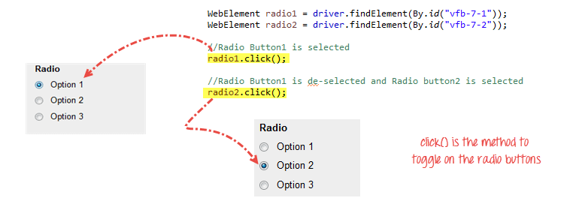
Introduction to WebElement, findElement(), findElements()
Submit Buttons: Submit buttons are used to submit the entire form to the server. We can either use the click () method on the web element like a normal button as we have done above or use the submit () method on any web element in the form or on the submit button itself.
(So the only difference is click() has to be done on the submit button and submit() can be done on any form element.)
Radio Button: Radio Buttons too can be toggled on by using the click() method.
Notes:
Gherkin’s grammar is defined in the Treetop grammar that is part of the Cucumber codebase. The grammar exists in different flavours for many spoken languages (60 at the time of writing), so that your team can use the keywords in your own language.

Slide 4
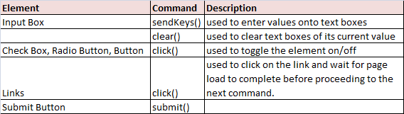
Introduction to WebElement, findElement(), findElements()
Check Box
Toggling a check box on/off is also done using the click() method.
isSelected() method is used to know whether the Checkbox is toggled on or off.
Notes:
Gherkin’s grammar is defined in the Treetop grammar that is part of the Cucumber codebase. The grammar exists in different flavours for many spoken languages (60 at the time of writing), so that your team can use the keywords in your own language.

Slide 5
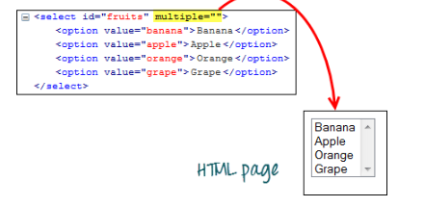
Drop-Down Box
Before we can control drop-down boxes, we must do following two things:
Import the package org.openqa.selenium.support.ui.Select
Instantiate the drop-down box as a "Select" object in WebDriver
Select fruits = new Select(driver.findElement(By.id("fruits")));
fruits.selectByVisibleText("Banana");
fruits.selectByIndex(1);
Notes:
Gherkin’s grammar is defined in the Treetop grammar that is part of the Cucumber codebase. The grammar exists in different flavours for many spoken languages (60 at the time of writing), so that your team can use the keywords in your own language.

Slide 6
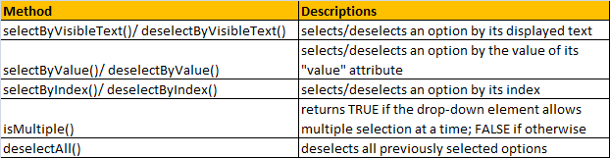
Drop-Down Methods
All Links
One of the common procedures in web Testing is to test if all the links present within the page are working.
Approach:
findElements() & By.tagName("a")
Java for-each loop
Notes:
Gherkin’s grammar is defined in the Treetop grammar that is part of the Cucumber codebase. The grammar exists in different flavours for many spoken languages (60 at the time of writing), so that your team can use the keywords in your own language.

Slide 7
All Links
public class P1 {
public static void main(String[] args) {
String baseUrl = "http://www.google.com/";
System.setProperty("webdriver.chrome.driver","G:\\chromedriver.exe");
WebDriver driver = new ChromeDriver();
String underConsTitle = "Under Construction: Mercury Tours";
driver.manage().timeouts().implicitlyWait(5, TimeUnit.SECONDS);
driver.get(baseUrl);
List<WebElement> linkElements = driver.findElements(By.tagName("a"));
String[] linkTexts = new String[linkElements.size()];
Notes:
Gherkin’s grammar is defined in the Treetop grammar that is part of the Cucumber codebase. The grammar exists in different flavours for many spoken languages (60 at the time of writing), so that your team can use the keywords in your own language.

Slide 8
All Links
Int i = 0;
//extract the link texts of each link element
for (WebElement e : linkElements) {
linkTexts[i] = e.getText();
i++;
} //test each link
for (String t : linkTexts) {
driver.findElement(By.linkText(t)).click();
if (driver.getTitle().equals(underConsTitle)) {
System.out.println("\"" + t + "\""
+ " is under construction.");
} else {
System.out.println("\"" + t + "\""
+ " is working.");
}
driver.navigate().back();
}
driver.quit();
}}
Notes:
Gherkin’s grammar is defined in the Treetop grammar that is part of the Cucumber codebase. The grammar exists in different flavours for many spoken languages (60 at the time of writing), so that your team can use the keywords in your own language.

Slide 9
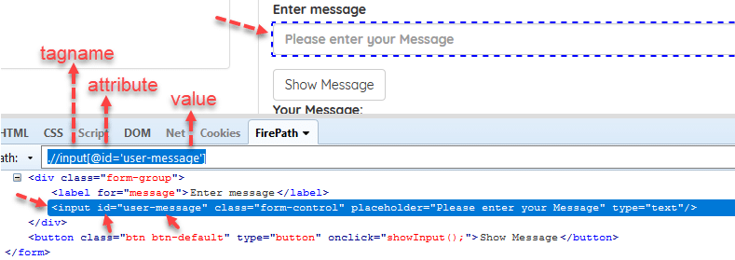
How to write XPATH
Syntax = //tagname[@attribute=’Value‘]
Example = //input[@id=’user-message‘]
Absolute and Relative Xpath
Starts with single slash “/” that means starting to search from the root.
It is a direct way to locate an element.
Ex: /html/body/div[2]/div/div[2]/div[1]/div[2]/form/div/input
Notes:
Gherkin’s grammar is defined in the Treetop grammar that is part of the Cucumber codebase. The grammar exists in different flavours for many spoken languages (60 at the time of writing), so that your team can use the keywords in your own language.

Slide 10
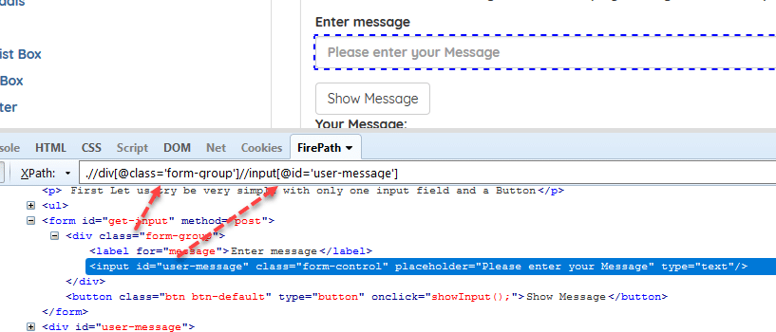
How to write XPATH
Relative XPath
Starts from the middle of the HTML DOM.
Starts with a double slash “//” that means it can start to search anywhere in the DOM structure.
Shorter than Absolute XPath.
Example: /div[@class=’form-group’]//input[@id=’user-message’]
Notes:
Gherkin’s grammar is defined in the Treetop grammar that is part of the Cucumber codebase. The grammar exists in different flavours for many spoken languages (60 at the time of writing), so that your team can use the keywords in your own language.

Slide 11

How to write XPATH
Writing Smart XPaths for Complex and Dynamic Elements
1. Writing XPath with Tag & Attribute & Value
//tag[@attribute=’value‘]
Example: //input[@id=‘user-message’]
Examples: Xpath = //input[@type=’send text’] Xpath = //label[@id=’clkBtn’] Xpath = //input[@value=’SEND’] Xpath = //*[@class=’swtestacademy’] –> “*” means, search “swtestacademy” class for all tags. Xpath = //a[@href=’https://www.swtestacademy.com/’] Xpath = /img[@src=’cdn.medianova.com/images/img_59c4334feaa6d.png’
Notes:
Gherkin’s grammar is defined in the Treetop grammar that is part of the Cucumber codebase. The grammar exists in different flavours for many spoken languages (60 at the time of writing), so that your team can use the keywords in your own language.

Slide 12
How to write XPATH
2. Writing XPath with contains()
When an attribute of an element is dynamic, then you can use contains() for the constant part of the web element
Syntax: //tag[contains(@attribute, ‘value‘)]
Example: //input[contains(@id, ‘er-messa’)]
Another Examples: Xpath = //*[contains(@name,’btnClk’)] –> It interrogates “btnClk” for all name attributes in the DOM. Xpath = //*[contains(text(),’here’)] –> It interrogates the text “here” in the DOM. Xpath = //*[contains(@href,’swtestacademy.com’)] –> It interrogates “swtestacademy.com” link in the DOM.
3) Writing XPath with starts-with
This method checks the starting text of an attribute. It is very handy to use when the attribute value changes dynamically but also you can use this method for non-changing attribute values.
Syntax: //tag[starts-with(@attribute, ‘value‘)]
Example: //input[starts-with(@id, ‘user’)]
Notes:
Gherkin’s grammar is defined in the Treetop grammar that is part of the Cucumber codebase. The grammar exists in different flavours for many spoken languages (60 at the time of writing), so that your team can use the keywords in your own language.

Slide 13
How to write XPATH
4. Writing XPath with “or” Statement
Syntax: //tag[XPath Statement-1 or XPath Statement-2]
Example: //*[@id=’user-message’ or @class=’form-control’]
5. Writing XPath with “and“ Statement
Syntax: //tag[XPath Statement-1 and XPath Statement-2]
Example: //*[@id=’user-message’ and @class=’form-control’]
6. Writing XPath with text()
Syntax: //tag[text()=’text value‘]
Example: .//label[text()=’Enter message’]
7. Writing XPath with ancestor
It finds the element before ancestor statement and set it as a top node and then starts to find the elements in that node. In below example,
1- First, it finds the class which id is “container-fluid”
2- Then, starts to find div elements in that node.
Example: //*[@class=’container-fluid’]//ancestor::div
Notes:
Gherkin’s grammar is defined in the Treetop grammar that is part of the Cucumber codebase. The grammar exists in different flavours for many spoken languages (60 at the time of writing), so that your team can use the keywords in your own language.

Slide 14
How to write XPATH
Writing XPath with following
Starts to locate elements after the given parent node. It finds the element before the following statement and set as the top node and then starts to find all elements after that node. In below example,
1- First, it finds the form which id is “gettotal”
2- Then, starts to find all input elements after that node.
Example: .//form[@id=’gettotal’]//following::input
Writing XPath with child
Selects all children elements of the current node.
Example: //nav[@class=’fusion-main-menu’]//ul[@id=’menu-main’]/child::li
Writing XPath with preceding
Select all nodes that come before the current node.
Example: //img[contains(@src,’cs.mailmunch.co’)]//preceding::li
Writing XPath with following-sibling
Select the following siblings of the context node.
Example: //*[@class=’col-md-6 text-left’]/child::div[2]//*[@class=’panel-body’]//following-sibling::li
Notes:
Gherkin’s grammar is defined in the Treetop grammar that is part of the Cucumber codebase. The grammar exists in different flavours for many spoken languages (60 at the time of writing), so that your team can use the keywords in your own language.

Slide 15
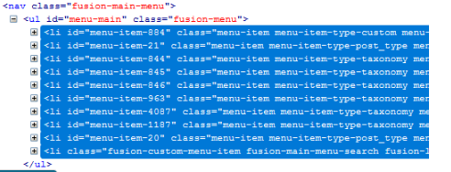
How to write XPATH
Writing XPath with Descendant
Identifies and returns all the element descendants to current element which means traverse down under the current element’s node.
Example: //nav[@class=’fusion-main-menu’]//*[@id=’menu-main’]//descendant::li
Writing XPath with Parent
Returns the parent of the current node.
The below example will selects the parent node of the input tag of Id='email'. Ex: //input[@id='email']/parent::*
Notes:
Gherkin’s grammar is defined in the Treetop grammar that is part of the Cucumber codebase. The grammar exists in different flavours for many spoken languages (60 at the time of writing), so that your team can use the keywords in your own language.

Slide 16

Locators Exercises
Identify an element using logical operator
Pass a dynamic values in to the locator and identify an element
Identify an element without using any attributes – can use indexing concept (for this task only)
Identify an element using following and parent and try if it works on combining both
Identify an element using contains, starts-with

Slide 17
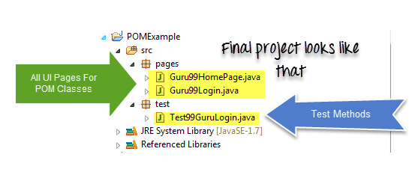
Page Object model
It is a design pattern to create Object Repository for web UI elements.
Each web page will have corresponding page class.
This Page class will find the WebElements of that web page and also contains Page methods which perform operations on those WebElements.
Name of these methods should be given as per the task they are performing, i.e., if a loader is waiting for the payment gateway to appear, POM method name can be waitForPaymentScreenDisplay().

Slide 18
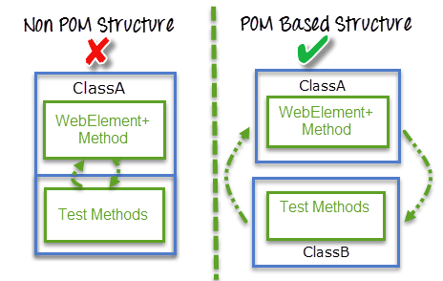
Page Object Model - Importance
Starting an UI Automation in Selenium WebDriver is NOT a tough task. You just need to find elements, perform operations on it.
When we add more and more lines to the code, things become tough.
Maintaining the script or multiple scripts from different page will consume time and error prone.
A better approach to script maintenance is to create a separate class file which would find web elements, fill them or verify them. This class can be reused in all the scripts using that element. In future, if there is a change in the web element, we need to make the change in just 1 class file and not 10 different scripts.

Slide 19
Page object model - Advantages
Code cleaner and easy to understand
Object repository is independent of test cases
Code becomes less and optimized because of the reusable page methods in the POM classes
Methods get more realistic names which can be easily mapped with the operation happening in UI. i.e. if after clicking on the button we land on the home page, the method name will be like 'gotoHomePage()'.

Slide 20
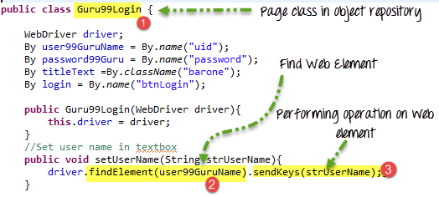
How to implement POM
It's the basic structure of Page object model (POM) where all Web Elements of the AUT and the method that operate on these Web Elements are maintained inside a class file.A task like verification should be separate as part of Test methods.

Slide 21

Listened much…
Feeling tired…
Need break…???
Lets Conclude and see you in next session

Slide 22


