Slide 1

Fresher Learning Program
Selenium – Day 4

Slide 2
WebDriver wait
ImplicitlyWait Command
Selenium WebDriver has borrowed the idea of implicit waits from Watir. This means that we can tell Selenium that we would like it to wait for a certain amount of time before throwing an exception that it cannot find the element on the page. We should note that implicit waits will be in place for the entire time the browser is open.
WebDriver driver => new FirefoxDriver();
driver.manage().timeouts().implicitlyWait(10, TimeUnit.SECONDS);
driver.get("http://url_that_delays_loading");
WebElement myDynamicElement = driver.findElement(By.id("myDynamicElement"));
Notes:
Gherkin’s grammar is defined in the Treetop grammar that is part of the Cucumber codebase. The grammar exists in different flavours for many spoken languages (60 at the time of writing), so that your team can use the keywords in your own language.

Slide 3
WebDriver wait
Fluent Wait
The fluent wait is used to tell the web driver to wait for a condition, as well as the frequency with which we want to check the condition before throwing an "ElementNotVisibleException" exception.
Syntax:
Wait wait = new FluentWait(WebDriver reference)
.withTimeout(timeout, SECONDS)
.pollingEvery(timeout, SECONDS)
.ignoring(Exception.class);
//Example
// Waiting 30 seconds for an element to be present on the page, checking
// for its presence once every 5 seconds.
Wait wait = new FluentWait(driver)
.withTimeout(30, SECONDS)
.pollingEvery(5, SECONDS)
.ignoring(NoSuchElementException.class);
Notes:
Gherkin’s grammar is defined in the Treetop grammar that is part of the Cucumber codebase. The grammar exists in different flavours for many spoken languages (60 at the time of writing), so that your team can use the keywords in your own language.

Slide 4
WebDriver wait
Fluent Wait
WebElement foo = wait.until(new Function() {
public WebElement apply(WebDriver driver) {
return driver.findElement(By.id("foo")); } });
Explicit Wait
The explicit wait is used to tell the Web Driver to wait for certain conditions (Expected Conditions) or the maximum time exceeded before throwing an "ElementNotVisibleException" exception.
Example:
WebElement testElement;
testElement =wait.until(ExpectedConditions.visibilityOfElementLocated(By.id( "test")));
testElement.click();
Notes:
Gherkin’s grammar is defined in the Treetop grammar that is part of the Cucumber codebase. The grammar exists in different flavours for many spoken languages (60 at the time of writing), so that your team can use the keywords in your own language.

Slide 5
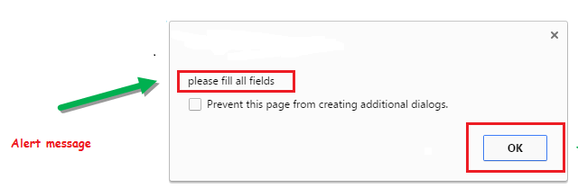
Alert
Alert is a small message box which displays on-screen notification to give the user some kind of information or ask for permission to perform certain kind of operation. It may be also used for warning purpose.
Simple Alert - This simple alert displays some information or warning on the screen.
Notes:
Gherkin’s grammar is defined in the Treetop grammar that is part of the Cucumber codebase. The grammar exists in different flavours for many spoken languages (60 at the time of writing), so that your team can use the keywords in your own language.

Slide 6
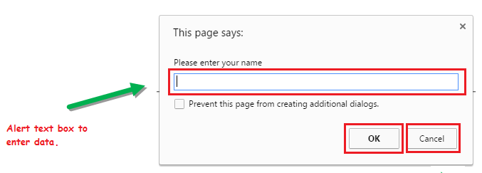
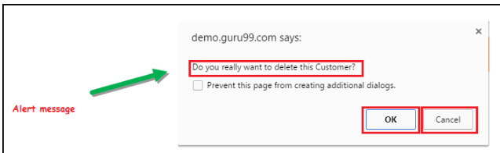
Alert
Prompt Alert - This Prompt Alert asks some input from the user and selenium webdriver can enter the text using sendkeys(" input…. ").
Confirmation Alert - This confirmation alert asks permission to do some type of operation.
Notes:
Gherkin’s grammar is defined in the Treetop grammar that is part of the Cucumber codebase. The grammar exists in different flavours for many spoken languages (60 at the time of writing), so that your team can use the keywords in your own language.

Slide 7
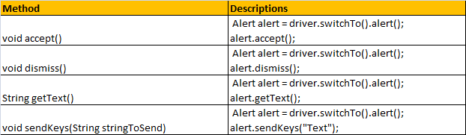
Alert Methods
Notes:
Gherkin’s grammar is defined in the Treetop grammar that is part of the Cucumber codebase. The grammar exists in different flavours for many spoken languages (60 at the time of writing), so that your team can use the keywords in your own language.

Slide 8

1.Goto http://newtours.demoaut.com/index.php? url
and click on ‘REGISTER’ link and perform registration.
2.Perform IRCTC Registration.
3.Go to http://book.theautomatedtester.co.uk
/ and click on “Chapter 1” link then perform below.
• Select radio, checkbox
• Click on ‘load text to the page’ button and verify “To be used after the AJAX section of the book”.
• Select “Selenium Grid” from dropdown.
• Navigate back and select “Chapter 2” and verify “chocolate” button.
4. Workout all cssSelector (id,class, substring and +) and Xpath (contains,parent,attribute) in any registration page.
5. Workout alert method. (accept,dismiss,getText and sendKeys).
Notes:
Gherkin’s grammar is defined in the Treetop grammar that is part of the Cucumber codebase. The grammar exists in different flavours for many spoken languages (60 at the time of writing), so that your team can use the keywords in your own language.

Slide 9
Browser – Maximize
There are times when we want to maximize the browser window during the execution of our script .For this purpose webdriver providers a built-in method and here is the syntax :
//Syntax WebDriver driver;
driver.manage().window().maximize();
isDisplayed, isSelected, isEnabled
Boolean isSelected(): This method determines if an element is selected or not. It returns true if the element is selected and false if it is not. It is widely used on check boxes, radio buttons and options in a select.
Boolean isDisplayed(): This method determines if an element is displayed or not. It returns true if the element is displayed and false if it is not.
Boolean isEnabled(): This method determines if an element is enabled or not. It returns true if element is enabled and false if otherwise.
Notes:
Gherkin’s grammar is defined in the Treetop grammar that is part of the Cucumber codebase. The grammar exists in different flavours for many spoken languages (60 at the time of writing), so that your team can use the keywords in your own language.

Slide 10
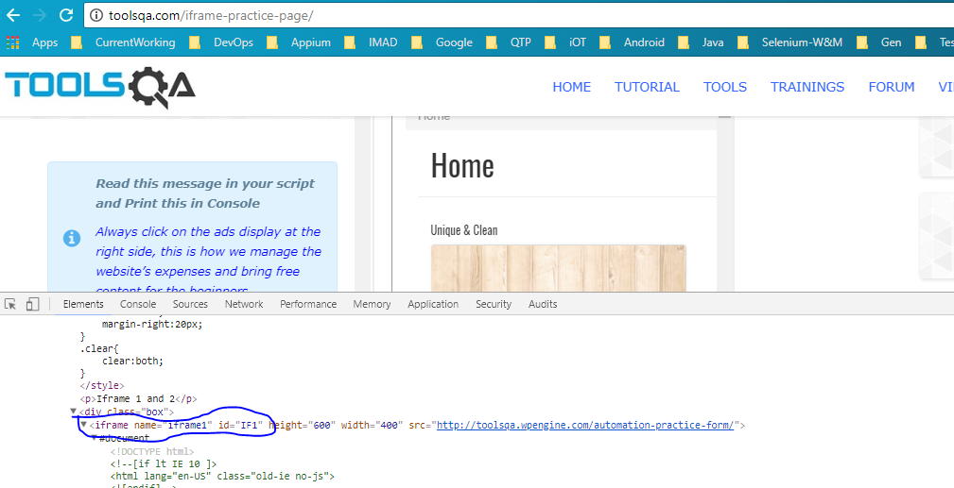
Handling Frames (iFrame)
The IFrame is often used to insert content from another source, such as an advertisement, into a Web page. The <iframe> tag specifies an inline frame.
Notes:
Gherkin’s grammar is defined in the Treetop grammar that is part of the Cucumber codebase. The grammar exists in different flavours for many spoken languages (60 at the time of writing), so that your team can use the keywords in your own language.

Slide 11
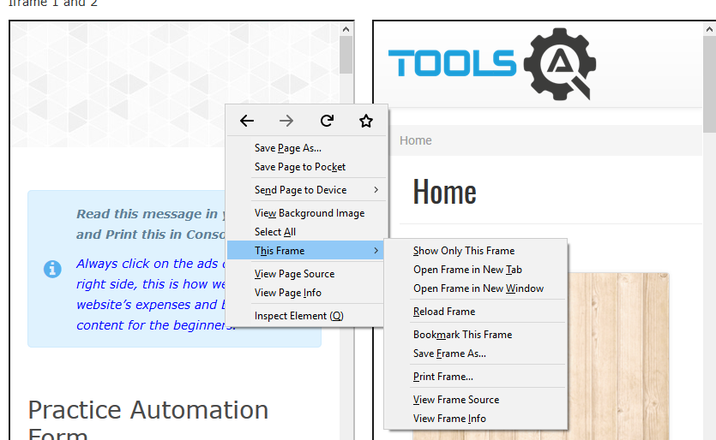
Handling Frames (iFrame)
How to identify the iframe:
We cannot detect the frames by just seeing the page or by inspecting Firebug.
We can identify the iframes using methods given below:
Right click on the element, If you find the option like 'This Frame' then it is an iframe.(Please refer the above diagram)
Notes:
Gherkin’s grammar is defined in the Treetop grammar that is part of the Cucumber codebase. The grammar exists in different flavours for many spoken languages (60 at the time of writing), so that your team can use the keywords in your own language.

Slide 12
Handling Frames (iFrame)
Right click on the page and click 'View Page Source' and Search with the 'iframe', if you can find any tag name with the 'iframe' then it is meaning to say the page consisting an iframe.
Ex:
<iframe name="iframe1" id="IF1" height="600" width="400" src="http://toolsqa.wpengine.com/automation-practice-form/"></iframe>
// get the frame size from the page
int size = driver.findElements(By.tagName("iframe")).size();
Notes:
Gherkin’s grammar is defined in the Treetop grammar that is part of the Cucumber codebase. The grammar exists in different flavours for many spoken languages (60 at the time of writing), so that your team can use the keywords in your own language.

Slide 13
Switch over the elements in iframes
By Index
By Name or Id
By Web Element
Switch to the frame by index:
//Example
driver.switchTo().frame(0);
Switch to the frame by Name or ID:
driver.switchTo().frame("iframe1");
Switch to the frame by Web Element:
driver.switchTo().frame(WebElement);
switch back to the Main Frame
driver.switchTo().parentFrame();
driver.switchTo().defaultContent();
Notes:
Gherkin’s grammar is defined in the Treetop grammar that is part of the Cucumber codebase. The grammar exists in different flavours for many spoken languages (60 at the time of writing), so that your team can use the keywords in your own language.

Slide 14
Switch over the frame
public class SwitchToFrame_ID {
public static void main(String[] args) {
WebDriver driver = new FirefoxDriver(); //navigates to the Browser
driver.get("http://demo.guru99.com/test/guru99home/");
// navigates to the page consisting an iframe
driver.manage().window().maximize();
driver.switchTo().frame("a077aa5e"); //switching the frame by ID
driver.findElement(By.xpath("html/body/a/img")).click();
}
}
Notes:
Gherkin’s grammar is defined in the Treetop grammar that is part of the Cucumber codebase. The grammar exists in different flavours for many spoken languages (60 at the time of writing), so that your team can use the keywords in your own language.

Slide 15
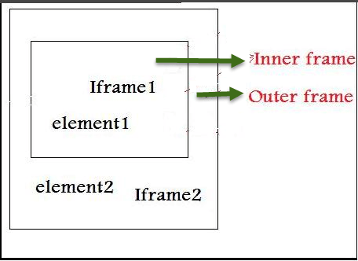
Switch over the frame
Concept of Nested Frames(Frames inside Frames):
Notes:
Gherkin’s grammar is defined in the Treetop grammar that is part of the Cucumber codebase. The grammar exists in different flavours for many spoken languages (60 at the time of writing), so that your team can use the keywords in your own language.

Slide 16
Switch over the frame
try {
driver.switchTo().frame(ParentFrame).switchTo().frame(ChildFrame);
System.out.println("Navigated to inner frame with id " + ChildFrame
+ "which is present on frame with id" + ParentFrame);
} catch (NoSuchFrameException e) {
System.out.println("Unable to locate frame with id " + ParentFrame
+ " or " + ChildFrame + e.getStackTrace());
} catch (Exception e) {
System.out.println("Unable to navigate to innerframe with id "
+ ChildFrame + "which is present on frame with id"
+ ParentFrame + e.getStackTrace());
}
How to switch back to the Main Frame
driver.switchTo().parentFrame();
driver.switchTo().defaultContent();
Notes:
Gherkin’s grammar is defined in the Treetop grammar that is part of the Cucumber codebase. The grammar exists in different flavours for many spoken languages (60 at the time of writing), so that your team can use the keywords in your own language.

Slide 17
Windows Handling
In automation, when we have multiple windows in any web application, the activity may need to switch control among several windows from one to other in order to complete the operation.
In selenium web driver there are methods through which we can handle multiple windows.
Syntax:
Driver.getWindowHandles();
To handle all opened windows by web driver, we can use "Driver.getWindowHandles()" and then we can switch window from one window to another in a web application. Its return type is Iterator<String>.
Syntax:
driver.switchTo().window(ChildWindow);
Driver.getWindowHandle();
Notes:
Gherkin’s grammar is defined in the Treetop grammar that is part of the Cucumber codebase. The grammar exists in different flavours for many spoken languages (60 at the time of writing), so that your team can use the keywords in your own language.

Slide 18
Windows Handling
When the site opens, we need to handle the main window by driver.getWindowHandle(). This will handle the current window that uniquely identifies it within this driver instance. Its return type is String
// Sample code
import java.util.Iterator;
import java.util.Set;
import org.openqa.selenium.By;
import org.openqa.selenium.WebDriver;
import org.openqa.selenium.firefox.FirefoxDriver;
public class WindowHandle_Demo {
public static void main(String[] args) throws InterruptedException {
WebDriver driver=new FirefoxDriver();
//Launching the site.
driver.get("http://demo.guru99.com/popup.php");
driver.manage().window().maximize();
driver.findElement(By.xpath("//*[contains(@href,'popup.php')]")).click();
Notes:
Gherkin’s grammar is defined in the Treetop grammar that is part of the Cucumber codebase. The grammar exists in different flavours for many spoken languages (60 at the time of writing), so that your team can use the keywords in your own language.

Slide 19
Windows Handling
String MainWindow=driver.getWindowHandle();
// To handle all new opened window.
Set<String> s1=driver.getWindowHandles();
Iterator<String> i1=s1.iterator();
while(i1.hasNext())
{
String ChildWindow=i1.next();
if(!MainWindow.equalsIgnoreCase(ChildWindow))
{
// Switching to Child window
driver.switchTo().window(ChildWindow);
driver.findElement(By.name("emailid"))
.sendKeys("gaurav.3n@gmail.com");
driver.findElement(By.name("btnLogin")).click();
driver.close();
}
} // Switching to Parent window i.e Main Window.
driver.switchTo().window(MainWindow);
}}
Notes:
Gherkin’s grammar is defined in the Treetop grammar that is part of the Cucumber codebase. The grammar exists in different flavours for many spoken languages (60 at the time of writing), so that your team can use the keywords in your own language.

Slide 20

Windows Exercises
Open any weblink in new windows and try to traverse in between windows and perform interactions
Close a particular window and navigate back to previous window and perform operations

Slide 21
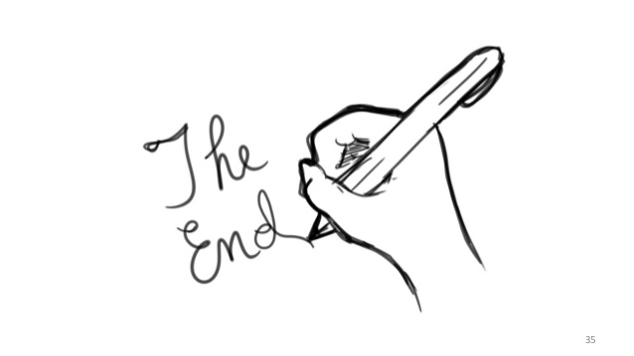
Lets Conclude and see you in next session

Slide 22


