Slide 1

Fresher Learning Program
Selenium - Day 5

Slide 2
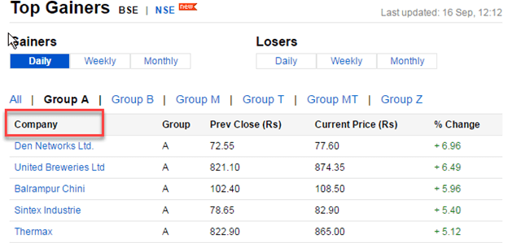
Handling Web Tables Using Selenium WebDriver
There are two types of HTML tables published on the web:
Static tables: Data is static i.e. Number of rows and columns are fixed.
Dynamic tables: Data is dynamic i.e. Number of rows and columns are NOT fixed.
Xpath for dynamic web table:
Notes:
Gherkin’s grammar is defined in the Treetop grammar that is part of the Cucumber codebase. The grammar exists in different flavours for many spoken languages (60 at the time of writing), so that your team can use the keywords in your own language.

Slide 3
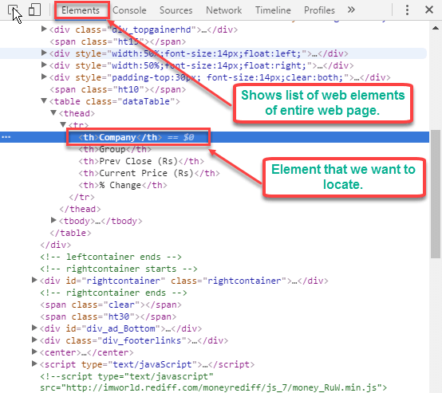
Handling Web Tables Using Selenium WebDriver
Right click on web element whose x-path is to be fetched. In our case, right click on "Company" Select Inspect option. The following screen will be shown -
Notes:
Gherkin’s grammar is defined in the Treetop grammar that is part of the Cucumber codebase. The grammar exists in different flavours for many spoken languages (60 at the time of writing), so that your team can use the keywords in your own language.

Slide 4
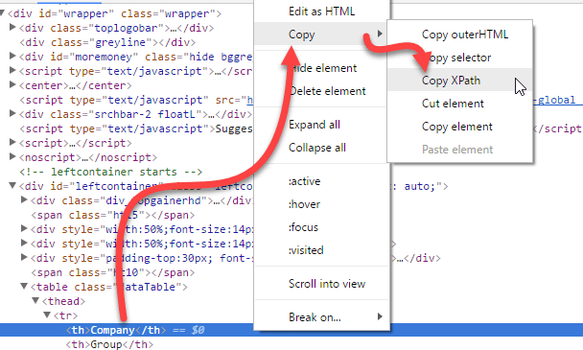
Handling Web Tables Using Selenium WebDriver
Right Click on highlighted web element > Select Copy -> Copy x-path option.
Use the copied X-path "//*[@id="leftcontainer"]/table/thead/tr/th [1]"
in Selenium WebDriver to locate the element.
Notes:
Gherkin’s grammar is defined in the Treetop grammar that is part of the Cucumber codebase. The grammar exists in different flavours for many spoken languages (60 at the time of writing), so that your team can use the keywords in your own language.

Slide 5
Handling Web Tables Using Selenium WebDriver
//Row Count in WebTable
WebElement table = driver.findElement(By.xpath("//table[@class='gf-table']"));
List<WebElement> row = table.findElements(By.tagName("tr"));
System.out.println("Total Number of Rows = " + row.size());
//Column Count in WebTable
List<WebElement> column = row.get(10).findElements(By.tagName("td")); System.out.println("Total Number of Column = " + column.size());
//Print content of Rows
for (int i=0;i<=row.size()-1 ;i++)
{
System.out.println(row.get(i).getText());
}
// Print content of 2nd Column
List<WebElement> firstcol = driver.findElements(By.xpath("//table[@class='gf-table']/tbody/tr/td[2]"));
int i=2;
List<WebElement> firstcol = driver.findElements(By.xpath("//table[@class='gf-table']/tbody/tr/td[“+i+”]"));
Notes:
Gherkin’s grammar is defined in the Treetop grammar that is part of the Cucumber codebase. The grammar exists in different flavours for many spoken languages (60 at the time of writing), so that your team can use the keywords in your own language.

Slide 6
Handling Web Tables Using Selenium WebDriver
//to get 3rd row's 2nd column data
WebElement cellIneed =driver.findElement(By.xpath("//*[@id=\"leftcontainer\"]/table/tbody/tr[3]/td[2]"));
String valueIneed = cellIneed.getText();
//Row iteration to get 4th column
for (int i =1;i<rows.size();i++)
{
max= wd.findElement(By.xpath("html/body/div[1]/div[5]/table/tbody/tr[" + (i+1)+ "]/td[4]")).getText();
}
Notes:
Gherkin’s grammar is defined in the Treetop grammar that is part of the Cucumber codebase. The grammar exists in different flavours for many spoken languages (60 at the time of writing), so that your team can use the keywords in your own language.

Slide 7
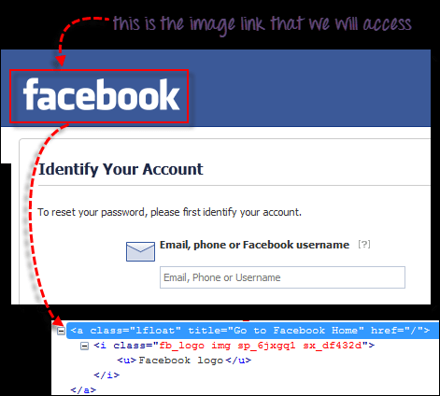
Accessing Image links
Image links are the links in web pages represented by an image which when clicked navigates to a different window or page.
Since they are images, we cannot use the By.linkText() and By.partialLinkText() methods because image links basically have no link texts at all.
In this case, we should resort to using either By.cssSelector or By.xpath.
Notes:
Gherkin’s grammar is defined in the Treetop grammar that is part of the Cucumber codebase. The grammar exists in different flavours for many spoken languages (60 at the time of writing), so that your team can use the keywords in your own language.

Slide 8
Accessing Image links
// click on the image link and verify the element
//click on the "Facebook" logo on the upper left portion
driver.findElement(By.cssSelector("a[title=\"Go to Facebook home\"]")).click();
//verify that we are now back on Facebook's homepage
if (driver.getTitle().equals("Facebook - log in or sign up"))
{
System.out.println("We are back at Facebook's homepage");
}
else
{
System.out.println("We are NOT in Facebook's homepage");
}
Notes:
Gherkin’s grammar is defined in the Treetop grammar that is part of the Cucumber codebase. The grammar exists in different flavours for many spoken languages (60 at the time of writing), so that your team can use the keywords in your own language.

Slide 9
Snapshot
Screenshots are desirable for bug analysis. Selenium can automatically take screenshots during execution. You need to type cast WebDriver instance to TakesScreenshot.
// Code snippet
public static void takeSnapShot(WebDriver webdriver,String fileWithPath) throws Exception{
//Convert web driver object to TakeScreenshot
TakesScreenshot scrShot =((TakesScreenshot)webdriver);
//Call getScreenshotAs method to create image file
File SrcFile=scrShot.getScreenshotAs(OutputType.FILE);
//Move image file to new destination
File DestFile=new File(fileWithPath);
//Copy file at destination
FileUtils.copyFile(SrcFile, DestFile) }
Notes:
Gherkin’s grammar is defined in the Treetop grammar that is part of the Cucumber codebase. The grammar exists in different flavours for many spoken languages (60 at the time of writing), so that your team can use the keywords in your own language.

Slide 10
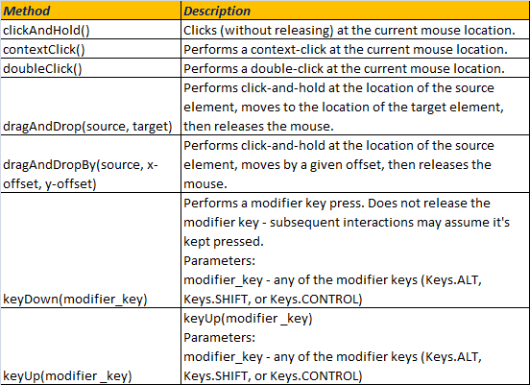
Keyboard & Mouse Event using Action Class in Selenium Webdriver
Handling Keyboard & Mouse Events
Handling special keyboard and mouse events are done using the Advanced User Interactions API. It contains the Actions and the Action classes that are needed when executing these events
Notes:
Gherkin’s grammar is defined in the Treetop grammar that is part of the Cucumber codebase. The grammar exists in different flavours for many spoken languages (60 at the time of writing), so that your team can use the keywords in your own language.

Slide 11
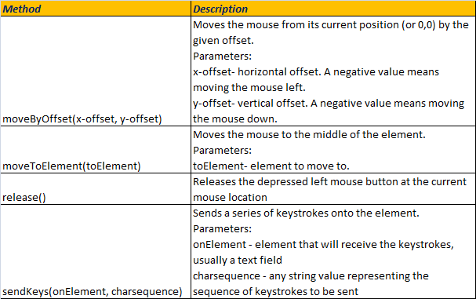
Keyboard & Mouse Event using Action Class in Selenium Webdriver
Notes:
Gherkin’s grammar is defined in the Treetop grammar that is part of the Cucumber codebase. The grammar exists in different flavours for many spoken languages (60 at the time of writing), so that your team can use the keywords in your own language.

Slide 12
Keyboard & Mouse Event using Action Class in Selenium Webdriver
//Example
Actions actions = new Actions(driver);
WebElement mainMenu = driver.findElement(By.linkText("menulink"));
actions.moveToElement(mainMenu);
WebElement subMenu = driver.findElement(By.cssSelector("subLinklocator"));
actions.moveToElement(subMenu);
actions.click().build().perform();
Here 'build()' method is used to compile all the list of actions into a single step and ready to be performed
Drag and Drop
Ex: http://jqueryui.com/resources/demos/droppable/default.html
Notes:
Gherkin’s grammar is defined in the Treetop grammar that is part of the Cucumber codebase. The grammar exists in different flavours for many spoken languages (60 at the time of writing), so that your team can use the keywords in your own language.

Slide 13
Keyboard & Mouse Event using Action Class in Selenium Webdriver
driver.get("http://jqueryui.com/droppable/#default");
driver.manage().window().maximize();
Actions act = new Actions(driver);
// Script for dragging an element and dropping it in another place
WebElement iFrame = driver.findElement(By.tagName("iframe"));
System.out.println(iFrame.getSize()); driver.switchTo().frame(iFrame);
WebElement From = driver.findElement(By.id("draggable"));
System.out.println(From.getLocation());
WebElement To = driver.findElement(By.id("droppable"));
System.out.println(To.getLocation());
act.dragAndDrop(From, To).build().perform();
Notes:
Gherkin’s grammar is defined in the Treetop grammar that is part of the Cucumber codebase. The grammar exists in different flavours for many spoken languages (60 at the time of writing), so that your team can use the keywords in your own language.

Slide 14
Keyboard & Mouse Event using Action Class in Selenium Webdriver
Other Ways to do DragAndDrop
act.clickAndHold(From).build().perform();
act.moveToElement(To).build().perform();
act.release(To).build().perform();
OR
act.dragAndDropBy(From, 140, 18).perform();
Here 140 and 8 are the x and y offset of the target element.
We can find the location of the element by using the getLocation() method.
Notes:
Gherkin’s grammar is defined in the Treetop grammar that is part of the Cucumber codebase. The grammar exists in different flavours for many spoken languages (60 at the time of writing), so that your team can use the keywords in your own language.

Slide 15
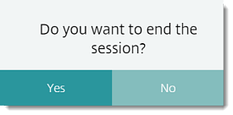
.
Notes:
Gherkin’s grammar is defined in the Treetop grammar that is part of the Cucumber codebase. The grammar exists in different flavours for many spoken languages (60 at the time of writing), so that your team can use the keywords in your own language.

Slide 16


