Slide 1

Fresher Learning Program
Selenium – Day 6

Slide 2
Scroll up and down in Selenium Webdriver
What is a Scrollbar?
A Scrollbar is a lets you move around screen in horizontal or vertical direction if the current page scroll does not fit the visible area of the screen. It is used to move the window up and down.
Scroll bar is of two type: Horizontal and vertical scroll bar as shown in below screenshot.
Scroll in Selenium
To scroll using Selenium, you can use JavaScriptExecutor interface that helps to execute JavaScript methods through Selenium Webdriver
Syntax :
JavascriptExecutor js = (JavascriptExecutor) driver; js.executeScript(Script,Arguments);
Script – This is the JavaScript that needs to execute.
Arguments – It is the arguments to the script. It's optional.
.
Notes:
Gherkin’s grammar is defined in the Treetop grammar that is part of the Cucumber codebase. The grammar exists in different flavours for many spoken languages (60 at the time of writing), so that your team can use the keywords in your own language.

Slide 3
Scroll up and down in Selenium Webdriver
Scenario 1: To scroll down the web page by pixel.
JavascriptExecutor js = (JavascriptExecutor) driver;
js.executeScript("window.scrollBy(0,1000)");
Scenario 2: To scroll down the web page by the visibility of the element.
JavascriptExecutor js = (JavascriptExecutor) driver;
WebElement Element = driver.findElement(By.linkText("Linux"));
//This will scroll the page till the element is found js.executeScript("arguments[0].scrollIntoView();", Element)
Scenario 3: To scroll down the web page at the bottom of the page.
JavascriptExecutor js = (JavascriptExecutor) driver; //This will scroll the web page till end.
js.executeScript("window.scrollTo(0, document.body.scrollHeight)")
Scenario 4: Horizontal scroll on the web page.
// horizontally right
((JavascriptExecutor)driver).executeScript(“window.scrollBy(2000,0)”);
//horizontally left
((JavascriptExecutor)driver).executeScript(“window.scrollBy(-2000,0)”);
.
Notes:
Gherkin’s grammar is defined in the Treetop grammar that is part of the Cucumber codebase. The grammar exists in different flavours for many spoken languages (60 at the time of writing), so that your team can use the keywords in your own language.

Slide 4
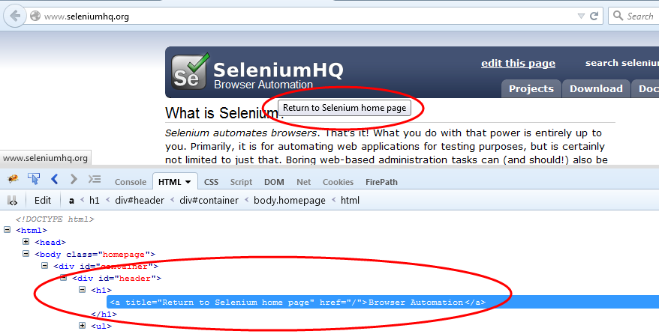
ToolTip Verification
The tooltip is a text that appears when a mouse hovers over an object like a link, an image, a button, text area, etc. in a web page. The text often gives more information about the object on which it appears.
Method 1:
WebElement element = driver.findElement(By.cssSelector(".header"));
String toolTipText = element.getAttribute("title");
Notes:
Gherkin’s grammar is defined in the Treetop grammar that is part of the Cucumber codebase. The grammar exists in different flavours for many spoken languages (60 at the time of writing), so that your team can use the keywords in your own language.

Slide 5
ToolTip verification
Tool Tip verification with Actions class
driver.navigate().to("https://jqueryui.com/tooltip/");
// As there is frame, we have to navigate to frame
WebDriverWait wait = new WebDriverWait(driver, 5);
wait.until(ExpectedConditions.frameToBeAvailableAndSwitchToIt(By.cssSelector(".demo-frame")));
// Text box field, where we mouse hover
WebElement element = driver.findElement(By.id("age"));
Notes:
Gherkin’s grammar is defined in the Treetop grammar that is part of the Cucumber codebase. The grammar exists in different flavours for many spoken languages (60 at the time of writing), so that your team can use the keywords in your own language.

Slide 6

Tool Tip verification
// Use action class to mouse hover on Text box field
Actions action = new Actions(driver);
action.moveToElement(element).build().perform();
WebElement toolTipElement = driver.findElement(By.cssSelector(".ui-tooltip"));
// To get the tool tip text and assert
String toolTipText = toolTipElement.getText();
Assert.assertEquals("We ask for your age only for statistical purposes.", toolTipText);
.
Notes:
Gherkin’s grammar is defined in the Treetop grammar that is part of the Cucumber codebase. The grammar exists in different flavours for many spoken languages (60 at the time of writing), so that your team can use the keywords in your own language.

Slide 7
Find Broken links
How to check the Broken Links and images
For checking the broken links, you will need to do the following steps.
Collect all the links in the web page based on <a> tag.
Send HTTP request for the link and read HTTP response code.
Find out whether the link is valid or broken based on HTTP response code.
Repeat this for all the links captured.
//Sample program
List<WebElement> links = driver.findElements(By.tagName("a"));
Iterator<WebElement> it = links.iterator();
while(it.hasNext()){
url = it.next().getAttribute("href");
System.out.println(url);
if(url == null || url.isEmpty()){
System.out.println("URL is either not configured for anchor tag or it is empty");
continue; }
.
Notes:
Gherkin’s grammar is defined in the Treetop grammar that is part of the Cucumber codebase. The grammar exists in different flavours for many spoken languages (60 at the time of writing), so that your team can use the keywords in your own language.

Slide 8
Find Broken links
if(!url.startsWith(homePage)){
System.out.println("URL belongs to another domain, skipping it.");
continue;
}
try {
huc = (HttpURLConnection)(new URL(url).openConnection());
huc.setRequestMethod("HEAD");
huc.connect();
respCode = huc.getResponseCode();
if(respCode >= 400){
System.out.println(url+" is a broken link");
}
else{
System.out.println(url+" is a valid link");
}} catch (MalformedURLException e) {
// TODO Auto-generated catch block
e.printStackTrace();} }}
Notes:
Gherkin’s grammar is defined in the Treetop grammar that is part of the Cucumber codebase. The grammar exists in different flavours for many spoken languages (60 at the time of writing), so that your team can use the keywords in your own language.

Slide 9
Assertion in Selenium WebDriver
Hard Assertion in Webdriver using TestNg
A hard assert throw AssertException immediately after a test fails and the test is marked as failed. Perhaps test suite continues with next @Test annotation.
A hard assertion can be of following types:
assertEquals - Assert.assertEquals(actual,expected);
assertNotEquals - Assert.assertNotEquals(actual,expected,Message);
assertTrue - Assert.assertTrue(condition);
assertFalse - Assert.assertFalse(condition);
assertNull - Assert.assertNull(object);
assertNotNull - Assert.assertNotNull(object);
Notes:
Gherkin’s grammar is defined in the Treetop grammar that is part of the Cucumber codebase. The grammar exists in different flavours for many spoken languages (60 at the time of writing), so that your team can use the keywords in your own language.

Slide 10
Assertion in Selenium WebDriver
SoftAssert in Webdriver using TestNg
Failed assertions will be reported in the testNg report and not making the test to abort anywhere.
SoftAssert softAssert = new SoftAssert();
@Test
public void softAssertion(){
softAssert.assertNull("assertion");
System.out.println("We are using Soft assertion in this method,"
+ " so this line of code will also be executed even if "
+ "the assetion fails.Wherever we want to execute full "
+ "testcase/method, we should use SoftAssertion");
softAssert.assertAll();
}
.
Notes:
Gherkin’s grammar is defined in the Treetop grammar that is part of the Cucumber codebase. The grammar exists in different flavours for many spoken languages (60 at the time of writing), so that your team can use the keywords in your own language.

Slide 11

Assertion Exercises
Perform Assertion for test – using the assertion statements
Provide the difference in console for a soft assert and an assertion

Slide 12
Page Factory
Outline:
What is Page Factory
Annotation of Page Factory
AjaxElementLocatorFactory
How to do it
Summary

Slide 13
Page Factory
Page Factory is an inbuilt Page Object Model concept for Selenium WebDriver but it is very optimized
Following the concept of separation of Page Object Repository and Test Methods
It is used to initialize elements of a Page class without having to use ‘FindElement’ or ‘FindElements’.
Annotations can be used to supply descriptive names of target objects to improve code readability.
There is however a few differences between C# and Java implementation – Java provide greater flexibility with PageFactory.

Slide 14
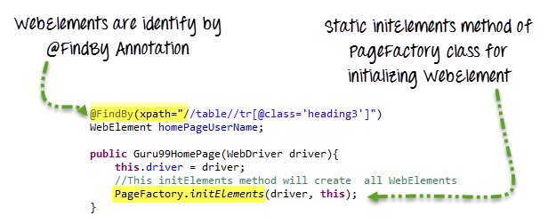
Page Factory - Annotation
We use annotations @FindBy to find WebElement. We use initElements method to initialize web elements
@FindBy can accept tagName, partialLinkText, name, linkText, id, css, className, xpath as attributes

Slide 15
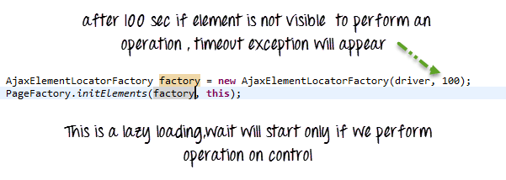
AjaxElementLocatorFactory
It is working on lazy loading concept, i.e. a timeout for a WebElement will be assigned to the Object page class with the help of AjaxElementLocatorFactory .
Here, when an operation is performed on an element the wait for its visibility starts from that moment only. If the element is not found in the given time interval, Testcase execution will throw 'NoSuchElementException' exception.

Slide 16
Page Factory - Summary
Page Object Model is an Object Repository design pattern in Selenium WebDriver.
POM creates our testing code maintainable, reusable.
Page Factory is an optimized way to create object repository in POM concept.
AjaxElementLocatorFactory is a lazy load concept in Page Factory pattern to identify WebElements only when they are used in any operation.

Slide 17
Page Factory Exercises
Convert the project in to a page factory model
Use the page factory different locators

Slide 18
Exercises
.
Find the script to navigate certificate navigation error
Use all 3 types of waits in a flow to synchronize the automation execution flow
Various capabilities in IE and Chrome
Save screenshots in the order of time in a folder
List the number of similar elements in a web page and print its content
Notes:
Gherkin’s grammar is defined in the Treetop grammar that is part of the Cucumber codebase. The grammar exists in different flavours for many spoken languages (60 at the time of writing), so that your team can use the keywords in your own language.

Slide 19
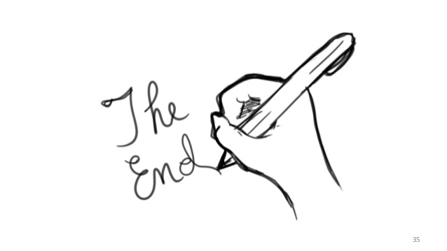
Lets Conclude and see you in next session

Slide 20


