Slide 1

SELENIUM – Day 9, 10, 11 & 12

Slide 2
INDEX
MAVEN
Jenkins
GIT

Slide 3
Maven
OUTLINE:
What is Maven
Maven Build Lifecycle and basic phases

Slide 4
Maven
Maven is a build tool, It is a software project management tool which provides new concept of project object model (POM).
Maven increases reusability and takes care of most of build related tasks. It helps in bypassing my steps like adding jars to the project library, building reports
Maven Local Repository - This is the place where Maven stores all the project jars files or libraries or dependencies. By default the folder name ‘.m2‘
Maven Central Repository - Maven central repository is the default location ‘http://mvnrepository.com/‘ for Maven to download all the project dependency libraries.
Maven Dependency:
<dependency>
<groupId>org.seleniumhq.selenium</groupId>
<artifactId>selenium-java</artifactId>
<version>2.43.1</version>
</dependency>

Slide 5
Maven - Build Life cycle
The sequence of steps which is defined in order to execute the tasks and goals of any maven project is known as build life cycle in maven.
Basic list of phases:
compile - compile the source code of the project
test - test the compiled source code using a suitable unit testing framework. These tests should not require the code be packaged or deployed
Verify - run any checks on results of integration tests to ensure quality criteria are met
install - install the package into the local repository, for use as a dependency in other projects locally
Sample Maven command to execute:
clean compile test
In a build environment, use the following call to cleanly build and execute the test.
.

Slide 6

Maven Exercises
Create a new maven project and download the dependencies
Find the dependencies version that we have used in maven online repo and create a maven project
Execute the project using maven commands from command line and from eclipse
Run the project for clean, clean and test, test, compile and provide observations

Slide 7
Jenkins
Terminology
Job – Work for a project
View – Collection of jobs
Master – Central Jenkins, where job scheduling happens
Slave – Executes one or more jobs within slot
Workspace – Working area

Slide 8
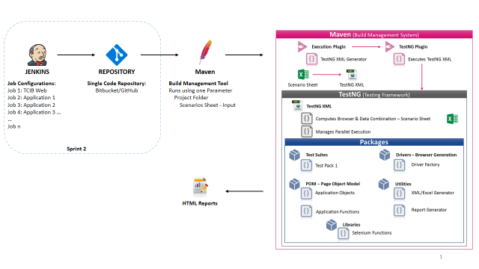
Automation - Architecture

Slide 9
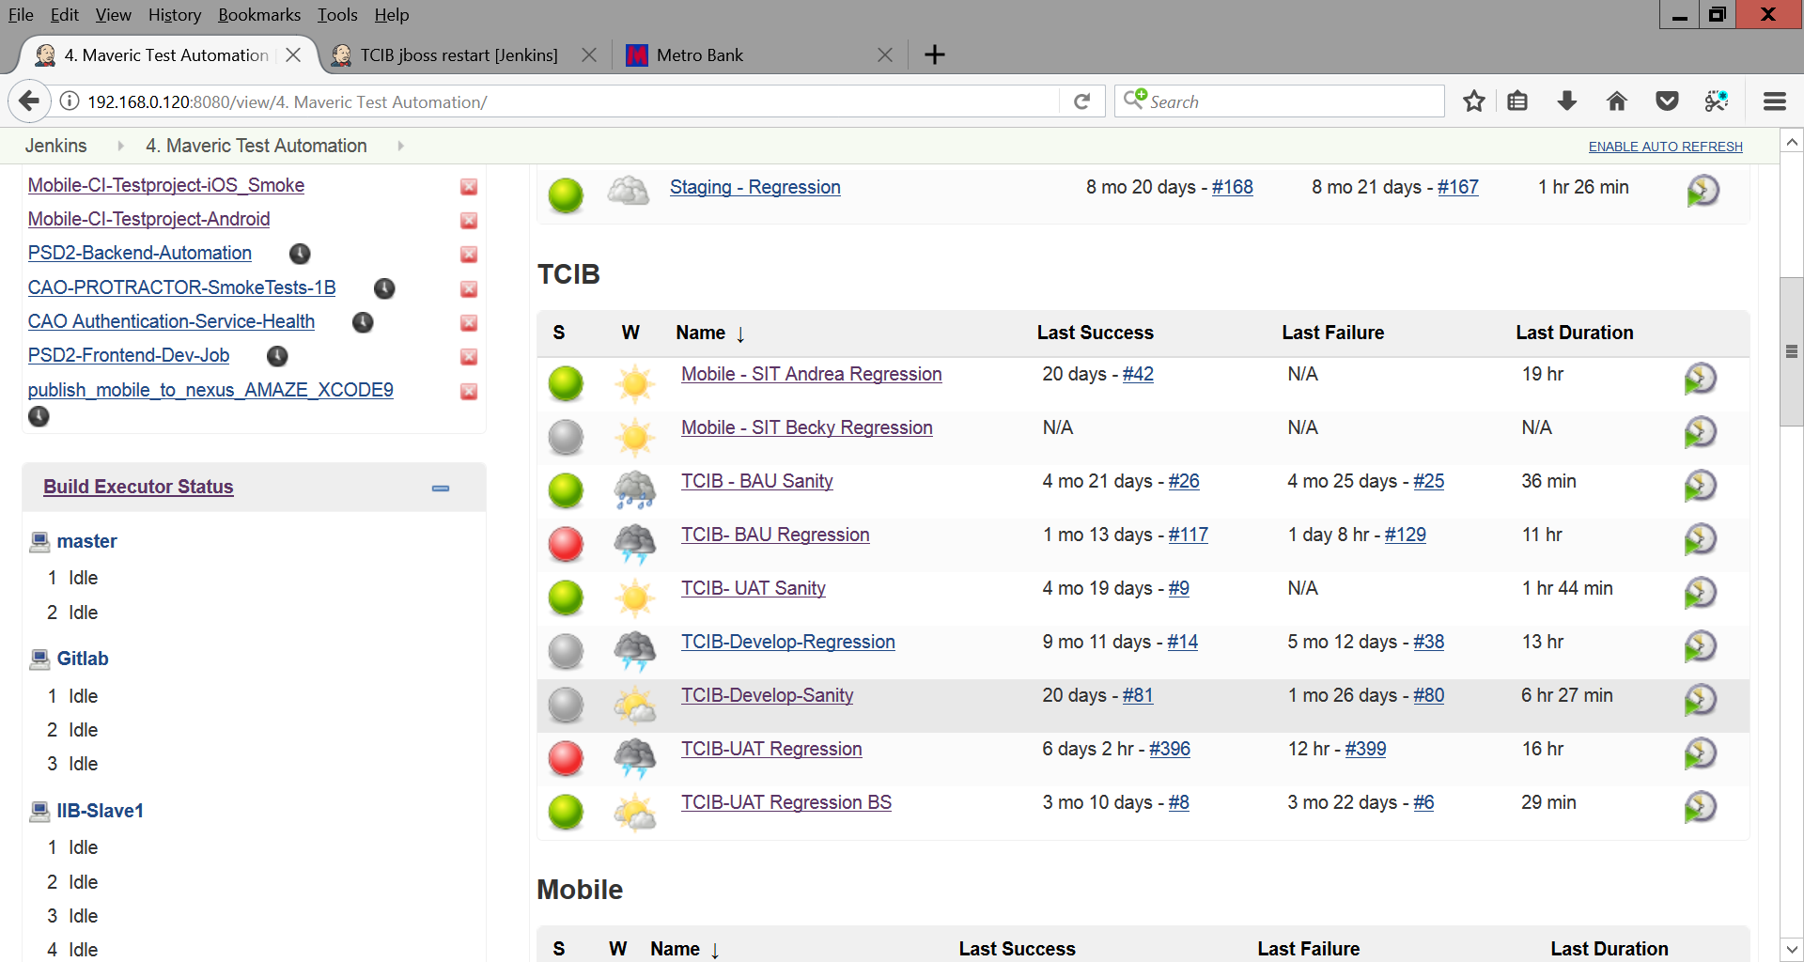
Automation – Jenkins
Jenkins
Sanity and Regression Jobs
Different environments like DEV, UAT, BAU, Mobile SIT Andrea and SIT Becky
Automatic Triggering based on build and time
For eg(every day 00:12:23 AM …)

Slide 10
Jenkins – Overview
Jenkins
Building, Testing and Deploying Softwares
Change Support – Repo like SVN, Git, Bitbucket..
Email Integration – Status of the build
Easy Configuration.
Continuous Integration(CI) – Tools
Code Repositories
SVN, Mercurial, Git
Continuous Build Systems
Jenkins, Bamboo, Cruise Control
Test Frameworks
JUnit, Cucumber, CppUnit
Artifact Repositories
Nexus, Artifactory, Archiva

Slide 11
GIT
OUTLINE:
What is GIT
What is VCS ( Version Control System)
Benefits of GIT
Basic GIT commands

Slide 12
GIT :
GIT is a most popular “Version Control System” developed by “Linus Torvalds”
Version control system is a kind of database where every change made in the code is recorded and tracked, along with
Who made the change
Why the change was made
GIT helps you to record the changes that we made to our software where we can recall at anytime and analyze it
Irrespective to Geographic locations, developers/testers from different locations can use and conflicts are saved/recorded
GIT provides us a stable code base and keeps our previous version of our codes safe
GIT is an Open Source Distributed Version Control System. It is designed for
Speed
Simplicity
Fully Distributed
Excellent support for parallel development, support for hundreds of parallel branches.
Integrity

Slide 13
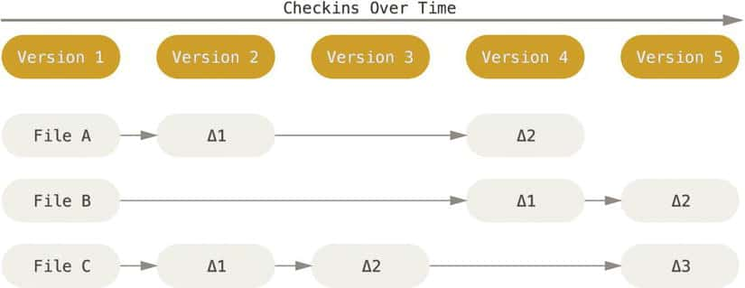
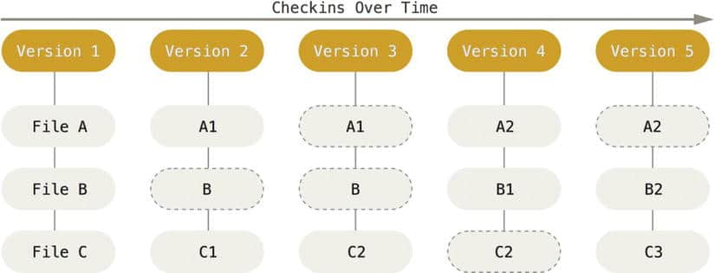
GIT ( Continued )
Here we can see how GIT works:
Version control systems store the difference between the two versions
Here ‘File A’ has been changed three times. The other system stores the changes to given file over time.
GIT on the hand stores the “SNAPSHOT” of the changed file. If the file has not changed between two versions, GIT will keep a reference of the original file instead of copying it again in the new version

Slide 14
GIT ( Benefits ):
Performance: Committing, branching and merging
Security : With Cryptographic method SHA-1
Branching Model : Context switching, role- based code and disposable experimentation
Staging Area: Formatting and Modifications
Distributed: Repository or complete code base is mirrored
Open Source : Contribution from developers globally make the software more powerful through features and additional plugins

Slide 15
GIT ( Basic Commands) :
Command name | Command | Description
Clone | git clone ssh://git@github.com/[username]/[repository-name].git | Create a local copy of a remote repository
Branching | git branch git branch -a | List branches (the asterisk denotes the current branch) List all branches (local and remote)
Merging | git merge [branch name] git merge [source branch] [target branch] | Merge a branch into the active branch Merge a branch into a target branch
Push | git push | Push changes to remote repository (remembered branch)

Slide 16
GIT Basic Commands ( Continued )
Command name | Command | Description
Pull | git pull git pull origin [branch name] | Update local repository to the newest commit Pull changes from remote repository
Commit | git commit -m "[commit message]" | Commit changes
Tags | git tag 1.0.0 <commitID> | You can use tagging to mark a significant change set, such as a release

Slide 17
GIT Exercises
1. Convert the existing project into a git project
2. Create a repository in Github
3. Commit and push new codes to local repo and online repo
4. Create new branches in the online repo
5. Clone a different user project from git
6. Create a version of the project in git

Slide 18

Demo of the Following
Configuring a maven project in Jenkins and triggering an execution
Connecting a git project to Jenkins and triggering execution
Directing an execution to different systems and cloud services
Parallel execution in cloud or physical machines
Connecting a report jar in to the project and extracting reports

Slide 19

Lets Conclude and see you in next session

Slide 20


