Slide 1






Data - The perfect middleware
Raja Kumaravel
Technical Architect
https://www.linkedin.com/in/rajakumaravel

Slide 2

Agenda
What is the BizTalk?
Prerequisites of BizTalk
BizTalk Demo using message based scenario
BizTalk Demo using Orchestration based scenario
Q & A
Twitter @GABChennai

Slide 3
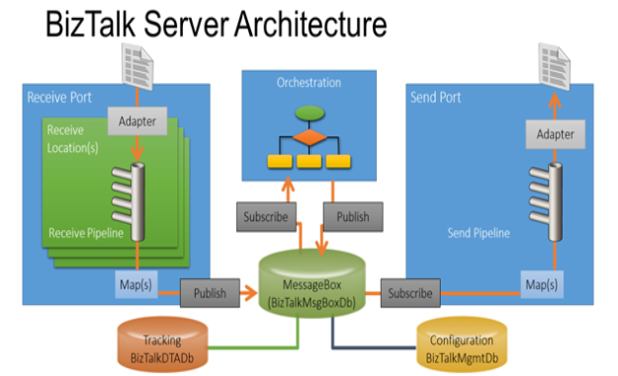
BizTalk Server Architecture
The BizTalk Server runtime is built on a publish/subscribe architecture, sometimes called "content-based publish/subscribe". Messages are published into BizTalk, transformed to the desired format, and then routed to one or more subscribers.

Slide 4
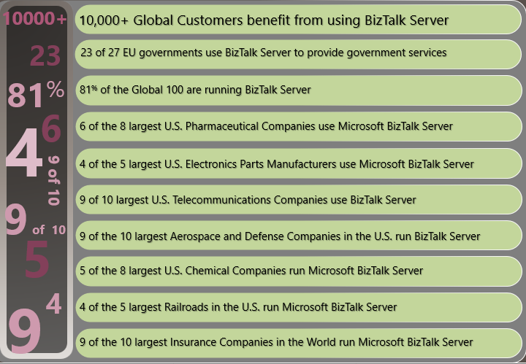
Who uses BizTalk Server?
BizTalk is an Inter-Organizational Middleware System (IOMS) that enables companies to automate business processes, through the use of adapters which are tailored to communicate with different software systems used in an enterprise.

Slide 5
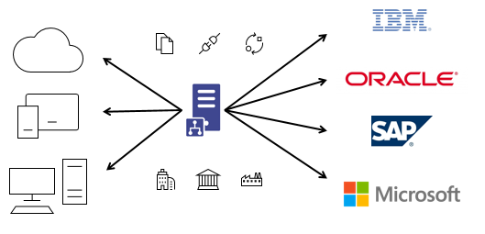
What does BizTalk Server do?
BizTalk is a message conversion system. You give it MessageA and it converts it to MessageB. For example, if MessageA is an EDI (Electronic Data Interchange) message, then BizTalk is able to easily read the message and convert it into just about any other message type such as an XML document (MessageB).

Slide 6
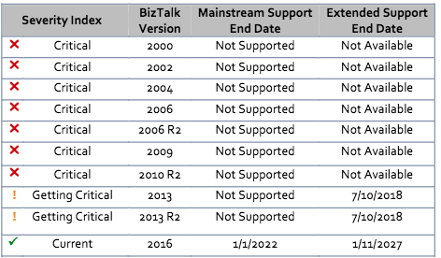
BizTalk 2016 support Lifecycle
If you are using 2013R or earlier – it’s time to investigate an upgrade.
BizTalk Server 2016 Feature Pack 1(Application Insights and Power BI integration; Swagger-compatible REST APIs)
BizTalk Server 2016 Feature Pack 2 (Azure integration)
BizTalk Server 2016 Feature Pack 3 (Office 365 integration)

Slide 7
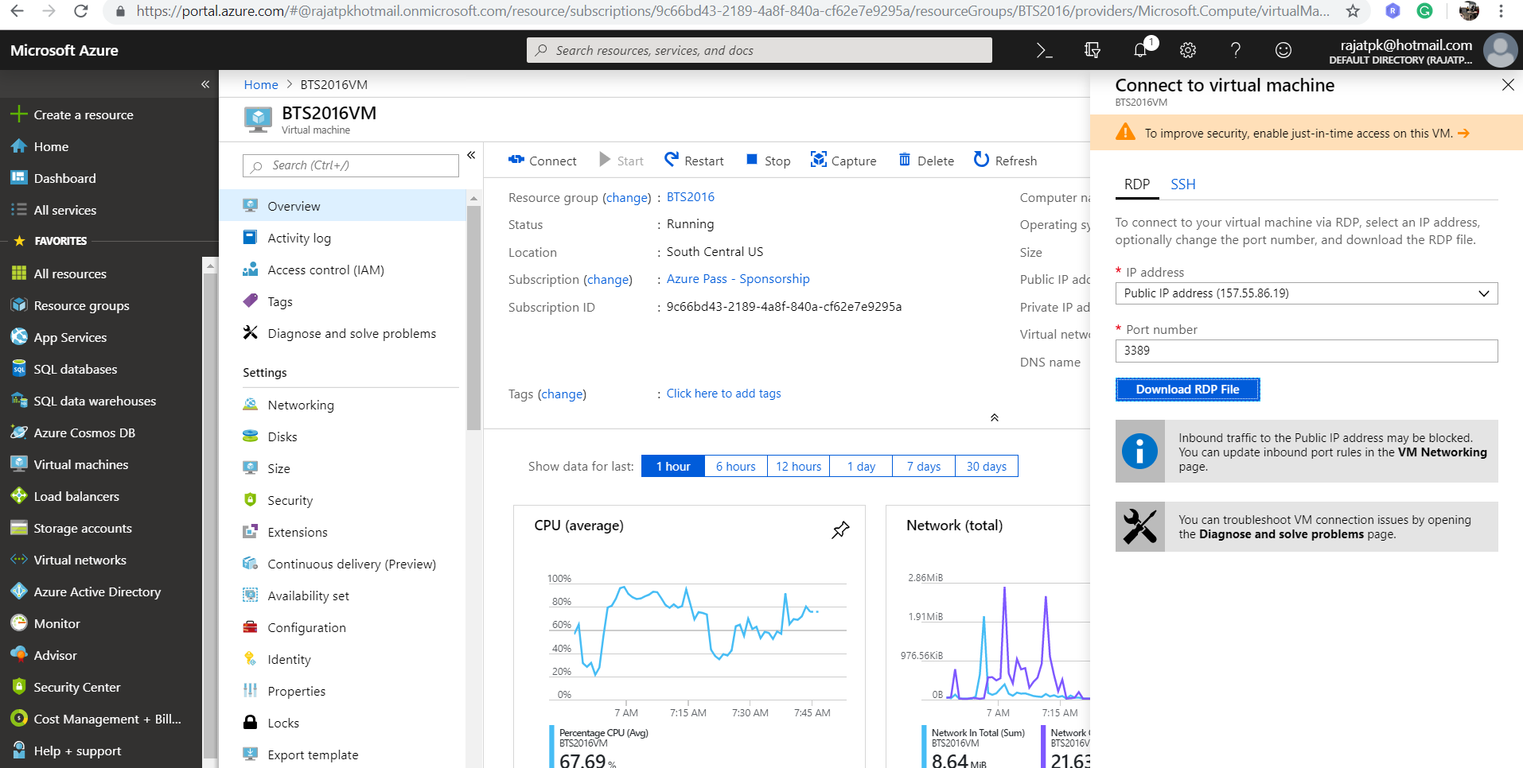
BizTalk 2016 on Azure

Slide 8
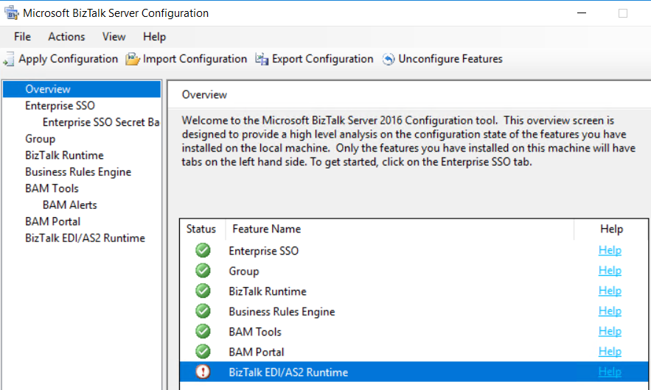
BizTalk 2016 Configuration Screen
Configure BizTalk Server using basic configuration or custom configuration.

Slide 9
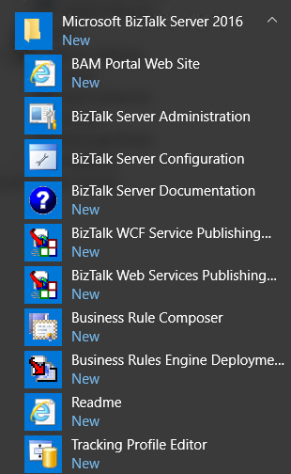
BizTalk 2016 after Installation

Slide 10
BizTalk Server Services
Services are:
1. BizTalk Service BizTalk Group:<BizTalkServerApplication>
2. Enterprise Single Sign-On Service
3. Rule Engine Update Service

Slide 11
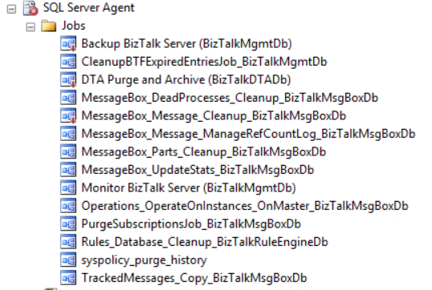
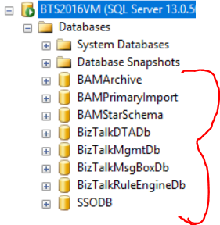
SQL Server 2016 AlwaysOn Availability Groups
With SQL Server 2016, MSDTC support has been added to availability group, providing the way for BizTalk to support it.

Slide 12
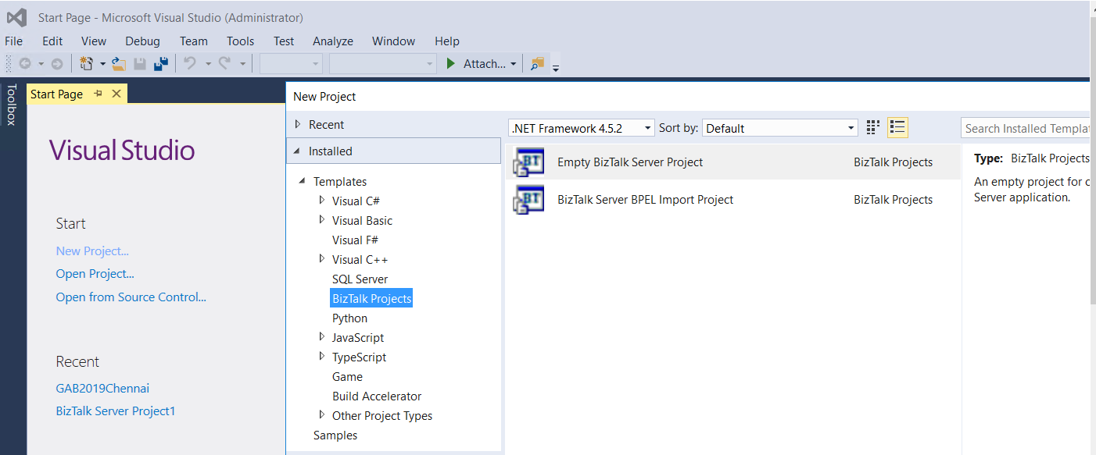
Visual Studio 2015
Ability to create BizTalk Application in .NET Framework 4.6.x. If you write lots of .NET components such as pipeline components and other C# components you can use latest .NET framework features

Slide 13
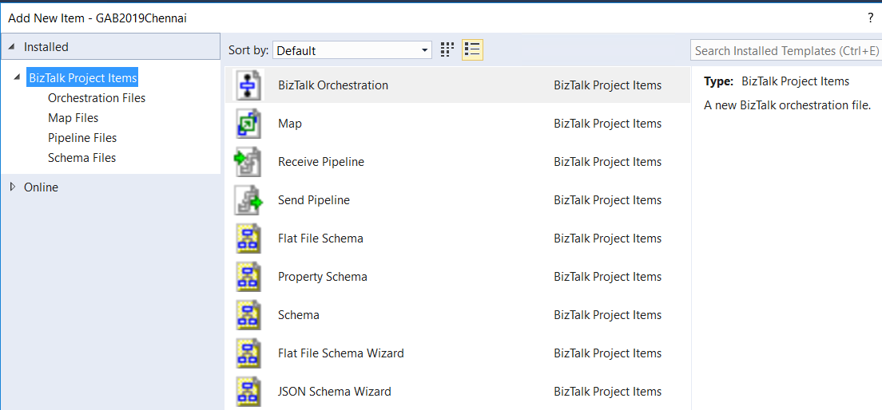
BizTalk Artifacts in VS 2015
we can use the BizTalk project system to create, organize, and configure BizTalk solutions in the Microsoft Visual Studio environment.

Slide 14
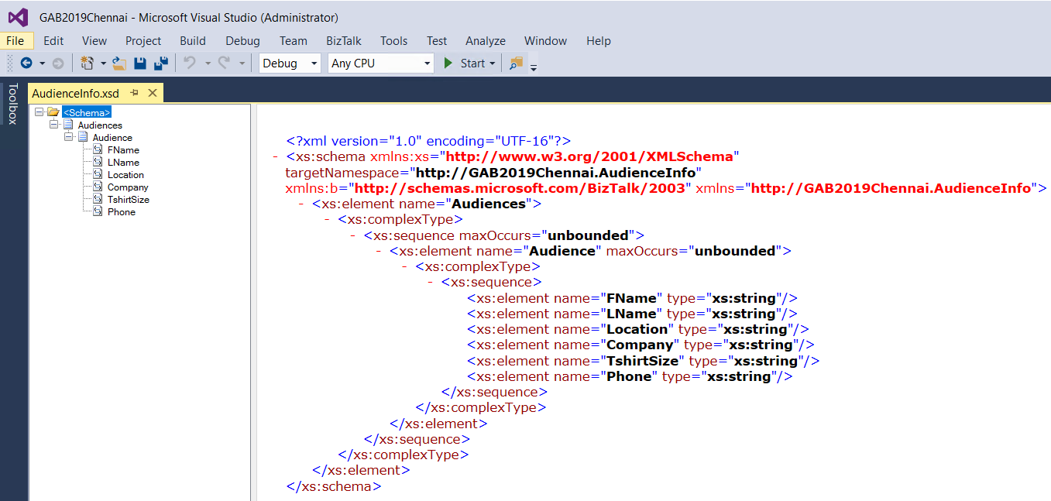
Source Schema
BizTalk uses the XML Schema definition (XSD) language to define the structure of all messages that it processes.

Slide 15
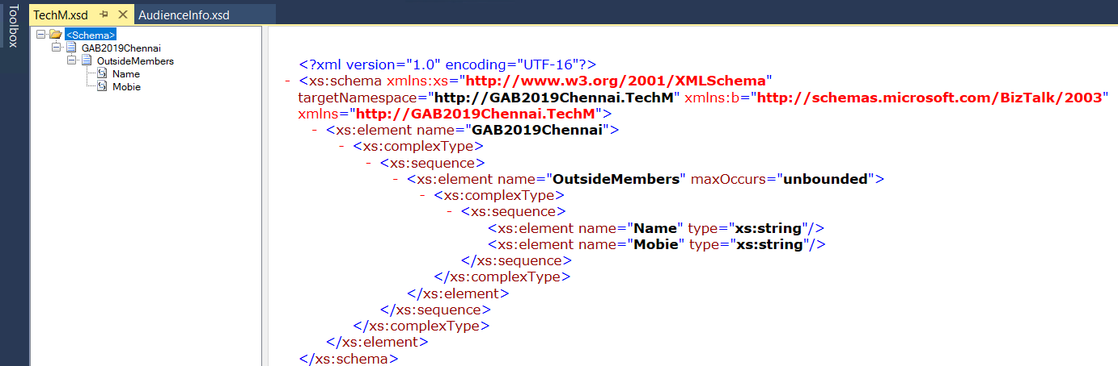
Target Schema
These structured messages can take any form, large or small, and target a wide array of back-end systems and data stores.

Slide 16
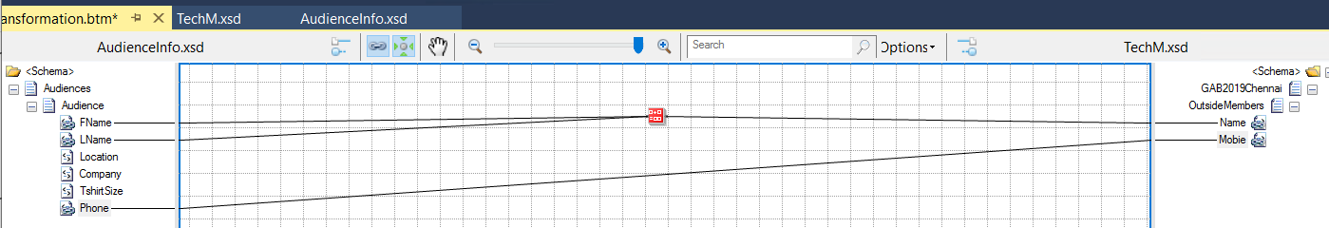
BizTalk Mapper
Using BizTalk Mapper, you define the relationship between an input and an output schema by using links and functoids.

Slide 17
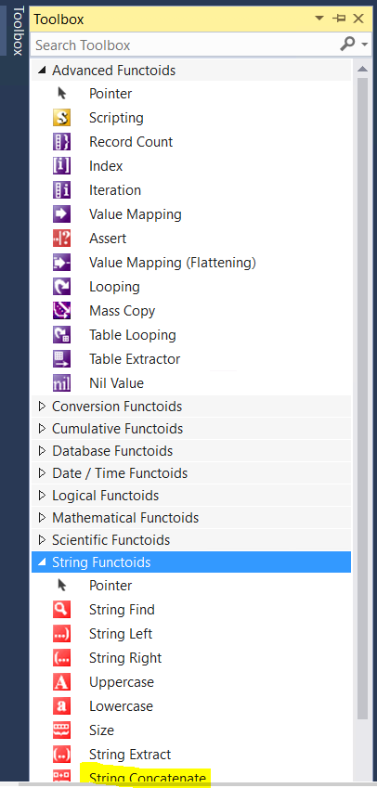
Functoids in Map
For example, the Record Count functoid
returns the total count of a looping
record in an instance message.

Slide 18
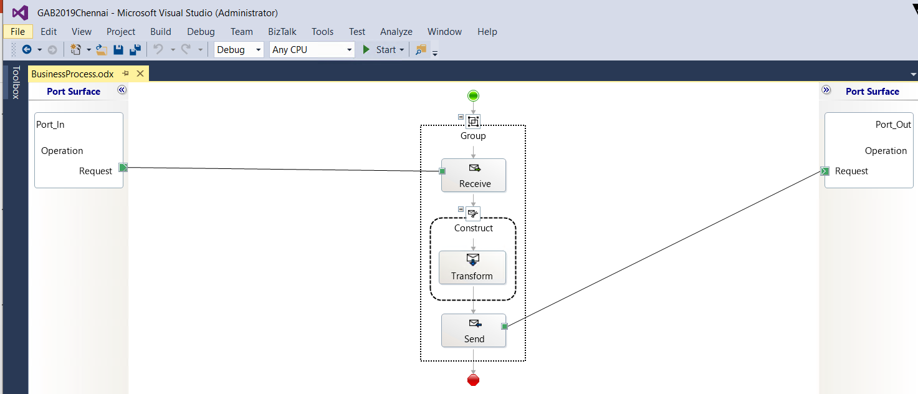
Orchestration
Orchestration is the executable code to run a workflow supporting a business process.

Slide 19
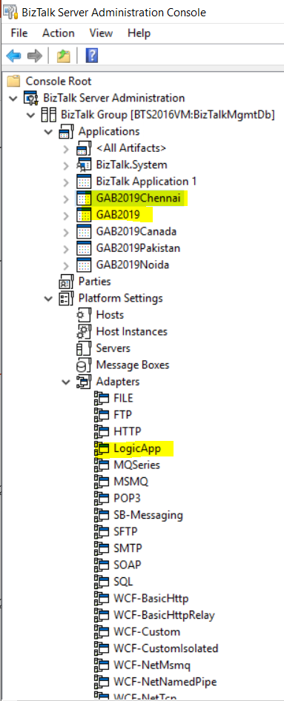
BizTalk 2016 Admin Console
The BizTalk Server Administration
console is the primary management
tool for BizTalk Server.
Only 7 applications are allowed in
Developer edition.

Slide 20
Q&A
Questions?

Slide 21
Thank you.
Raja Kumaravel
Technical Architect,
Encore
https://www.linkedin.com/in/rajakumaravel

