Slide 1
Technology selection Vehicle fitness TEST

Slide 2
Technology Options
Vehicle Fitness: Decision Matrix
Si.no | Technology choice | Details
1 | Web Applications | Website which can work OS independent using js, angular, node js etc
2 | Stand alone device | 32bit uP with on board Linux with LCD screen and OBD interface
3 | Mobile / Tablet Application | Android / iOS Application that can run on mobile / Tablet
4 | OCR / OMR | Optical Mark reading using template and pencil marking of MCQ ( Multiple choice Questions)

Slide 3
Technology selection using Pugh Method
Vehicle Fitness: Decision Matrix
Si.no | Features | Weight | Manual Method (Classic) | Web Applications | Stand alone device | Mobile / Tablet Application | OCR / OMR
1 | Field operation (Handy) | 5 | 0 | 2 | 4 | 4 | 1
2 | Intelligence Reduce human effort | 5 | 0 | 3 | 5 | 5 | 0
3 | Safety / security | 5 | 4 | 5 | 4 | 4 | 5
4 | Scalability | 5 | 0 | 4 | 3 | 4 | 4
5 | Operational cost | 5 | 0 | 4 | 0 | 5 | 2
7 | Total |  | 4 | 19 | 16 | 22 | 12

Slide 4
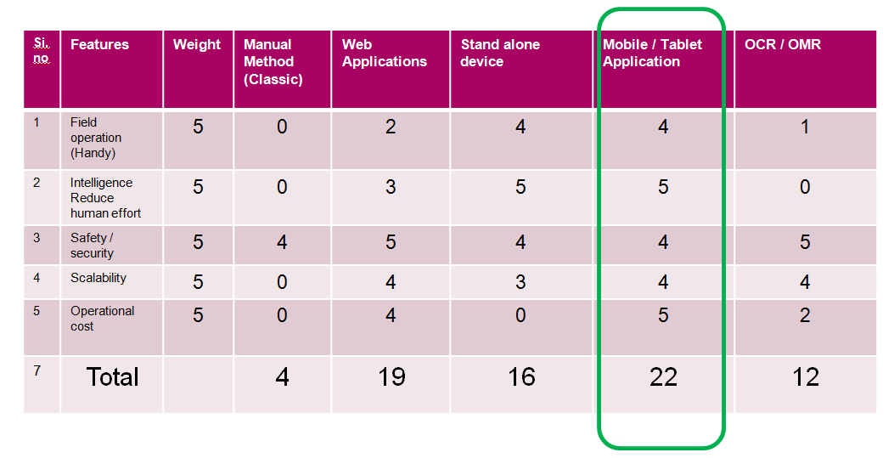
Technology selection using Pugh Method
Vehicle Fitness: Decision Matrix
Finalized technology:
Mobile app using Android or iOS

Slide 5
Oracle Server
Mobile Application
API management system
Encrypted
source file
Python application
-> AI/ML for image, video, sound , behaviour
-> Tensorflow
-> Open CV
-> MRCNN
-> tesseract
-> pydub
File storage
Database

