Slide 1
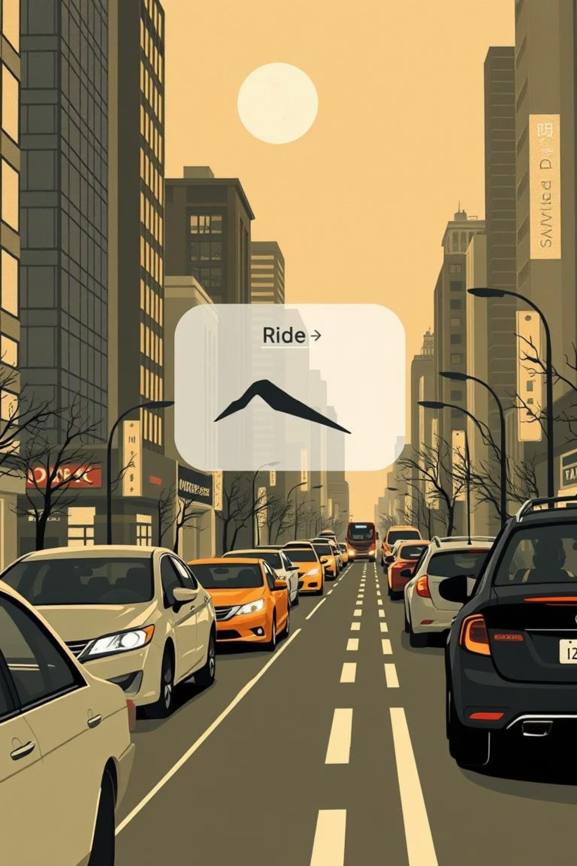
Ola Data Analyst Project – End-to-End Analysis
This project presents an end-to-end analysis of a 100,000-row Ola ride dataset from Bengaluru over one month. Key objectives include analyzing ride patterns, cancellations, revenue, and customer/driver behavior, utilizing various data points like booking value, distance, and ratings.

Slide 2




Essential Tools for Data Mastery
We used powerful tools to transform raw data into actionable insights.
Excel
Data cleaning & analysis
MySQL
Efficient querying
Power BI
Interactive dashboards

Slide 3
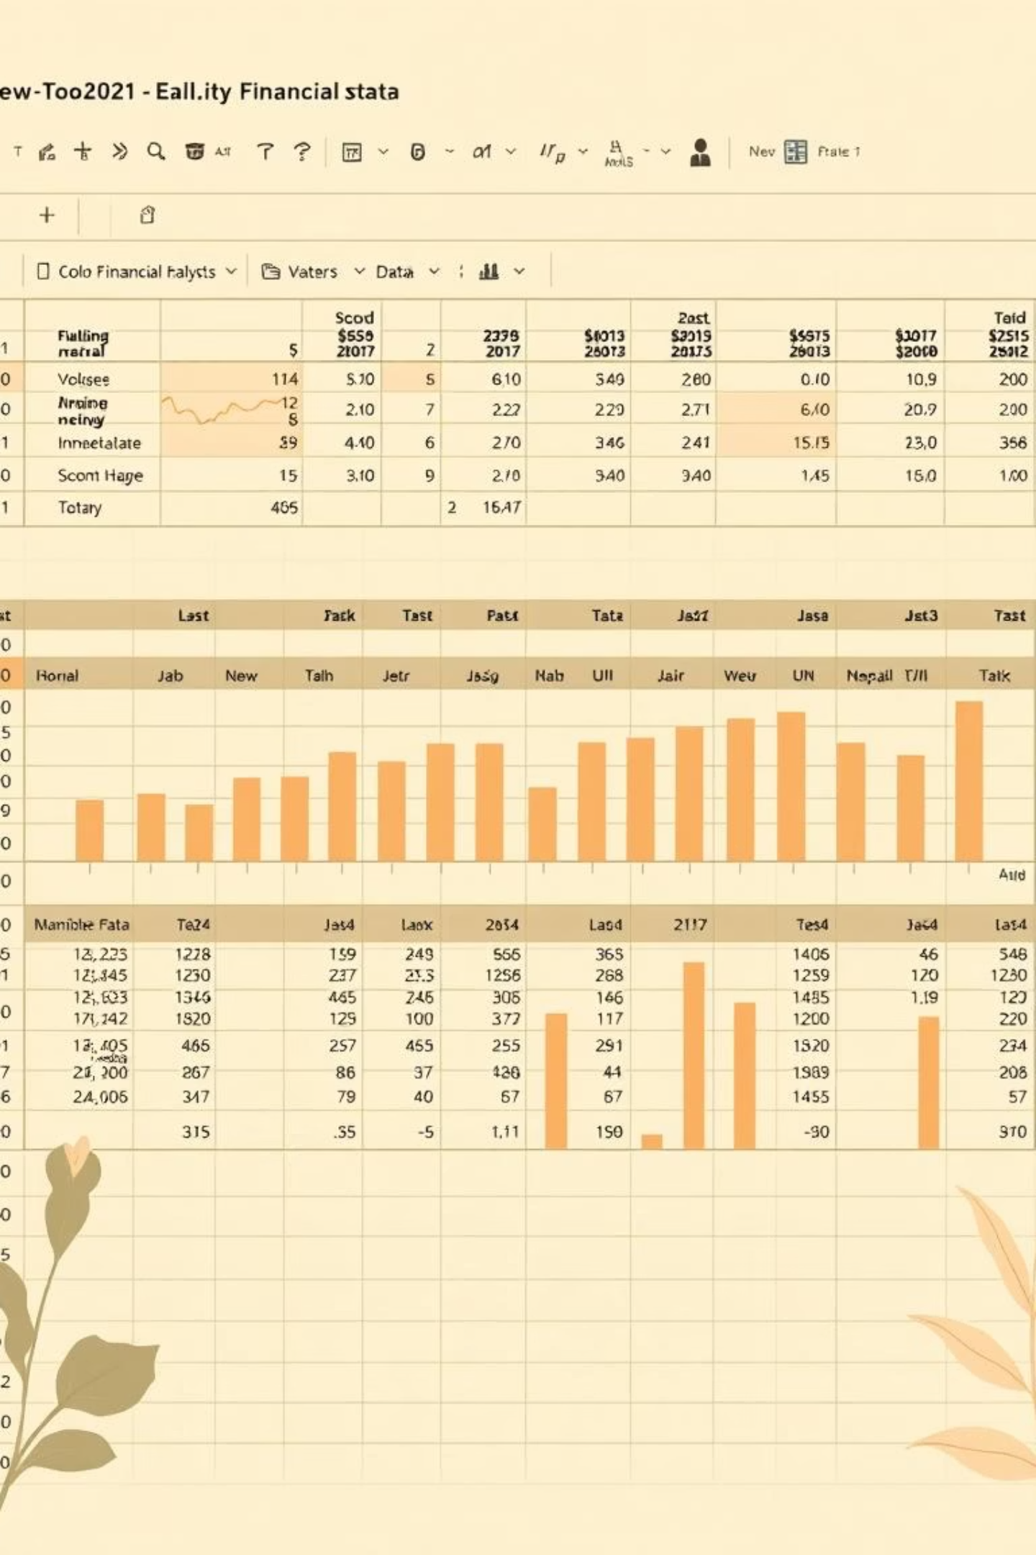
Deep Dive: Statistical Analysis in Excel
Descriptive Statistics
Analyzed Booking Value & Ride Distance.
Correlation Insights
Identified relationship between ride distance & booking value.

Slide 4
MySQL: Unlocking Data with SQL Queries
Our analysis relied on precise SQL queries to extract critical information from the dataset, enabling a detailed understanding of ride operations and performance.
Successful Bookings
Avg. Ride Distance
Retrieved all completed ride records by filtering for ride_status = 'completed', identifying the core operational volume.
Calculated the average ride distance for each vehicle_type using AVG(distance) GROUP BY vehicle_type to assess efficiency.
Cancelled Rides
Top 5 Customers
Counted total cancelled rides by customer_id and driver_id where ride_status = 'cancelled' to pinpoint cancellation sources.
Identified the top 5 customers with the highest ride volume using COUNT(ride_id) GROUP BY customer_id ORDER BY count DESC LIMIT 5.
Driver Ratings
Successful Booking Value
Determined the maximum and minimum driver_rating specifically for Prime Sedan vehicles to evaluate segment performance.
Aggregated the total booking_value for all successful rides using SUM(booking_value) WHERE ride_status = 'completed' to determine overall revenue.

Slide 5
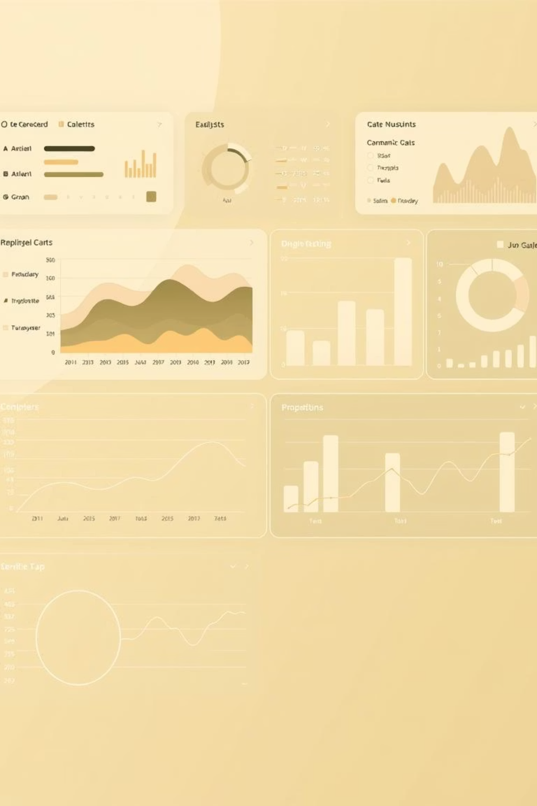
Power BI: Dynamic Insights with DAX
DAX functions in Power BI were instrumental in creating dynamic measures and interactive reports.
Revenue Calculation
Using CALCULATE(SUM()) for accurate totals.
Avg. Customer Rating
Broken down by vehicle type.
Time Intelligence
Analyzed daily ride counts & YTD trends.
Customer Ranking
Identified top 5 by booking value.

Slide 6



Key Insights: Ride Volume & Status
Ride volume spikes on weekends and during major events, indicating higher demand for leisure and special occasions.
18%
7%
62%
Driver Cancellations
Customer Cancellations
Overall Success Rate
Significant driver impact.
Low customer initiated.
Rides completed.

Slide 7



Key Insights: Vehicle Performance & Distance
Different vehicle types contribute uniquely to revenue and ride volume.
Prime Sedan & SUV
Auto & Bike
Avg. Distance Variation
Higher revenue per ride, premium service.
High ride volume, lower value per trip.
Significantly varies by vehicle type, impacting revenue.

Slide 8



Key Insights: Customer & Driver Ratings
Ratings provide crucial feedback on service quality and customer satisfaction.
4.2
4.5
Prime Sedan Rating
Driver Consistency
High customer satisfaction.
Generally stable ratings.
5
Value-Rating Link
Higher booking value correlates with better ratings.

Slide 9

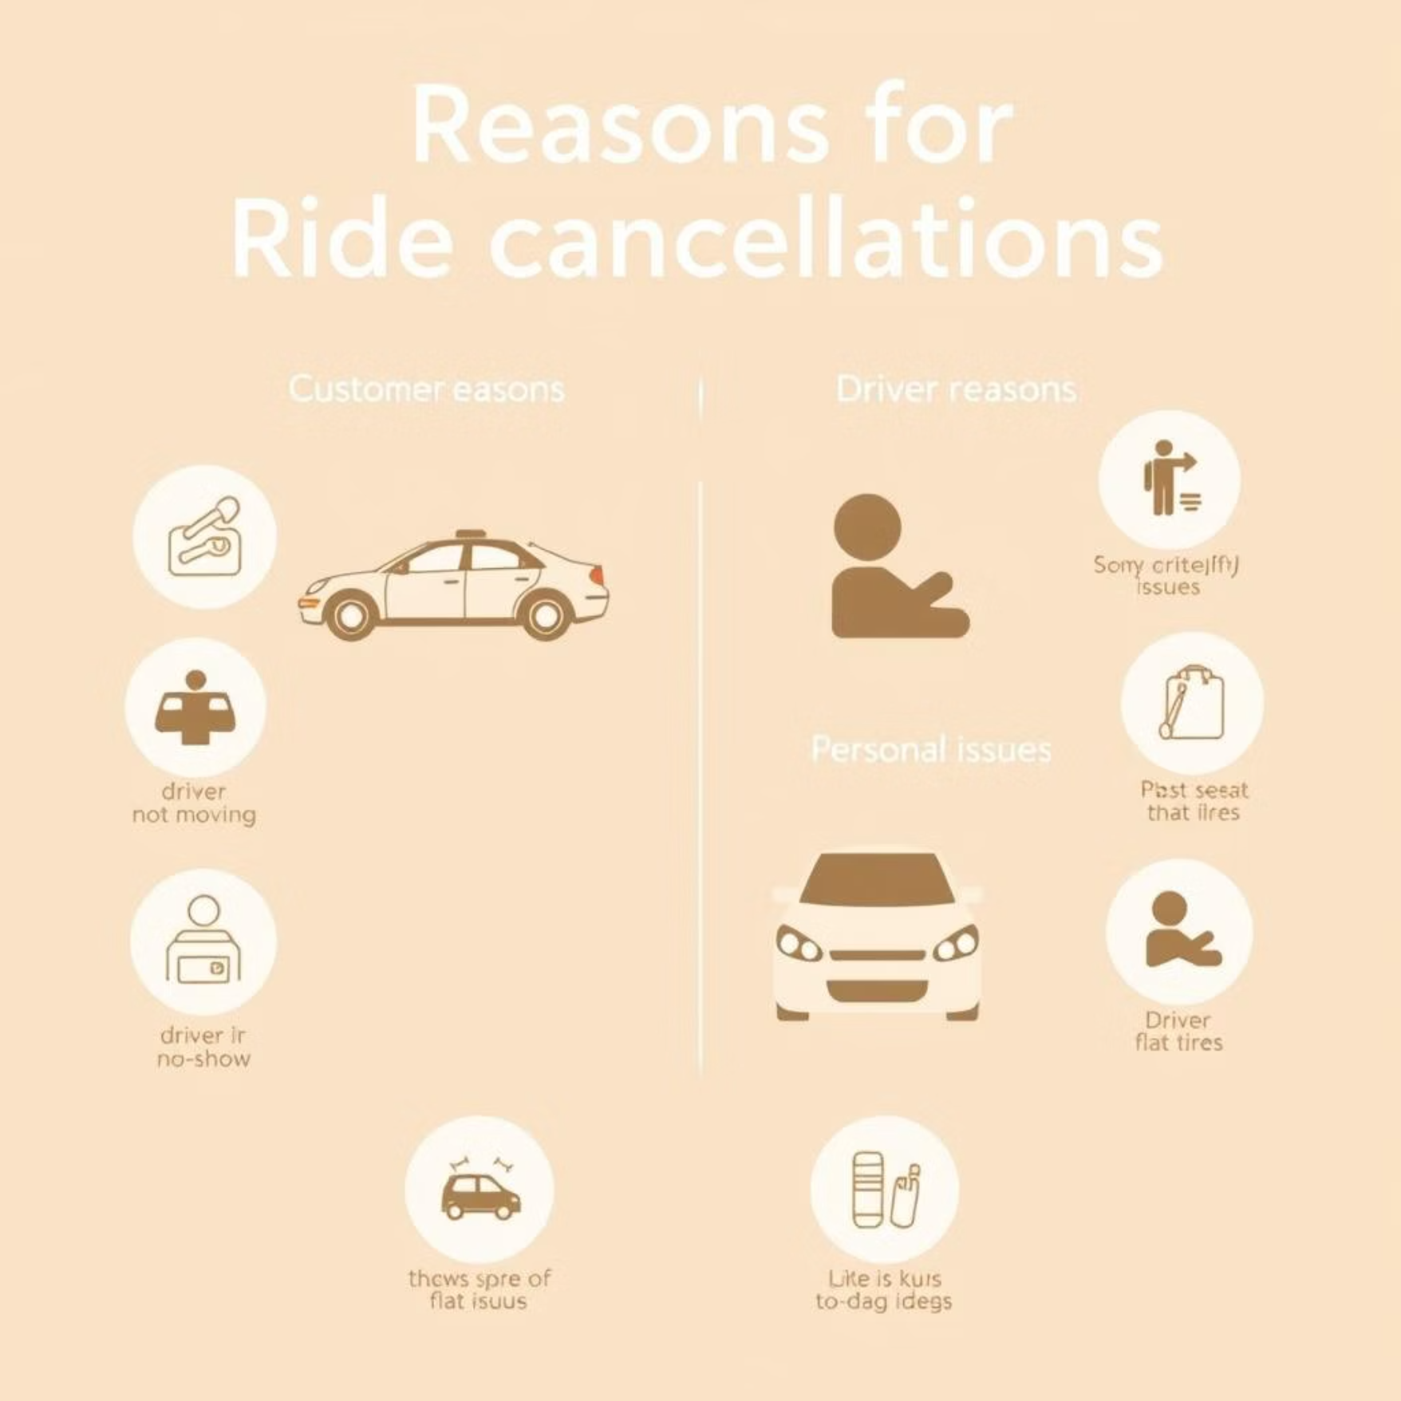
Revenue Drivers & Cancellation Factors
Understanding revenue streams and cancellation root causes is vital for business optimization.
Top Payment Methods: UPI and Cash dominate transactions.
Key Cancellation Reasons:
Customers → “Driver not moving towards pickup” most common
Revenue Concentration: The top 5 customers contribute significantly to overall revenue.
Drivers → “Personal & Car related issues” highest share

Slide 10
Strategic Recommendations for Growth
Implementing these recommendations can significantly improve service quality, reduce cancellations, and boost revenue, leveraging insights from our ride volume, cancellation factors, vehicle performance, and customer data.
Enhance Driver Reliability
1
Introduce a tiered incentive program for drivers maintaining a cancellation rate below 5% and provide access to discounted car maintenance services to address "Personal & Car related issues" which contribute heavily to driver cancellations.
Optimize Customer Ride Tracking
2
Improve the real-time GPS accuracy and communication features within the app. Implement automated notifications for customers when a driver's ETA changes or if a driver isn't moving for more than 2 minutes at the pickup location, directly addressing the "Driver not moving towards pickup" cancellation reason.
Boost Premium Vehicle Utilization
3
Launch targeted promotions, such as discounted first rides or loyalty point bonuses, for Prime Sedan and SUV bookings during peak hours to capitalize on their higher revenue per ride and increase their overall market share.
Cultivate Customer Loyalty
4
Develop a structured loyalty program with exclusive benefits (e.g., discounted rides, priority booking, dedicated support) for the top 5% of customers, who significantly contribute to overall revenue and show higher booking values.
Incentivize UPI Payments
5
Offer small, immediate cashbacks (e.g., ₹5-₹10) or exclusive partner discounts for rides completed using UPI, aiming to further increase the adoption of digital payments and improve transaction efficiency, building on UPI's already strong presence.

