Slide 1
J2EE

Slide 2
Introduction to J2EE Platform
Java is a mature programming languages which can be used to develop enterprise applications.
Over the years, java has been evolved from running small applets on the web browser to large enterprise distributed application run on multiple servers.
Java has three different platforms. They are
J2SE – can create client applications with GUI, database access, directory access, CORBA,RMI and many other functions.
J2EE – platform for building server side components may be web component or EJB component.
J2ME – platform for building applications for micro devices with limited display and memory requirements
J2EE provides a powerful way for developing Multi-tiered web applications.
It uses distributed application model for enterprise applications.

Slide 3
Technologies used in J2EE
Java Servlets,
JSP
EJB,
JMS,
JNDI,
JDBC,
Java Mail API,

Slide 4
Advantages of J2EE
Simplify the structure
It simplifies the component based development
It is based on J2SE so it has a support of Write once run anywhere portability
Follows the standard server model
Support heterogeneous environment
Improve development efficiency
Since it uses the component based technology, application can develop parallel.
Portability

Slide 5
Advantages of J2EE (cont’d)
Reusability
Since the applications are developed as component so that it can be reused in any of the target application that needs that services.
Ease of maintenance
Component based design simplifies maintenance of the application.
Components can be updated independently
New features can be increased easily.
Scalability
Any number of customers can access the component.

Slide 6
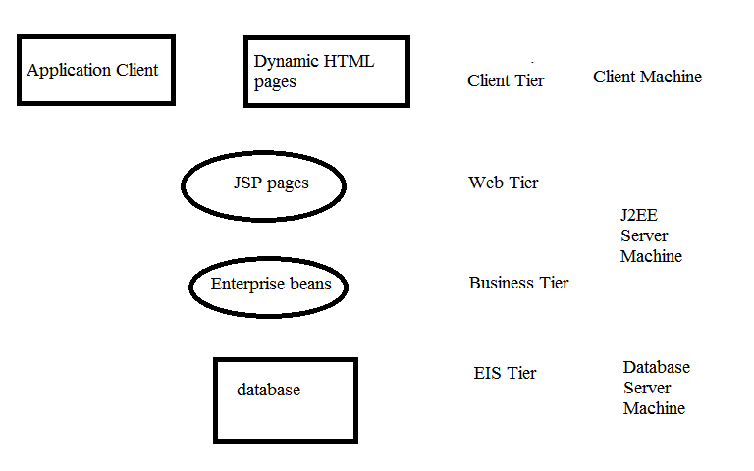

Slide 7
ENTERPRISE ARCHITECTURAL STYLES
Single tier architecture
Two tier architecture
Three tier architecture
N-tier architecture

Slide 8
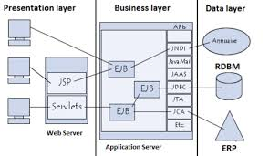
J2EE Architecture

Slide 9
CONTAINERS IN J2EE ARCHITECTURE
Applet Container – applet can be embedded with html
Application Container – classes, libraries and other files
EJB Container – executes EJB components and the container maintains the state, transaction and connection pooling
Web Container – executes the web components such as jsp and servlet.

Slide 10
J2EE TECHNOLOGIES
Component technologies
Services technologies
Communication technologies

Slide 11
MVC Architecture
The model view controller architecture is used to create a web application which separates the development part of an application from the design part of the application.
Basically the MVC has two approaches.
MVC1
MVC2
Model view controller architecture has three layers
Model layer =
Business logic +presentation logic
Like accounts officer
Uses Java Class(Java Bean)

Slide 12
MVC Architecture (Cont’d)
View Layer =
Presentation logic
Like beautician
Uses JSP, HTML
Controller Layer =
Controller logic
Like traffic police
Uses servlet

Slide 13
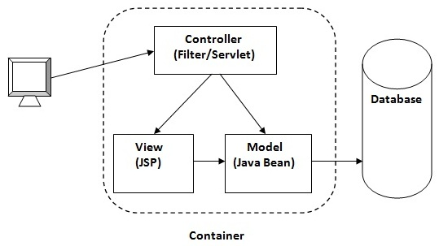
MVC 2 Architecture

Slide 14
Workflow of MVC 2 Architecture:
- Browser window gives request to web application.
- The controller servlet program traps and takes the request, reads the request data and performs validations.
- Controller servlet uses the integration logic to communicate with model layer.
- The model layer resource processes the request and also interacts with backend software by using persistence logic.
- The business logic generated results comes to the controller servlet program.
- The servlet program uses the logic to send the results to the view layer JSP program.
- Servlet program uses presentation logic and sends formatted result to browser window as a web page

Slide 15
N-Tier Application development
To develop the application there are two sides of programming.
Client side programming
Server side programming.
Though it is technically feasible to implement almost any business logic using client side programs, logically or functionally it carries no ground when it comes to enterprise applications (e.g. banking, air ticketing, e-shopping etc.). To further explain, going by the client side programming logic; a bank having 10,000 customers would mean that each customer should have a copy of the program(s) in his or her PC which translates to 10,000 programs! In addition, there are issues like security, resource pooling, concurrent access and manipulations to the database which simply cannot be handled by client side programs.

Slide 16
Types of Server Side Programs
Active Server Pages (ASP)
Java Servlets
Java Server Pages (JSPs)
Enterprise Java Beans (EJBs)
PHP

Slide 17
Java Servlets
How the internet works
Internet uses Client/Server technology for its working
The browser is used as the client software and the Web Server as the server software
The user types the required URL in the browser
The IP Address of the Server is found from the URL
The Web Server listens at Port No 80
The browser connects to Port No 80 of the specified Server
Based on the request, the Web Server will deliver the appropriate page to the browser

Slide 18
Java Servlets (cont’d)
HTTP Protocol
Client/Server communication should follow a protocol for its smooth functioning.
Hyper Text Transfer Protocol or HTTP is the protocol used by the Web
According to the HTTP protocol the client should send a request to the server in a special format
Based on the request, the server will send back a response, which again is in a special format

Slide 19
Dynamic Pages
Web contains static as well as dynamic pages
Static page is a page that does not change with user/time
Dynamic Page is a page that changes with user/ time
For delivering a static page, all that is required at the server side is the Web Server and the HTML file
But a dynamic page is not created in advance as an HTML file
So, to have a dynamic page, apart from the Web Server, a program is required to generate the dynamic content
The Web Server itself executes this program
In some cases, we may require an extra software component that can execute this program

Slide 20
What is servlet?
“Servlet is a dynamically loaded module that services requests from a web server”.
To access a servlet you need to compile the file and deploy that class file in a java enabled application server such as J2EE Application Server.
J2EE Application Server contains web container.
Web container manages the various components of web application.
Provides run time environment to run servlet

Slide 21
Web Container
Web container presents in web server/ Application server which is responsible to manage all the servlets.
what is web server?
A web-server that helps to deliver the web content to the client. It contains only web container to process the servlets.
Eg: Tomcat
What is Application server?
Application server which contains EJB container and Web container to process the enterprise bean and servlets.

Slide 22
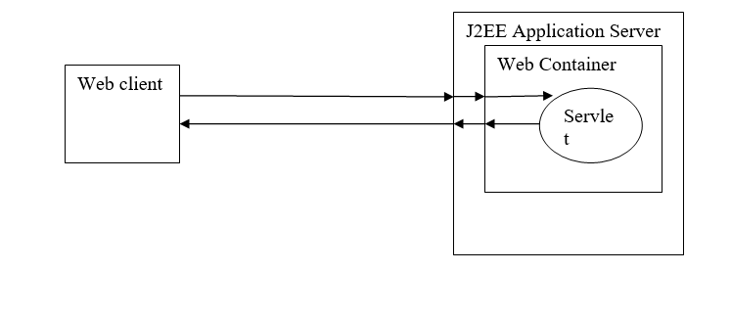
Interaction between application server and web container to process client request

Slide 23
The client sends a request to the application server for a particular servlet.
J2EE Application Server passes them to web container.
Web Container checks whether the requested servlet is exists.
If exists then web container delegates the request to that servlet and send responses back to client.
In case servlet instance does not exist, web container locates and loads the servlet class.
Create instance of the servlet and initializes it.
After initialize process the request.
Passes the generated response by the servlet to client.

Slide 24
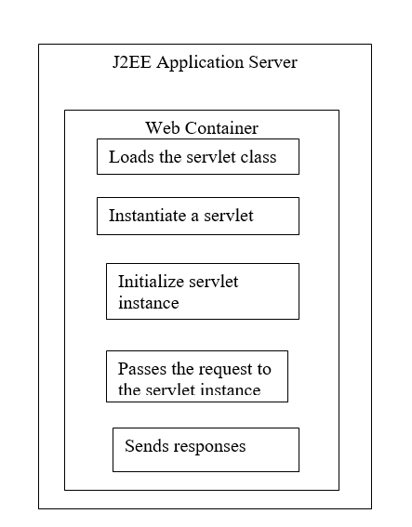
The job of the web-container when client request is received for first time:

Slide 25
SERVLET LIFE CYCLE METHODS
The Servlet Container creates a Servlet object, when it receives the very first request from the client
The Servlet Container first calls the init method of Servlet object
The Servlet Container then calls service method of Servlet object
The service method generates the dynamic page and delivers to the client
The Servlet Container executes the service method of the same Servlet again and again for each request
The Servlet is not instantiated for each request
The service method of the same Servlet object will be called in different threads for each request
This makes the Servlet technology faster and scalable
The destroy method is called and the Servlet object is garbage collected when the Servlet Container decides to unload the Servlet from the memory

Slide 26
HTTP Methods
GET and POST:
GET is a type of HTTP request method that is commonly used to retrieve static resources.
Example: When you type a URL on the address bar of your browser to view a static page, the browser uses the GET method to send request.
POST request sends the data as a part of the HTTP request body. As a result the data sent does not appear as a part of the URL.
If we want to send more information we can use doPost() method.
Example: If a client is entering registration data in an HTML form, the data can be sent using the POST method.

Slide 27
Building Servlet
Hello world example
Addition of two numbers.

Slide 28
JSP
Java Server Pages is a web technology for developing dynamic web pages which helps developers to insert the java code in HTML pages by making use of special JSP tags.
JSP collects the input from the user through the webpage, interact with database and return back the web content.

Slide 29
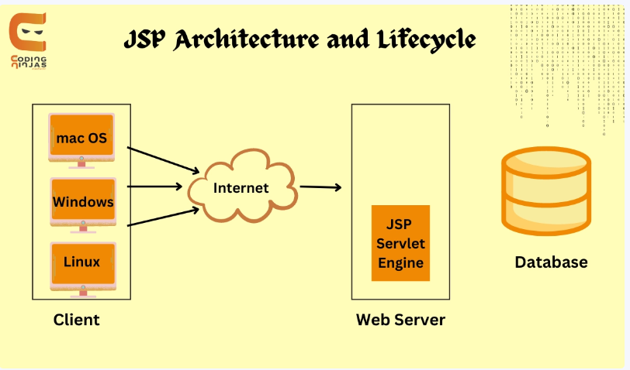
JSP Architecture

Slide 30
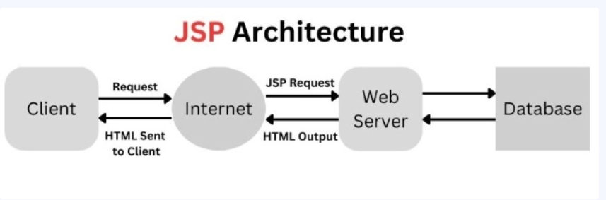

Slide 31
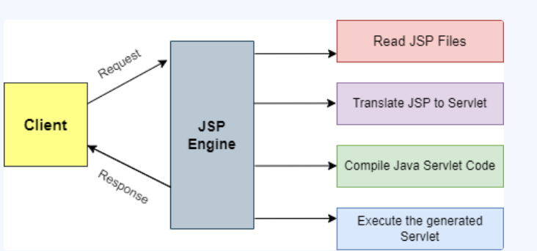

Slide 32
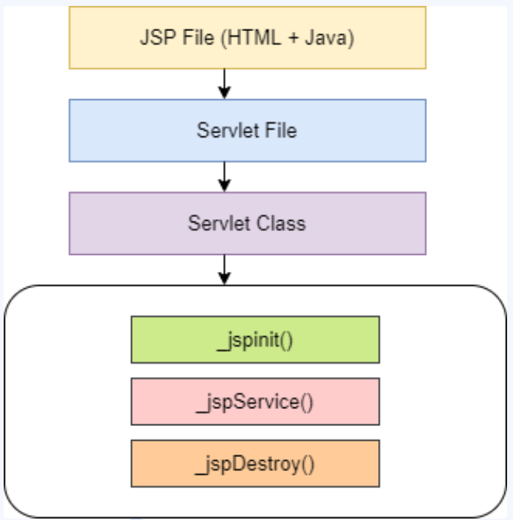
JSP Life Cycle
Translation
Compilation
Class Loading
Instantiation
Initialization
Request Processing
Destroy

Slide 33
JSP Elements
The JSP elements are used to embed the java code inside the HTML page.
JSP Scriptlets
JSP Declaration
JSP Expression
JSP Comments

Slide 34
JSP Directives
JSP directives provides the messages to the JSP engine about the entire page.
It helps the JSP engine to translate the JSP page into servlet code.
The syntax of directive would be <%@ %>
There are three directives available.
Page Directive <%@ page %>
Include Directive <%@ include %>
Taglib Directive <%@ taglib %>

Slide 35
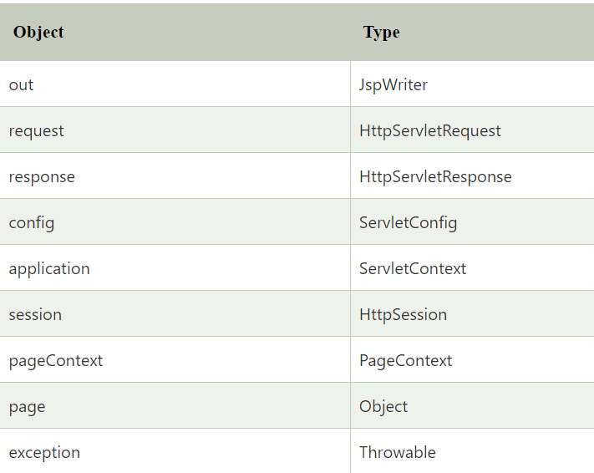
JSP Implicit Objects
There are 9 jsp implicit objects. These objects are created by the web container that are available to all the jsp pages.

Slide 36
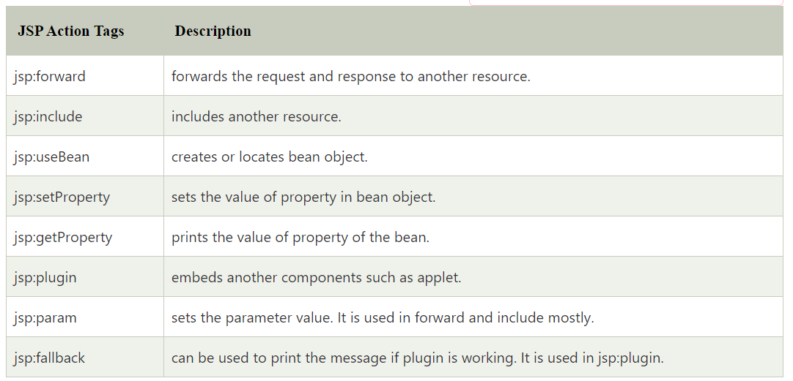
JSP Standard Action tags

Slide 37
JSTL
The JSP Standard Tag Library (JSTL) represents a set of tags to simplify the JSP development.
Advantage of JSTL
Fast Development JSTL provides many tags that simplify the JSP.
Code Reusability We can use the JSTL tags on various pages.
No need to use scriptlet tag It avoids the use of scriptlet tag.

Slide 38
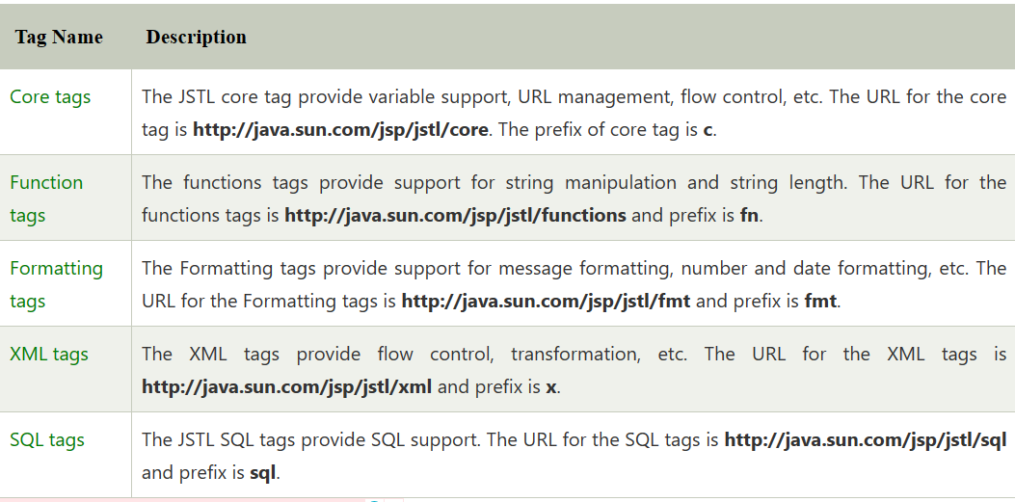

Slide 39


Slide 40
Introduction to Spring Framework
Spring is an open source framework which was created by Rod Jhonson.
He addressed the complexity of the enterprise application development using J2EE.
Using Spring, we can develop stan dalone applications, desktop applications, two-tier applications, web applications, distributed applications, enterprise applications, and so on.
The Spring Framework provides comprehensive infrastructure support for developing Java EE applications, where the Spring Framework handles the infrastructure and so developers can focus on application development.

Slide 41
Features of the Spring Framework
Lightweight
Non intrusive
Inversion of control(IOC)
Aspect Oriented Programming
JDBC Exception handling
Spring MVC Framework
Spring security
Spring Webservices, Batch, Social and Mobile

Slide 42
Advantage of Spring Framework
Develop web applications, REST APIS , standalone application.
Create loosely coupled applications using dependency injection.
Does not need an application server like weblogic to deploy application.
Instead can use a servlet container like tomcat server
Spring can integrate with framework like struts , logging frameworks hibernate very easily.
Spring converts the technology specific exceptions into unchecked exceptions.
Testing of spring application is very simple as it uses java bean as pojo classes.

Slide 43
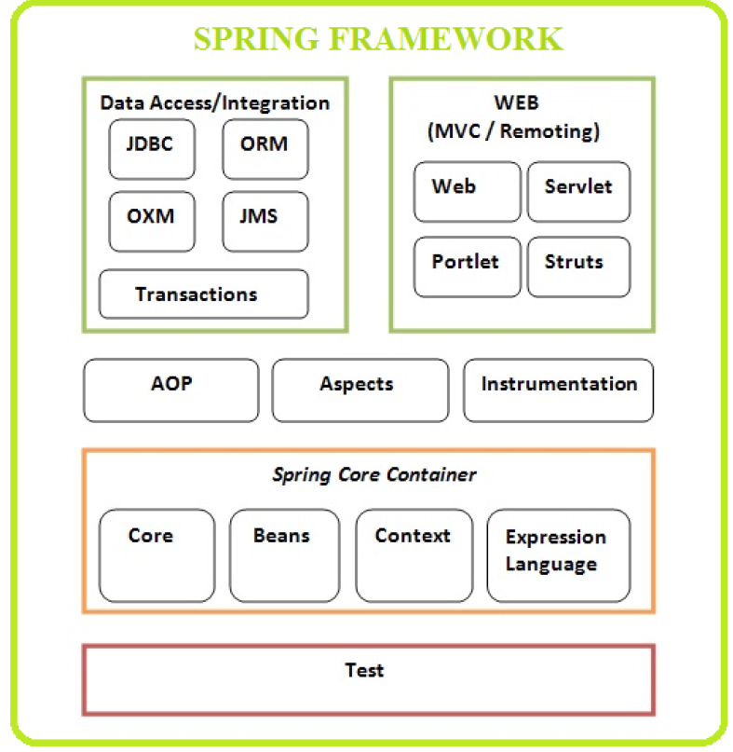
Spring Architecture

Slide 44
Inversion of Control(IOC)
The IOC is a container which is responsible for creating the java objects and injecting the dependencies needed for these objects in an application.
The IOC container is responsible for creating and assembling the spring beans in an application.
The IOC containers are
BeanFactory
ApplicationContext

Slide 45
Example of IOC Container
Consider an example there are classes called Employee and Address.
The IOC container creates object for the classes Employee and Address injects the Address object to the Employee object.

Slide 46
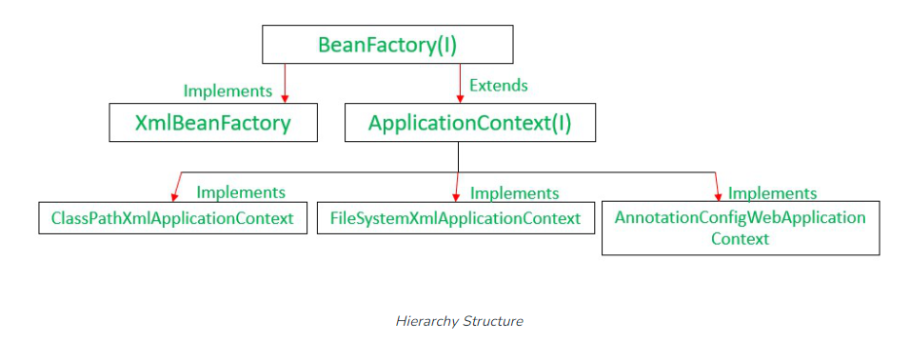
Spring Container

Slide 47
Bean Factory
Spring creates all the instances, along with the references to the objects you require.
This is bit different from the object which you are creating with new keyword.
It follows the pattern called Factory Pattern.
BeanFactory will take the responsibility of creating a new objects, which you don’t have to create by yourself. To create the new objects it will read the configuration file written in XML, which contains the Bean definitions.
We can refer this configuration file as meta data or blue print.
BeanFactory is defined by the org.springframework.beans.factory.BeanFactory interface.
It is the core part of the IOC in spring which is responsible for containing and managing the beans.

Slide 48
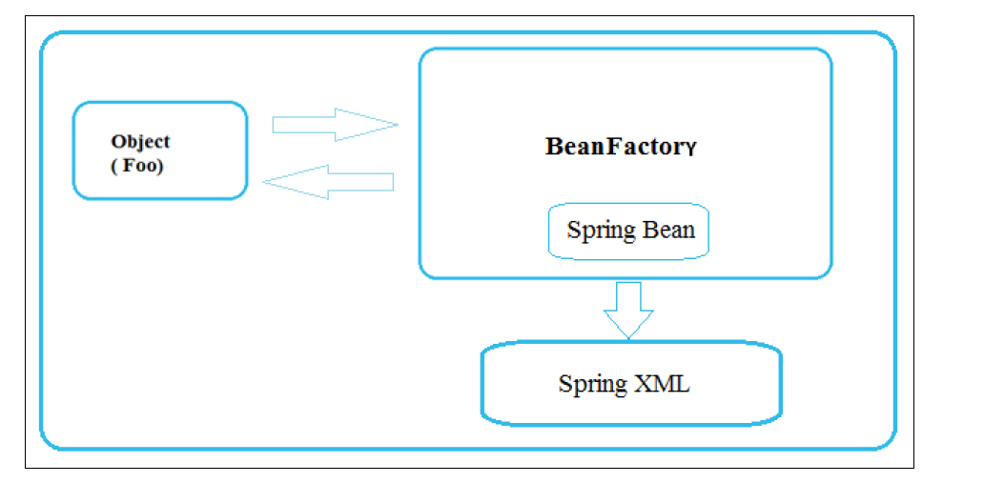

Slide 49
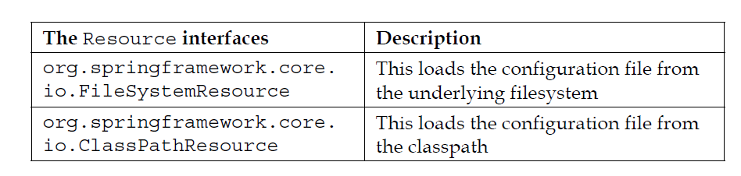
Implementation of Bean Factory
The BeanFactory interface is implemented by the class XmlBeanFactory.
The XmlBeanFactory constructor takes Resource interface object as a parameter which will helps to load the resource that is the xml configuration file from the file system or class path.
XmlBeanFactory (Resource resource)

Slide 50
Application Context
Application context is also used to represent the Spring Container.
Application context is always preferred over the BeanFactory, which includes all the functionality of BeanFactory.
org.springframework.context.ApplicationContext is the interface which provides a functionalities and attributes to create the enterprise level applications. Where as BeanFactory provides very less functionalities and that too can be accessed over ApplicationContext since the ApplicationContext interface extends the BeanFactory interface.

Slide 51
Implementation of ApplicationContext
The ApplicationContext can be implemented by the following ways.
FileSystemXmlApplicationContext
ApplicationContext ctx=new FileSystemXmlApplicationContext("F:/Beans.xml");
2. ClassPathXmlApplicationContext
ApplicationContext ctx = new ClassPathXmlApplicationContext("Beans.xml");
To access the specific bean the ApplicationContext interface provides a method getBean() which takes the bean id as a parameter.
Using this getBean() method you can access the particular bean.
BeanPgm beans=(BeanPgm) ctx.getBean("bean1");

Slide 52
3. XmlWebApplicationContext The standard location of the configuration XML file is under WEB-INF and the default name is applicationcontext.xml.
4. AnnotationConfigApplicationContext Instead of using XML files it will use java based spring bean configuration for the bean definition.
5. AnnotationConfigWebApplicationContext This is also same as AnnotationConfigApplicationContext but this is used for web application.

Slide 53
Dependency Injection(DI)
Dependency Injection (DI) is a design pattern in which an object's dependency is injected by the framework rather than by the object itself. It reduces coupling between multiple objects as it is dynamically injected by the framework. In DI, the framework is completely responsible for reading configuration.

Slide 54
Advantages of DI
Loosely coupled architecture.
Separation of responsibility.
Configuration and code are separate.
A different implementation can be supplied using configuration without changing the code dependent.
Improves testability.
DI allows you to replace actual objects with mock objects. This improves testability by writing simple JUnit tests that use mock objects.

Slide 55
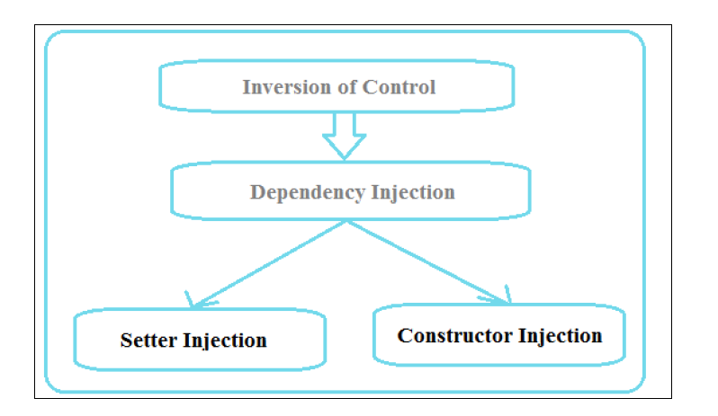
Types of Dependency Injection

Slide 56


Slide 57
What is Spring MVC?
Spring MVC is a Java based framework that is used to develop web based applications.
Spring MVC is design pattern which contains the following components.
Model – Contains data, it may be single objects or group of things.
Controller – The controller contains an application’s business logic. The @Controller annotation is used to identify the class as controllet.
View – A view is User Interface or presentation which display the content in format. To display the content it used JSP + JSTL and Thymeleaf.
Front Controller – The Dispatcher Servlet class serves as Front Controller, which will manage the flow of the Spring MVC application.(web.xml)

Slide 58
web.xml
controller
Front Controller
Dispatcher
Servlet
2(b)
2(a)
HandlerMapper
ModelAndView
1
Data
4
Client
view
model
5
7
3
View Resolver
6
prefix
view
suffix

Slide 59
Steps to create Spring MVC application
Configure dispatcher servlet.
Create Spring Configuration file.
Configure the View Resolver.
Create the controller.
Create a folder structure and view.
Run the application on the server.

Slide 60
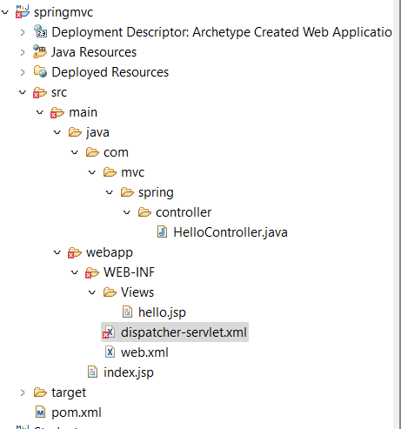
Folder Structure

Slide 61
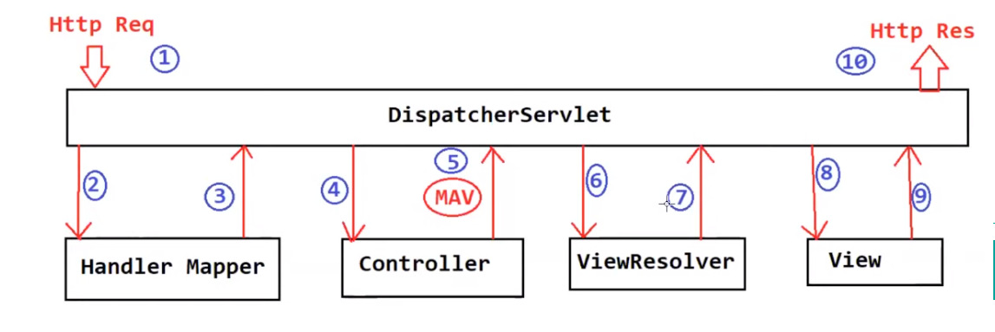
How the Spring MVC works internally?

Slide 62
Step 1 - When the client (browser) sends an HTTP request to a specific URL. The DispatcherServlet of Spring MVC receives the request.
Step 2 - DispatcherServlet consult to HandlerMapper to identify which controller is responsible to handle the HTTP request.
Step 3 - HandlerMapper selects the controller which is mapped to the incoming request URL and returns the (selected Handler) and Controller details to DispatcherServlet.
Step 4 - Now DispatcherServlet knows which controller is responsible to process the request so DispatcherServlet will forward that request to the corresponding controller to process the request.
Step 5 - Now the Controller process the request, validates the request, and creates a model with data. Finally, the Controller returns the logical name of view and model to the DispatcherServlet.
Step 6 - DispatcherServlet consult ViewResolver to resolve a logical view with the physical view that exists in the application.
Step 7 - ViewResolver responsible to map logical view with actual view and return the actual view details back to the DispatcherServlet.
Step 8 - Now DispatcherServlet sends the view and model to the View component.
Step 9 - The View component merge view and model and forms a plain HTML output. Finally, the View component sends HTML output back to the DispatcherServlet.
Step 10 - The DispatcherServlet finally sends HTML output as a response back to the browser for rendering.

