Slide 1
Data Mining
关联分析：基本概念与方法
吉林大学控制系
刘云

Slide 2
关联规则挖掘
给定一组交易清单，找到能够利用A条目预测B条目出现的规则
Market-Basket transactions
Example of Association Rules
{Diaper} → {Beer}, {Milk, Bread} → {Eggs,Coke}, {Beer, Bread} → {Milk},
表示共同出现，而不是因果关系！

Slide 3
Definition: 频繁项集
Itemset-项集
A collection of one or more items
Example: {Milk, Bread, Diaper}
k-itemset
An itemset that contains k items
Support count (σ)-支持数
Frequency of occurrence of an itemset
E.g. σ({Milk, Bread,Diaper}) = 2
Support-支持度
Fraction of transactions that contain an itemset
E.g. s({Milk, Bread, Diaper}) = 2/5
Frequent Itemset-频繁项集
An itemset whose support is greater than or equal to a minsup threshold

Slide 4
Definition: 关联规则
Association Rule
形式为X → Y的蕴含式, where X and Y are itemsets
Example: {Milk, Diaper} → {Beer}
Rule Evaluation Metrics
Support (s)-支持度
Fraction of transactions that contain both X and Y
=P(X,Y)/N
Confidence (c)-置信度
Measures how often items in Y appear in transactions that contain X
=P(X,Y)/P(X)
Example:

Slide 5
Association Rule Mining Task
给定一组交易记录T, 关联分析的任务是挖据出符合以下两个条件的所有的规则：
支持数 ≥ minsup threshold
置信度 ≥ minconf threshold
Brute-force approach-蛮力法:
List all possible association rules
Compute the support and confidence for each rule
Prune rules that fail the minsup and minconf thresholds
⇒ Computationally prohibitive!

Slide 6
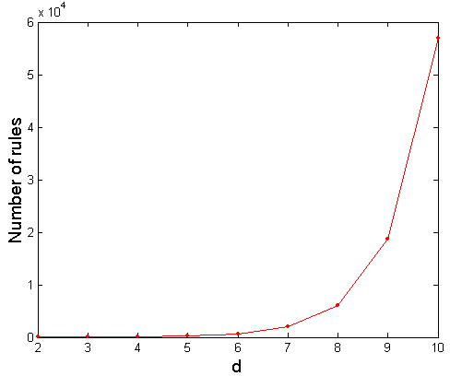
Computational Complexity
Given d unique items:
Total number of itemsets = 2^{d}
Total number of possible association rules:
If d=6, R = 602 rules

Slide 7
Mining Association Rules
Example of Rules:
{Milk,Diaper} → {Beer} (s=0.4, c=0.67) {Milk,Beer} → {Diaper} (s=0.4, c=1.0)
{Diaper,Beer} → {Milk} (s=0.4, c=0.67)
{Beer} → {Milk,Diaper} (s=0.4, c=0.67) {Diaper} → {Milk,Beer} (s=0.4, c=0.5)
{Milk} → {Diaper,Beer} (s=0.4, c=0.5)
Observations:
All the above rules are binary partitions of the same itemset: {Milk, Diaper, Beer}
Rules originating from the same itemset have identical support but can have different confidence
Thus, we may decouple the support and confidence requirements

Slide 8
Mining Association Rules
Two-step approach:
Frequent Itemset Generation-频繁项集的生成
Generate all itemsets whose support ≥ minsup
Rule Generation-规则的生成
Generate high confidence rules from each frequent itemset, where each rule is a binary partitioning of a frequent itemset
Frequent itemset generation is still computationally expensive

Slide 9
Frequent Itemset Generation
Given d items, there are 2^{d} possible candidate itemsets

Slide 10
Frequent Itemset Generation-生成
Brute-force approach-蛮力法:
Each itemset in the lattice is a candidate frequent itemset
Count the support of each candidate by scanning the database
Match each transaction against every candidate
Complexity ~ O(NMw) => Expensive since M = 2^{d} !!!

Slide 11
Frequent Itemset Generation Strategies
Reduce the number of candidates (M)
Complete search: M=2^{d}
Use pruning techniques to reduce M
Reduce the number of transactions (N)
Reduce size of N as the size of itemset increases
Used by DHP and vertical-based mining algorithms
Reduce the number of comparisons (NM)
Use efficient data structures to store the candidates or transactions
No need to match every candidate against every transaction

Slide 12
Reducing Number of Candidates
Apriori principle-先验原则:
If an itemset is frequent, then all of its subsets must also be frequent-一个频繁项集的所有子集都是频繁项集
逆反命题也成立
Apriori principle holds due to the following property of the support measure:
一个项集的支持数永远不会超过它的任一子集
This is known as the anti-monotone property-反单调性质 of support

Slide 13
Illustrating Apriori Principle
Found to be Infrequent
Pruned supersets

Slide 14
Illustrating Apriori Principle
Items (1-itemsets)
Minimum Support = 3
If every subset is considered,
⁶C₁ + ⁶C₂ + ⁶C₃
6 + 15 + 20 = 41
With support-based pruning,
6 + 6 + 4 = 16

Slide 15
Illustrating Apriori Principle
Items (1-itemsets)
Minimum Support = 3
If every subset is considered,
⁶C₁ + ⁶C₂ + ⁶C₃
6 + 15 + 20 = 41
With support-based pruning,
6 + 6 + 4 = 16

Slide 16
Illustrating Apriori Principle
Items (1-itemsets)
Pairs (2-itemsets)
(No need to generate candidates involving Coke or Eggs)
Minimum Support = 3
If every subset is considered,
⁶C₁ + ⁶C₂ + ⁶C₃
6 + 15 + 20 = 41
With support-based pruning,
6 + 6 + 4 = 16

Slide 17
Illustrating Apriori Principle
Items (1-itemsets)
Pairs (2-itemsets)
(No need to generate candidates involving Coke or Eggs)
Minimum Support = 3
If every subset is considered,
⁶C₁ + ⁶C₂ + ⁶C₃
6 + 15 + 20 = 41
With support-based pruning,
6 + 6 + 4 = 16

Slide 18
Illustrating Apriori Principle
Items (1-itemsets)
Pairs (2-itemsets)
(No need to generate candidates involving Coke or Eggs)
Minimum Support = 3
Triplets (3-itemsets)
If every subset is considered,
⁶C₁ + ⁶C₂ + ⁶C₃
6 + 15 + 20 = 41
With support-based pruning,
6 + 6 + 4 = 16
If every subset is considered,
⁶C₁ + ⁶C₂ + ⁶C₃
6 + 15 + 20 = 41
With support-based pruning,
6 + 6 + 4 = 16

Slide 19
Illustrating Apriori Principle
Items (1-itemsets)
Pairs (2-itemsets)
(No need to generate candidates involving Coke or Eggs)
Minimum Support = 3
Triplets (3-itemsets)
If every subset is considered,
⁶C₁ + ⁶C₂ + ⁶C₃
6 + 15 + 20 = 41
With support-based pruning,
6 + 6 + 4 = 16

Slide 20
Illustrating Apriori Principle
Items (1-itemsets)
Pairs (2-itemsets)
(No need to generate candidates involving Coke or Eggs)
Minimum Support = 3
Triplets (3-itemsets)
If every subset is considered,
⁶C₁ + ⁶C₂ + ⁶C₃
6 + 15 + 20 = 41
With support-based pruning,
6 + 6 + 4 = 16
6 + 6 + 1 = 13

Slide 21
Apriori Algorithm-先验算法
F_{k}: frequent k-itemsets
L_{k}: candidate k-itemsets
Algorithm
Let k=1
Generate F₁ = {frequent 1-itemsets}
Repeat until F_{k} is empty
Candidate Generation: Generate L_{k+1} from F_{k}
Candidate Pruning: Prune candidate itemsets in L_{k+1} containing subsets of length k that are infrequent
Support Counting: Count the support of each candidate in L_{k+1} by scanning the DB
Candidate Elimination: Eliminate candidates in L_{k+1} that are infrequent, leaving only those that are frequent => F_{k+1}
生成——修剪——计算支持度——删除

Slide 22
Candidate Generation: Brute-force method

Slide 23
Candidate Generation: Merge Fk-1 and F1 itemsets

Slide 24
Candidate Generation: F_{k-1} x F_{k-1} Method
Merge two frequent (k-1)-itemsets if their first (k-2) items are identical
F₃ = {ABC,ABD,ABE,ACD,BCD,BDE,CDE}
Merge(ABC, ABD) = ABCD
Merge(ABC, ABE) = ABCE
Merge(ABD, ABE) = ABDE
Do not merge(ABD,ACD) because they share only prefix of length 1 instead of length 2

Slide 25

单选题
1分
Let F₃ = {ABC,ABD,ABE,ACD,BCD,BDE,CDE} be the set of frequent 3-itemsets
L₄ = {ABCD,ABCE,ABDE} is the set of candidate 4-itemsets generated (from previous slide)
经过修剪后，还剩余哪些candidate itemset？
A
ABCD
B
ABCE
C
ABDE
提交

Slide 26
Candidate Generation: Fk-1 x Fk-1 Method

Slide 27
Illustrating Apriori Principle
Items (1-itemsets)
Pairs (2-itemsets)
(No need to generate candidates involving Coke or Eggs)
Minimum Support = 3
Triplets (3-itemsets)
If every subset is considered,
⁶C₁ + ⁶C₂ + ⁶C₃
6 + 15 + 20 = 41
With support-based pruning,
6 + 6 + 1 = 13
Use of F_{k-1}xF_{k-1} method for candidate generation results in
only one 3-itemset. This is eliminated after the support counting step.

Slide 28
Alternate F_{k-1} x F_{k-1} Method-另一种方法
Merge two frequent (k-1)-itemsets if the last (k-2) items of the first one is identical to the first (k-2) items of the second.
F₃ = {ABC,ABD,ABE,ACD,BCD,BDE,CDE}
Merge(ABC, BCD) = ABCD
Merge(ABD, BDE) = ABDE
Merge(ACD, CDE) = ACDE
Merge(BCD, CDE) = BCDE

Slide 29
Candidate Pruning for Alternate F_{k-1} x F_{k-1} Method
Let F₃ = {ABC,ABD,ABE,ACD,BCD,BDE,CDE} be the set of frequent 3-itemsets
L₄ = {ABCD,ABDE,ACDE,BCDE} is the set of candidate 4-itemsets generated (from previous slide)
Candidate pruning
Prune ABDE because ADE is infrequent
Prune ACDE because ACE and ADE are infrequent
Prune BCDE because BCE
After candidate pruning: L₄ = {ABCD}

Slide 30
Rule Generation-规则生成
Given a frequent itemset L, find all non-empty subsets f ⊂ L such that f → L – f satisfies the minimum confidence requirement
If {A,B,C,D} is a frequent itemset, candidate rules:
ABC →D, ABD →C, ACD →B, BCD →A, A →BCD, B →ACD, C →ABD, D →ABC AB →CD, AC → BD, AD → BC, BC →AD, BD →AC, CD →AB,
If |L| = k, then there are 2^{k} – 2 candidate association rules (ignoring L → ∅ and ∅ → L)
计算费时！

Slide 31
Rule Generation
In general, confidence does not have an anti-monotone property-置信度本身没有单调性
c(ABC →D) can be larger or smaller than c(AB →D)
But confidence of rules generated from the same itemset has an anti-monotone property
但在同一个项集内，却存在单调性
E.g., Suppose {A,B,C,D} is a frequent 4-itemset: c(ABC → D) ≥ c(AB → CD) ≥ c(A → BCD)
Confidence is anti-monotone w.r.t. number of items on the RHS of the rule

Slide 32
Rule Generation for Apriori Algorithm
Lattice of rules
Low Confidence Rule
Pruned Rules

Slide 33
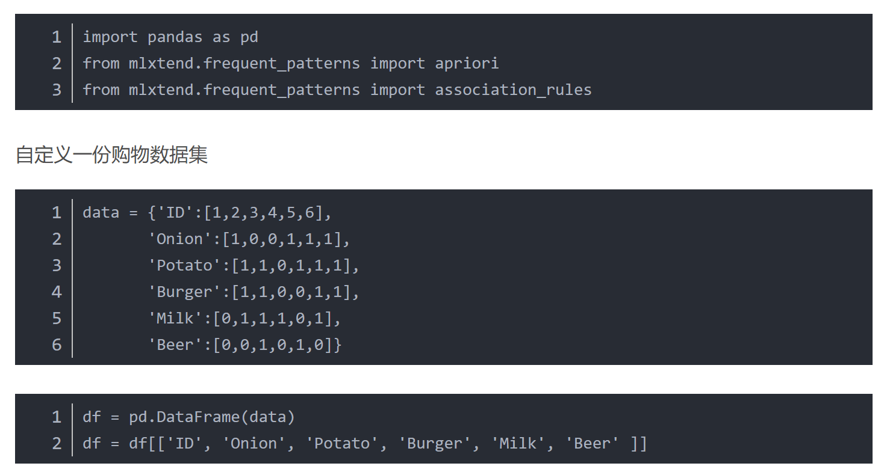
Python实现（https://blog.csdn.net/tangyudi/article/details/88822705）

Slide 34
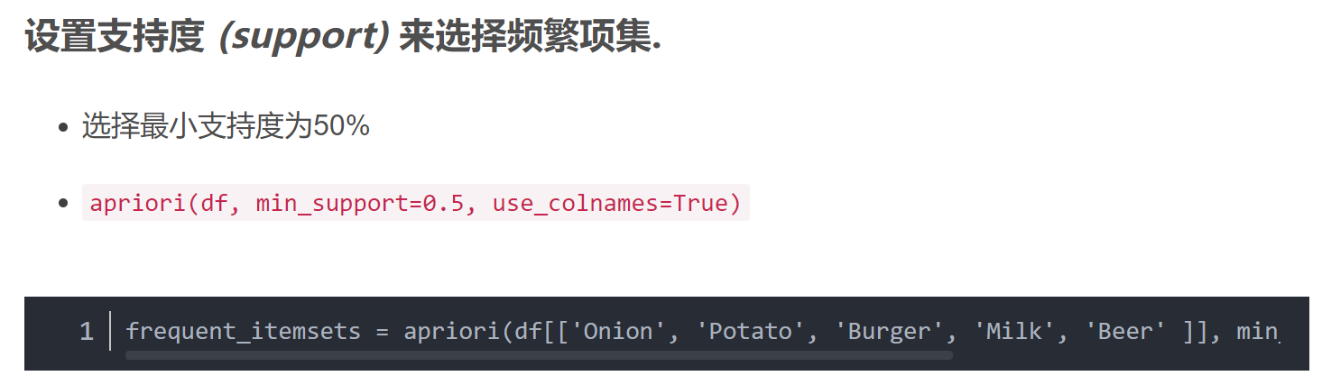
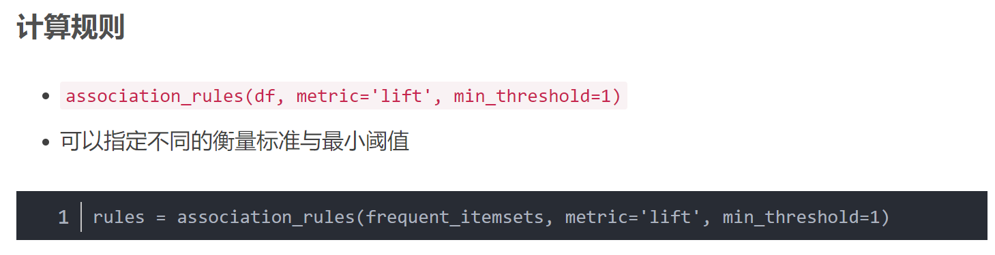
Python实现

