Slide 1
Association Analysis: Basic Concepts and Algorithms
算法与复杂度

Slide 2
Factors Affecting Complexity of Apriori
Choice of minimum support threshold
Dimensionality (number of items) of the data set
Size of database
Average transaction width

Slide 3
Factors Affecting Complexity of Apriori
Choice of minimum support threshold
lowering support threshold results in more frequent itemsets
this may increase number of candidates and max length of frequent itemsets
不能为了计算效率，增大支持度阈值
Dimensionality (number of items) of the data set
Size of database
Average transaction width

Slide 4
Factors Affecting Complexity of Apriori
Choice of minimum support threshold
lowering support threshold results in more frequent itemsets
this may increase number of candidates and max length of frequent itemsets
Dimensionality (number of items) of the data set
More space is needed to store support count of itemsets
If number of frequent itemsets also increases, both computation and I/O costs may also increase
Size of database
Average transaction width

Slide 5
Factors Affecting Complexity of Apriori
Choice of minimum support threshold
lowering support threshold results in more frequent itemsets
this may increase number of candidates and max length of frequent itemsets
Dimensionality (number of items) of the data set
More space is needed to store support count of itemsets
if number of frequent itemsets also increases, both computation and I/O costs may also increase
Size of database
run time of algorithm increases with number of transactions
每一个项集需要比对的记录数量
Average transaction width

Slide 6
Factors Affecting Complexity of Apriori
Choice of minimum support threshold
lowering support threshold results in more frequent itemsets
this may increase number of candidates and max length of frequent itemsets
Dimensionality (number of items) of the data set
More space is needed to store support count of itemsets
if number of frequent itemsets also increases, both computation and I/O costs may also increase
Size of database
run time of algorithm increases with number of transactions
Average transaction width
transaction width increases the max length of frequent itemsets
number of subsets in a transaction increases with its width, increasing computation time for support counting

Slide 7
Compact Representation of Frequent Itemsets-紧凑表示
Some itemsets are redundant because they have identical support as their supersets
Number of frequent itemsets
Need a compact representation

Slide 8
Maximal Frequent Itemset-最大频繁项集
An itemset is maximal frequent if it is frequent and none of its immediate supersets is frequent-所有超集都不是频繁项集的频繁项集
Maximal Itemsets
Infrequent Itemsets
Border

Slide 9
What are the Maximal Frequent Itemsets in this Data?
Minimum support threshold = 5
(A1-A10)
(B1-B10)
(C1-C10)

Slide 10
An illustrative example
Items
 | A | B | C | D | E | F | G | H | I | J
1
2
3
4
5
6
7
8
9
10
Support threshold (by count) : 5
Frequent itemsets: ?
Maximal itemsets: ?
Transactions

Slide 11
An illustrative example
Items
 | A | B | C | D | E | F | G | H | I | J
1
2
3
4
5
6
7
8
9
10
Support threshold (by count) : 5
Frequent itemsets: {F}
Maximal itemsets: {F}
Transactions

Slide 12

填空题
6分
 | A | B | C | D | E | F | G | H | I | J
1
2
3
4
5
6
7
8
9
10
Support threshold (by count): 4
频繁项集有： [填空1] 、 [填空2] 、 [填空3] 、 [填空4] ，最大频繁项集有： [填空5] 、 [填空6]
作答

Slide 13
An illustrative example
Items
 | A | B | C | D | E | F | G | H | I | J
1
2
3
4
5
6
7
8
9
10
Support threshold (by count) : 5
Frequent itemsets: {F}
Maximal itemsets: {F}
Support threshold (by count): 4
Frequent itemsets: {E}, {F}, {E,F}, {J}
Maximal itemsets: {E,F}, {J}
Support threshold (by count): 3
Frequent itemsets: ?
Maximal itemsets: ?
Transactions

Slide 14
An illustrative example
Items
 | A | B | C | D | E | F | G | H | I | J
1
2
3
4
5
6
7
8
9
10
Support threshold (by count) : 5
Frequent itemsets: {F}
Maximal itemsets: {F}
Support threshold (by count): 4
Frequent itemsets: {E}, {F}, {E,F}, {J}
Maximal itemsets: {E,F}, {J}
Support threshold (by count): 3
Frequent itemsets:
All subsets of {C,D,E,F} + {J}
Maximal itemsets:
{C,D,E,F}, {J}
Transactions

Slide 15
Another illustrative example
Items
 | A | B | C | D | E | F | G | H | I | J
1
2
3
4
5
6
7
8
9
10
Support threshold (by count) : 5
Maximal itemsets: {A}, {B}, {C}
Support threshold (by count): 4
Maximal itemsets: {A,B}, {A,C},{B,C}
Support threshold (by count): 3
Maximal itemsets: {A,B,C}
Transactions

Slide 16
Closed Itemset-闭项集
An itemset X is closed if none of its immediate supersets has the same support as the itemset X.
X is not closed if at least one of its immediate supersets has support count as X.

Slide 17
Maximal vs Closed Itemsets
Transaction Ids
Not supported by any transactions

Slide 18
Maximal Frequent vs Closed Frequent Itemsets
Minimum support = 2
Closed but not maximal
Closed and maximal
# Closed = 9
# Maximal = 4

Slide 19
What are the Closed Itemsets in this Data?
(A1-A10)
(B1-B10)
(C1-C10)

Slide 20
Example 1
Items
 | A | B | C | D | E | F | G | H | I | J
1
2
3
4
5
6
7
8
9
10
Itemsets | Support (counts) | Closed itemsets
{C} | 3
{D} | 2
{C,D} | 2
Transactions

Slide 21
Example 1
Items
 | A | B | C | D | E | F | G | H | I | J
1
2
3
4
5
6
7
8
9
10
Itemsets | Support (counts) | Closed itemsets
{C} | 3 | ✓
{D} | 2
{C,D} | 2 | ✓
Transactions

Slide 22
Example 2
Items
 | A | B | C | D | E | F | G | H | I | J
1
2
3
4
5
6
7
8
9
10
Itemsets | Support (counts) | Closed itemsets
{C} | 3
{D} | 2
{E} | 2
{C,D} | 2
{C,E} | 2
{D,E} | 2
{C,D,E} | 2
Transactions

Slide 23
Example 2
Items
 | A | B | C | D | E | F | G | H | I | J
1
2
3
4
5
6
7
8
9
10
Itemsets | Support (counts) | Closed itemsets
{C} | 3 | ✓
{D} | 2
{E} | 2
{C,D} | 2
{C,E} | 2
{D,E} | 2
{C,D,E} | 2 | ✓
Transactions

Slide 24
Example 3
Items
 | A | B | C | D | E | F | G | H | I | J
1
2
3
4
5
6
7
8
9
10
Closed itemsets: {C,D,E,F}, {C,F}
Transactions

Slide 25
Example 4
Items
 | A | B | C | D | E | F | G | H | I | J
1
2
3
4
5
6
7
8
9
10
Closed itemsets: {C,D,E,F}, {C}, {F}
Transactions

Slide 26
Maximal vs Closed Itemsets
最大频繁项集肯定是闭项集！
其超集的支持数肯定不一样！
最大频繁项集的子集不必再确定关联规则

Slide 27
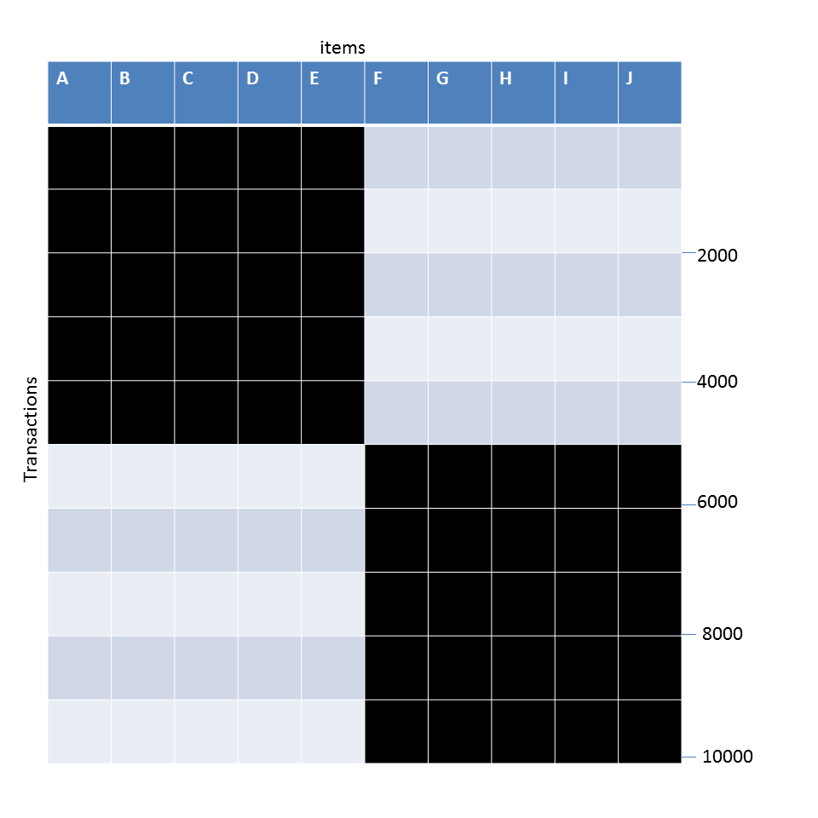
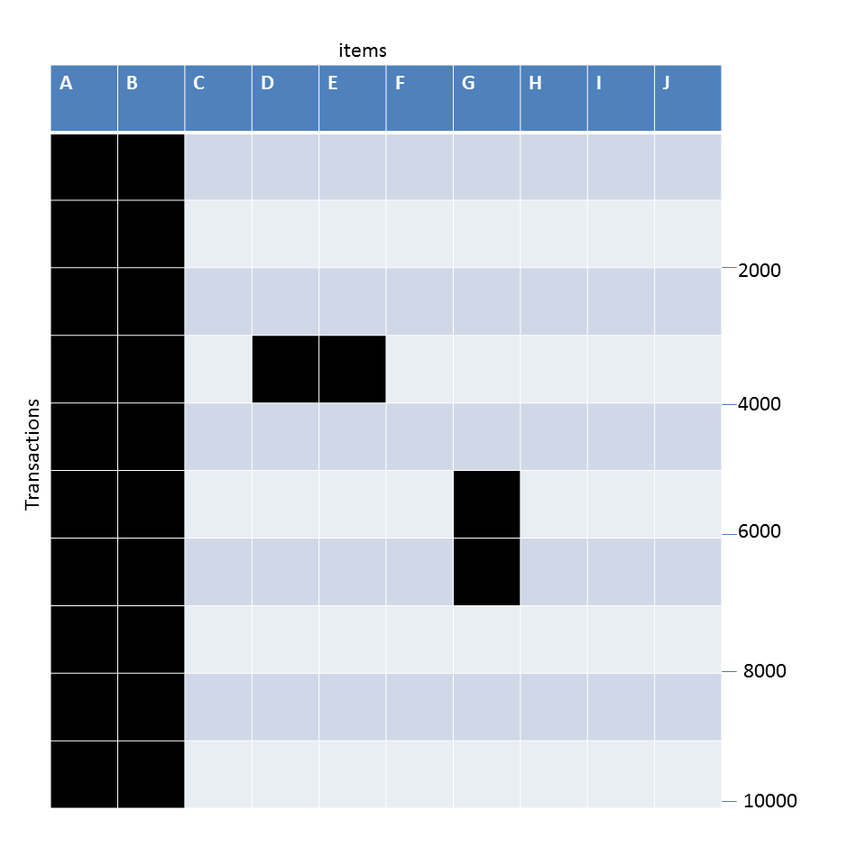
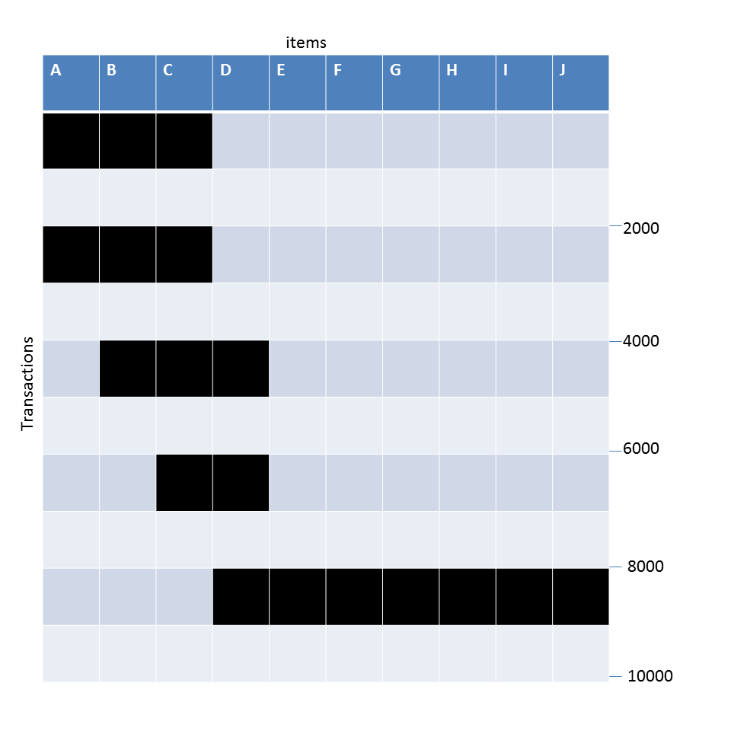
Example question
Given the following transaction data sets (dark cells indicate presence of an item in a transaction) and a support threshold of 20%, answer the following questions
DataSet: A
Data Set: B
Data Set: C
What is the number of frequent itemsets for each dataset? Which dataset will produce the most number of frequent itemsets?
Which dataset will produce the longest frequent itemset?
Which dataset will produce frequent itemsets with highest maximum support?
Which dataset will produce frequent itemsets containing items with widely varying support levels (i.e., itemsets containing items with mixed support, ranging from 20% to more than 70%)?
What is the number of maximal frequent itemsets for each dataset? Which dataset will produce the most number of maximal frequent itemsets?
What is the number of closed frequent itemsets for each dataset? Which dataset will produce the most number of closed frequent itemsets?

Slide 28
Pattern Evaluation
Association rule algorithms can produce large number of rules
Interestingness measures-趣味标准-can be used to prune/rank the patterns
In the original formulation, support & confidence are the only measures used

Slide 29
Computing Interestingness Measure
Given X → Y or {X,Y}, information needed to compute interestingness can be obtained from a contingency table-相依表
Contingency table
 | Y | Y
X | f₁₁ | f₁₀ | f₁₊
X | f₀₁ | f₀₀ | f_{o+}
 | f₊₁ | f₊₀ | N
f₁₁: support of X and Y f₁₀: support of X and Y f₀₁: support of X and Y f₀₀: support of X and Y
Used to define various measures
support, confidence, Gini, entropy, etc.

Slide 30
Drawback of Confidence
Customers | Tea | Coffee | …
C1 | 0 | 1 | …
C2 | 1 | 0 | …
C3 | 1 | 1 | …
C4 | 1 | 0 | …
…
Association Rule: Tea → Coffee
Confidence ≅ P(Coffee|Tea) = 150/200 = 0.75
Confidence > 50%, meaning people who drink tea are more likely to drink coffee than not drink coffee
So rule seems reasonable

Slide 31
Drawback of Confidence
 | Coffee | Coffee
Tea | 150 | 50 | 200
Tea | 650 | 150 | 800
 | 800 | 200 | 1000
Association Rule: Tea → Coffee
Confidence= P(Coffee|Tea) = 150/200 = 0.75
but P(Coffee) = 0.8, which means knowing that a person drinks tea reduces the probability that the person drinks coffee!
Note that P(Coffee|Tea) = 650/800 = 0.8125

Slide 32
Drawback of Confidence
Customers | Tea | Honey | …
C1 | 0 | 1 | …
C2 | 1 | 0 | …
C3 | 1 | 1 | …
C4 | 1 | 0 | …
…
Association Rule: Tea → Honey Confidence ≅ P(Honey|Tea) = 100/200 = 0.50
Confidence = 50%, which may mean that drinking tea has little influence whether honey is used or not
So rule seems uninteresting
But P(Honey) = 120/1000 = 0.12 (hence tea drinkers are far more likely to have honey

Slide 33
Measure for Association Rules
So, what kind of rules do we really want?
Confidence(X → Y) should be sufficiently high
To ensure that people who buy X will more likely buy Y than not buy Y
Confidence(X → Y) > support(Y)
Otherwise, rule will be misleading because having item X actually reduces the chance of having item Y in the same transaction
Is there any measure that capture this constraint?
Answer: Yes. There are many of them.

Slide 34
Statistical Relationship between X and Y
The criterion confidence(X → Y) = support(Y)
is equivalent to:
P(Y|X) = P(Y)
P(X,Y) = P(X) × P(Y) (X and Y are independent)
If P(X,Y) > P(X) × P(Y) : X & Y are positively correlated
If P(X,Y) < P(X) × P(Y) : X & Y are negatively correlated

Slide 35
Measures that take into account statistical dependence
lift is used for rules while interest is used for itemsets
相关系数

Slide 36
Example: Lift/Interest
 | Coffee | Coffee
Tea | 150 | 50 | 200
Tea | 650 | 150 | 800
 | 800 | 200 | 1000
Association Rule: Tea → Coffee
Confidence= P(Coffee|Tea) = 0.75
but P(Coffee) = 0.8
Interest = 0.15 / (0.2×0.8) = 0.9375 (< 1, therefore is negatively associated)
So, is it enough to use confidence/Interest for pruning?

Slide 37
There are lots of measures proposed in the literature

