Slide 1
Method based on transformers for the early suicide detection task
Student: Ilicea Anca-Ștefania

Slide 2
Overview of the theme
Depression is a disease that is affecting more and more people nowadays. Detecting it early could be life-saving, allowing patients suffering from depression to receive the appropriate medicine as soon as possible.
However, distinguishing between a text written by a person suffering from depression and a text written by a person suffering from more severe depression and on the verge of committing suicide is a difficult task due to the lack of sufficiently large and well-labeled datasets.

Slide 3
My Approach
01
02
03
05
Choose a dataset
Split the dataset in train and test
Analyse existing results on the dataset
Tokenize the data
04
Train a BERT model
Analyse final results

Slide 4
Dataset
The dataset, SDCNL , is taken from github (https://github.com/ayaanzhaque/SDCNL) and it contains aprox. 1500 labeled examples for train, and aprox 400 for test, positives and negatives (is suicide or is not)
It contains real posts from Reddit

Slide 5
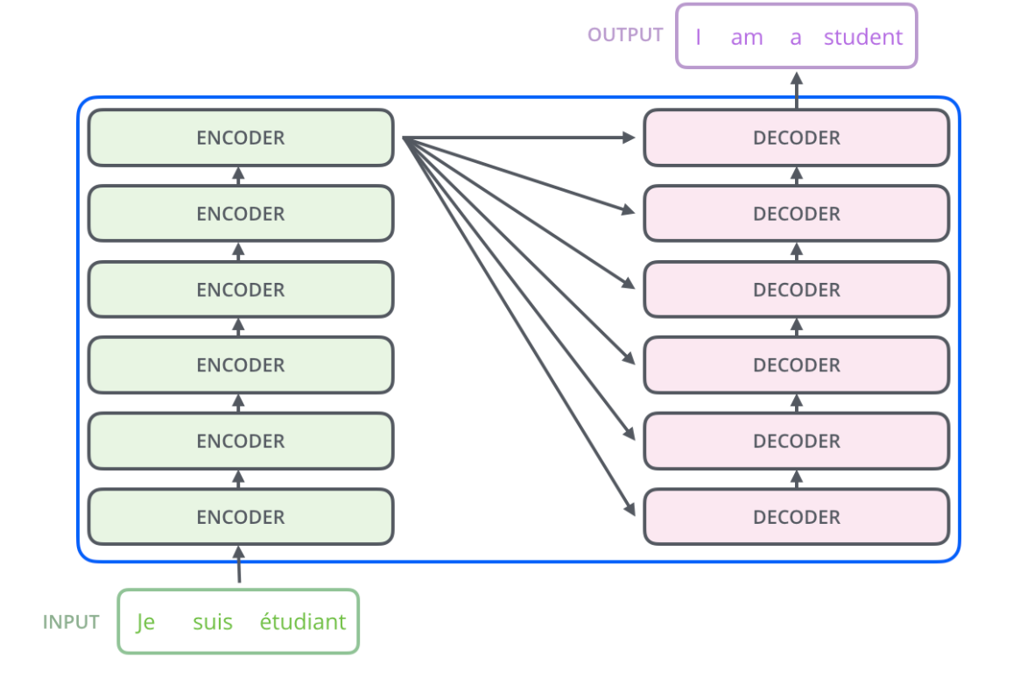
Method
The dominant models are based on complex recurrent or convolutional neural networks that include an encoder and a decoder. The best performing ones also connect the encoder and decoder through an attention mechanism. The Transformer is a simple network architecture, based solely on attention mechanisms, dispensing with recurrence and convolutions entirely.
1
I wish I was someone else. I wish I wasn’t so broken.

Slide 6

BERT
BERT stands for Bidirectional Encoder Representations from Transformers. The model is designed to pretrain deep bidirectional representations from unlabeled text by jointly conditioning on both left and right context in all layers. As a result, the pre-trained BERT model can be finetuned with just one additional output layer to create state-of-the-art models for a wide range of tasks, such as text classification, without substantial task specific architecture modifications.
RAW DATA
AUTOTOKENIZER
Train a base-bert-uncased model for 5 epochs, lr: 5e-5, batch size: 8
PREDICTIONS

Slide 7
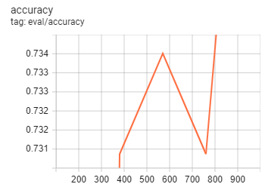
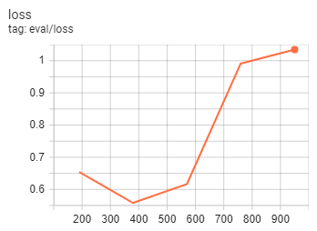
Results
Plots for base-bert-uncased
Initial labels
Model | Accuracy
Base-bert-uncased | 74.41%
SVM preprocessed data | 66.49%
SVM raw data | 64.37%
KNN preprocessed data | 56.20%
KNN raw data | 51.97%

Slide 8
Related work. Future work.
Initial labels
Model | Accuracy
Guse-bert | 72.24%
Bert-dense | 70.50%
Bert-bilstm | 71.50%
Bert-cnn | 72.14%
Predicted labels with Gaussian Mixture Model
Model | Accuracy
Guse-bert | 93.08%
Bert-dense | 83.74%
Bert-bilstm | 84.16%
Bert-cnn | 84.59%

Slide 9
CITATIONS
Jacob Devlin Ming-Wei Chang Kenton Lee Kristina Toutanova (2019), BERT: Pre-training of Deep Bidirectional Transformers for Language Understanding.
Ayaan Haque, Viraaj Reddi, and Tyler Giallanza (2021) Deep Learning for Suicide and DepressionIdentification with Unsupervised LabelCorrection
Jay Alammar (2018) The Illustrated Transformer
Katz, C., Bolton, J. & Sareen , The prevalence rates of suicide are likely underestimated worldwide: why it matters. Soc. PsychiatryPsychiatr. Epidemiol. 51, 125–127 (2016).

Slide 10
THANKS!

