Slide 1
LOGIC CIRCUITS

Slide 2
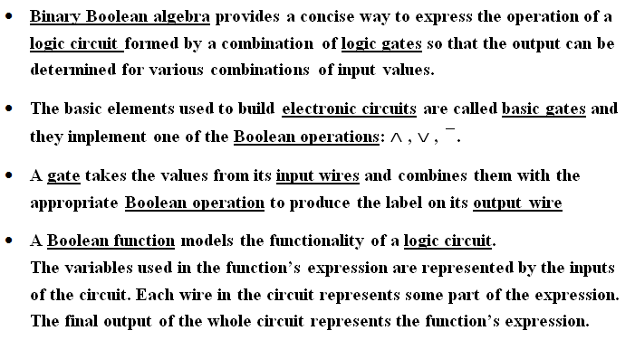
LOGIC CIRCUITS

Slide 3
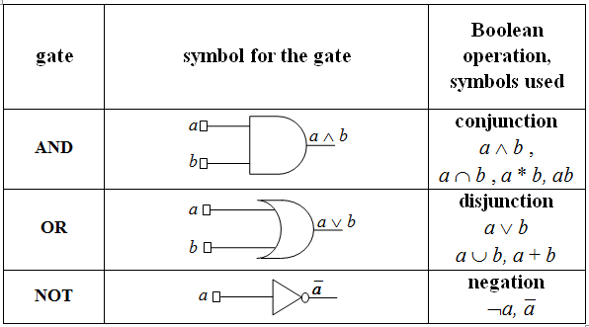
BASIC GATES – IEEE STANDARDS

Slide 4
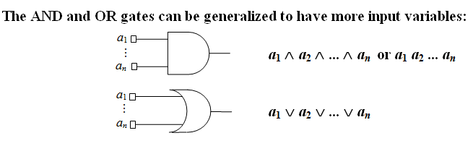
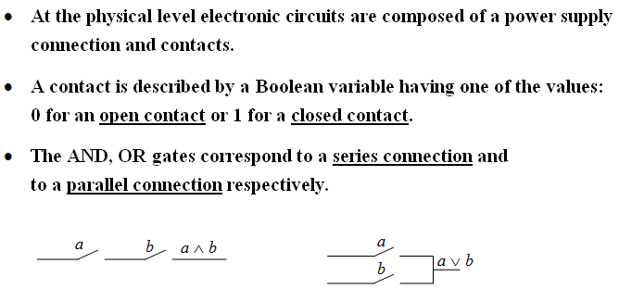

Slide 5
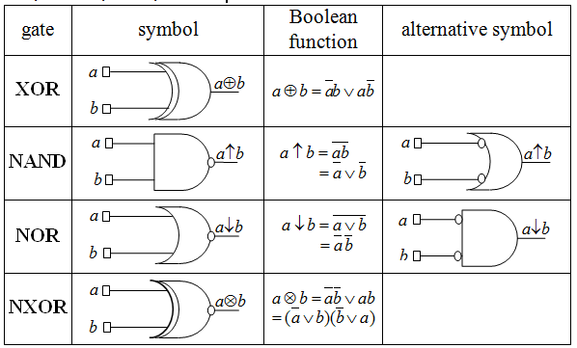

DERIVED GATES: XOR, NAND, NOR, NXOR

Slide 6
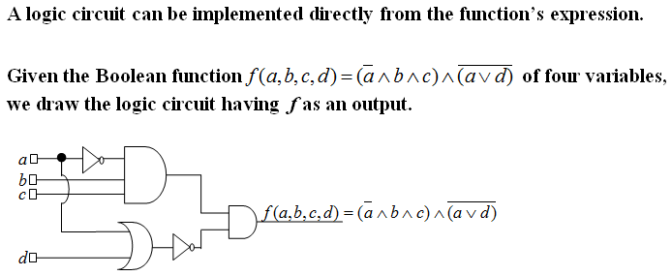
EXAMPLE 1

Slide 7
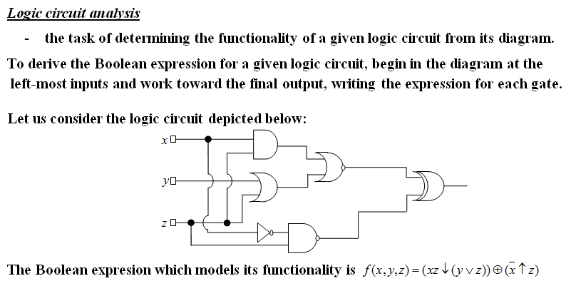
EXAMPLE 2

Slide 8
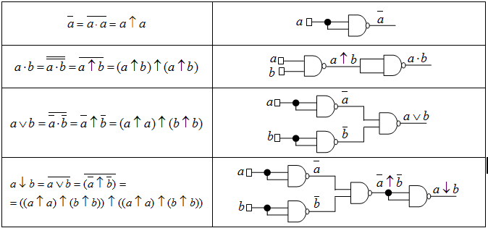
EXAMPLE 3. NAND IS A UNIVERSAL GATE
-IT CAN BE USED TO PRODUCE ALL THE OTHER GATES

Slide 9
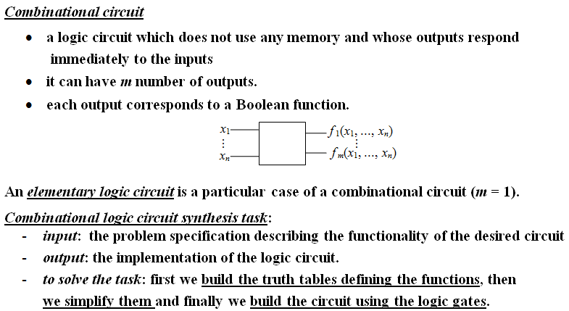
COMBINATIONAL CIRCUITS

Slide 10
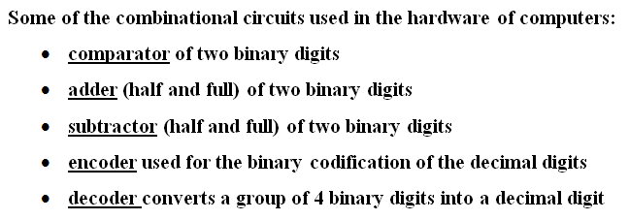
EXAMPLES OF USEFUL COMBINATIONAL CIRCUITS

Slide 11
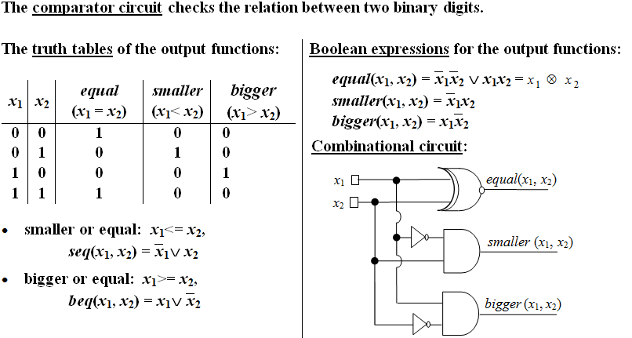
EXAMPLE 4

Slide 12
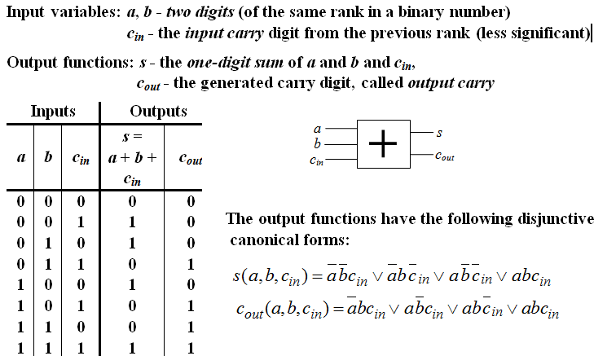
EXAMPLE 5. FULL ADDER

Slide 13
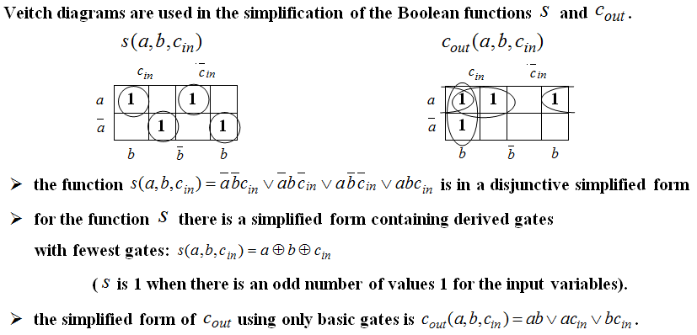
EXAMPLE 5. FULL ADDER (CONTD.)

Slide 14
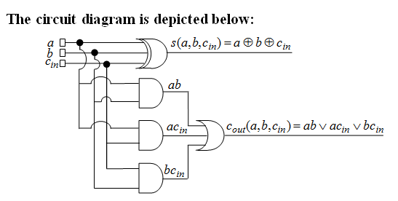
EXAMPLE 5. FULL ADDER (CONTD.)

Slide 15

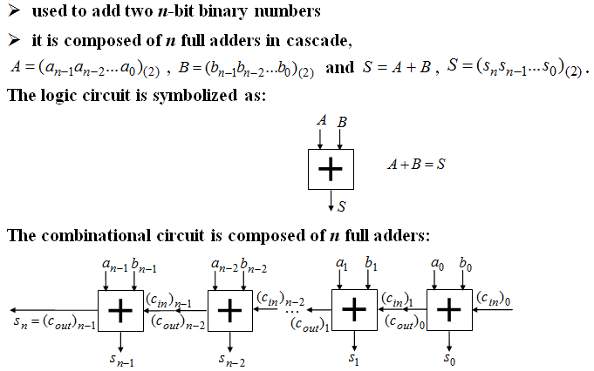

Slide 16

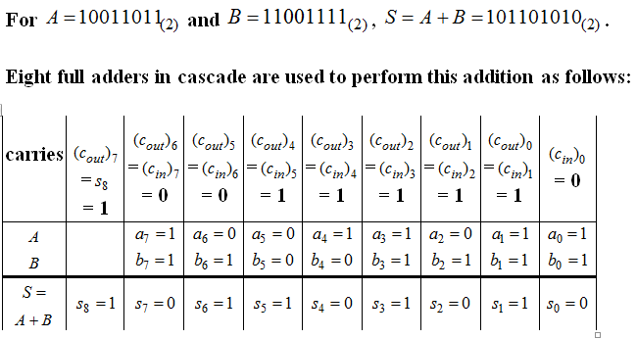

Slide 17
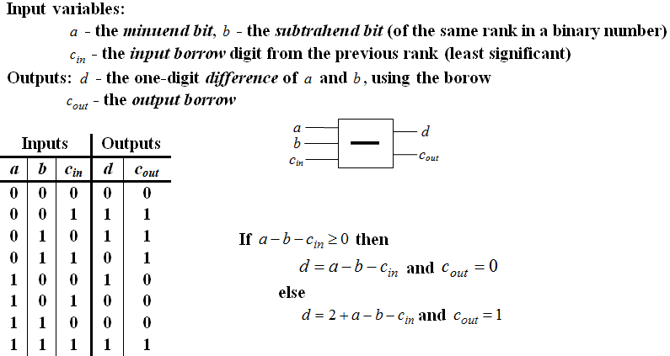
EXAMPLE 7. FULL SUBTRACTOR

Slide 18
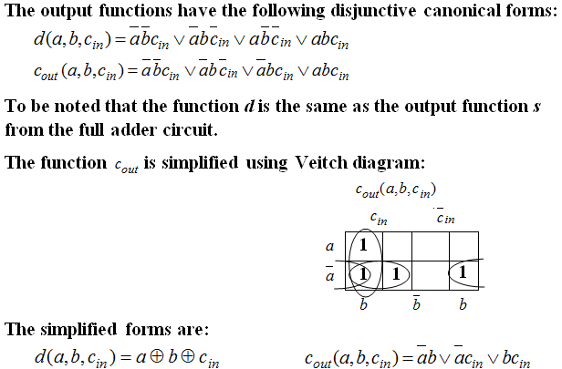
EXAMPLE 7. FULL SUBTRACTOR (CONTD.)

Slide 19
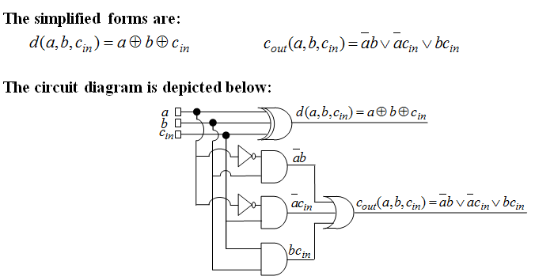
EXAMPLE 7. FULL SUBTRACTOR (CONTD.)

Slide 20

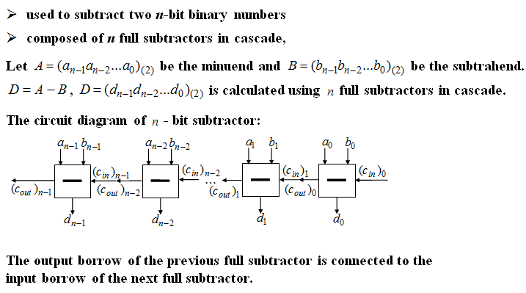

Slide 21

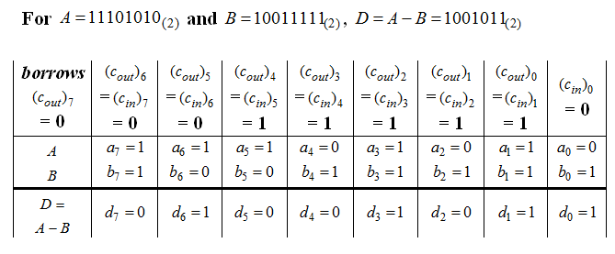

Slide 22
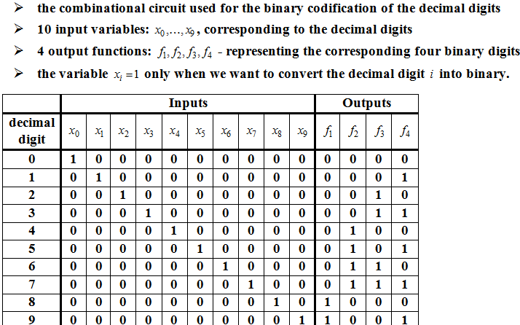
EXAMPLE 9. ENCODER

Slide 23
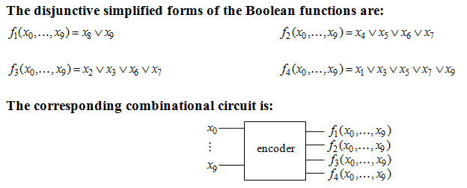
EXAMPLE 9. ENCODER (CONTD.)

Slide 24
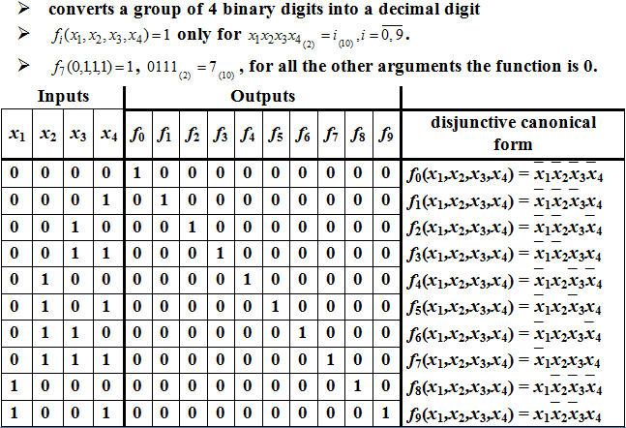
EXAMPLE 10. DECODER

Slide 25
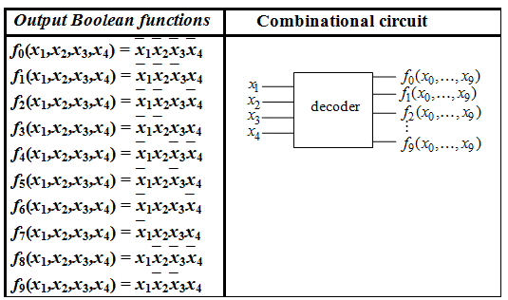
EXAMPLE 10. DECODER (CONTD.)

Slide 26
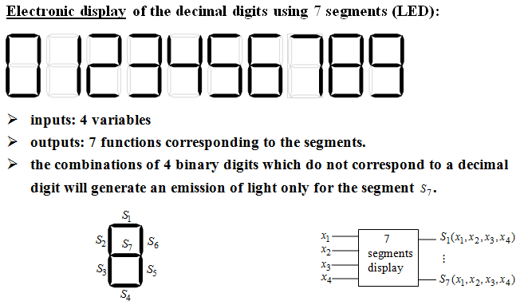
EXAMPLE 11. 7 SEGMENTS CIRCUIT

Slide 27
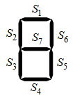
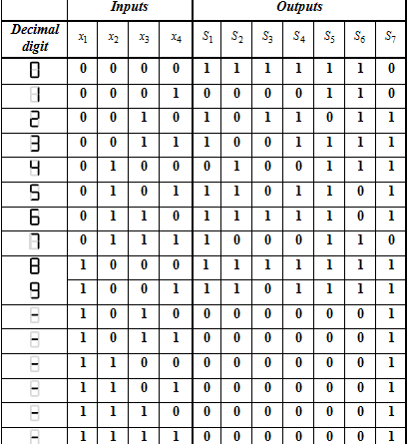
EXAMPLE 11. 7 SEGMENTS CIRCUIT

Slide 28
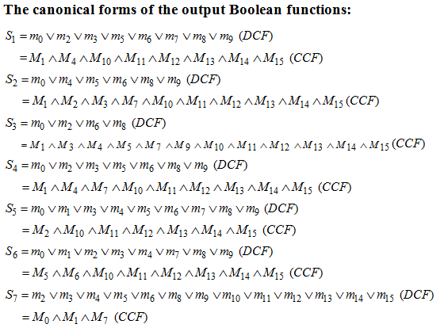
EXAMPLE 11. 7 SEGMENTS CIRCUIT (CONTD.)

Slide 29
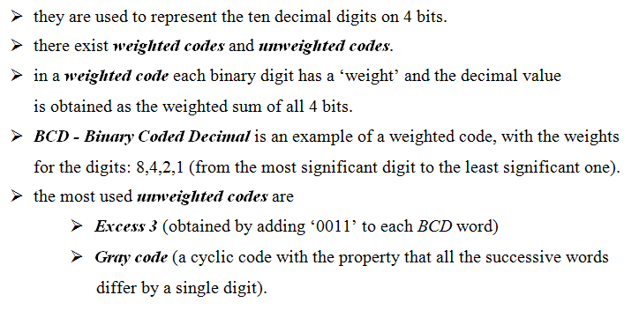
BINARY CODES

Slide 30
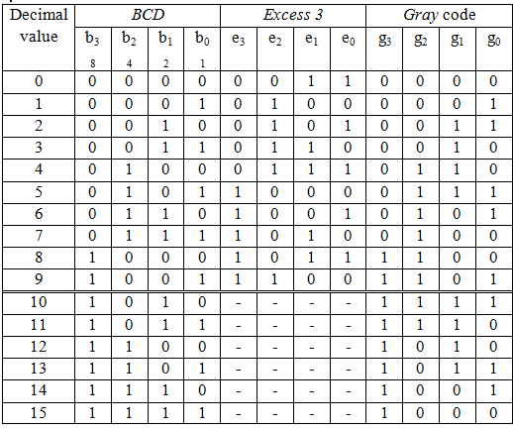
BINARY CODES (CONTD.)

Slide 31
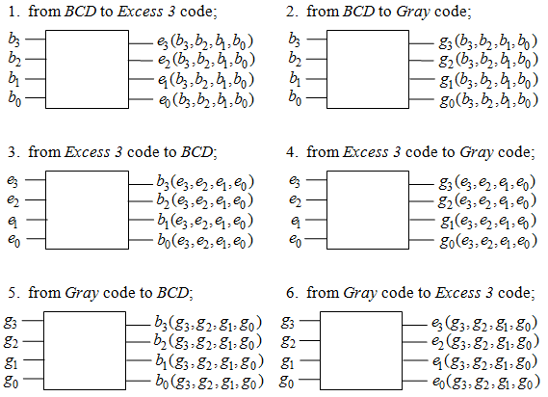
EXAMPLE 12.

