Slide 1
PROPOSITIONAL LOGIC
Syntactic Approach

Slide 2

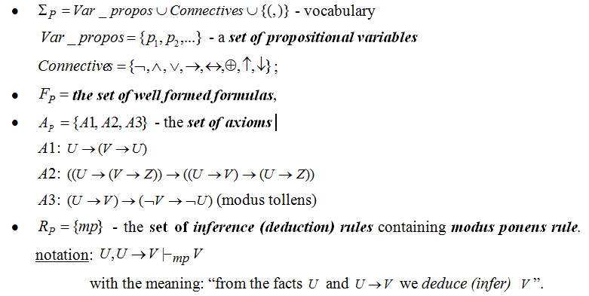
AXIOMATIC (FORMAL) SYSTEM:

Slide 3
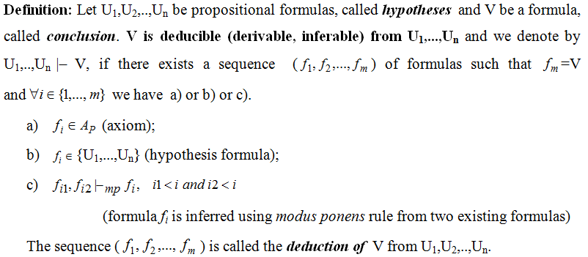
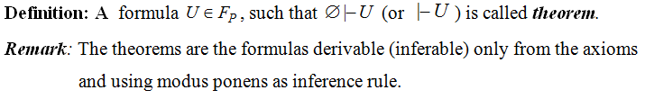
DEDUCTION

Slide 4
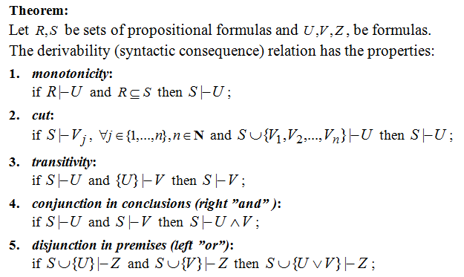
PROPERTIES OF DERIVABILITY RELATION

Slide 5
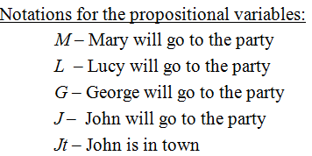
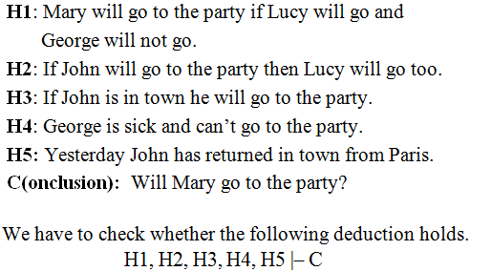
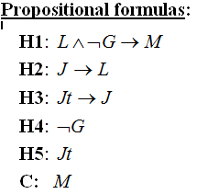
EXAMPLE 1 OF REASONING MODELING: PARTY

Slide 6
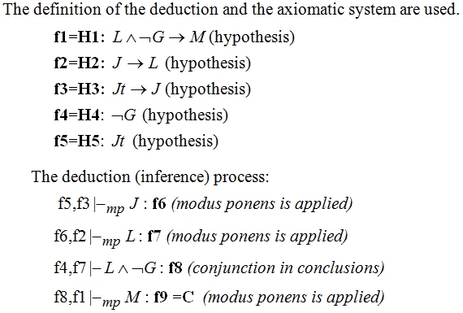
EXAMPLE 1 - BUILDING THE DEDUCTION

Slide 7
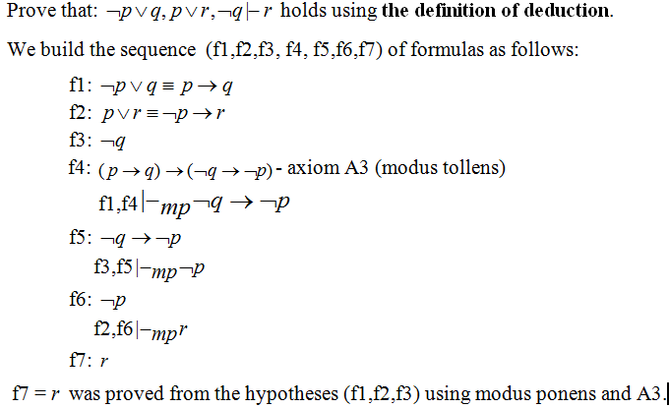
EXAMPLE 2

Slide 8
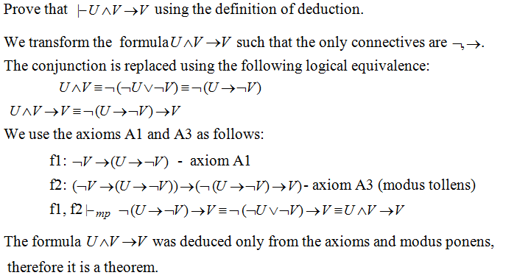
EXAMPLE 3

Slide 9
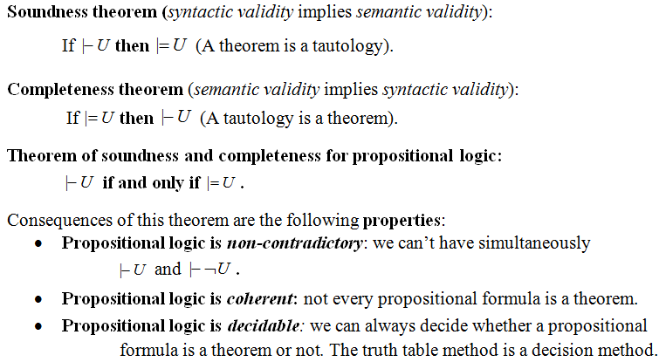
PROPERTIES OF PROPOSITIONAL LOGIC

Slide 10
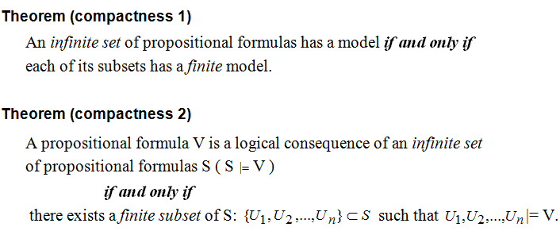
COMPACTNESS PROPERTY

Slide 11
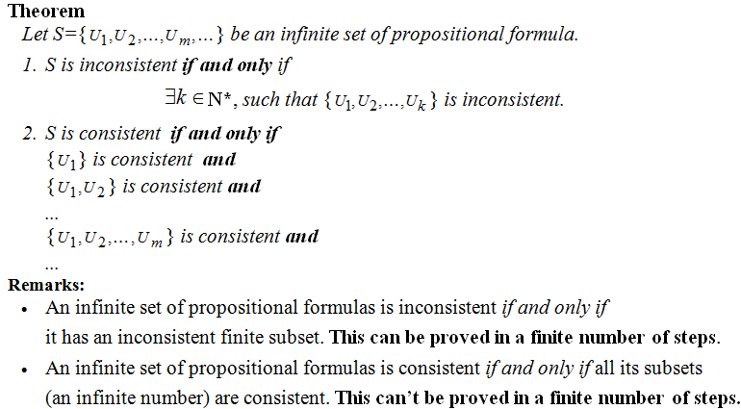
COMPACTNESS PROPERTY (CONTD.)

Slide 12
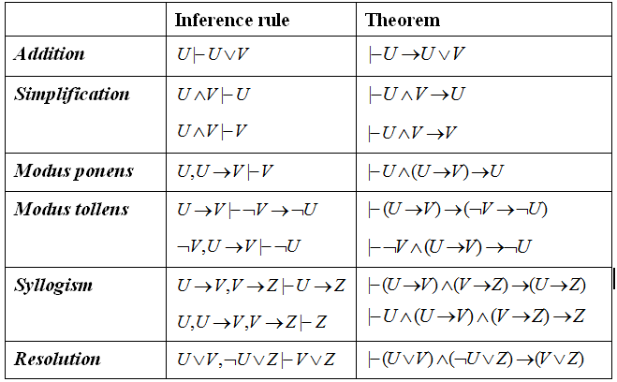
PROPOSITIONAL INFERENCE RULES

Slide 13
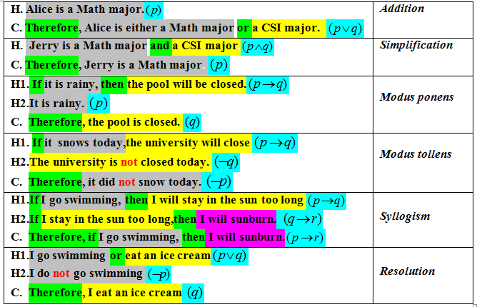
WHICH RULE OF INFERENCE IS USED IN EACH ARGUMENT BELOW?

Slide 14
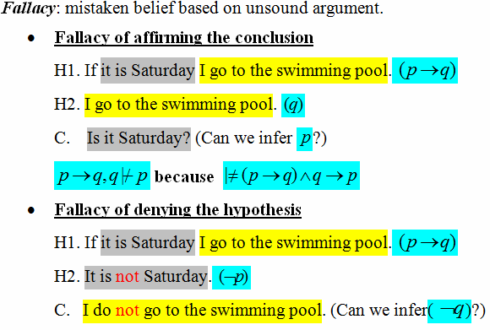
FALLACIES

Slide 15
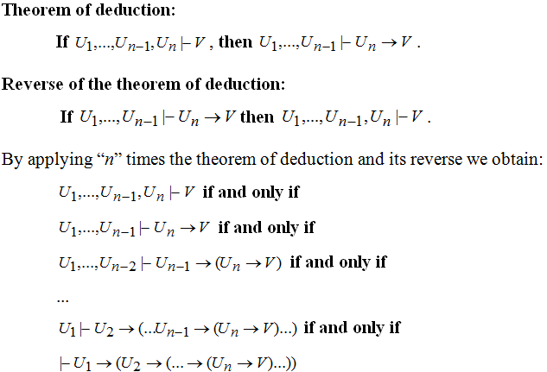
THEOREM OF DEDUCTION AND ITS REVERSE

Slide 16
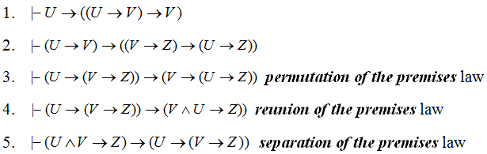
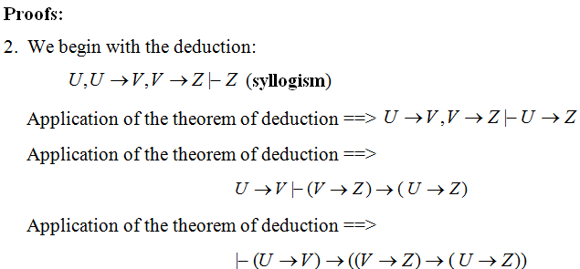
Theorem of deduction - consequences

Slide 17
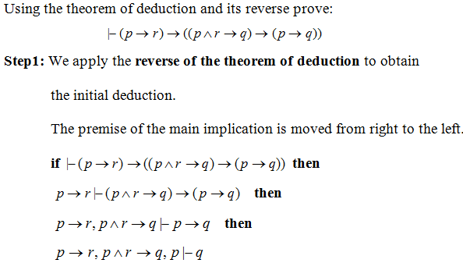
EXAMPLE 4 – THEOREM OF DEDUCTION

Slide 18
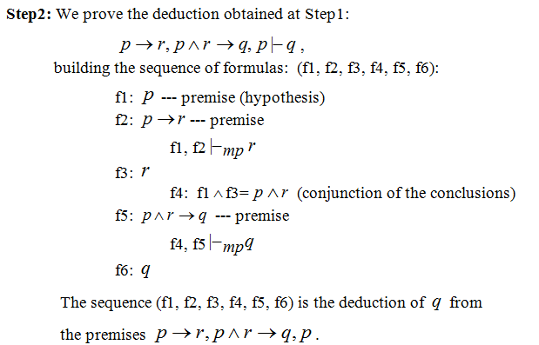
EXAMPLE 4 (CONTD.)

Slide 19
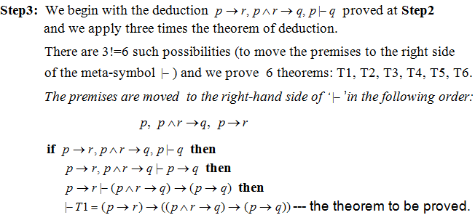
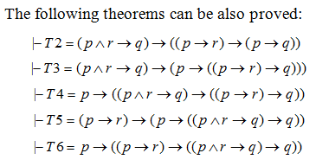
EXAMPLE 4 (CONTD.)

Slide 20
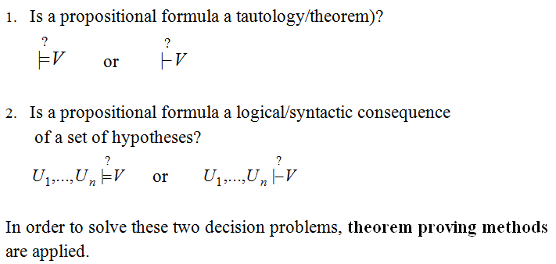
DECISION PROBLEMS
IN PROPOSITIONAL LOGIC

Slide 21
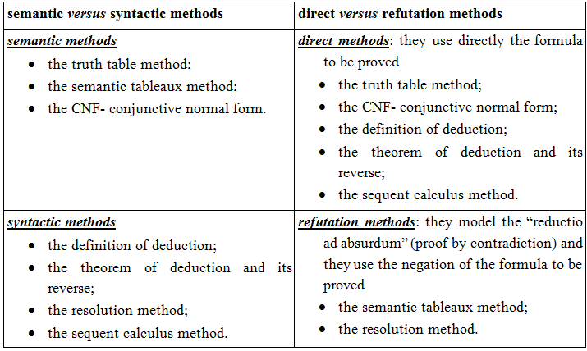
CLASSIFICATION OF PROOF METHODS

