Slide 1
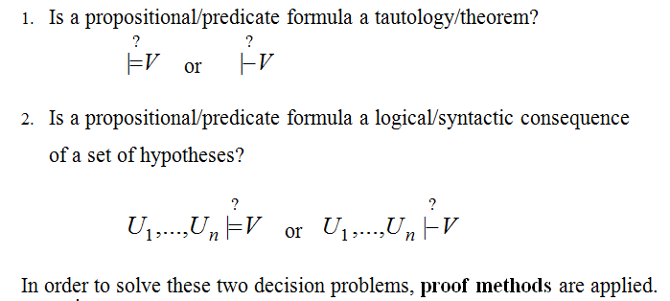
DECISION PROBLEMS IN
PROPOSITIONAL/PREDICATE LOGIC

Slide 2
Semantic Tableaux Method
It was proposed as a proof method for classical logics by
R. Smullyan in 1968.
Dedicated theorem provers: 3TAP, pTAP, leanTAP, Cassandra.
It was easily adapted to nonstandard logics (modal, temporal, many-valued, non-monotonic).
It is based on semantic considerations => semantic method.
Its basic aim is to decide consistency and to find all the models of a formula by decomposing the formula in subformulas.
The validity of a formula is proved by contradiction=>
=> refutation method.

Slide 3
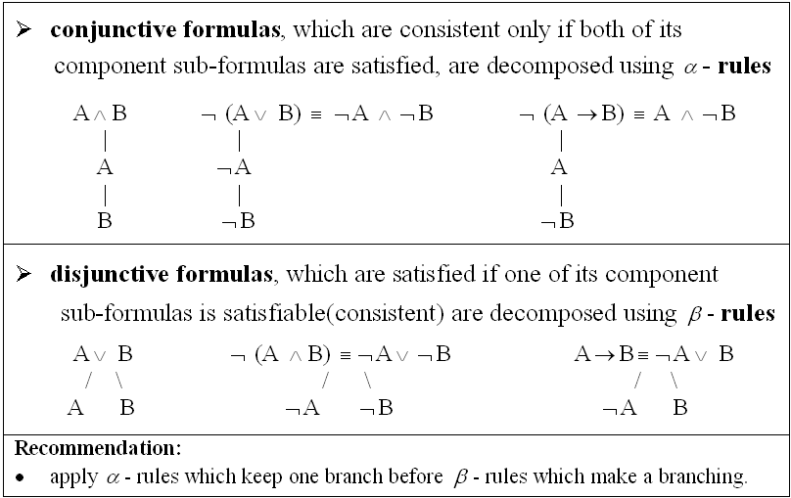
Decomposition rules for propositional formulas

Slide 4
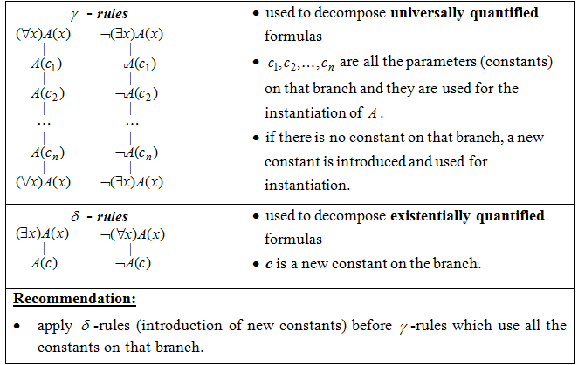
Decomposition rules for predicate formulas

Slide 5
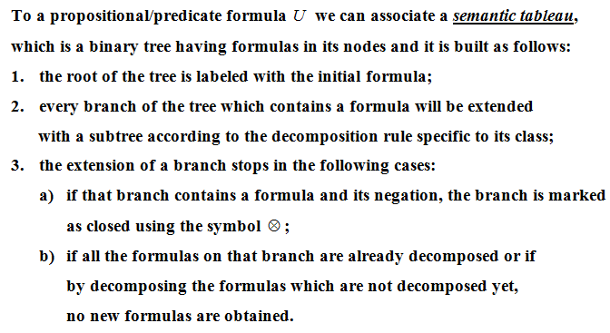
Construction of a semantic tableau

Slide 6
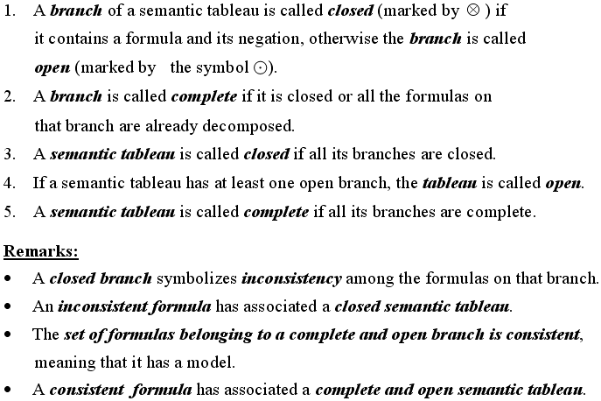
Definitions

Slide 7
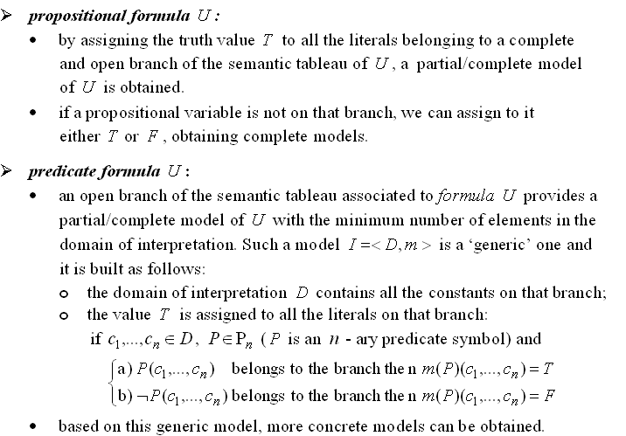
Models of a formula

Slide 8
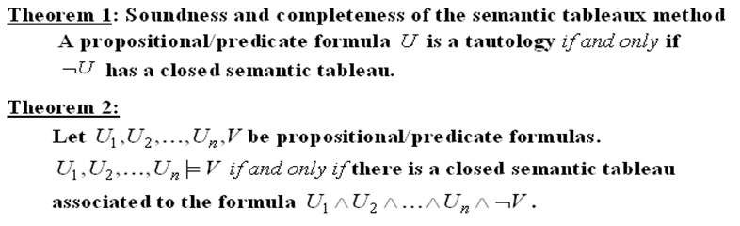
Semantic tableaux method – a refutation proof method

Slide 9
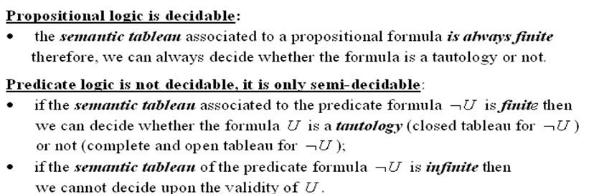

Slide 10
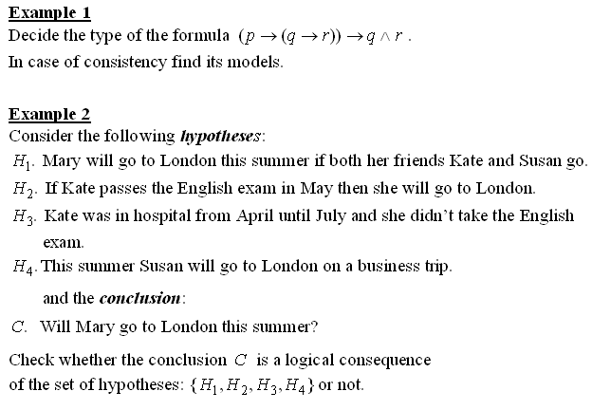
Examples

Slide 11
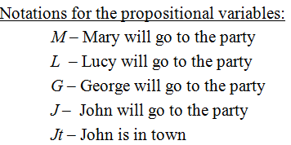
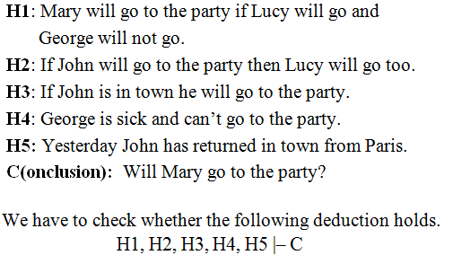
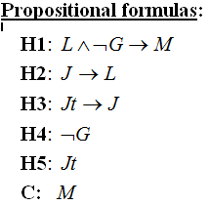
EXAMPLE OF REASONING MODELING: PARTY

Slide 12
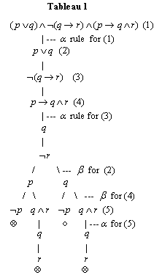
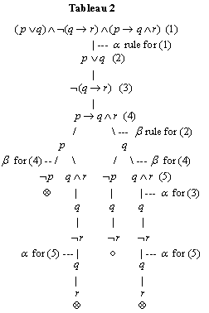
Example 3. Build two different semantic tableaux for the formula:

Slide 13
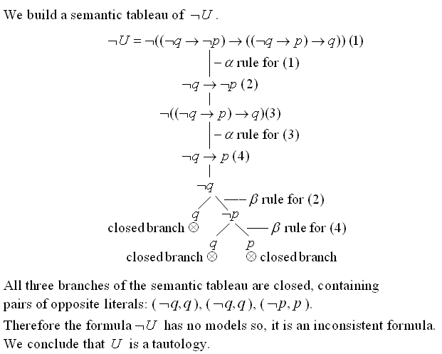
Example 4.
Prove the validity of

Slide 14
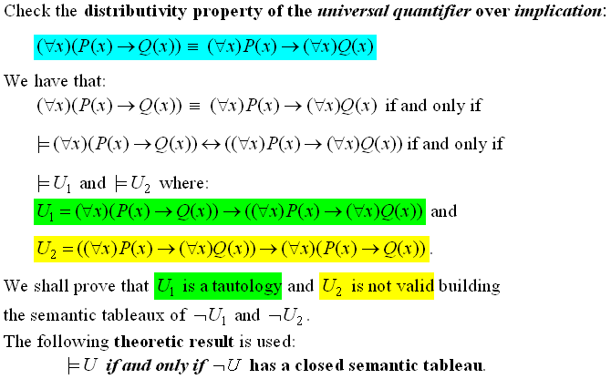
Example 5:

Slide 15

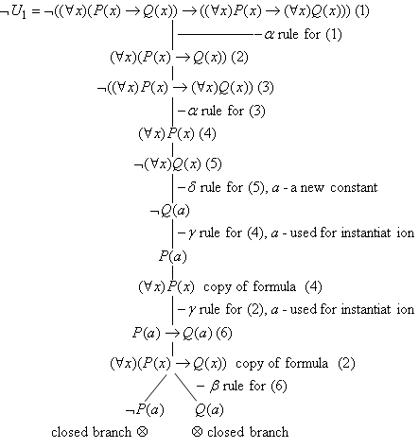

Slide 16

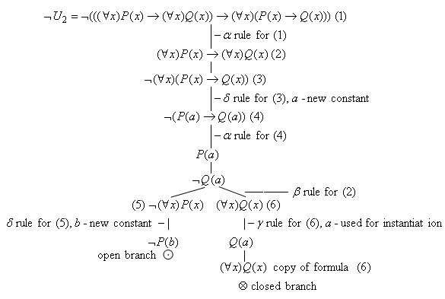

Slide 17

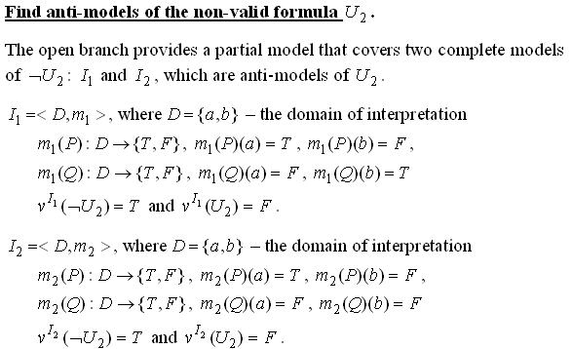

Slide 18
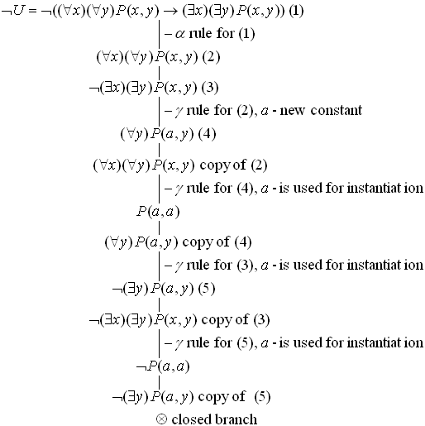
Example 6: Prove the validity of

Slide 19
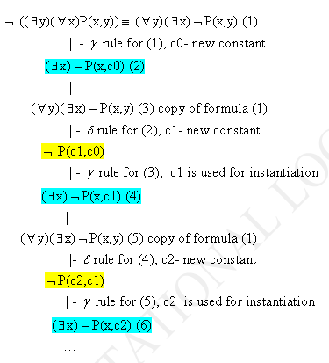
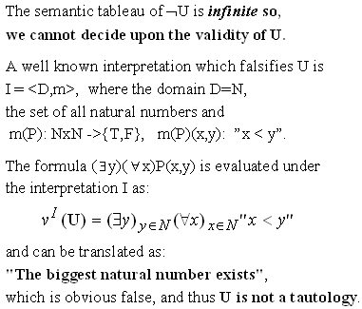
Example 7: Prove the non-validity of

Slide 20
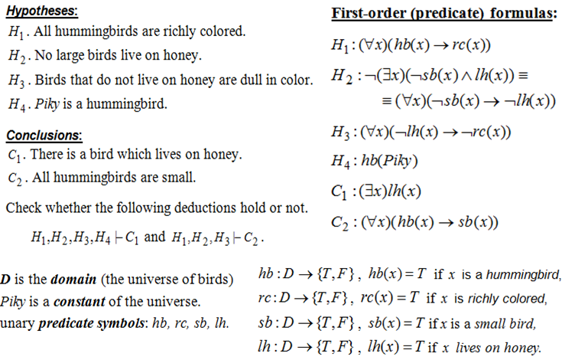
Example 8: Modeling reasoning

