Slide 1
RESOLUTION PROOF METHOD
IN PROPOSITIONAL LOGIC

Slide 2
RESOLUTION PROOF METHOD
It was proposed by J.A. Robinson in 1965 as a proof method for classical logics
Dedicated theorem provers based on resolution:
OTTER, PCPROOVE, AMPHION, Jape
It was easily adapted to nonstandard logics (modal, temporal, many-valued, non-monotonic).
Its basic aim is to check the consistency/inconsistency of a set of clauses.
It is based on syntactic considerations => syntactic method
The validity of a formula is proved by contradiction=>
=> refutation method

Slide 3
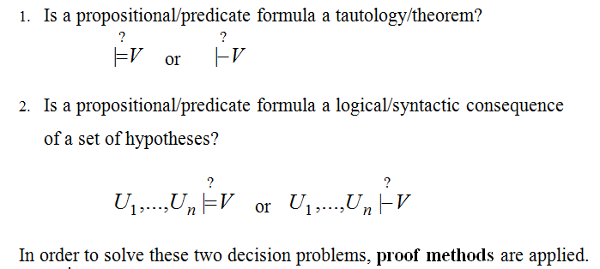
DECISION PROBLEMS IN
PROPOSITIONAL/PREDICATE LOGIC

Slide 4
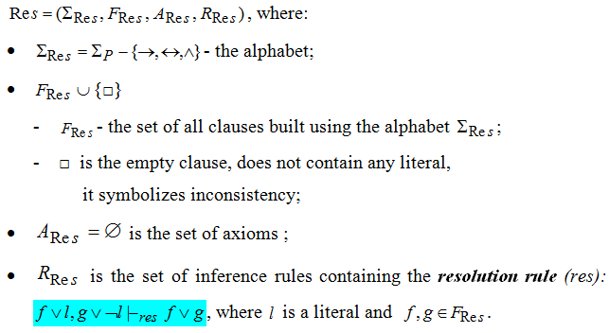
RESOLUTION METHOD
- FORMAL SYSTEM FOR PROPOSITIONAL LOGIC -

Slide 5
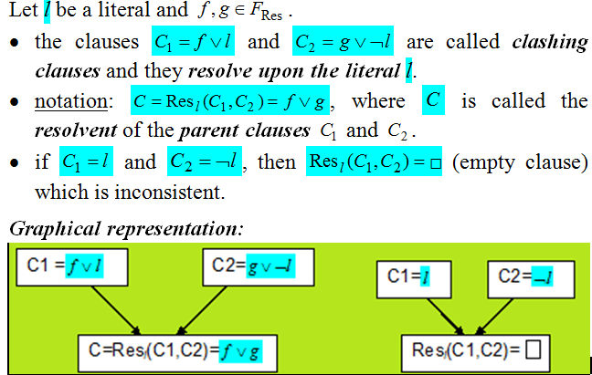
DEFINITIONS

Slide 6
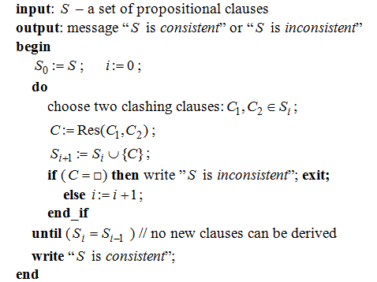
ALGORITHM: PROPOSITIONAL_RESOLUTION

Slide 7
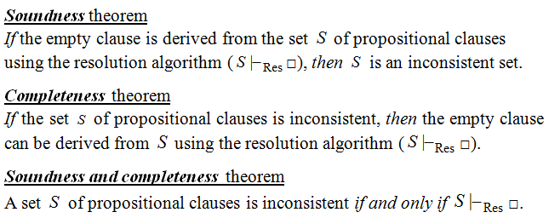
THEOREMS

Slide 8
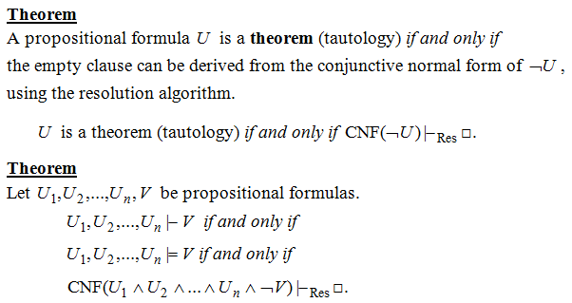
RESOLUTION - A REFUTATION PROOF METHOD

Slide 9
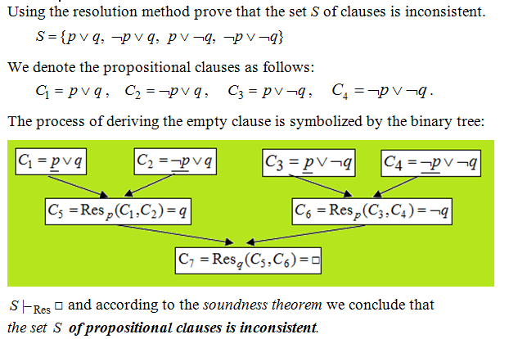
EXAMPLE 1

Slide 10
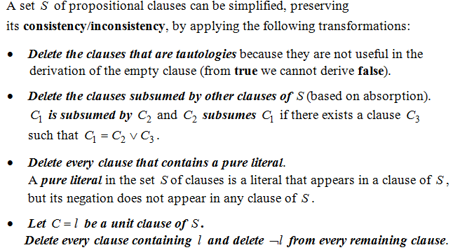
THEOREM
(BASED ON DAVIS-PUTMAN PROCEDURE)

Slide 11
STRATEGIES AND REFINEMENTS OF RESOLUTION
Strategies:
  assure that all the possible clauses to be derived are generated
  they try to avoid the derivation of redundant and irrelevant clauses in order to obtain the empty clause.
  level-saturation strategy, deletion strategy,
  set-of-support strategy
Refinements
  make the resolution process more efficient by imposing restrictions on the clashing clauses
  lock resolution, linear resolution,
  semantic resolution

Slide 12
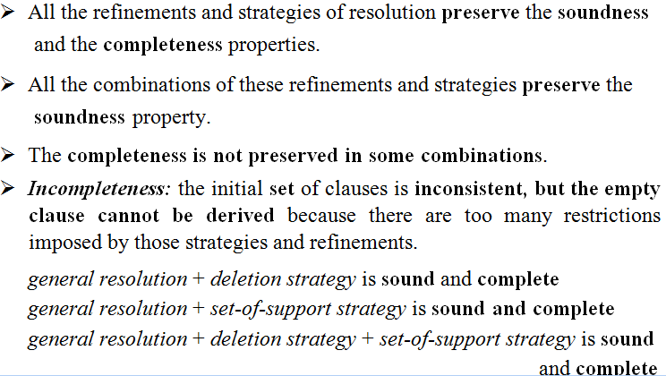
REMARKS

Slide 13
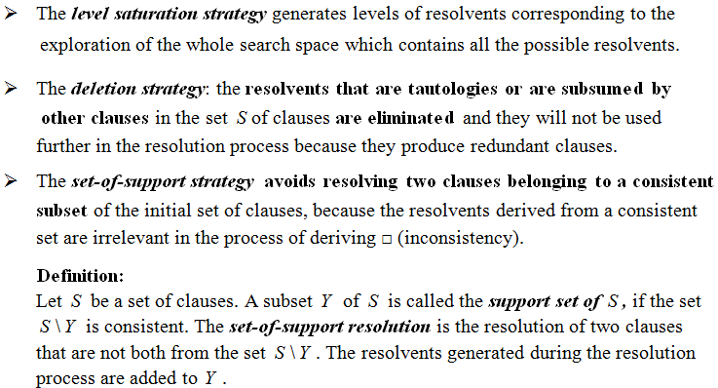
STRATEGIES OF RESOLUTION

Slide 14
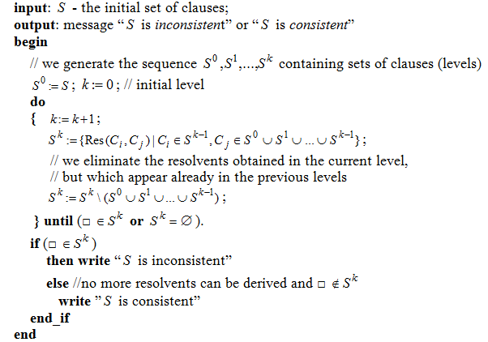
ALGORITHM: LEVEL-SATURATION-STRATEGY

Slide 15
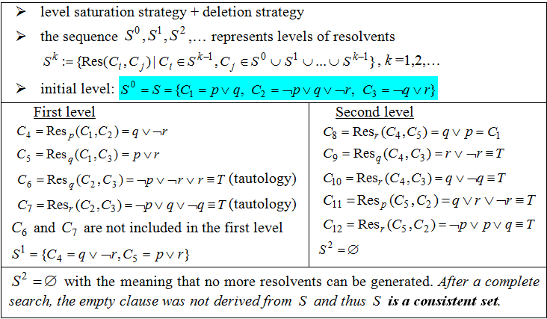
EXAMPLE 2

Slide 16
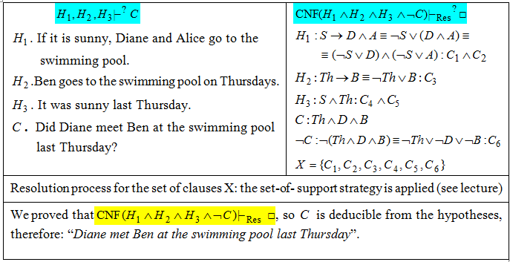
EXAMPLE 3. MODELING REASONING

Slide 17
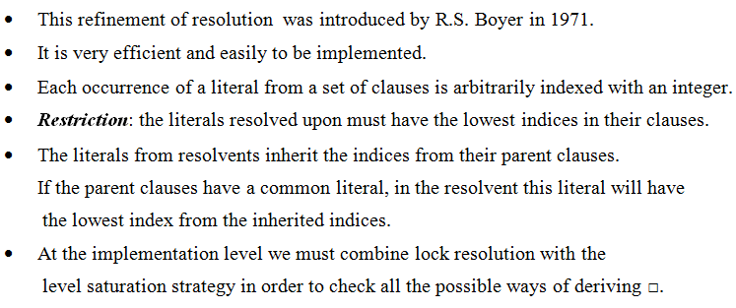
LOCK RESOLUTION

Slide 18
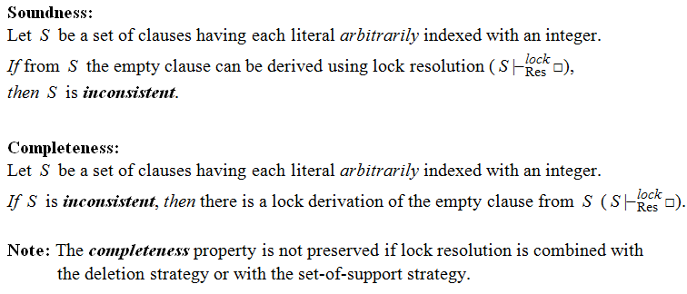
THEOREMS – LOCK RESOLUTION

Slide 19
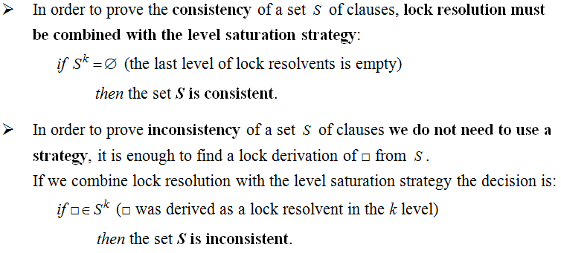
REMARKS

Slide 20
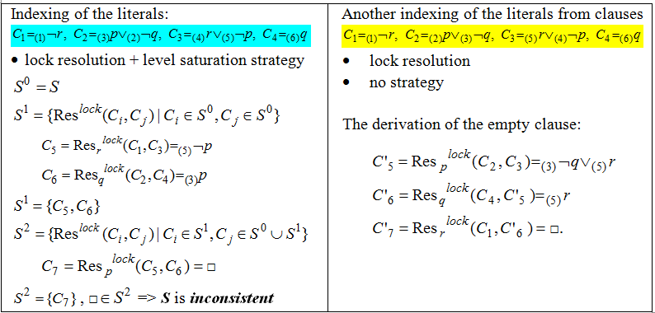
EXAMPLE 4

Slide 21
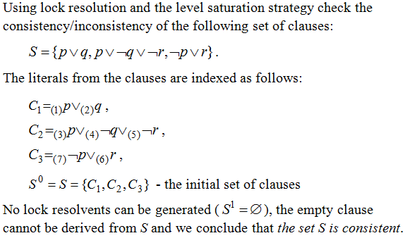
EXAMPLE 5

Slide 22
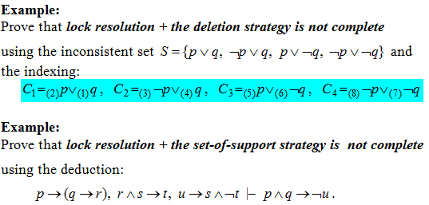
EXAMPLES (HOMEWORK)

Slide 23
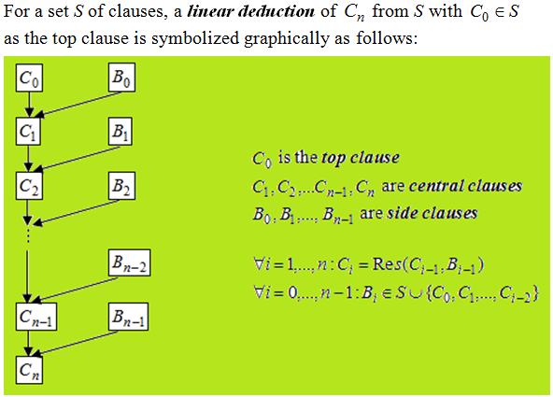
LINEAR RESOLUTION (LOVELAND 1971)

Slide 24
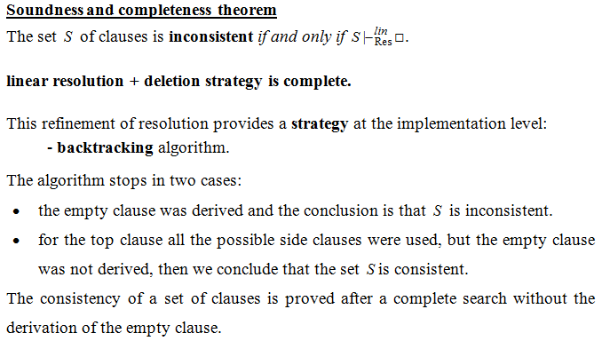
THEORETICAL RESULTS

Slide 25
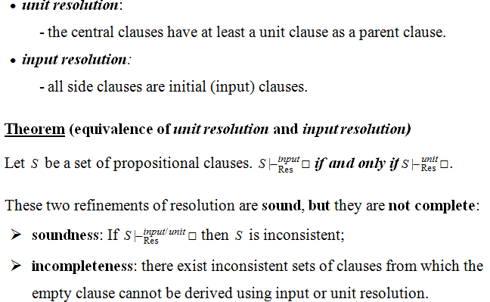
SPECIAL CASES OF LINEAR RESOLUTION

Slide 26
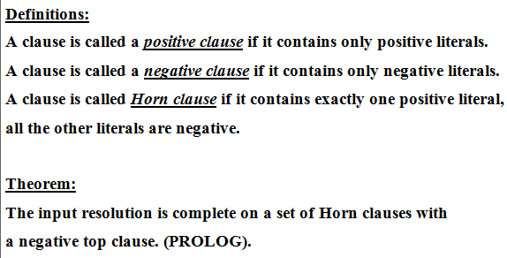
THEORETICAL RESULTS

Slide 27
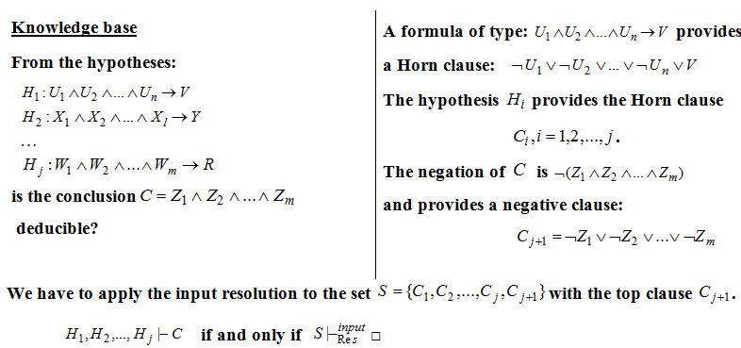
THEORETICAL RESULTS

Slide 28
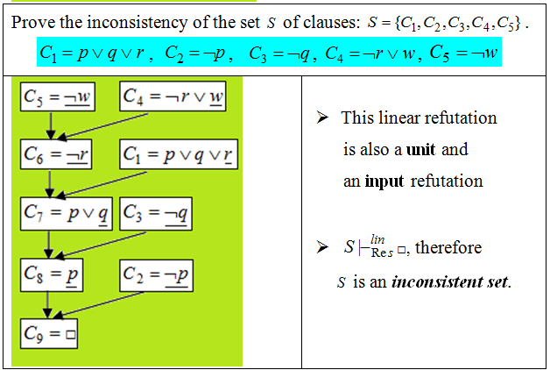
EXAMPLE 6

Slide 29
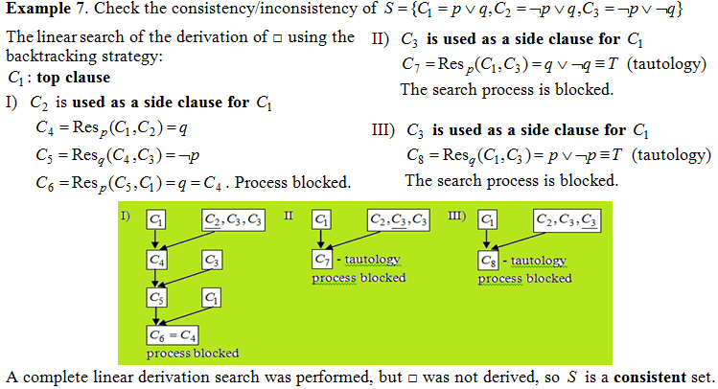

Slide 30
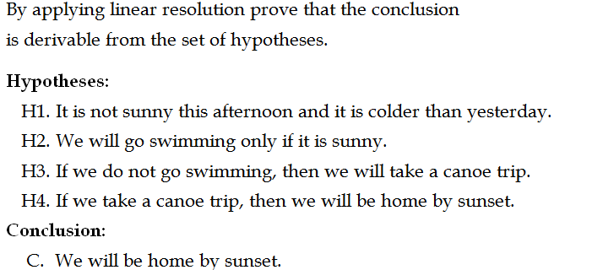
EXAMPLE 8. MODELING REASONING

