Slide 1
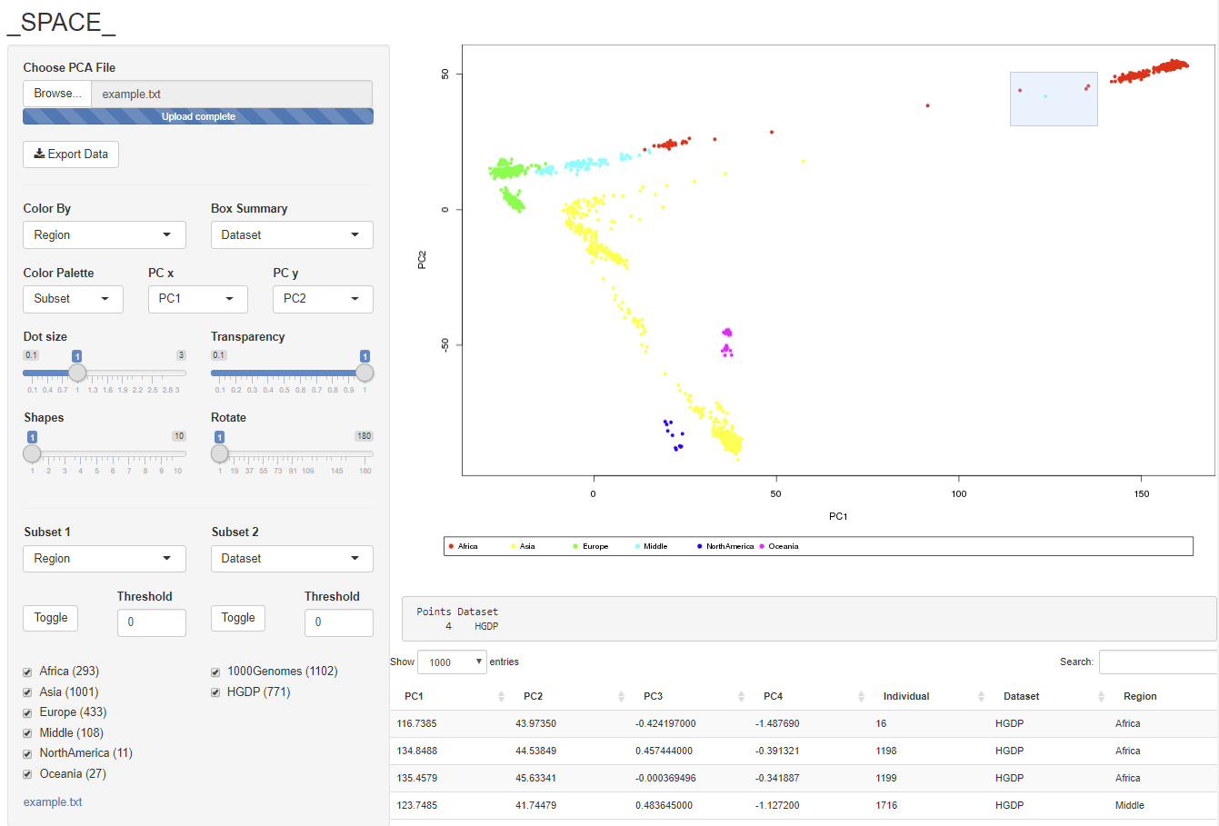
SPACE: A Visualization Tool For Principal Components Analysis Data
Selection
Plot area
Control Panel
Legend
Selection Summary
Selection Data

Slide 2
SPACE: A Visualization Tool For Principal Components Analysis Data
Installation
Getting Started
Features

Slide 3
Installation
SPACE can be launched from an R session
Alternately it can run on server running Shiny server
In either case it opens in a web browser such as Chrome, Firefox or Internet Explorer

Slide 4
Local Installation
Download the repo from github: https://github.com/Ancestry/SPACE
Put server.R and ui.R into a directory together, e.g. C:\Users\user_name\R_projects\SPACE-master
Install R (if it’s not already installed)
Open an R session
Install and load Shiny > install.packages("shiny") # first time only > library(shiny)

Slide 5
Local Installation
Navigate to the parent directory, e.g. > setwd("C:\Users\user_name\R_projects\") > runApp("SPACE-master")
SPACE will open in your default web browser.
Optionally, load the example file from the repo

Slide 6
Web Installation
Download the repo from github: https://github.com/Ancestry/SPACE
Install R (if it's not already installed) > sudo apt-get install r-base
Install shiny sudo su - -c "R -e \"install.packages('shiny')\"“
Install gdebi-core and shiny-server > sudo apt-get install gdebi-core > sudo gdebi shiny-server-1.5.4.deb

Slide 7
Web Installation
Start the shiny server > sudo systemctl start shiny-server
create a new directory in /srv/shiny-server e.g. > mkdir /srv/shiny-server/SPACE
put ui.R and server.R in the new directory
Navigate to your server in a browser. By default shiny server runs on port 3838 e.g. http://127.0.0.1:3838/SPACE/

Slide 8
Getting Started
Select a file to load
SPACE takes tab delimited text files. Any column that starts with “PC” is considered a data column. Other columns are considered labels. Columns can be in any order. An example input file might look like this:
ID | PC1 | PC2 | PC3 | PC4 | Region | Data Set
1 | .5 | .5 | .2 | .1 | Africa | HGDP
2 | .6 | .9 | .2 | .4 | Asia | HGDP
3 | .8 | .1 | .5 | .7 | Europe | HGDP
In this case PC1, PC2, PC3 and PC4 are data. Continent and Data Set are labels

Slide 9
Getting Started
Choose which PCs to plot
By default, the first two PC columns in the file are used to make the plot. Changing the PC dropdowns will control which PCs are used
ID | PC1 | PC2 | PC3 | PC4 | Region | Data Set
1 | .5 | .5 | .2 | .1 | Africa | HGDP
2 | .6 | .9 | .2 | .4 | Asia | HGDP
3 | .8 | .1 | .5 | .7 | Europe | HGDP

Slide 10
Features
Choose a label to color the plot
The Color By dropdown is automatically populated with all the label columns from the file, in this example there are just two: Region and Data Set. Any number of label columns is supported
ID | PC1 | PC2 | PC3 | PC4 | Region | Data Set
1 | .5 | .5 | .2 | .1 | Africa | HGDP
2 | .6 | .9 | .2 | .4 | Asia | HGDP
3 | .8 | .1 | .5 | .7 | Europe | HGDP

Slide 11
Features
Select Points to Inspect The Data
Clicking and dragging on the plot will make a selection box.
The data from the input file for the selected points is shown below. This is a useful method for inspecting outliers and other points of interest.

Slide 12
Features
Select Points to Inspect The Data
Selecting points also creates a summary based on the label columns. Here 4 points were selected, all from the HGDP data set.
The summary can be set to display any label or combination of labels using the Box Summary drop down.

Slide 13
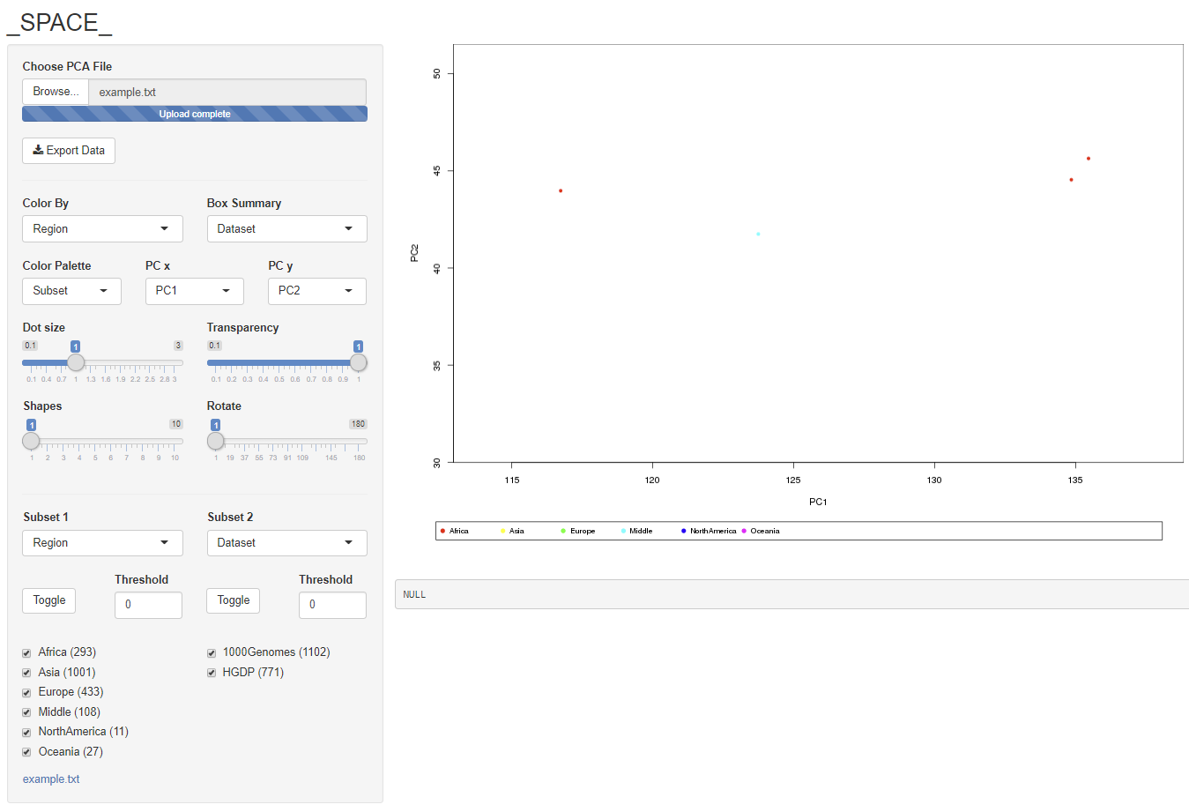
Features
Double Click to Zoom
Double clicking a selection zooms in on it. Double clicking again zooms back out

Slide 14
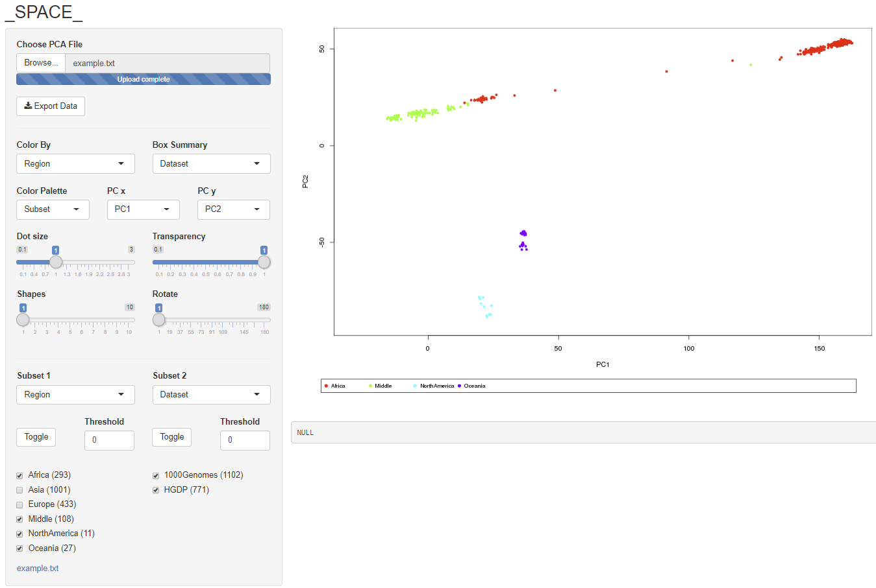
Features
Hide and Show Subsets By Label
SPACE makes a panel of check boxes based on the labels in the file. By default all boxes are checked. Unchecking a box will hide all data points the that label. The label column used to make the check boxes is set by a drop down. Selecting a different label will re-create the check boxes.
A second set of boxes can be used simultaneously. In this example, the user has chosen to show data from all data sets, but has hidden samples from Asia and Europe.

Slide 15
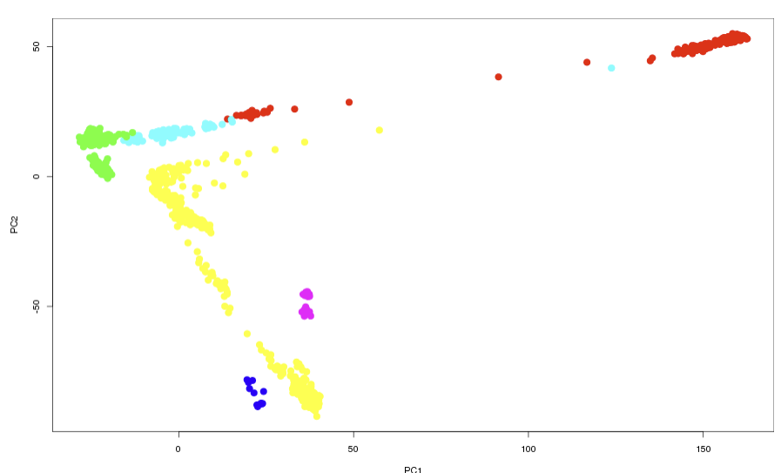
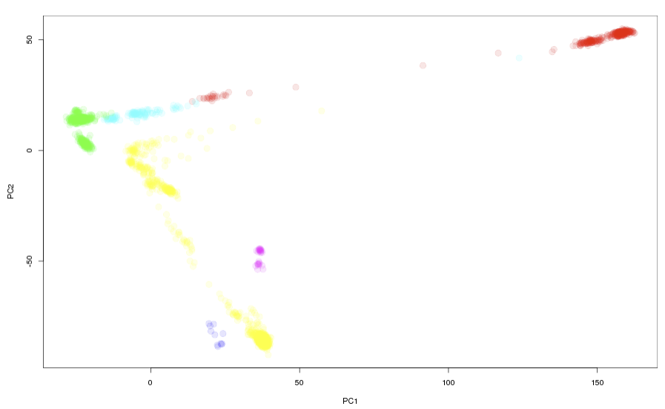
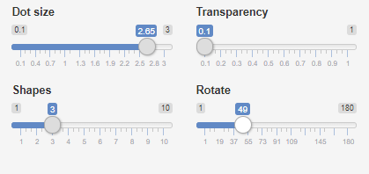
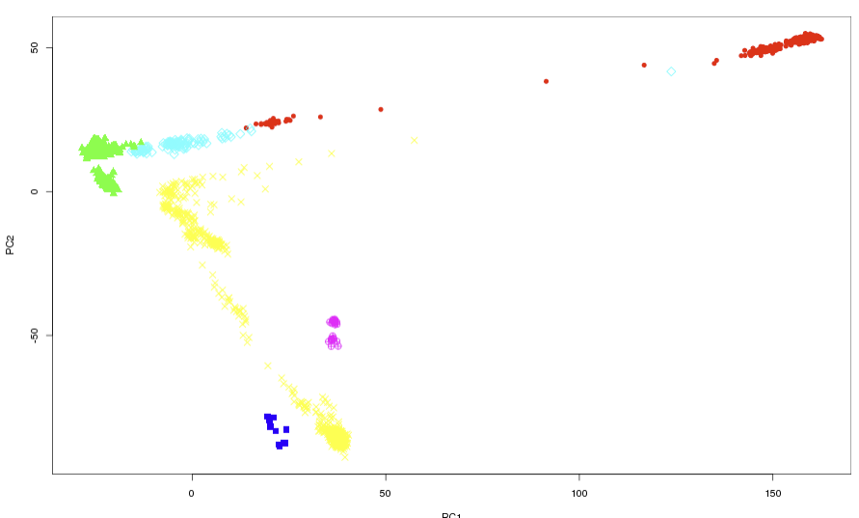
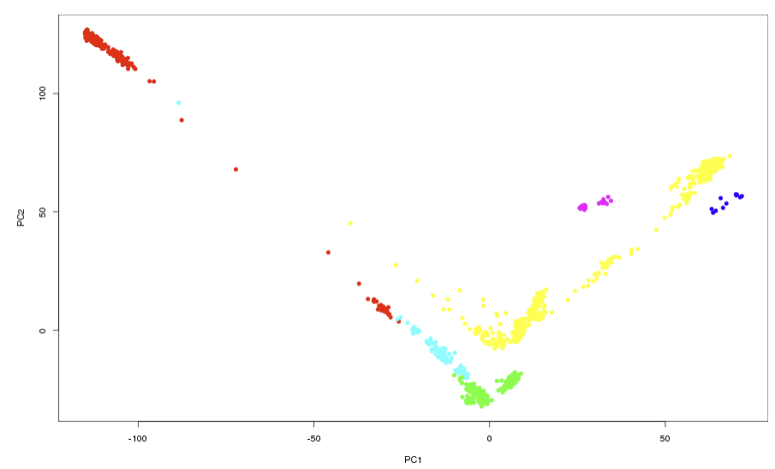
Features
Tune The Plot’s Look
A set of sliders control the look of the plot. Make the points larger or smaller. Visualize cluster density by changing the opacity of the plot
When the number of labels is large, it can be difficult to visually differentiate similar colors. In this case, SPACE can use more symbols for the points. SPACE can also rotate the plot for better clarity.

Slide 16
Advanced
Palette Options
By default SPACE colors using a rainbow palette based on the selected label. Hiding points will cause the plot to be recolored to spread out the tones.
Some users may wish to avoid the recoloring step to keep colors visually consistent during analysis. Choosing “All” from the palette drop down will force SPACE to keep the original colors.
As users hide and show points they may wish to orient themselves within the full PCA space. Choosing “Greyed Out” will show hidden points in grey. Clicking and dragging will not select greyed out points.

Slide 17
Advanced
Toggle
The toggle button unchecks all of the boxes. This is useful for users who want to add populations one by one rather than start with the full set and subtract them. Pressing the toggle a second time checks all the boxes.
Thresholding
Some data sets have a large number of labels, and certain labels may only apply to a small number of individuals. Depending on the experiment, these populations may be of interest or may simply contribute to visual noise. Setting a threshold automatically hides populations with a small number of individuals. For example setting the threshold to 10 will filter out individuals from populations smaller than 10

Slide 18
Advanced
Export
To make a new file containing a subset of individuals, select the group of interest and click the export button.

Slide 19
Got an idea for a new feature?
Source
SPACE is open source and free to use for academic and non-profit entities. Please review the license in the GitHub repository.
???

