Slide 1
IPL Auction Strategy for New Franchise Using Historical Data

Slide 2
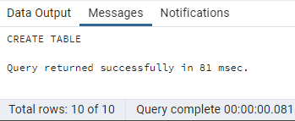
Creation of Deliveries and Matches Tables
Deliveries:-
Query:-
create table Deliveries(match_id int, inning int, over int, ball int, batsman varchar,non_striker varchar,bowler varchar,batsman_runs int,extra_runs int,total_runs int,is_wicket int,dismissal_kind varchar,player_dismissed varchar, fielder varchar,extras_type varchar,batting_team varchar,bowling_team varchar);
Output:-

Slide 3
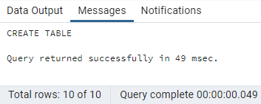
Matches:-
Query:-
create table matches (match_id int,match_city varchar,match_date date,player_of_match varchar,venue varchar,neutral_venue int,team1 varchar,team2 varchar,toss_winner varchar,toss_decision varchar,winner varchar,result varchar,result_margin int,elimination varchar,method varchar,umpire1 varchar,umpire2 varchar);
Output:-

Slide 4
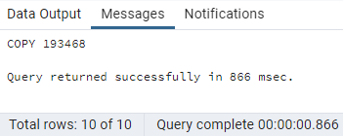
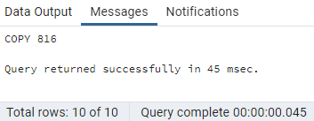
Copy Data into Deliveries and Matches Tables
Deliveries:-
Query:-
copy deliveries from 'D:\Internshala Projects\SQL\IPL Dataset\IPL_Ball.csv' csv header;
Output:-
Deliveries:-
Query:-
copy matches from 'D:\Internshala Projects\SQL\IPL Dataset\IPL_matches.csv' csv header;
Output:-

Slide 5
Your first priority is to get 2-3 players with high S.R who have faced at least 500 balls.And to do that you have to make a list of 10 players you want to bid in the auction so that when you try to grab them in auction you should not pay the amount greater than you have in the purse for a particular player. (strike rate is total runs scored by batsman divided by number of balls faced but remember when extras_type is 'wides' it is not counted as a ball faced neither counted as batsmen runs)
Task - 1:-
Description:-
To make the list of 10 players with a good average who have played more than 2 IPL seasons, I used the select statement with batsman, the sum function on batsman_runs to get runs_scored_by_batsman, and the sum function on is_wicket to get the number_of_dismissals. I extracted the year from match_date from the matches table and applied a distinct count function to it to get seasons_played. Next, I divided the sum (batsman_runs) by the sum (is_wicket) and rounded to two decimal places to get the average_of_batsman. Here, the data has been retrieved from two tables, deliveries as d and matches as m, and joined using the match_id field to relate deliveries to matches. Then, I applied the conditions that sum(is_wicket) is greater than or equal to 1 and seasons_played must be greater than 2, and then ordered the results in descending order of average_of_batsman, so the players with the highest batting average appear at the top, and finally restricted the output to the top 10 players with the highest batting average.

Slide 6
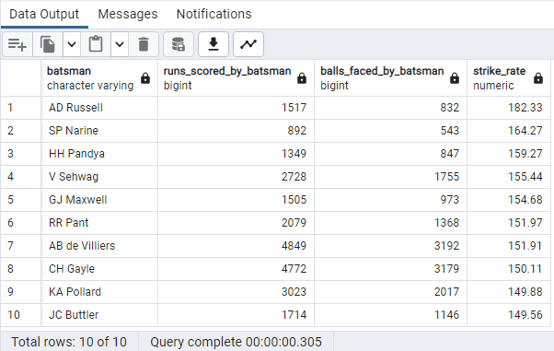
select batsman, sum(batsman_runs) as runs_scored_by_batsman, count(ball) as balls_faced_by_batsman, round((sum(batsman_runs)*1.0/count(ball))*100,2) as strike_rate from deliveries where extras_type not in ('wides') group by batsman having count(ball) >= 500 order by strike_rate desc limit 10;
Query:-
Output:-

Slide 7
Visualization:-

Slide 8
Now you need to get 2-3 players with good Average who have played more than 2 ipl seasons. And to do that you have to make a list of 10 players you want to bid in the auction so that when you try to grab them in auction you should not pay the amount greater than you have in the purse for a particular player. (Average is calculated as total runs scored divided by number of times batsman has been dismissed which can be calculated using wicket_ball field as 1 indicates out and 0 indicates not out, a batsman should’ve been dismissed at least once to calculate the sr i.e., you can exclude those players who have not been dismissed once )
Task - 2:-
Description:-
To make the list of 10 players with a good average who have played more than 2 IPL seasonsa, I used the select statement with the batsman, the sum function on batsman_runs to get runs_scored_by_batsman, nd the sum function on is_wicket to get the number_of_dismissals. I extracted the year from match_date from the matches table and applied a distinct count function to it to get seasons_played. Next, I divided the sum (batsman_runs) by the sum (is_wicket) and rounded to two decimal places to get the average_of_batsman. Here, the data has been retrieved from two tables, deliveries as d and matches as m, and joined using the match_id field to relate deliveries to matches. Then, I applied the conditions that sum(is_wicket) is greater than or equal to 1 and seasons_played must be greater than 2, and then ordered the results in descending order of average_of_batsman, so the players with the highest batting average appear at the top and finally restricted the output to the top 10 players with the highest batting average.

Slide 9
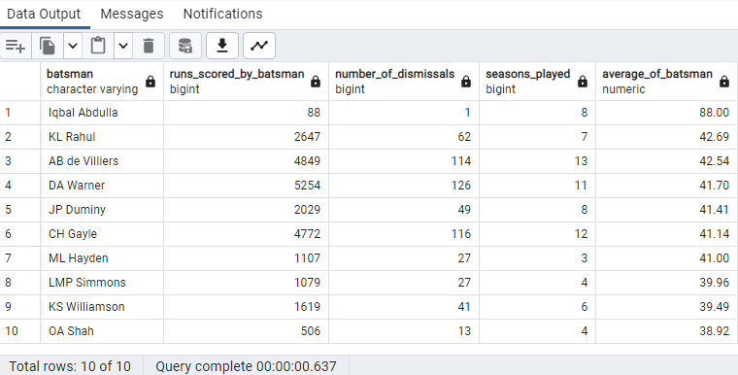
select d.batsman, sum(d.batsman_runs) as runs_scored_by_batsman, sum(d.is_wicket) as number_of_dismissals, count(distinct extract(year from m.match_date)) as seasons_played, round((sum(d.batsman_runs)*1.0/sum(d.is_wicket)),2) as Average_of_Batsman from deliveries as d join matches as m on d.match_id = m.match_id group by batsman having sum(d.is_wicket)>=1 and count(distinct extract(year from m.match_date))>2 order by Average_of_Batsman desc limit 10;
Query:-
Output:-

Slide 10
Visualization:-

Slide 11
Now you need to get 2-3 Hard-hitting players who have scored most runs in boundaries and have played more the 2 ipl season. To do that you have to make a list of 10 players you want to bid in the auction so that when you try to grab them in auction you should not pay the amount greater than you have in the purse for a particular player. (only 4 and 6 will be counted as boundaries so calculate how many 4 and 6 has been hit by each batsman and also calculate total runs scored to get the output as boundary percentage which will be runs in boundary divided by total runs scored)
Task - 3:-
Description:-
To make the list of 10 hard-hitting players who have scored the most runs and have played at least 2 IPL seasons, I used the select statement with the batsman and the sum function on batsman_runs to get runs_scored_by_batsman. I extracted the year from match_date from the matches table and applied a distinct count function to it to get seasons_played. Next, I used the case when statement and applied the condition that if batsman_runs is 4, then 1 else is 0, and then used the sum function on this case when statement to get number_of_fours. Similarly, I got number_of_sixes and total_number_of_boundaries. Next, I used the case when statement and applied the condition that if batsman_runs is both 4 and 6, then batsman_runs else 0, and then used the sum function on this case when statement to get runs_scored_by_boundaries. Next, I divided the runs_scored_by_boundaries by the sum of batsman_runs, multiplied the result by 100, and rounded to decimal places to get a percentage_of_boundaries. Here, the data has been retrieved from two tables, deliveries as d and matches as m, and joined using the match_id field to relate deliveries to matches. Then, I applied the condition that seasons_played must be greater than 2, and then ordered the results in descending order of percentage_of_boundaries, so the players with the highest percentage_of_boundaries appear at the top, and finally restricted the output to the top 10 players with the highest percentage_of_boundaries.

Slide 12
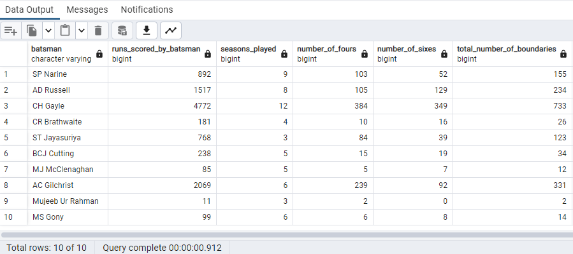
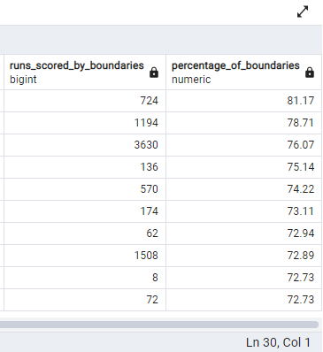
select d.batsman, sum(d.batsman_runs) as runs_scored_by_batsman, count(distinct extract(year from m.match_date)) as seasons_played, sum(case when d.batsman_runs = 4 then 1 else 0 end) as number_of_fours, sum(case when d.batsman_runs = 6 then 1 else 0 end) as number_of_sixes, sum(case when d.batsman_runs in (4,6) then 1 else 0 end) as total_number_of_boundaries, sum(case when d.batsman_runs in (4,6) then d.batsman_runs else 0 end) as runs_scored_by_boundaries, round((sum(case when d.batsman_runs in (4,6) then d.batsman_runs else 0 end)/(sum(d.batsman_runs)*1.0))*100,2) as percentage_of_boundaries from deliveries as d join matches as m on d.match_id = m.match_id group by d.batsman having count(distinct extract(year from m.match_date))>2 order by percentage_of_boundaries desc limit 10;
Query:-
Output:-

Slide 13
Visualization:-

Slide 14
Your first priority is to get 2-3 bowlers with good economy who have bowled at least 500 balls in IPL so far.To do that you have to make a list of 10 players you want to bid in the auction so that when you try to grab them in auction you should not pay the amount greater than you have in the purse for a particular player.(economy can be calculated by dividing total runs conceded with total overs bowled)
Task - 4:-
Description:-
To make a list of 10 players who have a good economy and bowled at least 500 balls in IPL, I used the select statement with the bowler, count function on the ball to get balls_bowled, count function on the ball, and divide it with 6 and rounded to get total_overs_bowled, sum function on total_runs to get total_runs_conceded. Next, I divided the count of balls by total_overs_bowled and rounded to two decimal places to get bowlers_economy. Then I applied some conditions that the count of balls must be greater than or equal to 500, and then ordered the results in ascending order of bowlers_economy. So, the players with the best economy will appear at the top, and finally, the output will be restricted to the top 10 players with the best bowling economy.

Slide 15
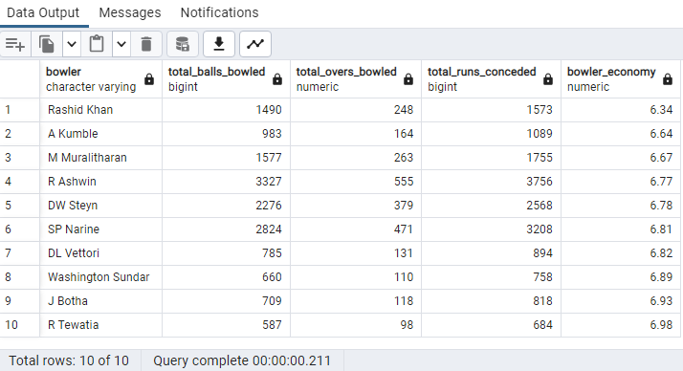
select bowler, count(ball) as total_balls_bowled, round(count(ball)*1.0/6) as total_overs_bowled, sum(total_runs) as total_runs_conceded, round((sum(total_runs)/round(count(ball)*1.0/6)*1.0),2) as bowler_economy from deliveries group by bowler having count(ball) >= 500 order by bowler_economy limit 10;
Query:-
Output:-

Slide 16
Visualization:-

Slide 17
Now you need to get 2-3 bowlers with the best strike rate and who have bowled at least 500 balls in IPL so far.To do that you have to make a list of 10 players you want to bid in the auction so that when you try to grab them in auction you should not pay the amount greater than you have in the purse for a particular player. (strike rate of a bowler can be calculated by number of balls bowled divided by total wickets taken )
Task - 5:-
Description:-
To make the list of 10 players with the best strike rate and who bowled at least 500 balls in IPL, I used the select statement with the bowler, count function on the ball to get balls_bowled. Next, I used the case when statement and applied the condition that if dismissal_kind is bowled, caught, caught and bowled, lbw, stumped, hit wicket then 1 else 0, and then used the sum function on this case when statement to get number_of_wickets_taken. Next, I divided the count of the balls by number_of_wickets_taken and rounded to two decimal places to get the bowler_strike_rate. Then I applied some conditions that the count of balls must be greater than or equal to 500 and then ordered the results in ascending order of bowlers_strike_rate. So, the players with the best bowling_strike_rate will appear at the top, and finally, the output will be restricted to the top 10 players with the best bowling_strike_rate.

Slide 18
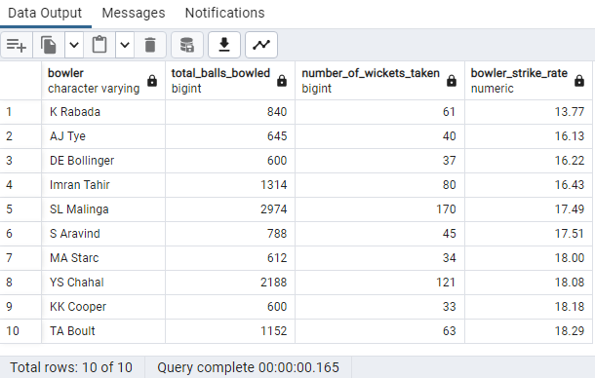
select bowler, count(ball) as total_balls_bowled, sum(case when dismissal_kind in ('bowled','caught','caught and bowled','lbw','stumped','hit wicket') then 1 else 0 end) as number_of_wickets_taken, round((count(ball)*1.0/sum(case when dismissal_kind in ('bowled','caught','caught and bowled','lbw','stumped','hit wicket') then 1 else 0 end)),2) as bowler_strike_rate from deliveries group by bowler having count(ball) >= 500 order by bowler_strike_rate limit 10;
Query:-
Output:-

Slide 19
Visualization:-

Slide 20
Now you need to get 2-3 All_rounders with the best batting as well as bowling strike rate and who have faced at least 500 balls in IPL so far and have bowled minimum 300 balls.To do that you have to make a list of 10 players you want to bid in the auction so that when you try to grab them in auction you should not pay the amount greater than you have in the purse for a particular player. ( strike rate of an all rounder can be calculated using the same criteria of batsman similarly the bowling strike rate can be calculated using the criteria of a bowler)
Task - 6:-
Description:-
To make the list of 10 players with the best batting as well as bowling strike rate and faced at least 500 balls and bowled a minimum of 300 balls, I used the select statement with batter, runs_scored_by_batsman,balls_faced_by_batsman, batting_strike_rate and then applied some conditions that extras_type must not be in wides and balls_faced_by_batsman must be greater than or equals to 500 and then named this entire select statement as batting. Next, I used another select statement with bowler,total_balls_bowled,number_of_wickets_taken, and bowling_strike_rate and then applied some conditions that total_balls_bowled must be greater than or equal to 300 and then named this entire select statement as bowling. Next, I joined both the batting and bowling using batsman from batting and bowler from bowling and then ordered the result in descending order of batting_strike_rate and ascending order of bowling_strike_rate. So, the players with the best bowling_strike_rate and batting_strike_rate will appear at the top, and finally, the output will be restricted to the top 10 players with the best bowling_strike_rate and batting_strike_rate.

Slide 21
select batting.batsman as allrounder, batting.runs_scored_by_batsman as total_runs_scored, batting.balls_faced_by_batsman as balls_faced, batting.batting_strike_rate as batting_strike_rate, bowling.total_balls_bowled as balls_bowled, bowling.number_of_wickets_taken as wickets_taken, bowling.bowling_strike_rate as bowling_strike_rate from (select batsman, sum(batsman_runs) as runs_scored_by_batsman, count(ball) as balls_faced_by_batsman, round((sum(batsman_runs)*1.0/count(ball))*100,2) as batting_strike_rate from deliveries where extras_type not in ('wides') group by batsman having count(ball) >= 500) as batting join (select bowler, count(ball) as total_balls_bowled, sum(case when dismissal_kind in ('bowled','caught','caught and bowled','lbw','stumped','hit wicket') then 1 else 0 end) as number_of_wickets_taken, round((count(ball)*1.0/sum(case when dismissal_kind in ('bowled','caught','caught and bowled','lbw','stumped','hit wicket') then 1 else 0 end)),2) as bowling_strike_rate from deliveries group by bowler having count(ball) >= 300) as bowling on batting.batsman = bowling.bowler order by batting_strike_rate desc,bowling_strike_rate asc limit 10;
Query:-

Slide 22
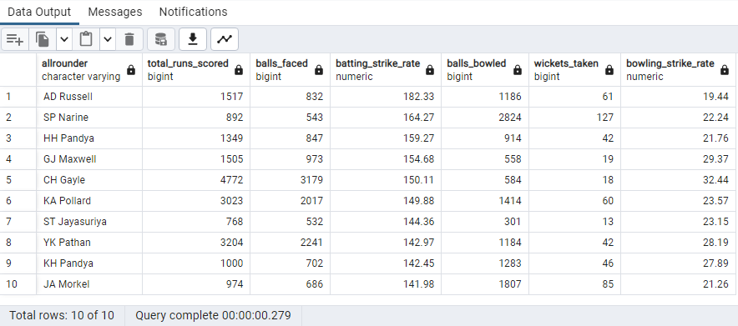
Output:-

Slide 23
Visualization:-

Slide 24
Wicketkeeper
A wicketkeeper is a player in a cricket team who stands behind the wicket to stop balls that the batsman misses or to catch balls that the batsman hits.
In T20 cricket, the role of the wicketkeeper is somewhat different from that in longer forms of the game.
In T20 cricket, the main goal is to score runs quickly, so the wicketkeeper is often expected to contribute to the team’s run total with aggressive batting.
They may also be called upon to bowl a few overs of spin or medium pace.
Also, the important role of the wicketkeeper is to catch the balls that the batsman hits, stop the balls that the batsman misses, and stump out the batsman.
In T20 cricket, where every run and wicket is crucial, a good wicketkeeper can make a big difference to the team’s chances of winning.
Overall, the wicketkeeper is an important member of a T20 team and can have a significant impact on the outcome of a match.

Slide 25
Criteria for getting Two best Wicketkeepers from the given list
We need some wicketkeepers with a strong performance to complete and stabilize the team. So, I have defined the criteria to choose the best wicketkeepers from the given list of wicketkeepers.
I assume that the given list contains the following data they are Total_runs, Balls_faced, Batting_Strike_rate, Batting_Average, Bowling_Strike_rate, Bowling_Economy, Dismissals as WicketKeepers Table.
Using this data, we have to choose the two best wicketkeepers from the given WicketKeepers Table.
To get the best wicketkeepers from the list, I have applied some conditions that the Balls_faced must be greater than or equal to 500, Batting_Strike_rate must be greater than or equal to 140, Batting_Average must be greater than or equal to 30, Bowling_Strike_rate must be less than or equals to 30, Bowling_Economy must be less than or equals to 10.
Next, I have ordered them in descending order of Batting_Strike_rate, Dismissals and ascending order of Bowling_Strike_rate.
And finally the output will be restricted to 2 players with limit 2 and then we get the Two best Wicketkeepers from the given list.

Slide 26
Query:-
Select Wicketkeeper,
Total_runs, Balls_faced, Batting_Strike_rate, Batting_Average,
Bowling_Strike_rate, Bowling_Economy, Dismissals
from WicketKeepers where Balls_faced >= 500
and Batting_Strike_rate >= 140
and Batting_Average >= 30
and Bowling_Strike_rate <= 30
and Bowling_Economy <= 10
order by Batting_Strike_rate desc, Bowling_Strike_rate asc, Dismissals desc limit 2;
Output:-
As a final result, we get the Two best wicketkeepers from the above query with the given list of wicketkeepers.

Slide 27
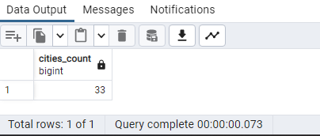
Additional Questions
1.) Get the count of cities that have hosted an IPL match
Description:-
To get the count of cities, I have used the count function. To get the count of unique cities, I have used a distinct keyword in the count function.
Query:-
select count(distinct match_city) from Matches;
Output:-

Slide 28
Visualization:-

Slide 29
2.) Create table deliveries_v02 with all the columns of the table ‘deliveries’ and an additional column ball_result containing values boundary, dot or other depending on the total_run (boundary for >= 4, dot for 0 and other for any other number) (Hint 1: CASE WHEN statement is used to get condition based results) (Hint 2: To convert the output data of the select statement into a table, you can use a subquery. Create table table_name as [entire select statement].
Description:-
Here I have used the create statement to create a table deliveries_v02 from the deliveries table and then in the subquery, I have used a case when statement to create a new column ball_result with a given condition that is if total_run >=4 then ‘boundary’, if total_run = 0 the ‘dot’, else ‘other’.
Query:-
create table deliveries_v02 as select *,
case when total_runs >= 4 then 'Boundary' when total_runs = 0 then 'Dot' else 'Other' end as ball_result
from deliveries;

Slide 30
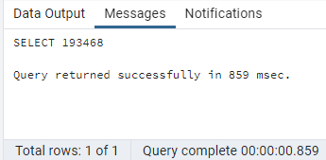
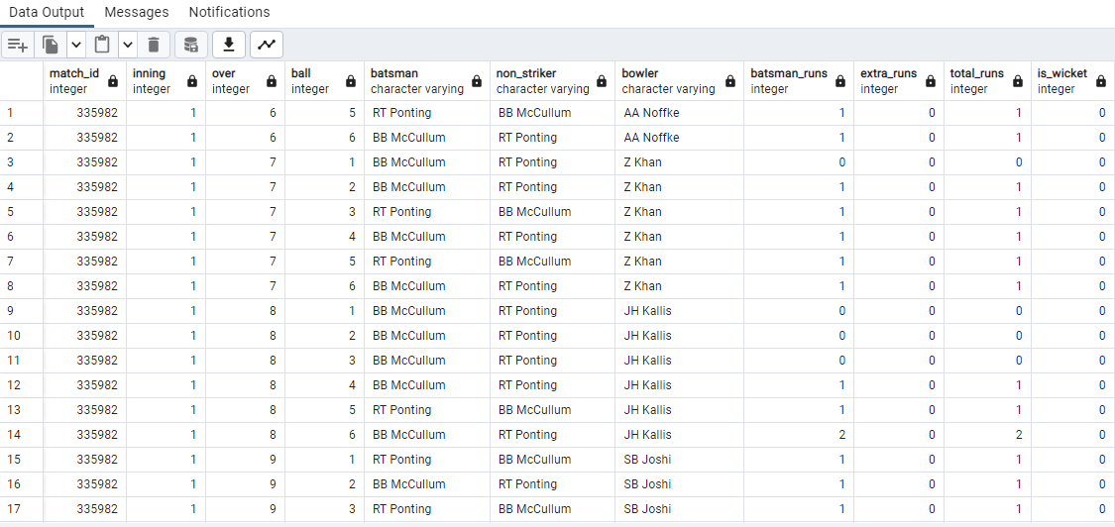
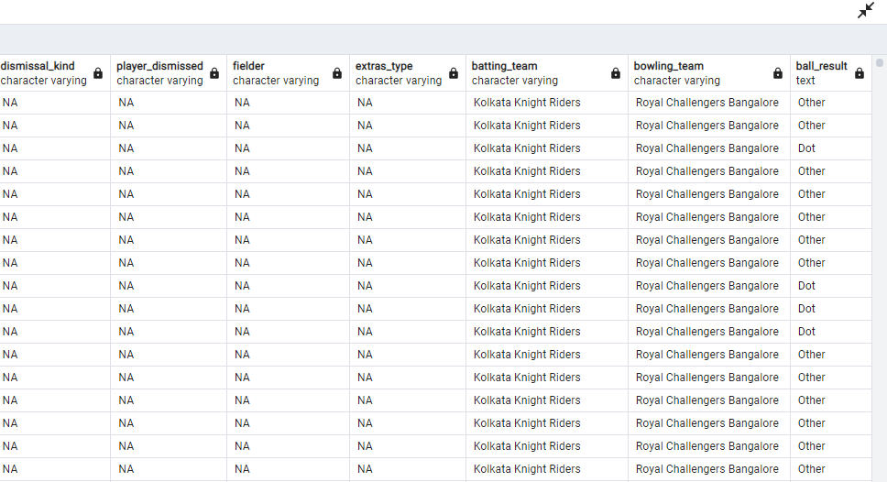
Output:-
Select * from deliveries_v02 ;

Slide 31
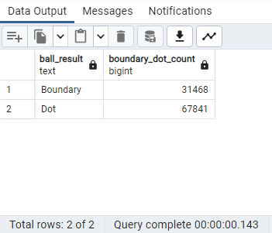
3.) Write a query to fetch the total number of boundaries and dot balls from the deliveries_v02 table.
Description:-
To fetch the total number of boundaries and dots, I have used the count function with the specific condition that ball_result must boundary and dot.
Query:-
select ball_result, count(*) from deliveries_v02 where ball_result in ('Boundary','Dot') group by ball_result;
Output:-

Slide 32
Visualization:-

Slide 33
4.) Write a query to fetch the total number of boundaries scored by each team from the deliveries_v02 table and order it in descending order of the number of boundaries scored.
Description:-
To fetch the total number of boundaries scored by each team, I have used the count function with the specific condition that ball_result must be a boundary.
Query:-
select batting_team,count(ball_result) as boundaries_scored_by_each_team from deliveries_v02 where ball_result = 'Boundary' group by batting_team order by boundaries_scored_by_each_team desc;

Slide 34
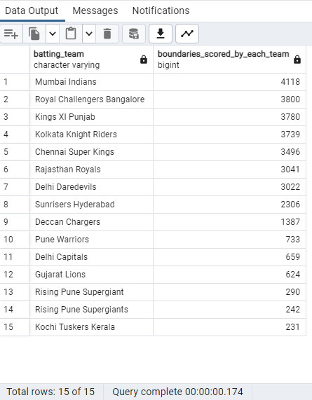
Output:-

Slide 35
Visualization:-

Slide 36
5.) Write a query to fetch the total number of dot balls bowled by each team and order it in descending order of the total number of dot balls bowled.
Description:-
To fetch the total number of dots bowled by each team, I have used the count function with the specific condition that ball_result must be a dot.
Query:-
select batting_team,count(ball_result) as boundaries_scored_by_each_team from deliveries_v02 where ball_result = 'Boundary' group by batting_team order by boundaries_scored_by_each_team desc;

Slide 37
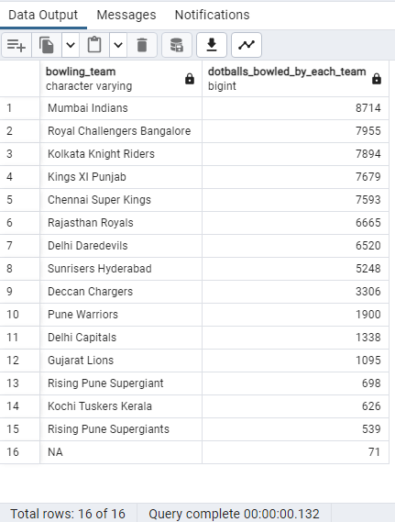
Output:-

Slide 38
Visualization:-

Slide 39
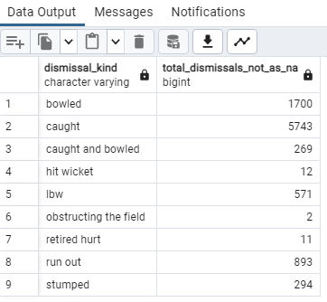
6.) Write a query to fetch the total number of dismissals by dismissal kinds where dismissal kind is not NA
Description:-
To fetch the total number of dismissals by dismissal kinds where dismissal kind is not NA, I have used the count function with the specific condition that dismissal_kind is not in NA.
Query:-
select dismissal_kind,count(*) as total_dismissals_not_as_NA from deliveries_v02 where dismissal_kind not in ('NA') group by dismissal_kind;
Output:-

Slide 40
Visualization:-

Slide 41
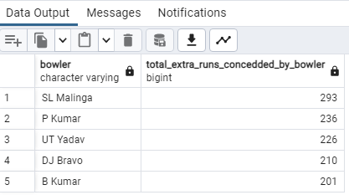
7.) Write a query to get the top 5 bowlers who conceded maximum extra runs from the deliveries table
Description:-
To get the top 5 bowlers who conceded maximum extra runs, I have used the sum function on extra_runs. So I got extra runs conceded by the bowler and next, I kept them in descending order to get the top 5 bowlers who conceded maximum extra runs.
Query:-
select bowler,sum(extra_runs) as total_extra_runs_concedded_by_bowler from deliveries group by bowler order by total_extra_runs_concedded_by_bowler desc limit 5;
Output:-

Slide 42
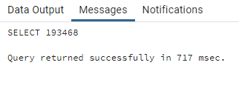
8.) Write a query to create a table named deliveries_v03 with all the columns of deliveries_v02 table and two additional columns (named venue and match_date) of venue and date from table matches.
Description:-
Here I have used the create statement to create a table deliveries_v03 from the deliveries_v02 table and then in the subquery, I have used the Matches table to get venue and match_date and then connected the deliveries_v02 and matches tables with inner join.
Query:-
create table deliveries_v03 as select d2.*,m.venue,m.match_date from deliveries_v02 as d2 inner join matches as m on d2.match_id = m.match_id;
Output:-

Slide 43
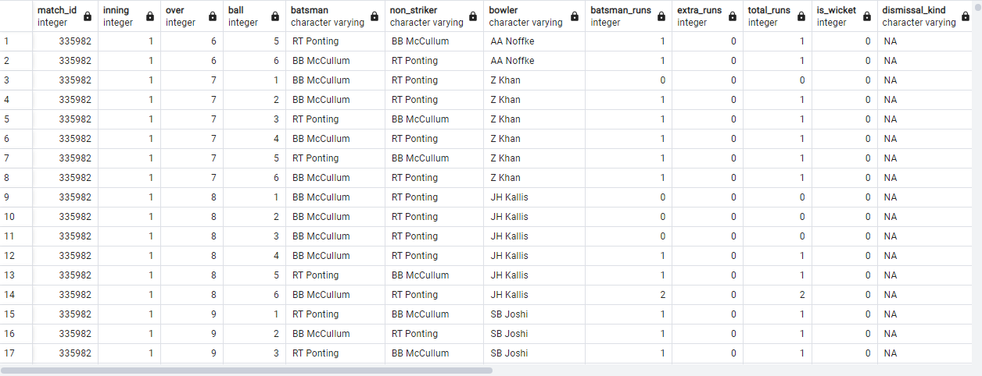
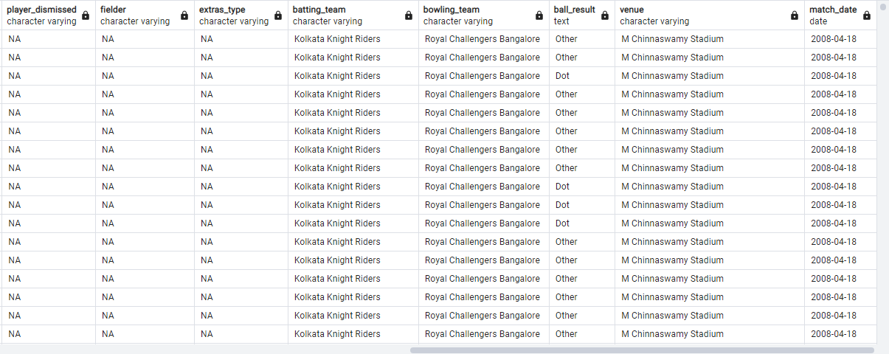
Select * from deliveries_v03 ;

Slide 44
9.) Write a query to fetch the total runs scored for each venue and order it in the descending order of total runs scored.
Description:-
To fetch the total runs scored for each venue, I have used the sum function on total_runs. So, I got the total runs scored for each venue and then I ordered them in descending order
Query:-
select venue,sum(total_runs) as runs_scored_in_each_venue from deliveries_v03 group by venue Order by runs_scored_in_each_venue desc;

Slide 45
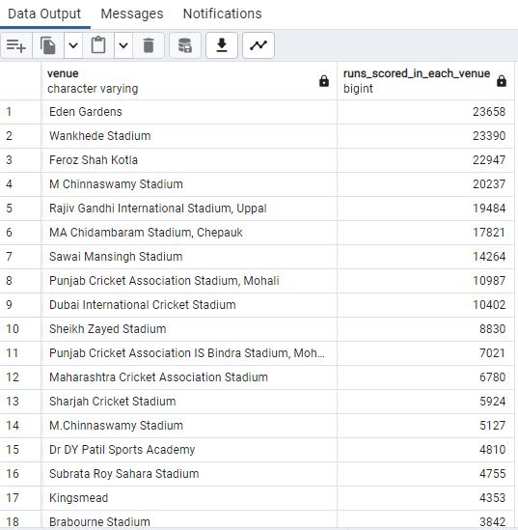
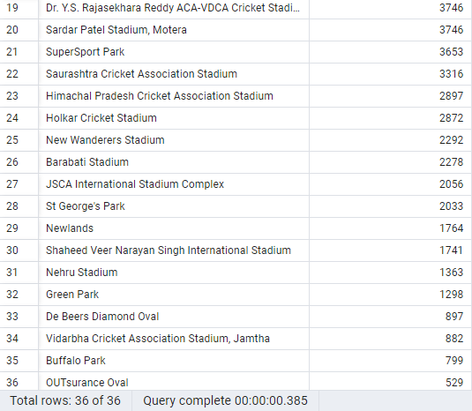
Output:-

Slide 46
Visualization:-

Slide 47
10.) Write a query to fetch the year-wise total runs scored at Eden Gardens and order it in the descending order of total runs scored.
Description:-
First, I retrieved the year from the match_date, then I used the sum function on total_runs to get runs_scored_in_each_year with the condition that the venue must be Eden Garden and ordered them in descending order of runs_scored_in_each_year, and finally, we obtained the year-wise total runs scored at Eden Gardens.
Query:-
select extract(year from match_date) as ipl_year, sum(total_runs) as runs_scored_in_each_year from deliveries_v03 where venue = 'Eden Gardens' group by ipl_year order by runs_scored_in_each_year desc;

Slide 48
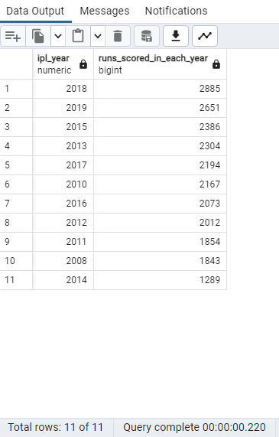
Visualization:-
Output:-

