Slide 1



Slide 2
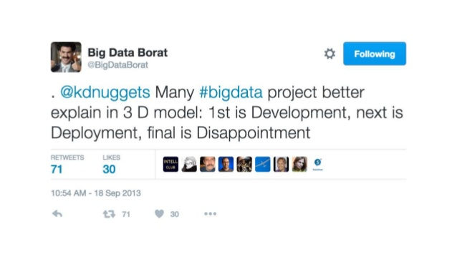
Motivation
Social Media is taking control in every field.
Twitter is one of the biggest platforms where people express their opinions.
It can be really interesting if a user has an insight of how many likes or retweets he can get on his Tweet.

Slide 3


Tools Used
Tableau
Python

Slide 4
Methodology
Data Collection
Data Cleaning
Statistical Analysis and Visualizations
Predictions

Slide 5
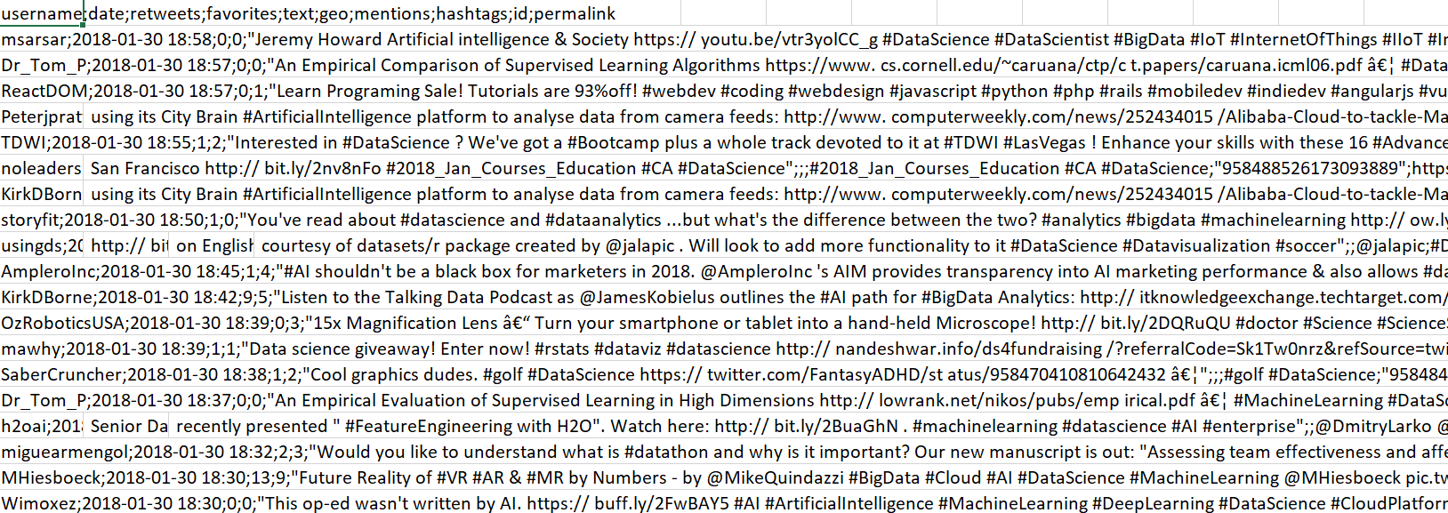
Data Collection
Collected Data for Year 2018 for Tweets with “DataScience” using Tweepy(A python library)
About 2.5 millions records were obtained.

Slide 6
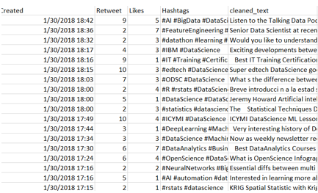
Data Cleaning
Cleaned the data using Python libraries like nltk
Columns after cleaning:
Date – Creation date of Tweet
Retweet- Count of Retweets
Likes- Count of Likes
Text – Cleaned Tweet Text
Hashtags – Hashtags used in Tweets

Slide 7
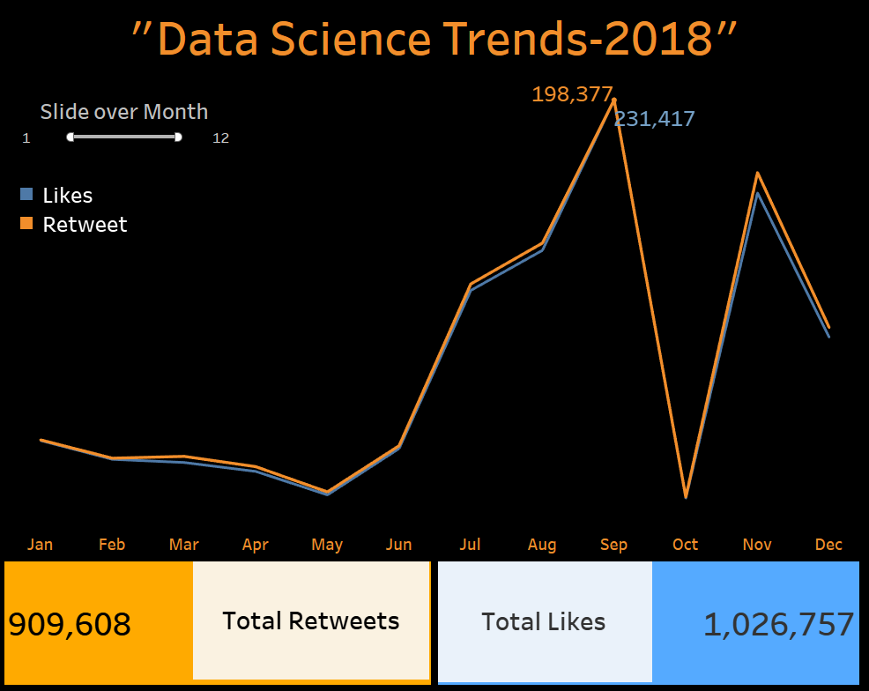
Trend Analysis
Used Line chart to see the trends over the Year
Used Range filter to slide over the month
The numbers on the line chart gives the highest number of likes and retweets during the range selected
The total Retweets and Likes represent the total number received during the time period selected.
The motive was to analyze the trend of Data Science among people

Slide 8
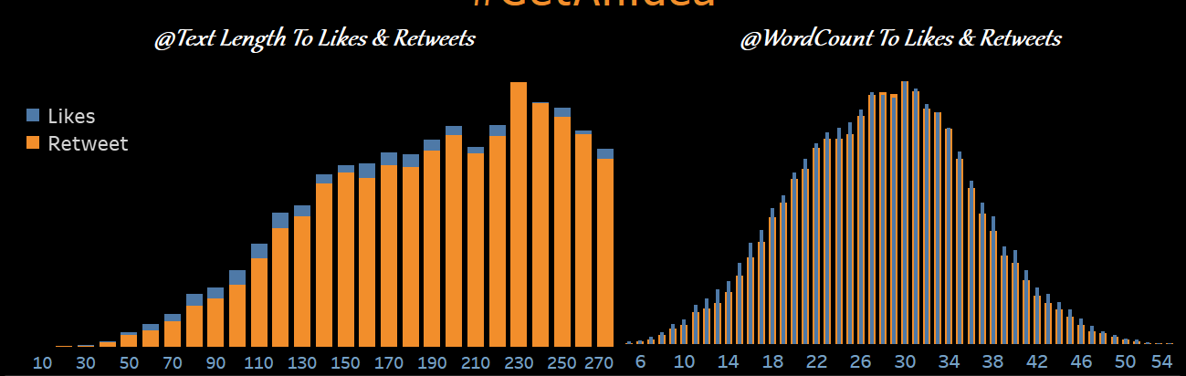
Feature Selection
Next Part of the Story was to figure out the features on which a Tweet can depend.
Analyzed Tweet Length and Word count .
We used stacked bar chart and dual axis for Comparing retweets and likes.
We found that maximum likes and retweets can be obtained with Text length of around 230 and word count of 30.

Slide 9
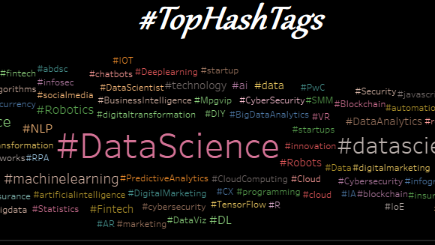
Word Cloud
We analyzed the hashtags in the data
Used Size , Color and Text on the Marks card
Filtered top words.
Greater the size, more frequent is the word.

Slide 10
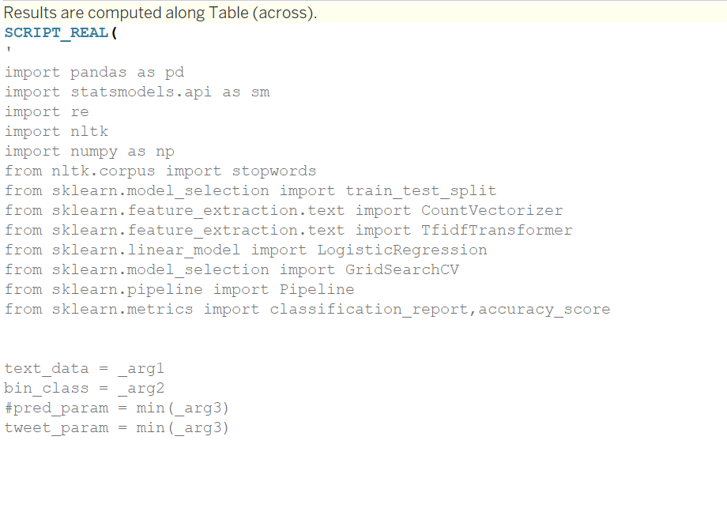

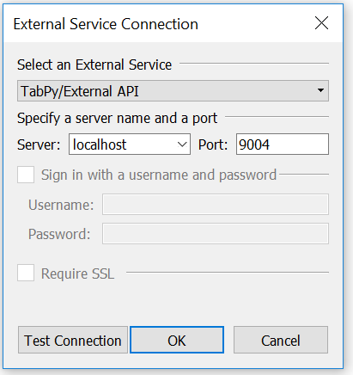
Predictions
We used Tabpy to connect python and Tableau.
Created a calculated field which consists of the python script.
The Logistic Regression Model runs in the script and provides the predictions

Slide 11
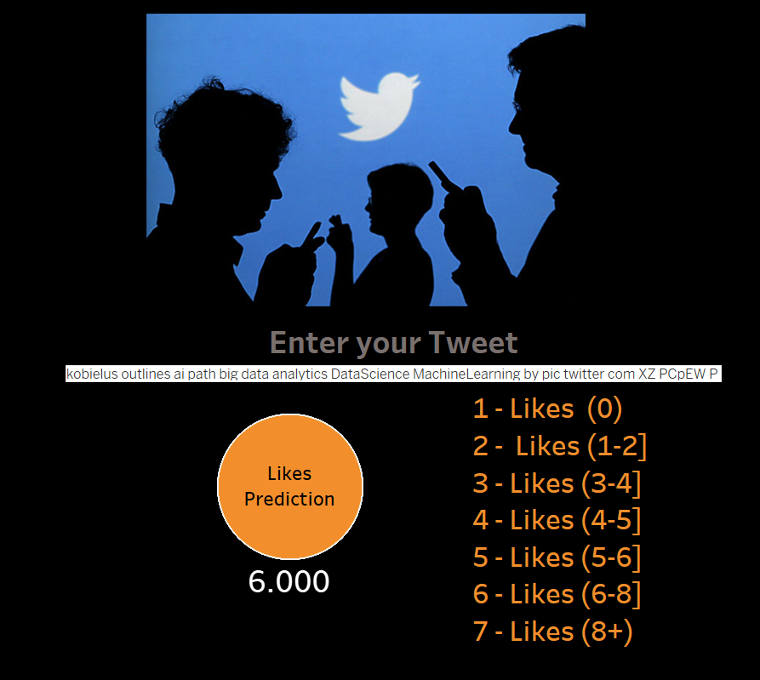
Through this platform a user can enter a tweet and get a prediction of likes he can get. We used a text parameter for entering the Tweet.

Slide 12
Test
Tweet | Predicted Likes | Factor Consideration
What We Expect to See in perspectives of BigData #DataScience #AI #Python #RStats #TensorFlow #JavaScript #Analytics #architecture #DevOps #DataEngineering #ML #Java #ReactJS #VueJS #GoLang #CloudComputing #Serverless #infoq #com #articles #infoq #retrospective | 6 (6-8] | More Words and large Text Length, Use of frequent words
AI is evolving | 2 (1-2] | Small Sentence
AI is evolving. Learning is fun with #AI #BigData #MachineLearning #NLP | 3 (2-3] | Use of frequent words
As the server is quite slow, so we entered three tweets and tested.

Slide 13
Learnings & Future Work
Learning Tableau was a great fun to enhance our analytical skills.
We will be working on other models to provide better accuracy and fast predictions.

