Slide 1

Twitter Likes And Retweet Predictions
GROUP MEMBERS : ANCHAL GUPTA, ISHITA DAGA, RAJ VARDHAN

Slide 2
Importance
Twitter the primary channel for users to voluntarily share opinions, feelings, news, activities, interests, and other types of event-related information happening around them.
To create good impression and enhance interest of a reader, it is very important to focus on the content within the character limit of 280.
Predictions of likes and retweets can improve the content of information we receive from people, and usage among readers to extract the valuable information.

Slide 3
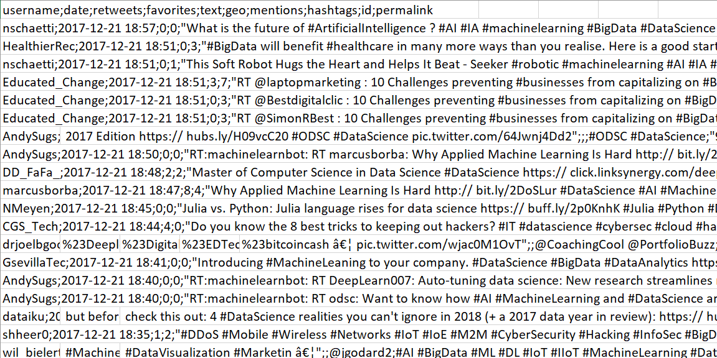
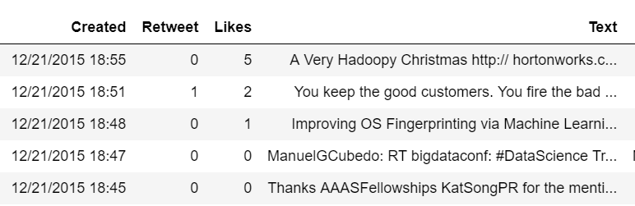
Data Collection
Collected 2 million tweets from Twitter using tweepy library for the Year 2015 to 2018 in the field Data Science
Converted the data into data frame and removed unwanted columns like Username, geo, mentions, hashtags, id, permalink.
Feature | Description | Scale
Created | When the Tweet was posted | Timestamp
Retweet | How many times that Tweet was shared | Nominal
Likes | How many times that Tweet was liked | Nominal
Text | The content of the Tweet | String

Slide 4
Data Cleaning
Removed Unwanted Characters and links using Regular Expressions
Removed Stop Words
Removed Duplicate Values

Slide 5
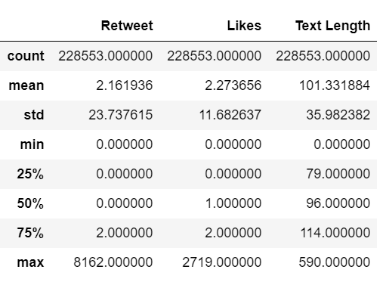
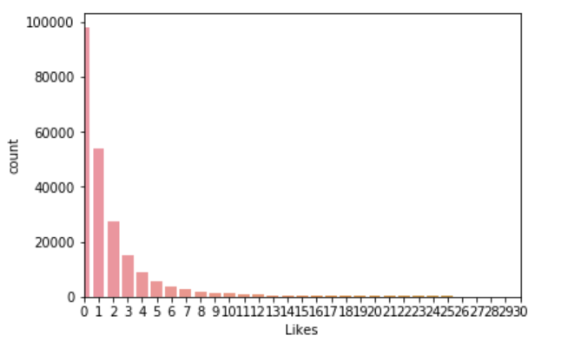
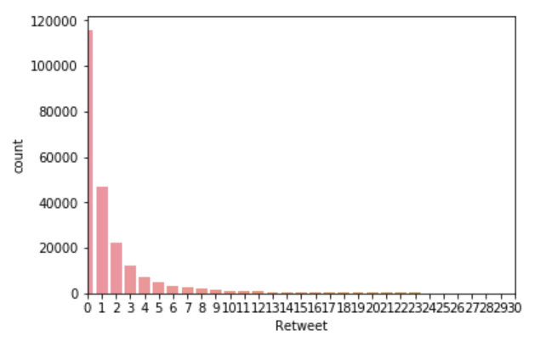
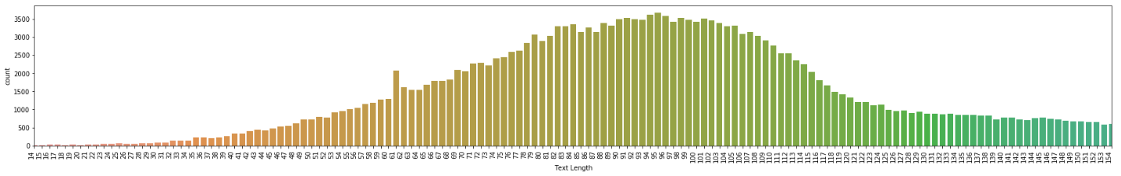
Data Exploration
Statistical Analysis
Bar Plots

Slide 6
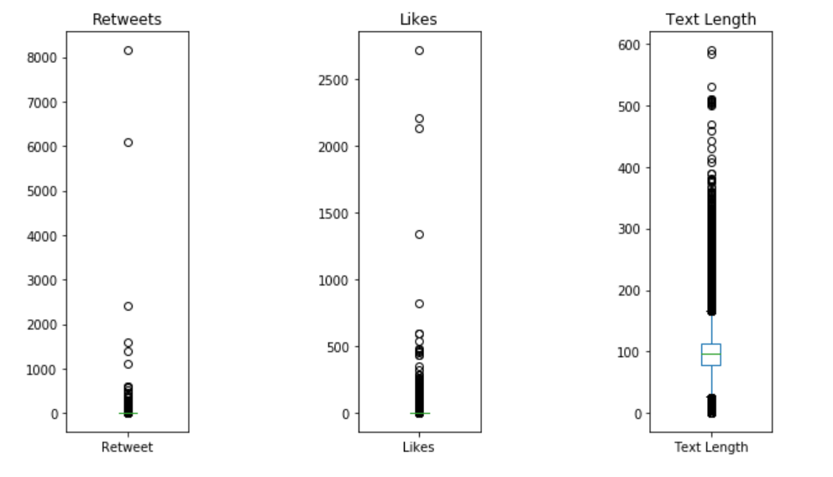
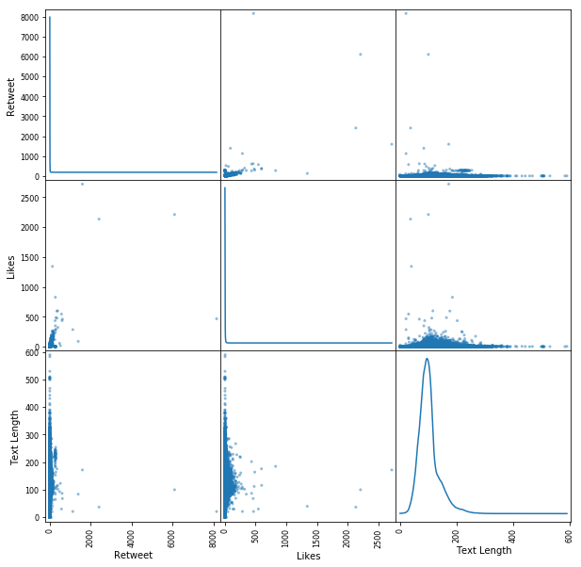
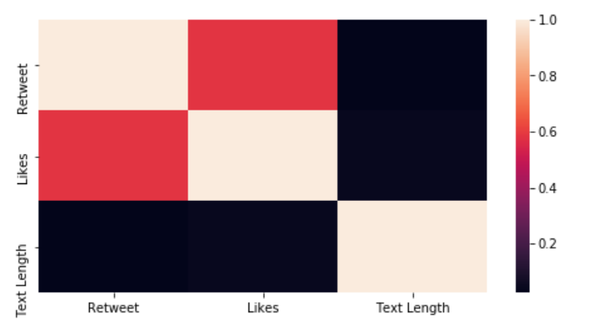
Data Exploration
Outlier Detection & Correlations
Bar

Slide 7
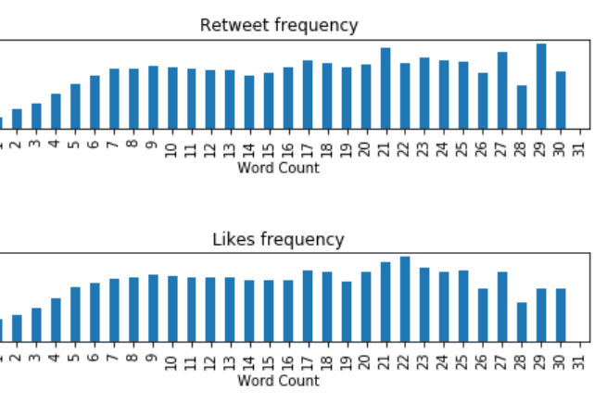
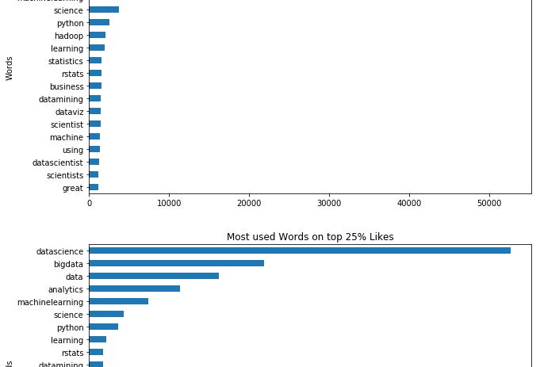
Categories that performed better

Slide 8
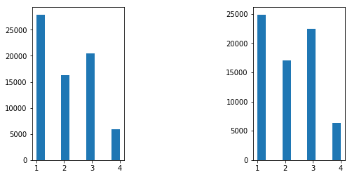
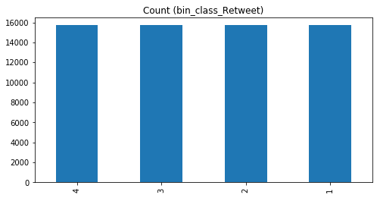
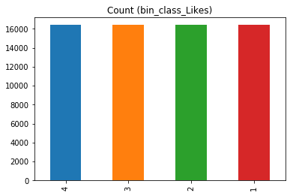
Data Preprocessing
Removing all the texts based on their text length, which have length between Q3 + 3∗IQR< Outlier < Q1 −3∗IQR
Made bins for our target variables.
Bin1- (0,1] ; Bin2 – (1,2] ; Bin3 – (2,5] ; Bin4 – (5+, )
Balancing all the classes.

Slide 9
Methodology
NLP Techniques
Bag of words - TFIDF
Embedding - Doc2Vec

Slide 10
TF-IDF
Term Frequency, Inverse Document Frequency
Reflect how relevant a term is in a given document.
Term Frequency- if a word occurs multiple times in a document, we should boost its relevance as it should be more meaningful than other words that appear fewer times
Inverse Document Frequency - if a word occurs many times in a document but also along many other documents, maybe it is because this word is just a frequent word; not because it was relevant or meaningful.

Slide 11
Doc2Vec
Based on word2vec, which is a well known concept, used to generate representation vectors out of words.
numeric representation for each word, that will be able to capture relations between different words.
the goal of doc2vec is to create a numeric representation of a document, regardless of its length.
A word vector W is generated for each word, and a document vector D is generated for each document.

Slide 12
MODELS
Logistic Regression (multinomial)
SVM
MultinimialNB
Random Forest
Neural Net

Slide 13
Logistic Regression
The Logistic regression estimates the parameters of this function (coefficients), and as result it predicts the probability of presence of the characteristic of interest.
This model was chosen, because provides probabilities for outcomes and a convenient probability scores for observations

Slide 14
SVM
SVM constructs a hyperplane (or a set) that can separate the points in the defined labels. The distance between the closest data points and the hyperplane is named margin.
1
This model was chosen, because it works well with linear and non-linear datasets. And due the fact we have more samples than number of features, it can generate a good prediction.
2

Slide 15
Multinomial Naïve Bayes
The multinomial Naive Bayes classifier is suitable for classification with discrete features
The multinomial distribution normally requires integer feature counts. However, in practice, fractional counts such as TD-IDF may also work.

Slide 16
Random Forest
Random forest is an ensemble learning method for classification, other tasks that operates by constructing a multitude of decision trees at training time.
We used this model to avoid overfitting of data.

Slide 17
Neural Nets
Deep Neural Networks are more complex neural networks in which the hidden layers perform much more complex operations than simple sigmoid or relu activations.
We used this network as we had large number of data points.

Slide 18
Results Retweets
Model Name | TF-IDF |  | Doc2Vec
 | Train | Test | Train | Test
Logistic Regression | 47.6 | 49.03 | 37.03 | 35.68
Support Vector Machine | 51.5 | 55.96 | 32.2 | 35.4
Random Forest | 51.04 | 54.5 | 80.02 | 62.67
Neural Network | 44.6 | 39.10 | 54.16 | 44.3
Multinomial Naïve Bayes | 51.4 | 56.22 | 34.02 | 35.68

Slide 19
Results Likes
Model Name | TF-IDF |  | Doc2Vec
 | Train | Test | Train | Test
Logistic Regression | 47.6 | 49.03 | 36.20 | 35.06
Support Vector Machine | 52.6 | 55.2 | 35.9 | 34.8
Random Forest | 51.4 | 54.8 | 90.28 | 60.08
Neural Network | 49.18 | 42.77 | 47.35 | 40.65
Multinomial Naïve Bayes | 48.4 | 50.5 | 33.38 | 35.08

Slide 20
Conclusion
Multinomial Naïve Bayes performed best with accuracy of 56.22% in case of Retweets and Support Vector Machine performed best with accuracy of 55.2% in case of Likes.
Random forest surprisingly overfitted the data in both the cases.

Slide 21
References
https://www.twitter.com.
https://www.medium.com.
https://medium.freecodecamp.org/.
Abdelhamid, A. Ayesh, F. Thabtah, S. Ahmadi, W. Hadi. MAC: A multiclass associative classiﬁcation algorithm J. Info. Know. Mgmt. (JIKM), 11 (2) (2012), pp. 125001-1-1250011-10 WorldScinet.
I.H. Witten, E. Frank, M.A. Hall. Data Mining: Practical Machine Learning Tools and Techniques. Morgan Kaufmann, Burlington, MA (2011).
Thabtah, S. Hammoud, H. Abdeljaber, Parallel associative classiﬁcation data mining frameworks based mapreduce, To Appear in Journal of Parallel Processing Letter, March 2015, World Scientiﬁc, 2015.
http://www.numpy.org/.
http://scikit-learn.org/stable/.

Slide 22
THANK YOU

