Slide 1

PRESENTATION BY: ANCHAL SADHU (s18000650081)

Slide 2
Index
Introduction to Big Data
4 V’s Of Big Data
Hadoop and its Components
MapReduce
Workflow of MapReduce
HIVE
Apache PIG
8. SQOOP
9. SQOOP Workflow

Slide 3
What’s Big Data ?
Big data usually consists of very large sets which organizations can analyze to generate desired output.
But apart from the large Datasets , Big Data also deals with the real time data generating from various online websites which includes the Data variety, Data velocity and Data veracity.

Slide 4
What’s Big Data ?
BIG DATA
Large Datasets
Accurate/Inaccurate Data
Structured & Unstructured
Data generation speed

Slide 5
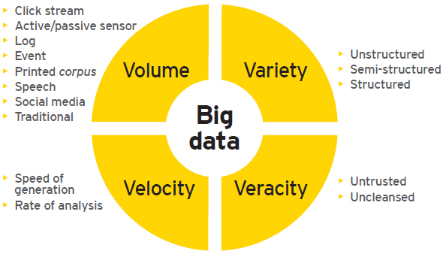
Four V’s of Big Data

Slide 6
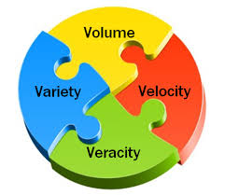
Volume
It is estimated that, on an average, 2.3 trillion gigabytes of data are generated every day. Forget analyzing, simply capturing such quantities of data is impractical. Most companies in the US have at least 100,000 gigabytes of data stored; and almost all of them will tell you that they aren’t collecting enough data.
The right approach is to fight the urge of making your company’s server a data dump. Efforts must be made to employ the right software to filter the relevant data.
Variety
Along with quantity, the diversity of data is equally important. The variety in data can be in terms of the devices or the sources of data generation

Slide 7
vELOCITY
Not only is the volume of data ever increasing, but the rate of data generation (from the Internet of Things, social media, etc.) is increasing as well.
Veracity
Not all data is good. In fact, unfiltered data is more likely to be bad than good. Although data quality and usability depend largely on the source, you can never rule out junk.
This unreliability of data makes many business heads reluctant to rely on information analysis. That’s the wrong approach.

Slide 8

HADOOP
Apache Hadoop is an open-source software framework used for distributed storage and processing
of very large data sets.
It consists of computer clusters built from commodity hardware.
All the modules in Hadoop are designed with a fundamental assumption that hardware
failures are a common occurrence and should be automatically handled by the frame.

Slide 9
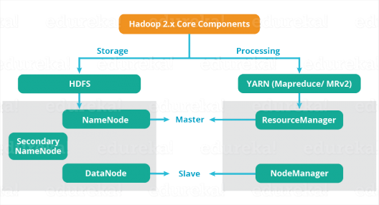
Hadoop Components
For processing Hadoop uses Apache Map Reduce
HDFS(Storage)
Map Reduce
Process/Compute
For storage Hadoop uses HDFS(Hadoop Distributed File System)

Slide 10
MapReduce
Hadoop MapReduce (Hadoop Map/Reduce) is a software framework for distributed processing of large data sets on compute clusters of commodity hardware. It is a sub-project of the Apache Hadoop project. The framework takes care of scheduling tasks, monitoring them and re-executing any failed tasks.
A MapReduce job usually splits the input data-set into independent chunks which are processed by the map tasks in a completely parallel manner. The framework sorts the outputs of the maps, which are then input to the reduce tasks. Typically both the input and the output of the job are stored in a file-system.

Slide 11
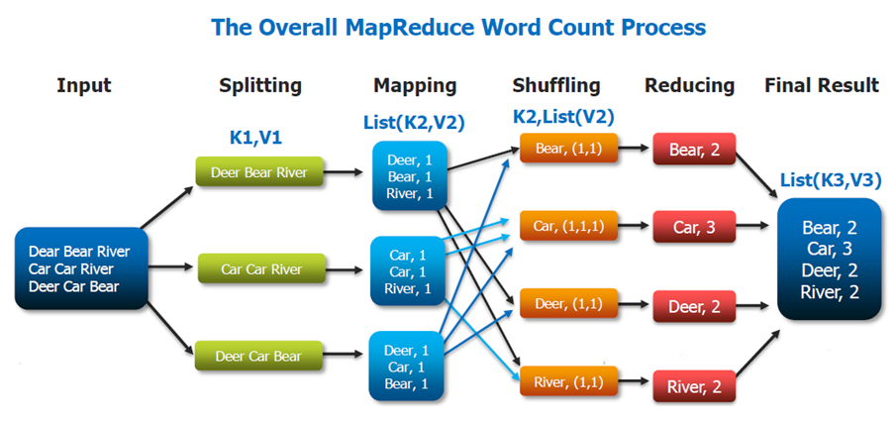

Slide 12

HIVE
Apache Hive is a data warehouse infrastructure built on top of Hadoop for providing data summarization, query, and analysis.
Hive gives an SQL-like interface to query data stored in various databases and file systems that integrate with Hadoop.
It is built on top of Hadoop and developed by Facebook. Hive provides a way to query the data using a SQL-like query language called HiveQL (Hive query Language).
Internally, a compiler translates HiveQL statements into MapReduce jobs, which are then submitted to Hadoop framework for execution.

Slide 13

Apache Pig
Apache Pig is a high-level platform for creating programs that run on Apache Hadoop. The language for this platform is called Pig Latin.
Pig can execute its Hadoop jobs in Map Reduce, Apache Tez, or Apache Spark. Pig Latin abstracts the programming from the Java Map Reduce idiom into a notation which makes Map Reduce programming high level, similar to that of SQL for RDBMS.
Pig Latin can be extended using User Defined Functions (UDFs) which the user can write in Java, Python, JavaScript, Ruby or Groovy and then call directly from the language.

Slide 14
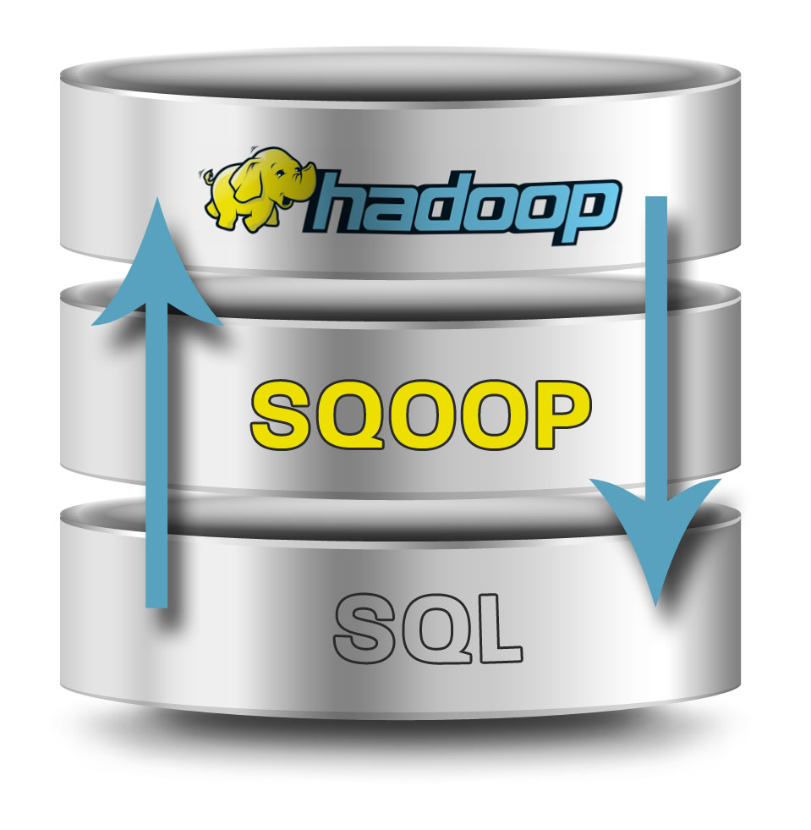
SQOOP
Sqoop is a tool designed to transfer data between Hadoop and relational database servers. It is used to import data from relational databases such as MySQL, Oracle to Hadoop HDFS, and export from Hadoop file system to relational databases.

Slide 15
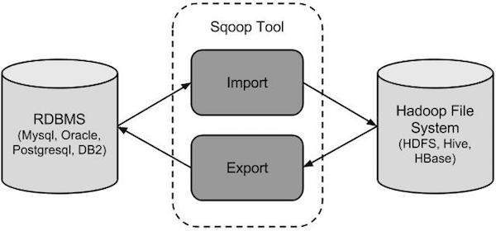
SQOOP WORKFLOW

Slide 16
SQOOP Import
The import tool imports individual tables from RDBMS to HDFS. Each row in a table is treated as a record in HDFS. All records are stored as text data in text files or as binary data in Avro and Sequence files.
.
SQOOP Export
The export tool exports a set of files from HDFS back to an RDBMS. The files given as input to SQOOP contain records, which are called as rows in table. Those are read and parsed into a set of records and delimited with user-specified delimiter

Slide 17


