Slide 1

Sales Analytics:
From Raw Data to Business Decisions
Data Storytelling & Statistical Validation
Presented by: Anchal Teepa
Data Analytics Internship – Task 4

Slide 2







From raw data to decisions
TOTAL REVENUE
TOTAL ORDERS
AVG. ORDER VALUE
TOTAL CUSTOMERS
REVENUE / CUSTOMER
₹13.94 Cr
1,000
₹139K
947
₹147K
ANALYTICS JOURNEY
Data
Cleaning
Exploratory
Data Analysis
SQL
Analysis
Customer
Segmentation
Power BI
Dashboard
Statistical
Validation
Business
Recommendations
BUSINESS OBJECTIVE
Analyze sales and customer data to identify revenue performance, customer behavior, product performance, geographic trends, statistical validation, and business growth opportunities.
Data Analytics Internship – Task 4
02

Slide 3



Product and geography identify the strongest growth pockets
TOP PRODUCTS BY REVENUE (₹ Cr)
TOP CITIES BY REVENUE (₹ Cr)
HIGHEST PRODUCT
TOP MARKET
LAPTOP LEADS PRODUCTS
ELECTRONICS LEAD
PATNA LEADS MARKETS
₹2.54 Cr — highest revenue generator
Highest revenue-generating category
₹1.93 Cr — strongest geographic market
Data Analytics Internship – Task 4
03

Slide 4


Nearly one-third of customers generate two-thirds of revenue
Customer segmentation reveals a concentrated revenue base.
REVENUE SHARE BY CUSTOMER VALUE
CUSTOMER VALUE MIX
High Value
66.3%
316 customers
66.3%
Medium Value
26.3%
315 customers
High Value
revenue share
Low Value
7.4%
316 customers
Priority: retain High Value customers and grow Medium Value customers.
BUSINESS IMPLICATION
Nearly one-third of customers generate approximately two-thirds of total revenue.
Data Analytics Internship – Task 4
04

Slide 5
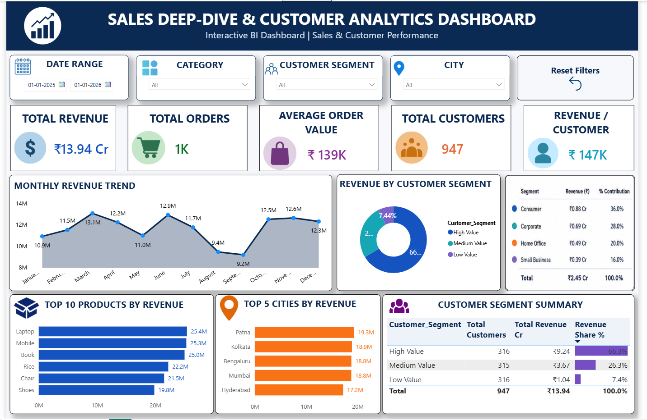
Revenue momentum is uneven across the year
MONTHLY REVENUE TREND (₹ Cr)
March: ₹1.31 Cr — strongest month
June: ₹1.29 Cr — strong momentum
Aug–Sep: relatively lower-performing period
Filters: Date, Category, Customer Segment, City, Reset Filters
Views: KPI Monitoring, Product Analysis, Customer Segmentation, Geographic Analysis
Data Analytics Internship – Task 4
05

Slide 6



Gender is not a statistically significant driver of average order sales
BUSINESS QUESTION
TEST USED
Does customer gender significantly impact average order sales?
Welch’s Independent Samples T-Test
ORDER-LEVEL COMPARISON
STATISTICAL READOUT
Metric | Male | Female
Total Orders | 511 | 489
Average Sales | ₹141,807.34 | ₹136,883.21
P-VALUE
T-STATISTIC
95% CI
0.4950
0.6826
-₹9,231.58 to
₹19,079.85
SIGNIFICANCE LEVEL
0.4950 > 0.05
0.05
H₀: No statistically significant difference in average order sales.
H₁: A statistically significant difference exists.
STATISTICAL DECISION
There is no statistically significant difference in average sales by gender.
Gender alone should not be considered a strong driver of customer spending behavior.
Fail to Reject H₀
Data Analytics Internship – Task 4
06

Slide 7






Focus resources on value, behavior, products, and markets
Retain High Value Customers
Grow Medium Value Customers
Prioritize Top Products
Use loyalty programs, personalized engagement, and premium benefits.
Use targeted promotions and cross-selling.
Maintain inventory availability and promotional support.
Strengthen Top Markets
Use Behavioral Targeting
Focus regional strategies on high-performing cities.
Prioritize customer value, purchasing behavior, product preferences, and geography rather than gender-based targeting.
FINAL TAKEAWAY
Focus resources on customer value, product performance, purchasing behavior, and geographic opportunities to improve customer retention and sustainable revenue growth.
Thank You
Anchal Teepa
Data Analytics Internship – Task 4
07

