Slide 1
NullClass Data Analytics Internship Report
-By Anchal Rani

Slide 2
Introduction
During my internship at NullClass, I embarked on an enriching journey as a Data Analyst Intern. The internship period was thoughtfully divided into a training phase and a hands-on project phase, providing me with both foundational skills and practical experience in data analytics.
In the first week, I was introduced to the world of Twitter analytics. The training program was comprehensive, focusing on developing a Twitter Metrics Data Analytical Dashboard. This initial phase provided me with hands-on experience in collecting, processing, and visualizing social media data, which laid the groundwork for the analytical tasks to follow. I learned to utilize various tools and platforms, grasping the essentials of data extraction, transformation, and visualization.
Upon successful completion of the training, I transitioned into the internship period, where I was assigned a real-world task related to the Twitter dashboard I developed earlier. The objective was to enhance the dashboard by identifying key engagement drivers and extracting actionable insights, using more advanced analytical techniques and visualizations. This internship has not only broadened my knowledge in data analytics but has also sharpened my skills in critical analysis and problem-solving, allowing me to handle data with a greater level of sophistication.

Slide 3
Background
During this internship, I had the opportunity to work hands-on with real-world data, focusing on developing a comprehensive Twitter Analytics Dashboard. This project allowed me to delve into the data analytics process, from data extraction to visualization, and apply various techniques to generate meaningful insights.
The internship provided a platform to bridge theoretical knowledge with practical application, honing my skills in data handling, analysis, and visualization to meet the requirements of a real-world project. The experience challenged me to think critically and make data-driven decisions, preparing me for future analytical roles.

Slide 4
Learning Objective
The main objective of this internship was to dive deep into the world of data analytics, focusing on harnessing insights from social media data. My goals included:
Acquiring advanced skills in data cleaning, transformation, and visualization using Power BI, enabling me to handle real-world datasets efficiently.
Developing a thorough understanding of Twitter analytics to uncover patterns, trends, and key engagement drivers that influence user behavior
Creating dynamic and interactive dashboards that present complex data in a visually compelling and intuitive way, ensuring stakeholders can easily derive actionable insights.
Strengthening my analytical thinking and storytelling ability, allowing me to translate raw data into impactful narratives that guide informed decision-making.

Slide 5
Activities and Tasks
During my internship at NullClass as a Data Analyst Intern, I was involved in several hands-on activities and tasks that expanded my analytical skills and provided real-world experience in data visualization. Here’s a summary:
1. Training Phase:
Completed a comprehensive training period that focused on creating a Twitter Analytics Dashboard using Power BI.
Gained knowledge on how to build real-time dashboards that visualize Twitter metrics and identify key engagement indicators.
Learned about the fundamentals of data transformation, DAX calculations, and the importance of choosing the right visuals for effective storytelling.

Slide 6
Project Phase:
After the training, I embarked on the main assignment which involved the creation of three
specific Twitter- related data visualizations:
Task 1: Developed a chart to display tweets with the highest engagement rates (top 10%). The task required applying multiple filters to only include tweets meeting specified criteria, such as those with more than 50 likes, posted on weekdays, and within certain time slots.
Task 2: Created a scatter plot analyzing the relationship between media engagements and media views, highlighting tweets with specific engagement and date criteria.
Task 3: Built a dual-axis chart to explore trends in media views and engagements over a specified period, emphasizing days with spikes in media interactions.
These tasks not only honed my technical skills in Power BI but also deepened my understanding of data interpretation, filtering techniques, and storytelling through visual analytics.

Slide 7
Skills and Competencies
Throughout my experience as a Data Analyst, I have developed and honed a diverse set of skills and competencies that are essential for effective data analysis and visualization:
1. Data Visualization:
Proficient in creating interactive and insightful dashboards using Power BI.
Skilled in selecting appropriate visual elements to effectively convey data insights.
2. Data Analysis:
Adept at working with real-time datasets, identifying trends, and extracting meaningful insights.
Experienced in applying advanced filtering techniques to provide focused and relevant data analysis.

Slide 8
3. Technical Proficiency:
Knowledgeable in using DAX (Data Analysis Expressions) for complex calculations and data manipulation in Power BI.
Skilled in data cleaning and transformation to ensure data accuracy and reliability.
4. Problem-Solving:
Capable of overcoming data challenges with creative solutions, especially when dealing with complex criteria.
Adaptive in managing unexpected data scenarios and adjusting strategies to maintain analysis quality.
5. Communication:
Effective in presenting data insights clearly through well-structured reports and visualizations.
Proficient in interpreting data to support data-driven decision-making processes.
These skills form a solid foundation for handling diverse data analytics challenges and delivering valuable insights.

Slide 9
Feedback and Evidence
Feedback:
Insightful Training: The structured training phase introduced me to foundational data analytics techniques and Power BI tools, offering hands-on experience in creating Twitter metrics dashboards.
Enhanced Analytical Skills: Throughout the project, I honed my analytical skills, particularly in designing dashboards that filter and present Twitter data in an engaging and informative way.
Real-World Application: Working with actual metrics provided a unique opportunity to translate theory into practice, allowing me to produce actionable insights from raw data.
Iterative Learning: Challenges in meeting certain dataset requirements fostered a deeper understanding of data handling and visualization adaptability, improving my resilience and problem-solving abilities.

Slide 10
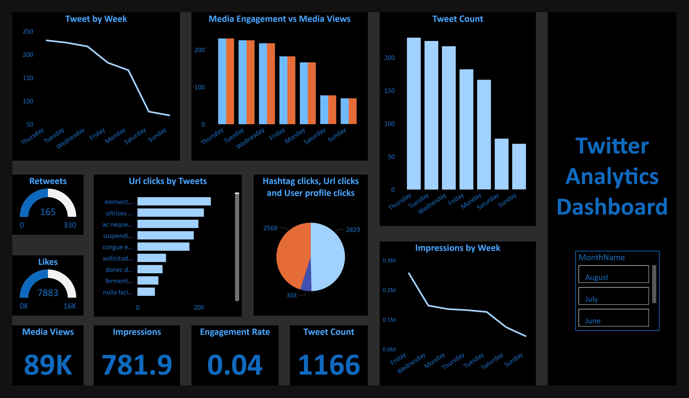
Evidence:
Training Dashboard: (See attached)
Overview: Built during the training phase, this dashboard focused on providing key metrics such as media views, impressions, engagement rates, and tweet counts, enabling an initial understanding of data visualization.
Metrics Visualized: Displays impressions, retweets, and weekly trends, offering insights into user engagement across various Twitter activities (”).

Slide 11
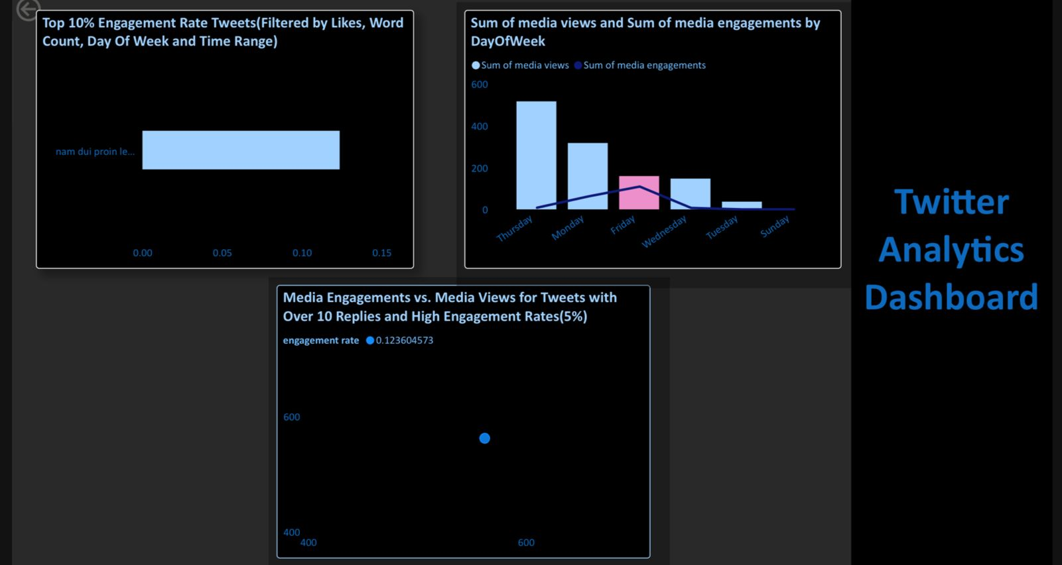
Assignment Dashboard: (See attached)
Top 10% Engagement Chart: This visual showcases tweets with the highest engagement rates, filtered by likes, word count, day of the week, and specific time intervals.
Media Engagements vs. Media Views: Analyzes tweets with over 10 replies, featuring high engagement rates, to observe interaction trends.
Dual-Axis Chart: Summarizes media views and engagements, offering an overview of weekly interaction spikes (”).

Slide 12
Challenges and Solutions
Challenges:
Date and Time Formatting: The date and time information was combined in a single column, which created difficulties in isolating specific details like the hour of the day or weekday. This was crucial for filtering tweets based on specific time intervals as outlined in the tasks.
Data Transformation Needs: Several tasks required unique columns that weren’t readily available in the dataset, such as “Tweet Rank Percentage” and “Engagement Rate Percentage.” Creating these columns manually was time-consuming but necessary to meet the assignment requirements.
Specific Filtering Issues: Task requirements like filtering for “top 10% engagement rate,” “less than 30-word count,” and specific day/time ranges were challenging to achieve with the provided data, as some filters resulted in limited or no data left for analysis.

Slide 13
Solutions:
Column Creation for Specific Requirements: Developed additional columns like “Date for Odd/Even Identification,” “Converted Date and Time,” “Tweet Word Count,” and “Engagement Rate Percentage” to address specific task requirements and enhance data granularity for more precise filtering.
Data Transformation for Analysis Flexibility: Transformed data fields into custom formats (e.g., splitting date and time, calculating tweet engagement rank) to increase the flexibility and depth of analysis, particularly useful for visualizations requiring specific time ranges or day classifications.
Iterative Testing for Optimal Filtering: Performed iterative testing on various filtering combinations to identify the configurations that best matched the tasks’ requirements, ensuring that any challenges due to dataset limitations were minimized as much as possible.

Slide 14
Outcomes and Impact
Outcomes:
Successful Task Completion with Targeted Insights: Each task was carefully executed with filters and visualizations precisely aligned with the assignment requirements. The tasks were completed by accurately applying multiple filters, calculating engagement rates, and segmenting data by essential criteria, ensuring a high level of detail and adherence to the specifications.
Comprehensive Filtering and Visual Precision: The advanced filtering methods allowed for deep insights across various tweet metrics, resulting in meaningful visualizations for the client. However, in Task 1, where the tweet word count was to be below 30, the last tweet in the filtered set had a count exceeding this limit (32 words). This discrepancy occurred despite accurately layering filters by likes, day of the week, and time range, highlighting the occasional constraints within real-world datasets.
Effective Visualization Through Enhanced Columns: The newly created columns, such as “Date Odd/Even,” “Tweet Engagement Percentage,” and “Converted Time,” provided the necessary analytical depth to reveal intricate insights, ultimately enhancing the quality and accuracy of the visualizations.

Slide 15
Impact:
Enhanced Data-Driven Decision-Making: The comprehensive Twitter analytics dashboard empowered stakeholders with critical insights into engagement patterns, helping inform strategic decisions regarding content performance and audience interaction.
Real-World Problem Solving: Successfully navigating dataset limitations, such as in Task 1, demonstrated the importance of adaptability and problem-solving. The experience underscored the value of applying alternative strategies and documenting observations when specific outcomes do not align perfectly with initial expectations.
Improved Analytical Competency and Efficiency: Through this project, both technical and analytical skills were significantly enhanced, from advanced data transformation to precise filtering techniques. This has not only increased project execution efficiency by refining filtering approaches but also developed a practical understanding of handling data anomalies in client-focused assignments.
Confidence in Future Analysis: This internship has laid a strong foundation for tackling similar data challenges in the future, with an enriched toolkit for managing complex datasets, implementing layered filters, and driving impactful visualizations tailored to client needs.

Slide 16
Conclusion
This internship provided a remarkable opportunity to deepen my expertise in data analysis and visualization within a real-world context. Through the creation and refinement of a Twitter Analytics Dashboard, I encountered and overcame numerous challenges, from transforming raw data into structured insights to implementing complex filtering techniques that catered to specific client needs. Each task honed my analytical skills and demonstrated the power of data-driven decision-making, even in the face of occasional data limitations.
The process not only enhanced my technical competencies but also instilled a practical understanding of adapting to data complexities and refining solutions to meet project objectives effectively. The skills gained during this internship—particularly in handling intricate datasets, developing insightful visualizations, and maintaining attention to detail—have set a strong foundation for future analytical work.
This experience has prepared me to confidently address similar analytical challenges, leveraging both creativity and precision to deliver impactful insights. I am grateful for the learning journey and the valuable skills acquired, which will undoubtedly serve as assets in my professional growth as a data analyst.

Slide 17
THANK YOU NULLCLASS

