Slide 1
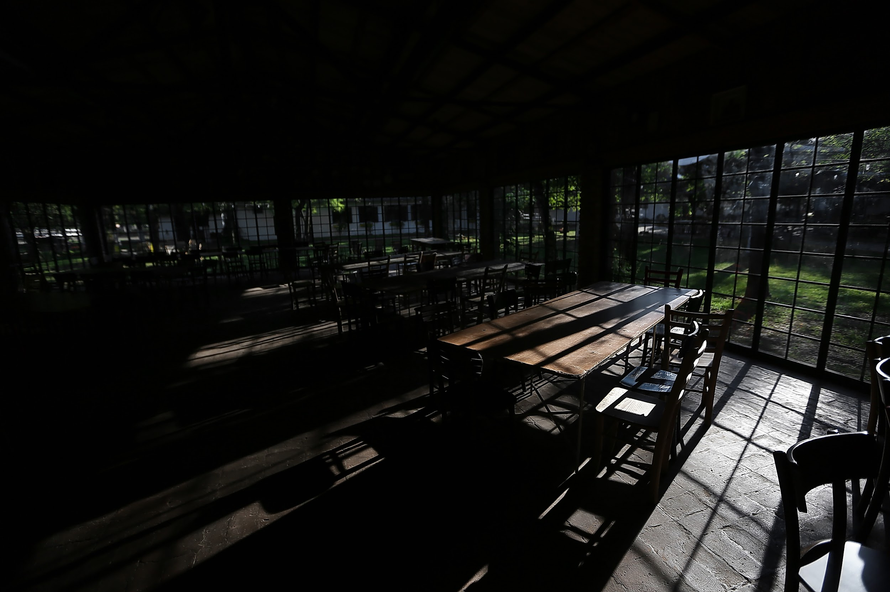
Title: Small Scale Restaurant Management
TEAM MEMBERS
Anchit Agarwal 19BCE2279
Prithish Samanta 19BCE2261
Ritvik Kohli 19BCE2223

Slide 2


Content
Introduction
Project Idea
Motivation
Objective
Literature Survey
Pros And Cons

Slide 3
Introduction
The goal of this project is to manage a restaurant database.
We are going to create a website for this project that will make it easier for consumers to order and waiters to serve.
To collect and extract data records, we will employ the concept of a relational database management system.
The goal of the project is to ensure that a restaurant runs well during peak rush hours.
This will speed up the delivery of meals from the kitchen to the customers' tables.

Slide 4

PROJECT IDEA
This Project helps small scale restaurants manage which orders are taken by whom, what date, which table, prepared by whom, what time, etc.
Not only this but it also automates the process of customer seeing the menu card, selecting items, deleting items while ordering, deleting items after the order is completed, feedback mechanism.
Our website is coded in such a way that whatever the customer selects from the menu, is sent to the database in a sorted order with specific table no, and waiters and chefs are assigned the orders in round robin fashion due to which the waiter will have to just give the order and not take the order thereby decreasing the amount of contacts with customers.
We are also implementing a custom scheduling algorithm to optimise the crowd going in a busy restaurant when many customers come at simultaneously.

Slide 5
MOTIVATION
Whenever we go to a restaurant, we need to always wait for the waiter to come to us with the menu card and then only we can give him our order.
This process is very time consuming and can sometimes take more than 10 mins.
This long and tedious process can anger the customers and also spoil the restaurant's reputation, which no restaurant owner wants to face. With our website, DBMS facilitates this problem can be solved easily and can also help the customers too have a pleasant meal.
Unfortunately some restaurants limited seatings gets super crowded during weekend. What can we do then?
We believe that with the help of our website we can speeden up the above process and make sure that the customers have a pleasant meal and a good experience.

Slide 6
OBJECTIVES
Our objective is to make an easy and aesthetic interface which will hide the complexity of database side programming so that anyone can use it without learning it from anyone or any prior training.
Our website’s main objective is to make sure that the customers or users are not made to wait in a restaurant for a long time just for ordering food.
Using our website he or she can give their orders smoothly and also efficiently. The customer’s responses will be prompted and updated quickly through this website and the chefs/ waiters will be able to serve our customers properly and create a wonderful experience for them.
Our customised algorithm will take in inputs of burst times of all the groups and calculate waiting time. The difference which this algorithm makes in that it assigns priority in the most optimised way possible. We will display the waiting times.
With our website, waiters will have to just give order and not take it as it is happening in an automated way, saving waiters time and making the process smoother.

Slide 7
YEAR | NAME AND AUTHOR | METHOD | RESEARCH GAP
2018 | Foody – Smart Restaurant Management and Ordering System By Vindhya Liyanage, Achini Ekanayake, Hiranthi Premasiri, Prabhashi Munasinghe, Samantha Thelijjagoda | Long wait times and serving the wrong order are two classic restaurant blunders that eventually contribute to customer displeasure. The goals of this online programme of the above paper are to fix these flaws and deliver speedy and accurate customer service by creating bespoke menus for each customer based on their preferences. This concept is realised as a mobile application that incorporates cutting-edge IT principles including Business Intelligence, Data Mining, Predictive Analysis, and Artificial Intelligence. The app displays a live map of the eatery. The table's colour changes to represent the current reservation status. | The algorithm which is used for sorting the orders and queueing them is not given properly i.e. the maths behind it or it's proof is not given. This paper does not include the method through which the most appropriate information of every ingredient present in the dish will be available. The table reservation dashboard is created using IOT, which is a little bit too much and it works on customer's location. What if the customer never gives his/her location permission?

Slide 8
YEAR | NAME AND AUTHOR | METHOD | RESEARCH GAP
2021 | Website Development of Restaurant Management By Prof. Jadhav A.K, Nupur Ligade, Renuka Savale, Malay Chitodkar, Rushikesh Salve | The Restaurant Management website provide convenience for the customer. The restaurant management system is there to help communication between all teams within a restaurant by minimizing the probability of human error and getting a more efficient and effective information. This System set up menu online and the customers easily places the order with a simple mouse click. By using the food menu online anyone can easily track the orders, maintain customer database and improve food delivery service. | The mechanism of registering table given in the paper is not clearly mentioned i.e. what algorithm or method they are using for that. It's mentioned that it is a restaurant management website, but there is no way or option to input and store customer feedbacks. Basic schema of the database is missing in this paper. It says that there needs to be a tablet on each table, if this is a website, then it can be replaced with a QR code.

Slide 9
YEAR | NAME AND AUTHOR | METHOD | RESEARCH GAP
2021 | AUTOMATED FOOD ORDERING SYSTEM BY PROCESS SCHEDULING SJF, SRTF, PRIORITY By See WEN Xiang , Aiman Arriady , Abu Sayed Roman, Hamid Madni | The main objective of this project is to develop a program for shortest job first scheduling Shortest Remaining Time First and Priority scheduling which helps to improve the Food Ordering process. There are many algorithms available for CPU scheduling. But we cannot implement in a real-time operating system because of high context switch rates, large waiting time, large response time, large turnaround time, and less throughput. The proposed program improves all the drawbacks of simple shortest job first scheduling Shortest Remaining Time First and Priority scheduling architecture. | The priority giving method is not optimised as it is only dependant on cooking time, can go into starvation. This paper mentions it is using Shortest Job First Technique in 'real time' which is ironical. This paper does not talk about cases when there are more than 2 orders placed simultaneously i.e. when arrival time is same. All these algorithms are highly dependant on cooking time which can be changed from staff to staff. Lastly, when this algorithm is actually implemented i.e. after in what intervals is not mentioned.

Slide 10
PROS
Our objective is to make an easy and aesthetic interface which will hide the complexity of database side programming so that anyone can use it without learning it from anyone or any prior training.
Our website’s main objective is to make sure that the customers or users are not made to wait in a restaurant for a long time just for ordering food.
Using our website he or she can give their orders smoothly and also efficiently.
The customer’s responses will be prompted and updated quickly through this website and the chefs/ waiters will be able to serve our customers properly and create a wonderful experience for them.
Lastly, the customised algorithm will help people know how much time will be needed and they can decide if they can wait until then or not.

Slide 11
Timeline Of the Project
REVIEW-1
Come up with all the features in the website. Make the ER diagram and normalise the database.
REVIEW-2
Complete the frontend. Complete the algorithm (only code wise). Code the ER diagram into MYSQL database and implement some basic queries.
REVIEW-3
Complete the backend, connect it with frontend. Implement that algorithm also into a website and use the code as backend.

