Slide 1



Customer Service & Professional Conduct
Face-to-Face Course for Field Engineers
2 HOURS
PRACTICAL
SCENARIO-LED

Slide 2
Why Does Customer Service Matter?
As a field engineer, you are often the only representative of our business the customer will ever meet in person. Everything you do — how you arrive, how you speak, how you work — shapes how the customer feels about the entire organisation.
Every visit affects trust and reputation
Professional behaviour is part of the job
A single poor interaction can lead to a complaint, a lost customer, or lasting reputational damage that spreads through reviews and word of mouth.
Conduct is not an add-on to technical work — it is a core requirement. How you do the job is as important as whether the job gets done.

Slide 3
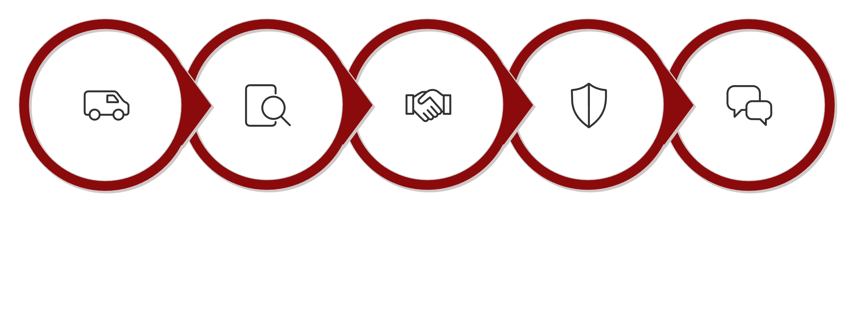
Today's Standard
Every visit, regardless of complexity, follows one consistent customer journey. This framework applies whether the job takes 20 minutes or all day — the standard does not change.
ARRIVE
CHECK
AGREE
PROTECT
COMMUNICATE
By the end of this session you will understand the expected behaviour at every stage and be able to apply it to real-world scenarios.

Slide 4
ARRIVE – The First 60 Seconds
The customer's assessment of you begins before you knock. How you park, how you walk to the door, and how you present yourself in those first moments sets the tone for the entire visit. First impressions are difficult to reverse.
Park Considerately
Present Professionally
Choose a safe, legal space. Blocking driveways or pavements signals disregard for the customer and the neighbourhood.
Clean uniform, tidy appearance. You represent the company from the moment you step out of your vehicle.
Show ID & Introduce Yourself
Confirm Customer & Purpose
Clearly state your name, company, and the purpose of your visit. Never assume the customer is expecting you.
Verify you are at the right address, speaking to the right person, and that the visit is expected and understood.

Slide 5
Activity – First Impressions
This activity asks you to look critically at two contrasting engineer arrivals and identify exactly what drives customer confidence — or destroys it — before a single word of technical work is discussed.
What Creates Confidence?
What Immediately Damages Trust?
Smart, clean uniform and tidy vehicle
Calm, purposeful approach to the door
Clear ID shown without being asked
Friendly, professional greeting
Confirmation of purpose and name
Scruffy appearance or unlabelled clothing
Parking across the driveway or on the pavement
No ID offered or vague introduction
Distracted by phone before knocking
Dismissive or impatient body language

Slide 6
CHECK – Before You Start
Entering a property and beginning work are two separate decisions. Before you pick up a single tool, you must assess the environment — both for the customer's wellbeing and for your own safety.
Responsible Adult Present
Vulnerable Customers & Individual Needs
Confirm that an appropriate person — an adult with authority to give access — is on the premises before work begins.
Identify any vulnerability, accessibility requirement, or communication need that should inform how you interact or work.
Safe Access & Work Area
Pets, Hazards & Existing Defects
Check that the proposed route and work area are physically safe. Do not assume access permission equals a safe environment.
Identify animals, obstructions, and any pre-existing damage before starting — record defects immediately and agree with the customer.

Slide 7
Scenario – Nobody Old Enough Is Home
You arrive for an installation and a 15-year-old answers the door. Their parent calls and says: "It is fine — just get on with it."
This is a genuine dilemma that engineers face. The pressure to complete the job is real — but so is the responsibility to follow procedure. Consider what is actually required and what the consequences of getting it wrong could be.
What Do You Do?
What Do You Say?
Continue / Stop / Escalate?
Follow company policy on responsible adult requirements. A phone call from a parent does not constitute an authorised adult being present on the premises.
Politely explain the requirement to the young person and, if possible, to the parent by phone. Be empathetic — this is policy, not personal.
Stop and escalate. Contact your supervisor or follow the approved process. Do not commence work unsupervised with a minor present.

Slide 8
Your Safety Matters Too
Protecting the customer is a core part of the role — but your personal safety carries equal weight. No job is worth completing at the cost of your own wellbeing. The environment at the start of a visit can change significantly before you finish.
Continually Reassess the Environment
Know Your Exit Route
Remove Yourself and Escalate
Always maintain awareness of how to leave the property quickly and safely. Never position yourself with your exit blocked.
What felt safe on arrival may change. New people may arrive, behaviour may escalate, or physical hazards may emerge during work.
If you feel unsafe at any point, withdraw to a secure position and follow the approved reporting and escalation process. Do not wait for an incident to occur.

Slide 9
Scenario – Drug Paraphernalia
You enter the property and identify drug paraphernalia. Used and exposed needles are close to the proposed work area. The customer says they will move them and asks you to carry on.
This scenario requires immediate, clear decision-making. The health risk is serious; sharps present a genuine infection hazard. Your instinct may be to accommodate the customer and get the job done. The correct response is different.
What Do You Do?
What Do You Say?
Continue / Stop / Escalate?
Do not touch or move sharps under any circumstances. Withdraw to a safe position away from the hazard. Do not continue work in the area.
Calmly explain that you are unable to work near the hazard and that the situation requires reporting before work can continue.
Stop and escalate immediately. Follow the approved reporting process. This is non-negotiable regardless of customer pressure.

Slide 10
Would You Carry On?
Quick-fire decision activity. For each situation below, decide immediately: CONTINUE, STOP, or ESCALATE? There is no middle ground — you must choose a position and be prepared to justify it.
Exposed Needles
Aggressive or Uncontrolled Dog
Threatening Behaviour
Sharps visible near the work area, customer says they will deal with them.
Customer raises their voice, moves into your personal space, makes threatening statements.
Large dog blocking access to the work area, owner is dismissive of the concern.
Unsafe Access
Intoxicated Occupant
The only route to the work area requires crossing a visibly unsafe floor or structure.
Customer appears heavily intoxicated and their behaviour is unpredictable during your visit.

Slide 11
Lone Working & Personal Safety
Working alone in a customer's home carries specific risks that a team environment reduces. Risk can affect any lone engineer and is not limited to any particular individual or area — it depends on behaviour, environment, and circumstances that can change at any moment.
Stay Situationally Aware
Maintain Your Exit Route
Leave Before It Escalates
Monitor the behaviour of everyone present, not just the named customer. New arrivals, changing moods, and unexpected visitors all affect your safety assessment.
Always know how you would leave quickly. If access to your exit becomes obstructed — even casually — treat this as a warning sign.
Do not stay because the job needs to be finished. Your personal safety always takes priority. Withdraw early and report — do not wait for an incident to occur.

Slide 12
Scenario – Something Doesn't Feel Right
A lone engineer attends a property in an area with recent reports of violence. A group is gathering near the engineer's vehicle. The customer becomes confrontational. The easiest exit is being obstructed.
This scenario tests your ability to read a situation early and act before it becomes dangerous. Multiple warning signs are present simultaneously — each one alone might be manageable, but together they demand a clear decision.
Warning Signs Present
The Right Response
Known high-risk area
Group gathering near your vehicle
Confrontational customer behaviour
Exit route becoming obstructed
Do not stay to complete the job. The combination of these factors justifies early withdrawal. Move to a safe position, contact your supervisor, and follow the escalation process. Document everything accurately.
Early withdrawal is not failure — it is correct professional judgement.

Slide 13
AGREE – Before You Drill
Agreement is not a formality; it is protection for both you and the customer. Work carried out without clear agreement is a leading cause of complaints, disputes, and damage claims. Never assume the customer understands what you intend to do.
01
02
Explain in Plain Language
Agree Cable Routes & Equipment Locations
Describe the planned work, route, and equipment locations without using technical jargon. Confirm the customer understands before proceeding.
Physically show and confirm where cables will run and where equipment will be placed. Get a clear verbal agreement.
03
04
Set Realistic Expectations
Gain Permission Before Starting or Changing
Be honest about timescales, limitations, and what the finished result will look like. Avoid over-promising.
Any deviation from the agreed plan, however minor, requires fresh agreement with the customer before work continues.

Slide 14
Activity – Explain It Without Jargon
Technical language is second nature to engineers — but it is a barrier to customers. This paired activity challenges you to communicate a real installation clearly and professionally, using only language a non-technical person can understand.
Engineer Role
Customer Role
Explain a fibre installation — including the route, equipment, and expected result — to a customer who has no telecoms knowledge. Use simple, everyday language throughout.
Listen as a real customer would. Ask questions if anything is unclear. After two minutes, swap roles and repeat the exercise.
Terms to avoid unless clearly explained: CSP, ONT, splice, CBT, RJ45, attenuation, throughput. If you use a technical term, follow it immediately with a plain-English explanation.

Slide 15
Scenario – Can You Move That For Me?
The agreed equipment location is behind a large cabinet. The customer says: "Just give me a hand moving it." The engineer needs access before the installation can continue.
This is a common and awkward moment. The customer's request is reasonable from their perspective — but company procedure is clear. The challenge is to decline without damaging the relationship or leaving the job incomplete.
Professional Response
The Standard
"I am not able to move customer furniture as part of this visit, but if the area can be made accessible I will be happy to continue with the installation straight away."
Offer to wait a short time, suggest the customer asks another household member, or discuss an alternative equipment location if one is feasible.
Do not move customer furniture where company procedure prohibits it. This rule exists to protect both the customer's belongings and the engineer from liability if damage occurs.

Slide 16
How Do You Say No Professionally?
Refusing a customer request without causing offence is a real skill. The goal is to be clear and honest about the limitation while keeping the relationship positive and leaving the customer with a route forward.
Avoid: "Not my job."
Avoid: "I can't do that."
Better: Explain + Offer a Path Forward
Blunt refusals without explanation feel dismissive and unhelpful. They create frustration and often lead to escalated complaints.
A flat "can't" without context gives the customer nowhere to go and no understanding of why the request cannot be met.
"I am unable to move customer furniture, but if the area can be made accessible I will be happy to continue." Always close with what can happen next.

Slide 17
PROTECT – Treat It Like Your Own Home
The customer is allowing you into their home. Everything in that property has value — practical and personal. Treating the customer's home with the same respect you would want for your own is not optional; it is a professional standard.
Record Existing Damage
Protect Floors & Belongings
Handle Personal Information Correctly
Photograph any pre-existing defects near your work area before starting. This protects both you and the customer from later disputes about cause.
Use dust sheets, cable covers, and appropriate protection. Move or cover items at risk from drilling, cutting, or cable pulling.
Treat passwords, Wi-Fi codes, account details, and any personal information you encounter with strict confidentiality. Never share or note down customer data outside of authorised systems.

Slide 18
Scenario – That Crack Was Already There
Existing wall damage is directly beside the proposed drilling location. The customer says: "It is fine — just drill it." The engineer has not yet started work.
This scenario is about protecting yourself as much as the customer. If you drill without recording the pre-existing damage, you have no evidence that the crack was there before you started — and a complaint is very difficult to defend.
What Do You Do?
What Do You Say?
Continue / Stop / Escalate?
Photograph the damage clearly before starting work. Make the customer aware that you are recording the pre-existing defect and explain why.
"Before I start, I need to photograph this existing damage so that both of us have a clear record. I just want to make sure we are both protected."
Continue — but only after recording the defect, gaining the customer's verbal agreement, and documenting it in your job record. Do not skip this step even under time pressure.

Slide 19
COMMUNICATE – Don't Disappear Into the Job
Once work starts, it is easy to focus entirely on the technical task and lose sight of the customer. But customers who feel ignored or uninformed become anxious — and anxiety turns quickly into complaints. Proactive communication prevents the vast majority of escalations.
Keep the Customer Informed
Explain Delays and Problems Early
Give brief, regular updates on progress. The customer does not need a technical commentary, just reassurance that everything is going to plan.
Never wait until the end of a job to tell the customer there is an issue. Bad news communicated early is far easier to manage than a surprise at the point of completion.
Re-Agree Any Changes
Never Over-Promise
If the plan needs to change, for any reason, stop, explain the situation, and gain fresh agreement before proceeding. Unauthorised changes are a leading cause of complaints.
Only commit to what you can deliver. A promise you cannot keep causes more damage than an honest explanation of a limitation.

Slide 20
Scenario – The Route Has Changed
The cable route was agreed before work started. Halfway through the installation, the customer changes their mind and requests a completely different route.
Mid-job changes are one of the most common sources of conflict. The customer may feel it is a small request — but for the engineer it means stopping, assessing feasibility, and obtaining authorisation before proceeding.
What Do You Do?
What Do You Say?
Continue / Stop / Escalate?
Stop work on the current route. Assess whether the new route is technically feasible and within scope. Do not begin the new route without authorisation.
"I completely understand — let me take a look at the new route and confirm whether it is achievable. I will need to check before I can make any changes to what has been agreed."
Stop and re-agree. Contact your supervisor if the change is outside your authorisation. Do not make unauthorised modifications simply to satisfy the customer in the moment.

Slide 21
When Customers Become Difficult
Most difficult customer interactions fall into one of two categories: a customer who is upset and frustrated, or a customer who poses a genuine personal-safety risk. Distinguishing between the two is critical — the response to each is very different.
Unhappy Customer — Stay & Manage
Safety Threat — Withdraw & Escalate
Stay calm and professional at all times
Do not argue or match the customer's tone
Acknowledge the frustration without accepting blame
Explain the available options clearly
Escalate via the complaint process if needed
Maintain physical distance and keep your exit clear
Do not attempt to resolve threats through conversation
Withdraw calmly without confrontation
Contact your supervisor or emergency services
Document the incident accurately and promptly

Slide 22
Scenario Challenge – STOP / CONTINUE / ESCALATE
Six scenarios. One decision each. For every situation, choose your position — then be ready to explain your reasoning to the group. There is a correct answer for each one.
Angry Customer Over a Delay
Loose Dog in the Work Area
Upset but not threatening. Raising their voice about a missed appointment window.
Large dog roaming freely. Owner says: "He's friendly, don't worry about it."
Cash Offered for Private Work
Exposed Needle Near Work Area
Customer offers cash to do additional work "off the books" while you are already on site.
Sharps visible on the floor adjacent to where you need to work.
Furniture Needs Moving
Unauthorised Route Change
Customer asks the engineer to help move a large cabinet to access the equipment location.
Customer insists on a different cable route mid-installation, without supervisor approval.

Slide 23
COMPLETE – The Last Impression
The end of a visit is just as important as the beginning. How you leave — the condition of the work area, the customer's understanding, their confidence in what has been installed — determines the final impression and directly affects satisfaction scores and complaints.
01
02
Tidy and Check the Work Area
Demonstrate the Completed Work
Remove all packaging, cable offcuts, dust, and debris. Leave the property in the same condition — or better — than you found it.
Show the customer that everything is working as expected. Walk them through the installation and confirm it meets the agreed outcome.
03
04
Explain What the Customer Needs to Know
Confirm Understanding & Leave Professionally
Cover anything the customer needs to operate, maintain, or report on the equipment. Use clear, jargon-free language.
Check the customer has no remaining questions. Say a proper goodbye — a professional close to the visit reinforces confidence in the service they have received.

Slide 24
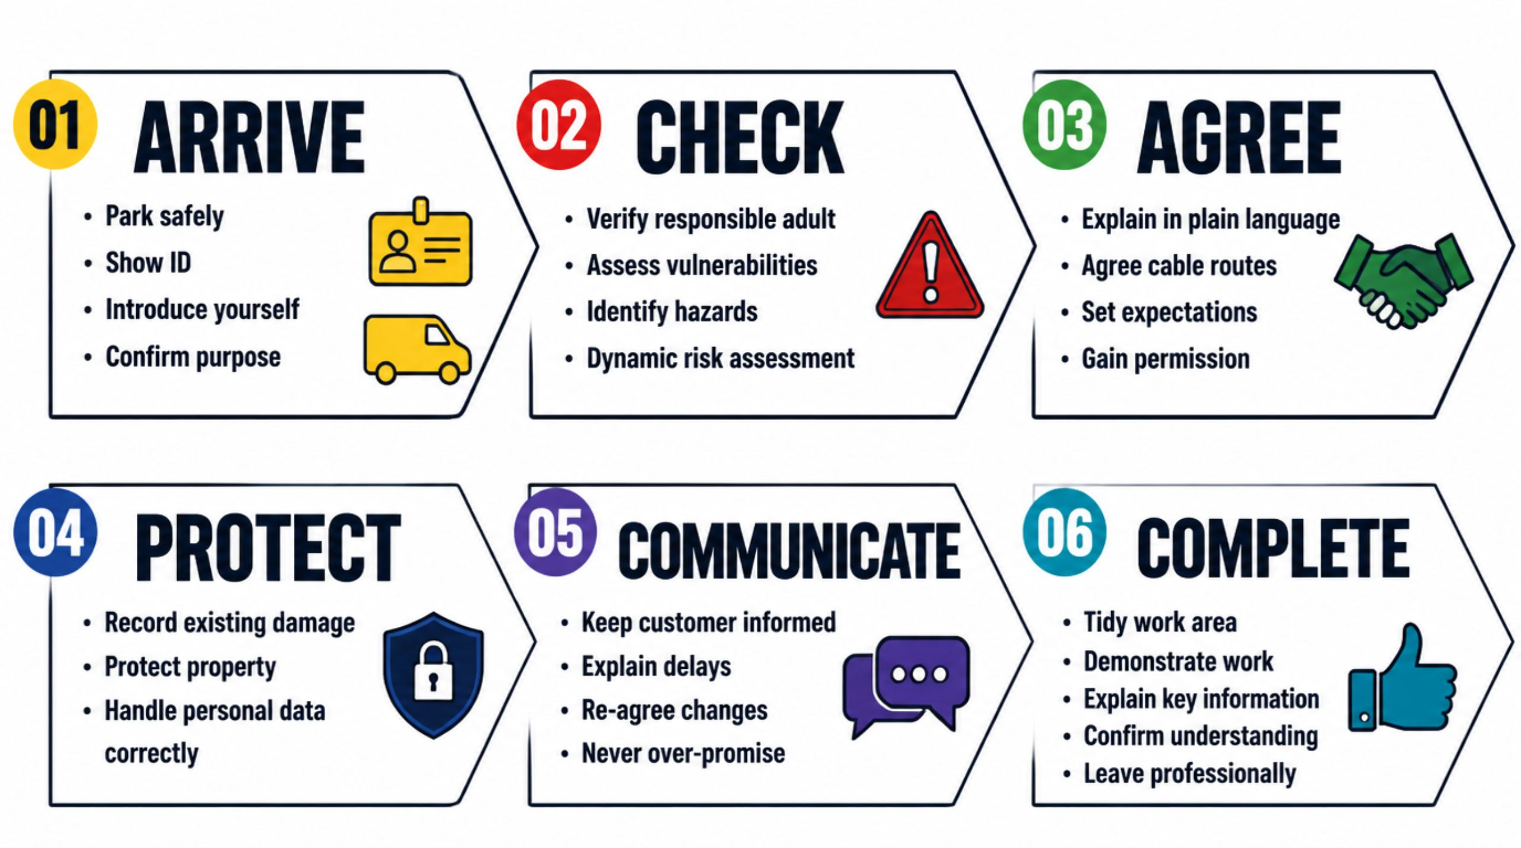
The Whole Customer Journey
Every visit follows the same six-stage standard — regardless of job type, property, or complexity. This is the framework that defines professional conduct at every door.
Without looking back at the slides, explain one expected behaviour for each of the six stages.

Slide 25

The Final Rule
IF YOU ARE UNSURE:
DON'T GUESS
STOP & MAKE SAFE
Making an unauthorised assumption to keep the job moving is how incidents, complaints, and liability claims begin. Uncertainty is a signal to stop, not to proceed.
Pause all work. Secure the area, protect the customer, and ensure you are in a safe position before taking any further action.
ESCALATE
Contact your supervisor and follow the approved process. Engineers are never expected to make unsupported decisions in complex or unsafe situations. That is what the process is for.

Slide 26
Summative Assessment
This assessment confirms that you have understood the key principles covered in this session. It must be completed individually, without support from the trainer or other learners. Read each question carefully before answering.
20
80%
Minutes
Pass Mark
Total time allowed for the assessment
Required to achieve a pass on first attempt
Format
Question Types
Coaching Rule
Online, individual assessment
Multiple-choice and situational judgement
No coaching or assistance during the assessment

