Slide 1
Airport Delay Analytics API COMP3011 Coursework 1 Mingxuan Zhang

Slide 2

Project Overview
• RESTful API for flight data management and analysis
• Supports CRUD operations
• Provides delay analytics and airport connectivity
• Uses real-world flight dataset (2018–2024)
System Architecture
API Layer (FastAPI) ↓ Business Logic (Routers) ↓ Database (SQLite + SQLAlchemy)

Slide 3
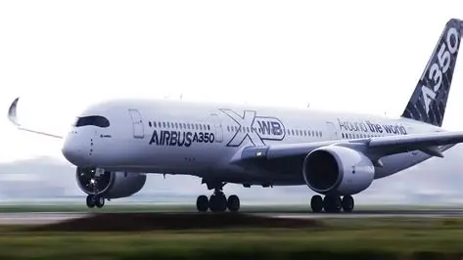
Data Source
• US DOT On-Time Performance Dataset (2018–2024)
• Real flight-level data
• Includes:
- origin / destination
- departure time
- delay information
API Design
Flights (CRUD):
• POST /flights
• GET /flights/{id}
• PUT /flights/{id}
• DELETE /flights/{id}
Other endpoints:
• /airports/{iata}/destinations
• /analytics/delay-rate
• /analytics/delay-by-hour

Slide 4
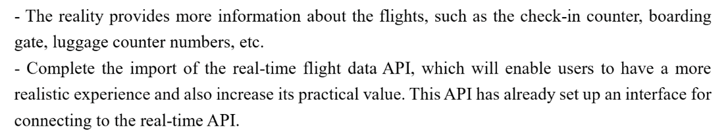
Features

Slide 5
Next, I will conduct a live demonstration on the computer.

Slide 6
Thank you for watching

