Slide 1
Airport Delay Analytics API COMP3011 Coursework 1 Mingxuan Zhang

Slide 2
Project Overview
• RESTful API for flight data management and analysis
• Supports CRUD operations
• Provides delay analytics and airport connectivity
• Uses real-world flight dataset (2018–2024)

Slide 3
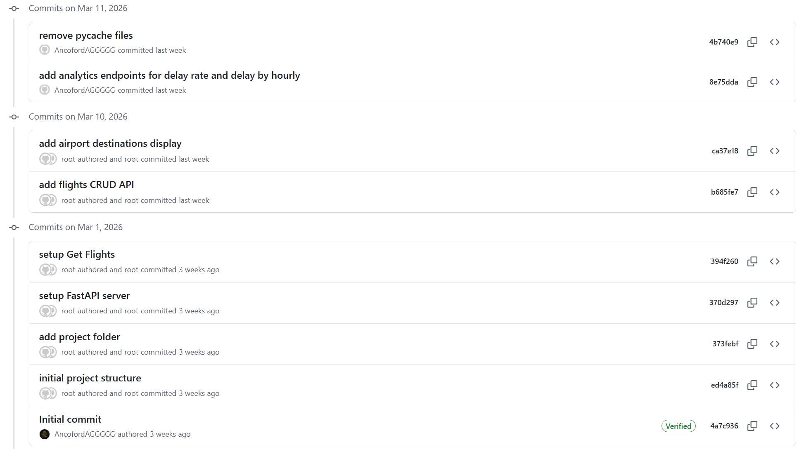
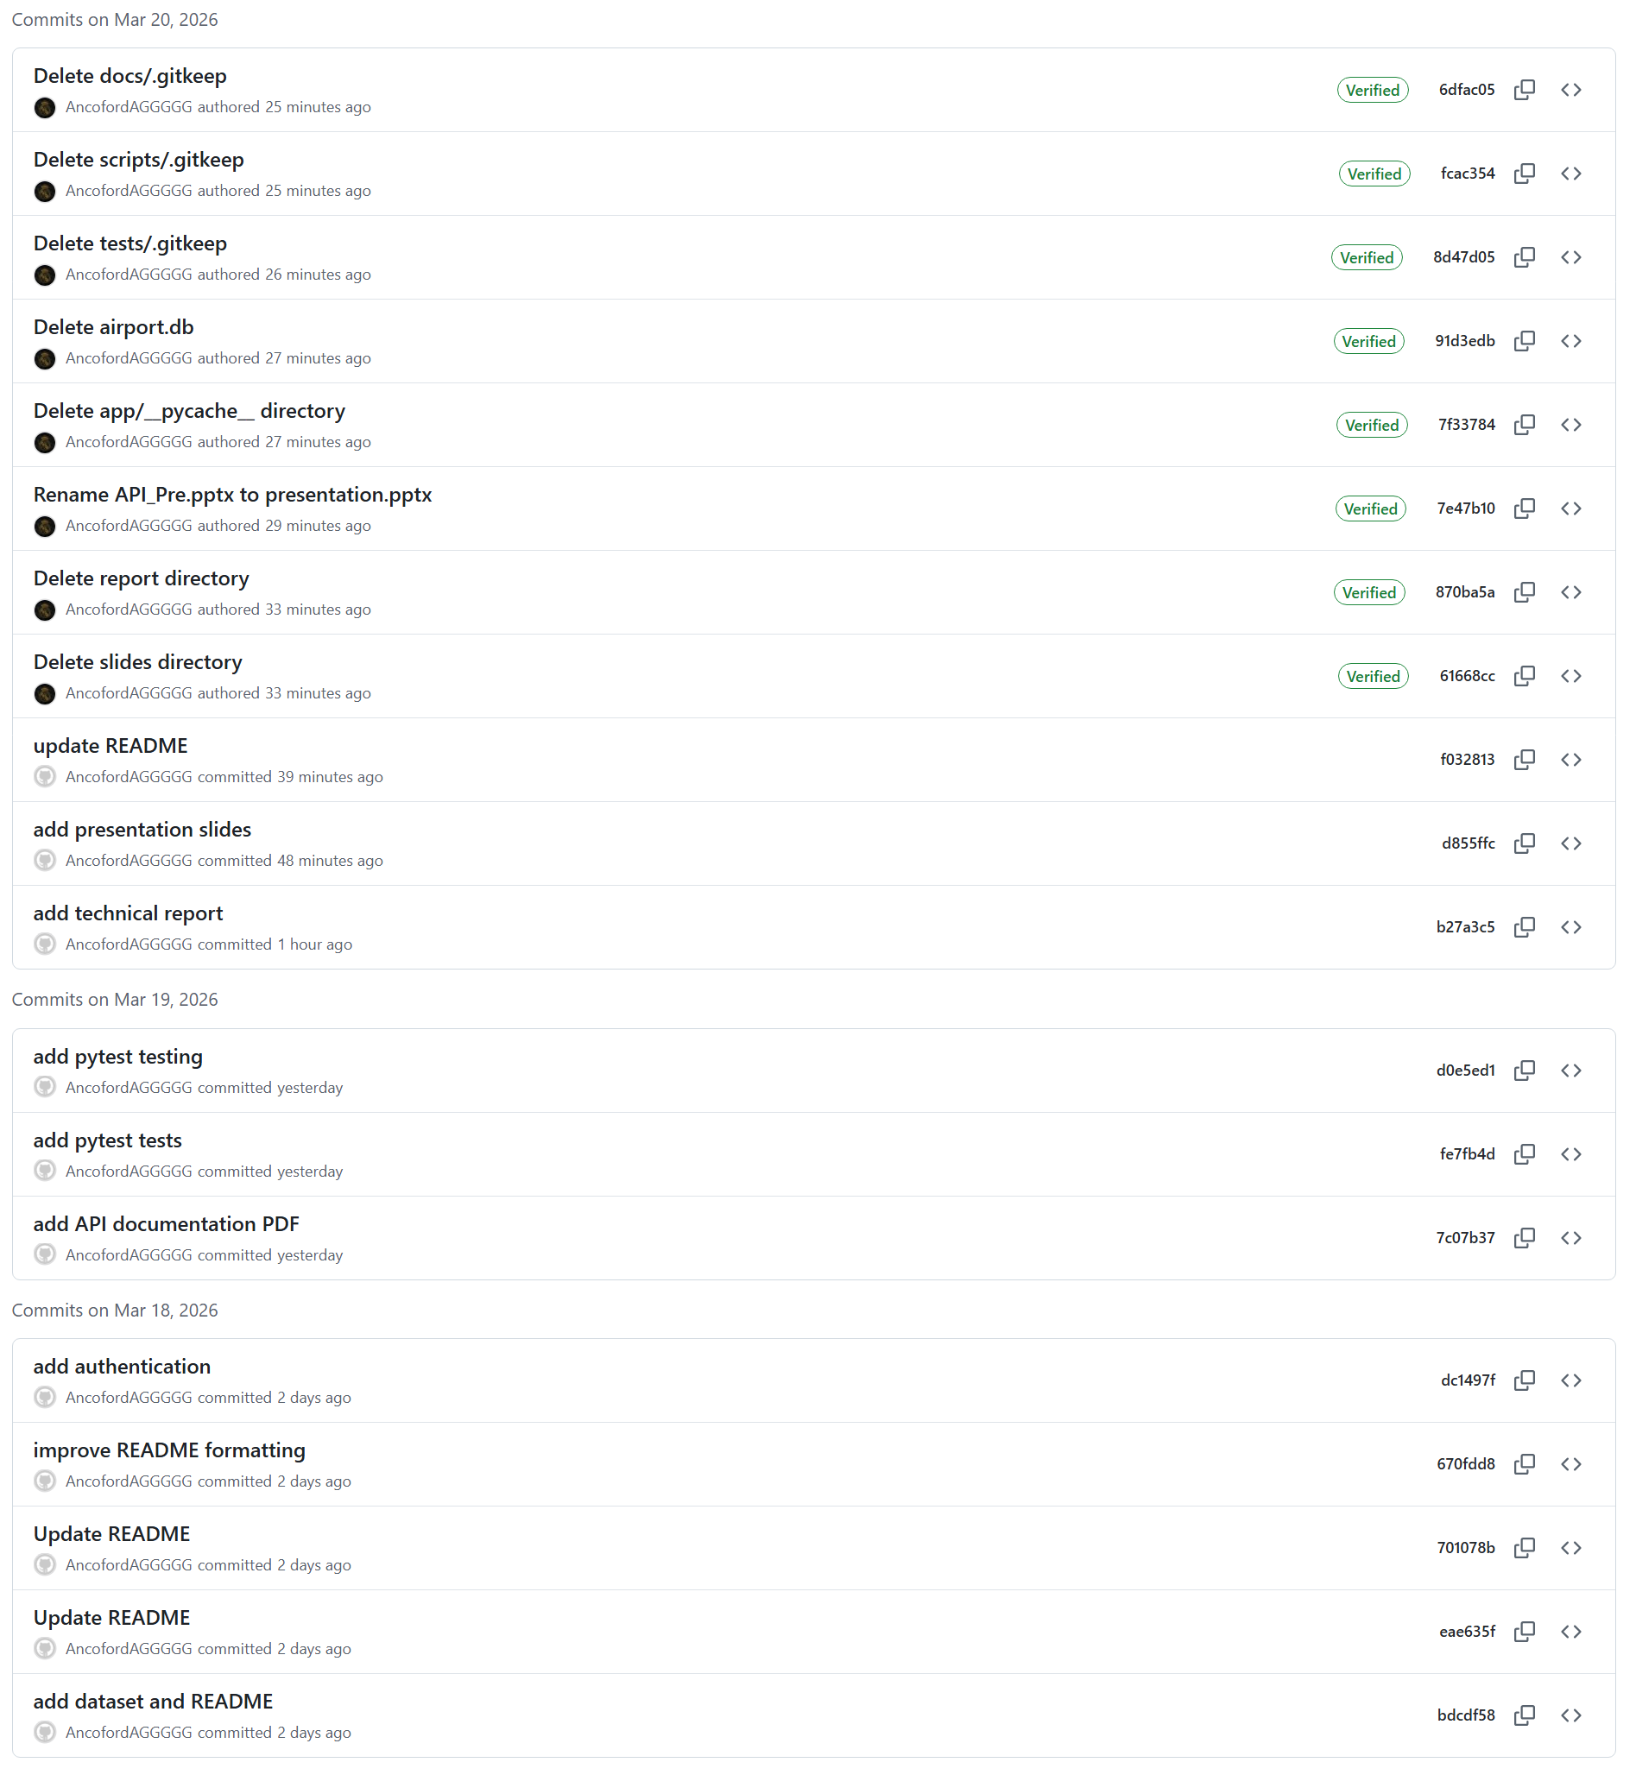
Version Control & Development Process
init project structure
add flight CRUD endpoints
implement delay-rate analytics
fix bug and write docs
add unit tests
final check

Slide 4
Data Source
API Design
• US DOT On-Time Performance Dataset (2018–2024)
• Real flight-level data
• Includes:
- origin / destination
- departure time
- delay information
Flights (CRUD):
• POST /flights
• GET /flights/{id}
• PUT /flights/{id}
• DELETE /flights/{id}
Other endpoints:
• /airports/{iata}/destinations
• /analytics/delay-rate
• /analytics/delay-by-hour

Slide 5
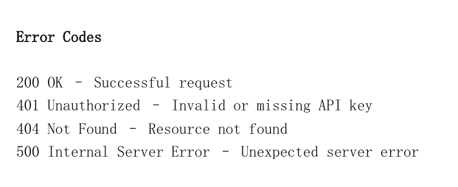
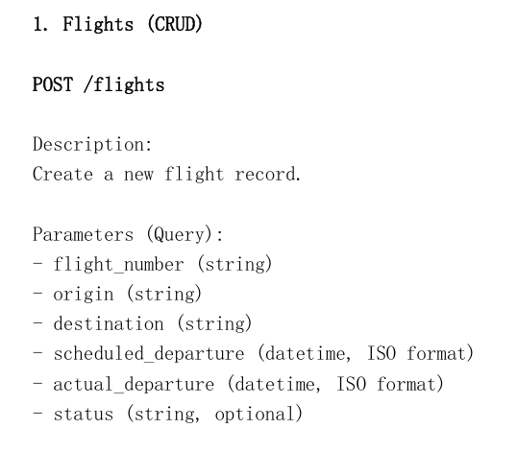
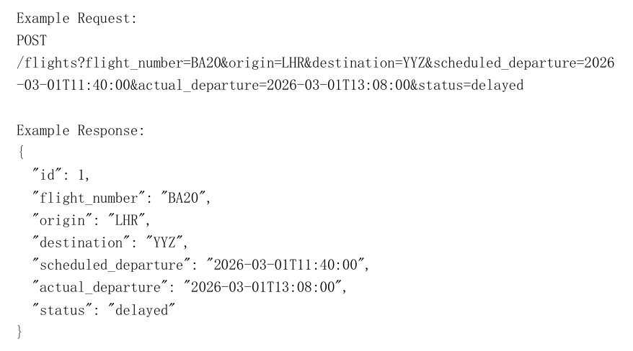
API Documentation
- Endpoints
- Parameters
- JSON response formats
Example requests and responses
- Authentication and error handling documented

Slide 6
Technical Report Highlights
• Describes system architecture and design decisions
• Explains data processing and dataset integration
• Details API implementation and analytics logic
• Discusses challenges and future improvements

Slide 7
Next, I will conduct a live demonstration on the computer.

Slide 8
Thank you for watching

