Slide 1
The Joys of JavaScript

Slide 2
Objectives
In today’s class we’ll be introducing:
JavaScript Definitions
JavaScript Basics:
- Variables
- Logging, Alerting, Prompting
- Arrays
If/Else Statements
Array Assignments
The Concept of For-Loops

Slide 3
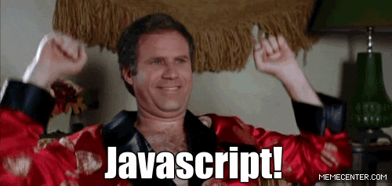
OMG JavaScript!
Prepare to become true coders.

Slide 4
How to Learn JavaScript

Slide 5
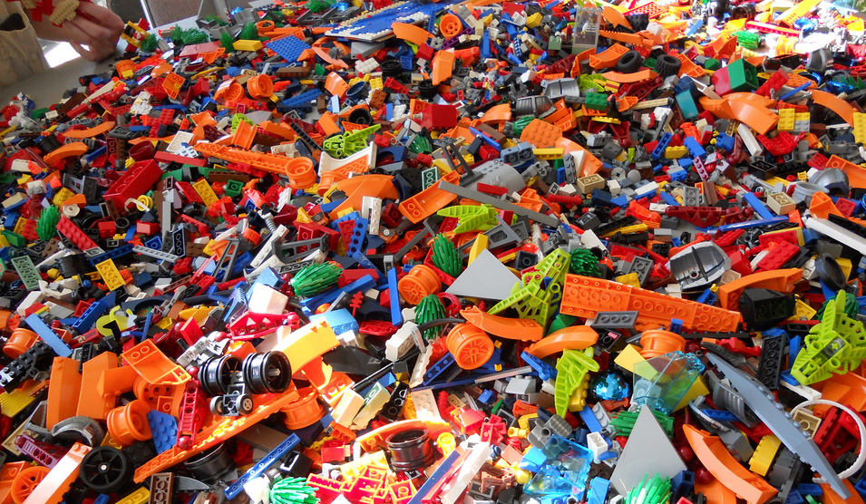
Your Brain on JavaScript…

Slide 6
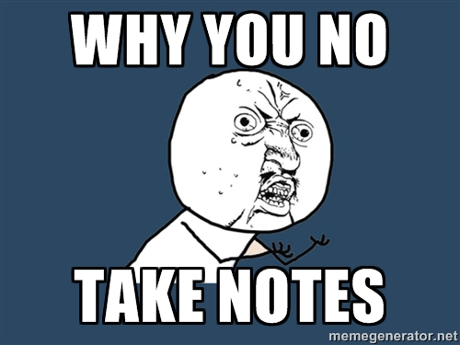
Time to Take Notes…

Slide 7
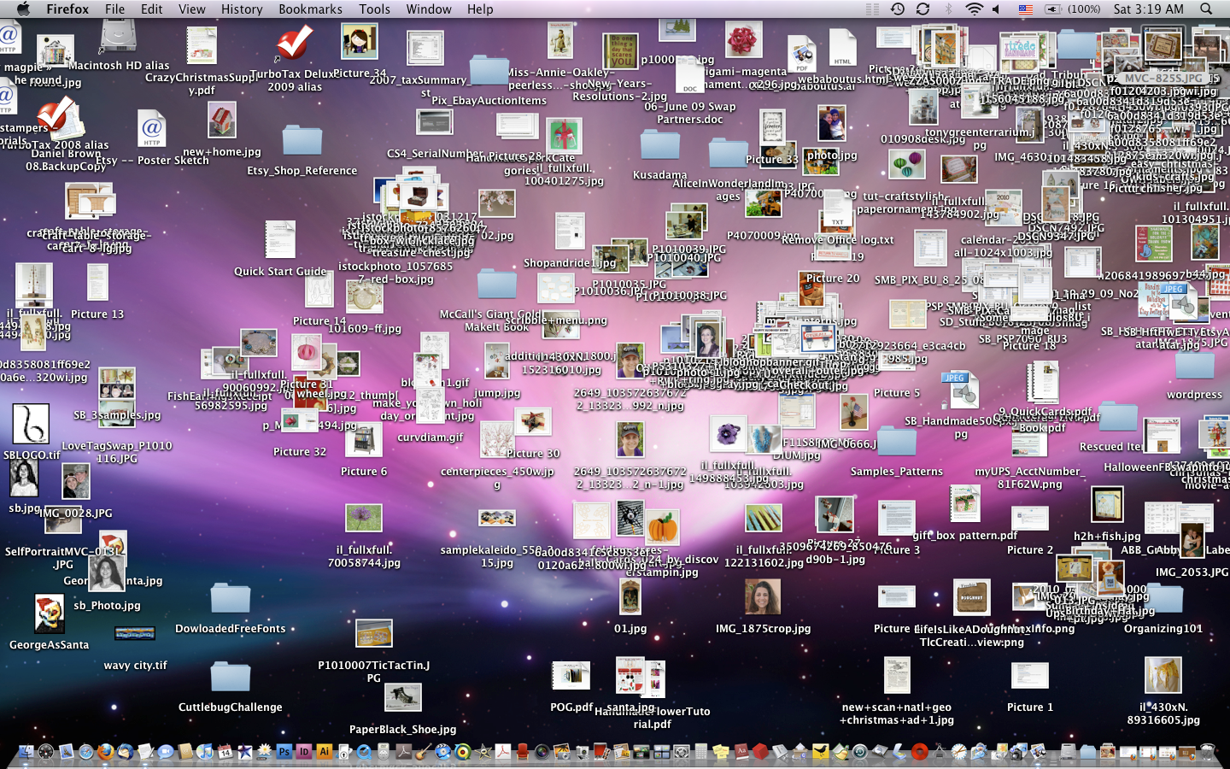
And Keep Organized!!!

Slide 8
Overall Tips
Review Immediately: We’ll be building upon these concepts quickly. The firmer your grasp now, the better off you’ll be.
Re-do the exercises in class: Don’t just re-read! Actually spend the time to re-do them from scratch on your own.
Get Help: Come to office hours. Ask conceptual questions. Ask specific questions. Just keep asking questions!
Don’t be Afraid: You will get this. It will take time, but you will get this. Just keep at it. Patience will pay off.

Slide 9
Warmup Activity

Slide 10
> YOUR TURN!!
Code Dissection:
Download the file sent to you via slack.
Open it in Chrome and observe what happens.
With a partner, try to explain how the code connects to the events that happen on the page.
p.s. We haven’t covered JavaScript before, but a big part of being a developer is learning on the fly!
MAJOR p.s. When downloading any code going forward, be sure to hit “Download”. If you copy and paste directly from Slack, your code will not work!

Slide 11
What is JavaScript?

Slide 12

JavaScript Definitions
JavaScript is the third of the three fundamental programming languages of the modern web (along with HTML, CSS).
JavaScript allows developers to create dynamic web applications capable of taking in user inputs, changing what’s displayed to users, animating elements, and much more.

Slide 13
Variables

Slide 14
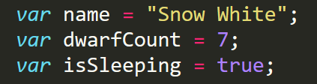
Basic Variables
Variables are the nouns of programming.
They are “things” (Numbers, Strings, Booleans, etc.).
They are composed of variable names and values.

Slide 15
Demo Time
Instructor: Demo
(BasicVariablesDemo | 02-BasicVariablesDemo)

Slide 16
Basic Variables (Syntax)
Var Keyword
Variable name
Assignment
Value
Termination
var
name
=
“Snow White”
;

Slide 17
Basic Variables (Syntax)
Var Keyword
Variable name
Assignment
Value
Termination
var
name
=
“Snow White”
;
Be sure to notice the quotes (“”),
which convey that Snow White is a string.

Slide 18
> YOUR TURN!!
Code Creation:
Using the instructions in the file sent to you, fill in the missing JavaScript code to create variables.
When you are done, open the file in Chrome and check the output.
If you successfully completed the activity, you should see a series of pop-up windows with text inside.
Finally, look at the rest of the code and try to figure out why the text displayed the way it did.

Slide 19
Logs, Prints, Alerts

Slide 20
Demo Time
Instructor: Demo
(ConsoleDemoInstructor.html | 04-ConsoleLogDemo)

Slide 21
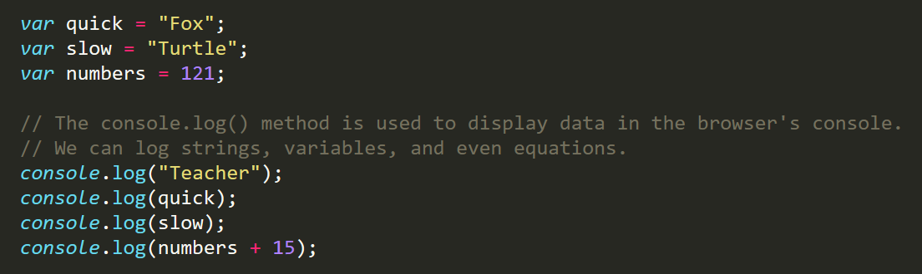
Console.log
console.log is a quick expression used to print content to the debugger.
It is a very useful tool to use during development and debugging.

Slide 22
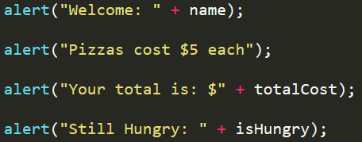
> YOUR TURN!!
Code Creation:
Using the file sent to you as a guide, modify the code so that is uses console.log instead of alerts to display messages.
Then open the file in the browser and open up chrome Developer tools -> Console to confirm the changes worked.
With a partner, discuss the different between using console.log and alert.

Slide 23
Demo Time
Instructor: Demo
(PromptDemo.html | 06-PromptDemo)

Slide 24
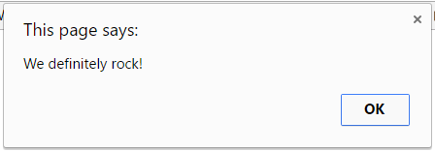
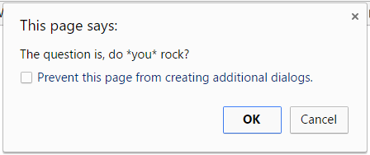
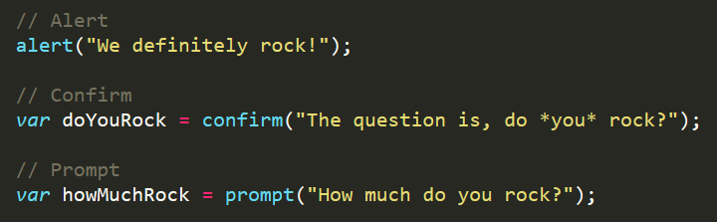
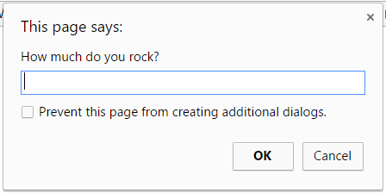
Alerts, Prompts, Confirms
Alerts, Confirms, and Prompts will create a popup box in the browser when run.
These are also useful for development and debugging.

Slide 25
> YOUR TURN!!
Code Creation:
Write JavaScript code that does the following:
Using a confirm, ask the user: “Do you like _____?” and store their response in a variable.
Using a prompt, ask the user: “What kind of _____? do you like?” and store their response in a variable.
Alert both variables to the screen.

Slide 26
Document Write

Slide 27
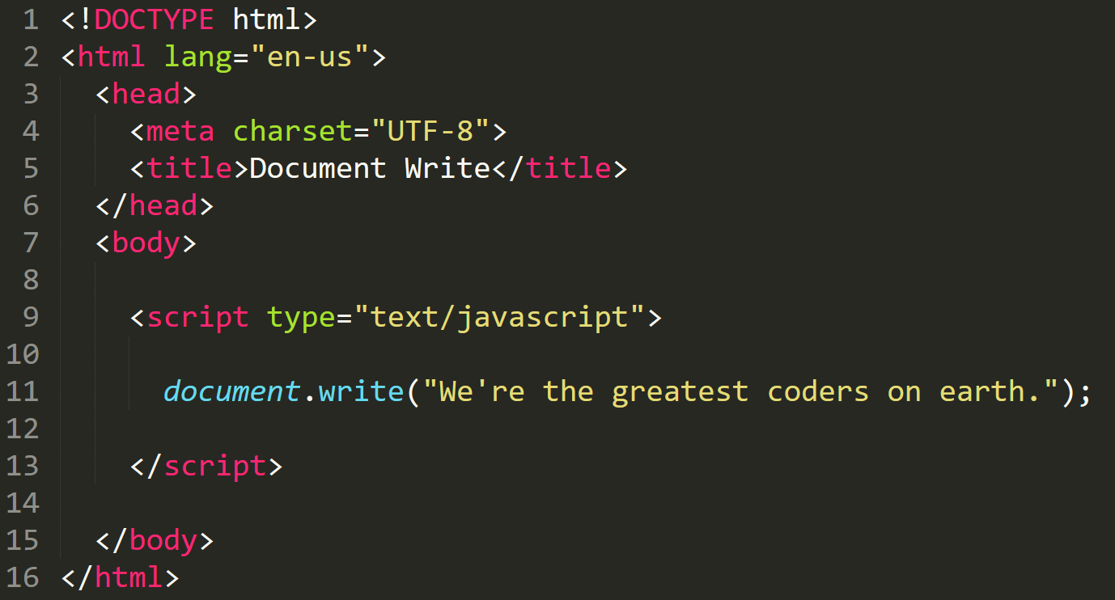

Writing to HTML
We can also use JavaScript to directly write to the HTML page itself using document.write( ).
Later we will go over much more advanced approaches for writing HTML using JavaScript and jQuery.
Test.html (chrome)
Test.html
(sublime)

Slide 28
If/Else Statements

Slide 29
Demo Time
Instructor: Demo
(conditionaldemo.html | 08-ConditionalDemo)

Slide 30
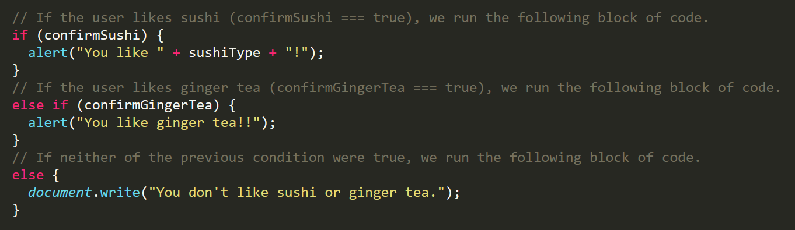
If/Else Statements
If/Else statements are critical.
Each statement is composed of an if, else-if, or else (keyword), a condition, and the resulting code in { } curly brackets.

Slide 31
> YOUR TURN!!
Code Creation:
Create a website (from scratch) that asks users if they eat steak.
If they respond with “yes”, write the following to the page: “Here’s a Steak Sandwich!”.
If they respond with “no”, write the following to the page: “Here’s a Tofu Stir-Fry!”.
Bonus: Ask what the user’s birth year is. If they are under 21, alert the following: “No Sake for you!”
Hint: You will need to use document.write( ) from the last activity.

Slide 32
> YOUR TURN!!
Code Dissection:
Open the file sent to you in Sublime.
With a partner, go through and predict what the result of each “conditional” statement will be (i.e. will the “if” or the “else” be triggered).
Then run the program to check if you are right. Note any that you got wrong and ask about it in class.

Slide 33
Arrays

Slide 34
The Zoo Pen
Array Name: zooAnimals
Zebra
Rhino
Giraffe
Owl
Index 0
Index 1
Index 2
Index 3

Slide 35
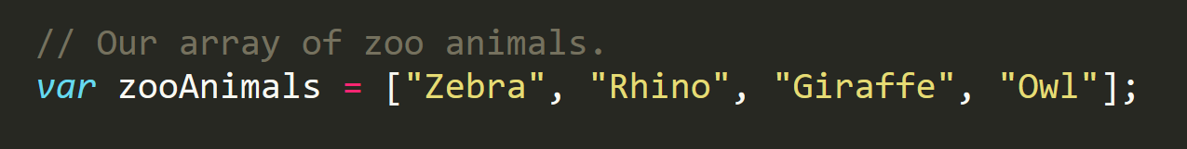
The Zoo Pen… Coded
Array Name: zooAnimals
Zebra
Rhino
Giraffe
Owl
Index 0
Index 1
Index 2
Index 3
Coded in JavaScript using an Array

Slide 36
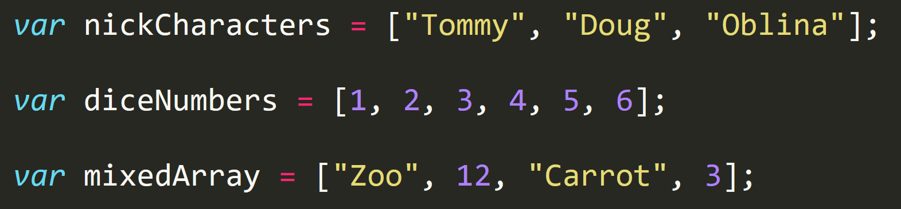
Basic Arrays
Arrays: a type of variable that are collections.
These collections can be made up of strings, numbers, Booleans, other arrays, objects, anything.
Each element of the array is marked by an index. Indexes always start with 0.

Slide 37
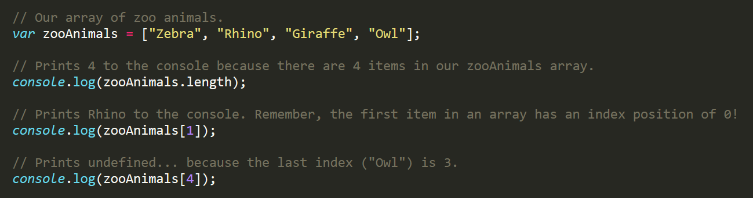
Basic Arrays Indices
To recover the value at any specific index you include the name of the array with a square bracket [ ] and inside the bracket is the element’s index.
You can easily grab the number of elements in the array using the method array.length.

Slide 38
Demo Time
Instructor: Demo
(ArraysDemo.html | 11-ArraysDemo)

Slide 39
> YOUR TURN!!
Class Code Dissection:
With a partner, take a few moments to look over the following code.
Above each console.log() write a comment “predicting” what you think the output will be.

Slide 40
Challenge Activity?

Slide 41
> YOUR TURN!!
Code Creation (Challenge):
Create a website that accomplishes the following:
Create an array of your favorite bands.
With a prompt, ask the user’s favorite band.
If it’s one of your favorites, alert: “YEAH I LOVE THEM!”.
If it’s not, alert: “Nah. They’re pretty lame.”.
Hint: You will need to research how to use .indexOf()
Hint: You will need to research how to use .toLowerCase()

Slide 42
> YOUR TURN!!
Activity: 14-JS Dissect | Suggested Time: 3 min
Code Dissection: Basic JS
Re-examine the file sent to you during yesterday’s class.
See if you can better understand how it works – after having gone through today’s class.
Prepare to share once the time is up.

Slide 43
> YOUR TURN!!
Activity: 15-CoolPeopleArray | Suggested Time: 5 min
Code Creation: Array Logging (If Needed)
Follow the instructions provided in the file to console.log each of the names in the “coolPeople” variable.
Hint: You should be repeating the same line 6 times.
Be prepared to share once time is up.

Slide 44
> YOUR TURN!!
Activity: 16-ArraySetting | Suggested Time: 7 min
Code Creation: Array Setting
Follow the instructions in the file provided to convert each item in the array to lower case.
Make sure to only add in lines of code where instructed.
Hint: You will need to use the method .toUpperCase(). Research if you don’t remember how to use it.
Be prepared to share once time is up.

Slide 45
For Loops

Slide 46
Back to The Zoo Pen
Array Name: zooAnimals
Zebra
Rhino
Giraffe
Owl
Index 0
Index 1
Index 2
Index 3

Slide 47
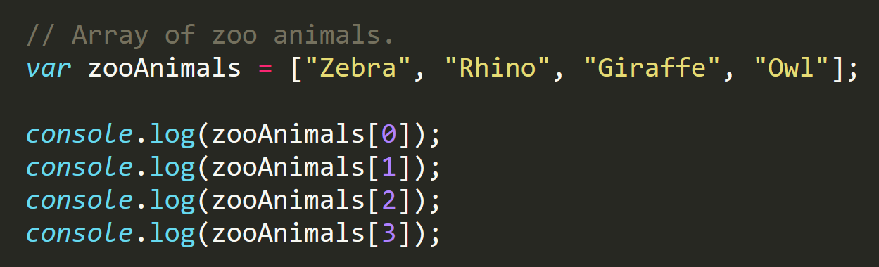
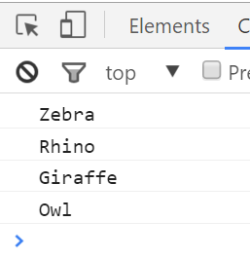
Back to The Zoo Pen (Logging)
Array Name: zooAnimals
Zebra
Rhino
Giraffe
Owl
Index 0
Index 1
Index 2
Index 3

Slide 48

Don’t Repeat Yourself (DRY)
Repeated Code!
Let’s be more efficient

Slide 49
> YOUR TURN!!
Activity: 17-MyFirstLoop | Suggested Time: 5 min
Code Creation: For Loop Dissection
With a partner, spend a few moments trying to dissect the code sent to you.
Try to explain to one another what is happening with each line of code.
Feel free to do research if you are stumped. As a hint, look into the phrase: “For-Loop”.
Be prepared to share when time is up.

Slide 50
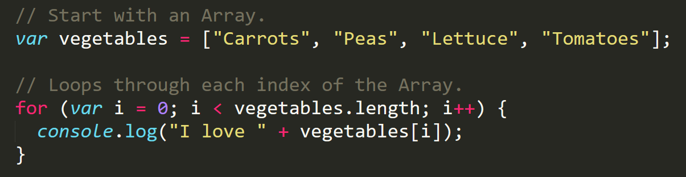
Enter the For-Loop
For loops are critical in programming.
We use for loops to run repeated blocks of code over a set period.
Each for loop is composed of a:
Variable declaration or counter (iterator)
A loop condition
An iteration (addition)

Slide 51
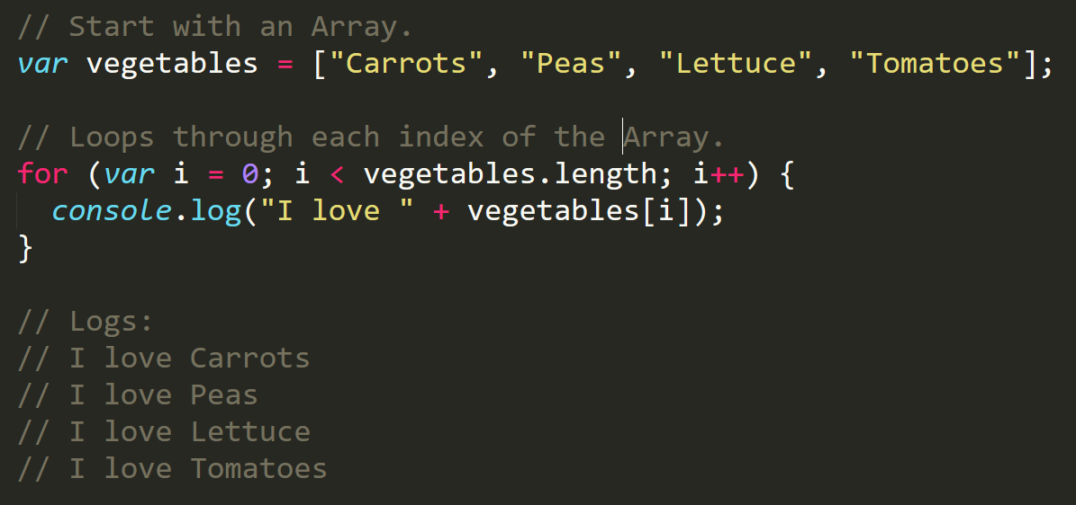
Enter the For-Loop
Iterator. Condition. Increment.

Slide 52
Enter the For-Loop
Code between the { } gets repeated each time the iterator is smaller than the condition. (i.e. in this case i < 4)

Slide 53
Enter the For-Loop
Running the code “loops” through and prints each element in the array.

Slide 54
Run That Loop
When i = 0 … console.log(“I love Carrots”)
Carrots
Peas
Lettuce
Tomatoes
Index 0
Index 1
Index 2
Index 3

Slide 55
Run That Loop
When i = 1 … console.log(“I love Peas”)
Carrots
Peas
Lettuce
Tomatoes
Index 0
Index 1
Index 2
Index 3

Slide 56
Run That Loop
When i = 2 … console.log(“I love Lettuce”)
Carrots
Peas
Lettuce
Tomatoes
Index 0
Index 1
Index 2
Index 3

Slide 57
Run That Loop
When i = 3 … console.log(“I love Tomatoes”)
Carrots
Peas
Lettuce
Tomatoes
Index 0
Index 1
Index 2
Index 3

Slide 58
> YOUR TURN!!
Activity: 18-ZooLoop | Suggested Time: 15 min
Code Creation: For-Loop Zoo
Spend a few moments, re-writing the code below using a for-loop.
If you need help, use the code from the previous example as a guide.
Then try to explain to the person next to you how your code works.

Slide 59
Homework #3

Slide 60
Questions?

