Slide 1
Masters of MongoDB

Slide 2
Project Recap

Slide 3
Project Recap
Awesome Job
(Y’all don’t need memes anymore. You are professionals now.)

Slide 4
Next Steps
Gif your GitHub Readme: Back-end projects like the ones you completed are harder to “see” for a recruiter. Throw in a Gif that flips through all the screens of your project. There are plenty of ways to record a video and convert it to Gif. This will look really impressive.
Create a Guest Login: Have a “dummy” Guest login to enter your application. Make it easily apparent on your readme.
Write a Tutorial: Pitch a tutorial to scotch.io if you used any unusual libraries. You will get $$$ and you will build credibility.

Slide 5
Next Steps
List your Niche Skills on LinkedIn: All of you should be listing out Node, Express, SQL, etc. on your LinkedIn Pages.
List your Project on LinkedIn: If you don’t have a lot of tech experience on LinkedIn milk the project you created for all it’s worth – especially if it was really good.
Consider Writing each Other Recommendations: I will remind you about this later as well… but consider writing recommendations for your group members and peers. Right now, you all are “students”, but you won’t be for long. Spread the credit!

Slide 6
Road Ahead…

Slide 7





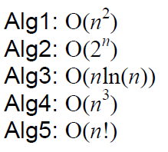
The Road Ahead…
Your Castle of Knowledge
Your Final Journey

Slide 8

This Should be You
A Castle of Knowledge

Slide 9

But if this is you…

Slide 10
Double Down
Then it’s time to double-down and get caught up.
You have access to myself and the TAs for another month.
Look through the code base. Identify your weaknesses.
Schedule a help session during office hours.
And put in the hard hours!
This is the absolute best time to learn this material.

Slide 11

Start Now.
Because let’s be real.
You aren’t going to start when you graduate.

Slide 12
For Reference…
Students who tend to be doing well in our classes are putting in an average of 35 hours per week.

Slide 13
MongoDB

Slide 14

What’s MongoDB?
MongoDB is a very popular noSQL Database
It uses a document-oriented model as opposed to a table-based relational model (SQL)
MongoDB stores data in BSON Format (effectively compressed JSONs)
MongoDB has tons of drivers and packages for connecting to Node, C++, Java, etc.

Slide 15
Relational Databases (SQL)
ID | Title | Author | Published
1 | The History of Blah | Blah Matic | 2010
2 | The Chronicles of Blahrnia | Sir Blahston | 2011
3 | Love in the Time of Blah | Gabriel Garcia Blah | 2013
SQL relies on Joins to combine relevant data
Author | Email | Phone Number
Blah Matic | blahston@gmail.com | 911-546-5454
Sir Blahston | blahby@gmail.com | 911-544-5112
Gabriel Garcia Blah | blahby231@gmail.com | 125-215-5645

Slide 16
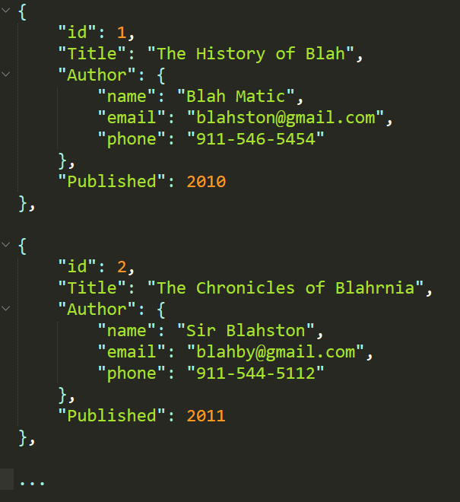
Document Database (noSQL)
noSQL Databases on the other hand are effectively JSONs.
They excel at heterogeneous data formats and are easy to implement.

Slide 17
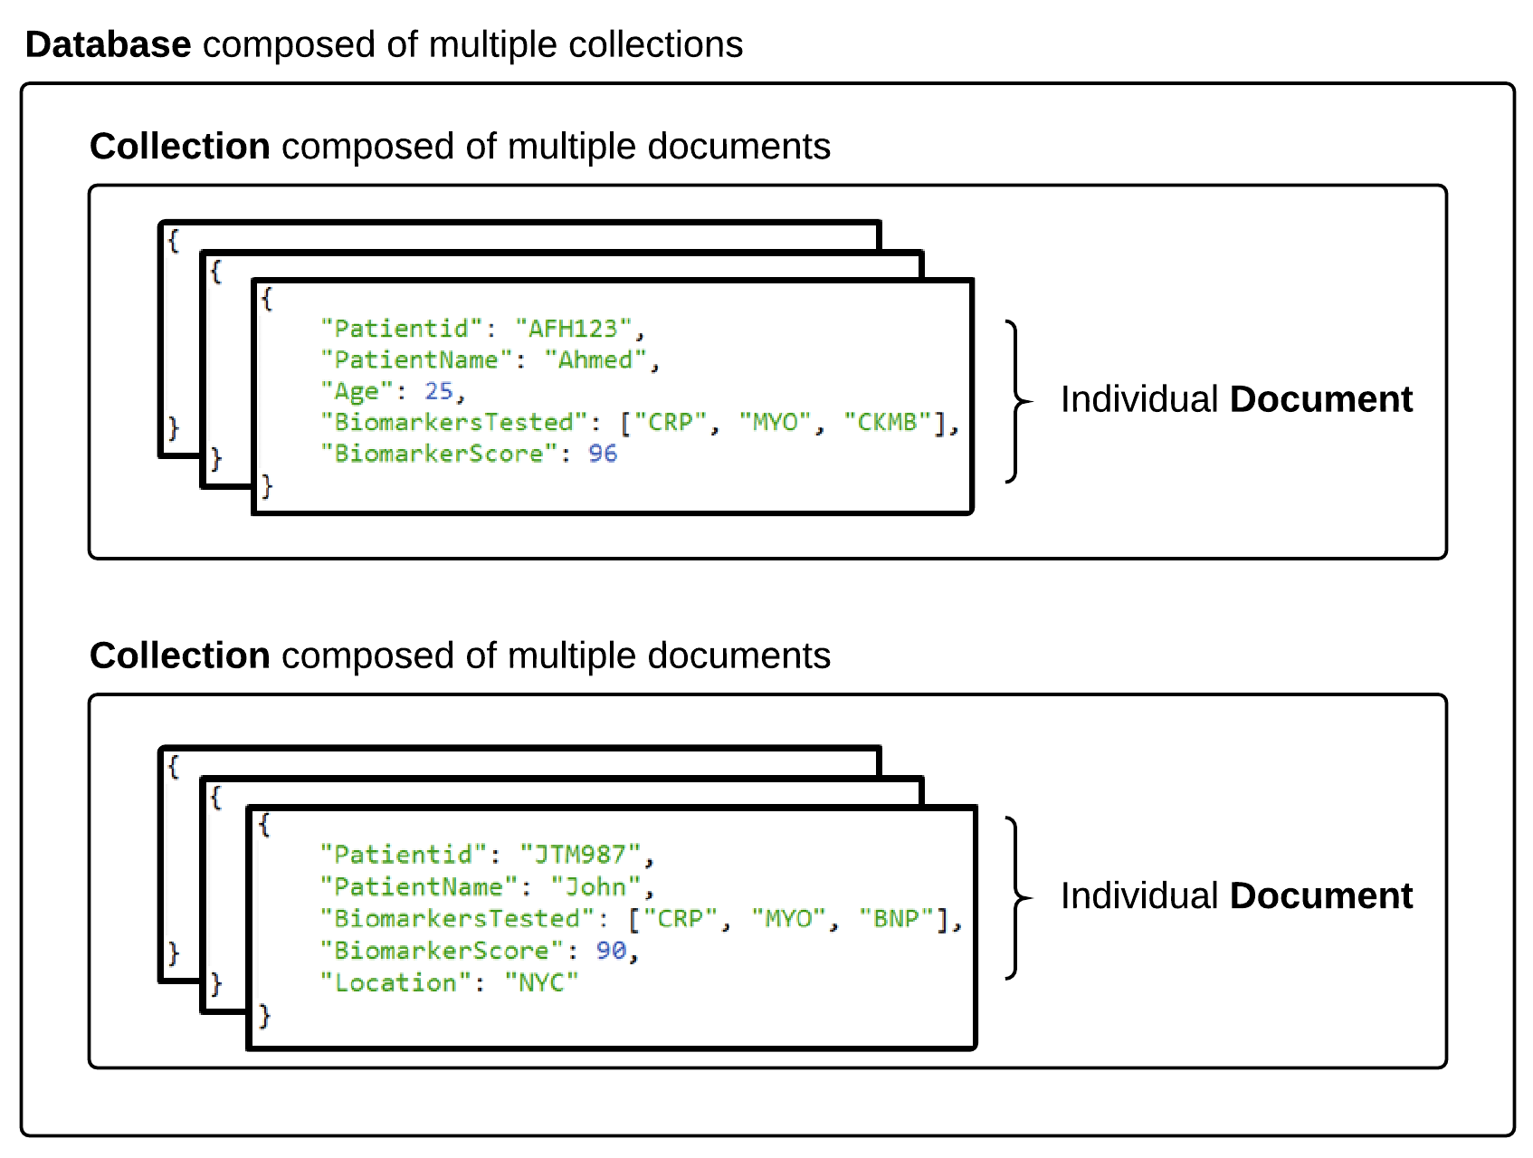

MongoDB Storage

Slide 18
MongoDB Storage
SQL Term | noSQL Term
Database | Database
Table | Collection
Row | Document
Column | Field
Terms are slightly different in the noSQL context.
Take note!

Slide 19
> YOUR TURN!!
Quick Activity:
Work with your neighbors to research the following
What are the advantages of using a noSQL database like MongoDB according to the MongoDB Website?
What are the advantages of using a noSQL database like MongoDB according to the web (places like Quora)?
What are the disadvantages of using a noSQL database like MongoDB according to the web (places like Quora)?

Slide 20
Code Time!

