Slide 1
React, Gently

Slide 2
A Throwback!

Slide 3

Obstacle #1 – The Great Confusion

Slide 4

Obstacle #2 – The Great Doubt

Slide 5
Welcome to ReactJS!!!

Slide 6

Note: This will not be you.
Do not treat this class as a “spoon feeding” session.

Slide 7

Note: This will be you.
Instead, it’s meant to be an immersion and exposure.

Slide 8

So… What is React?
React is an open-source Javascript Library developed by Facebook specifically for the task of developing User Interfaces.
It was developed for the purpose of building large apps with data that rapidly changes over time.
It relies on a component-based architecture. Each element of the UI is treated as sub-components of larger components.

Slide 9

But… what is React Not?
React is not a plug-and-play UI beautifier.
React is not a “magic bullet” to building awesome User Interfaces with a touch of a mouse.
It is not as simple to use as libraries like jQuery or Firebase – which are intended for limited use strict purposes.
No. It’s not magic.
Instead, react serves as a sort of “design-paradigm” and organization strategy for building complex front-end applications.

Slide 10
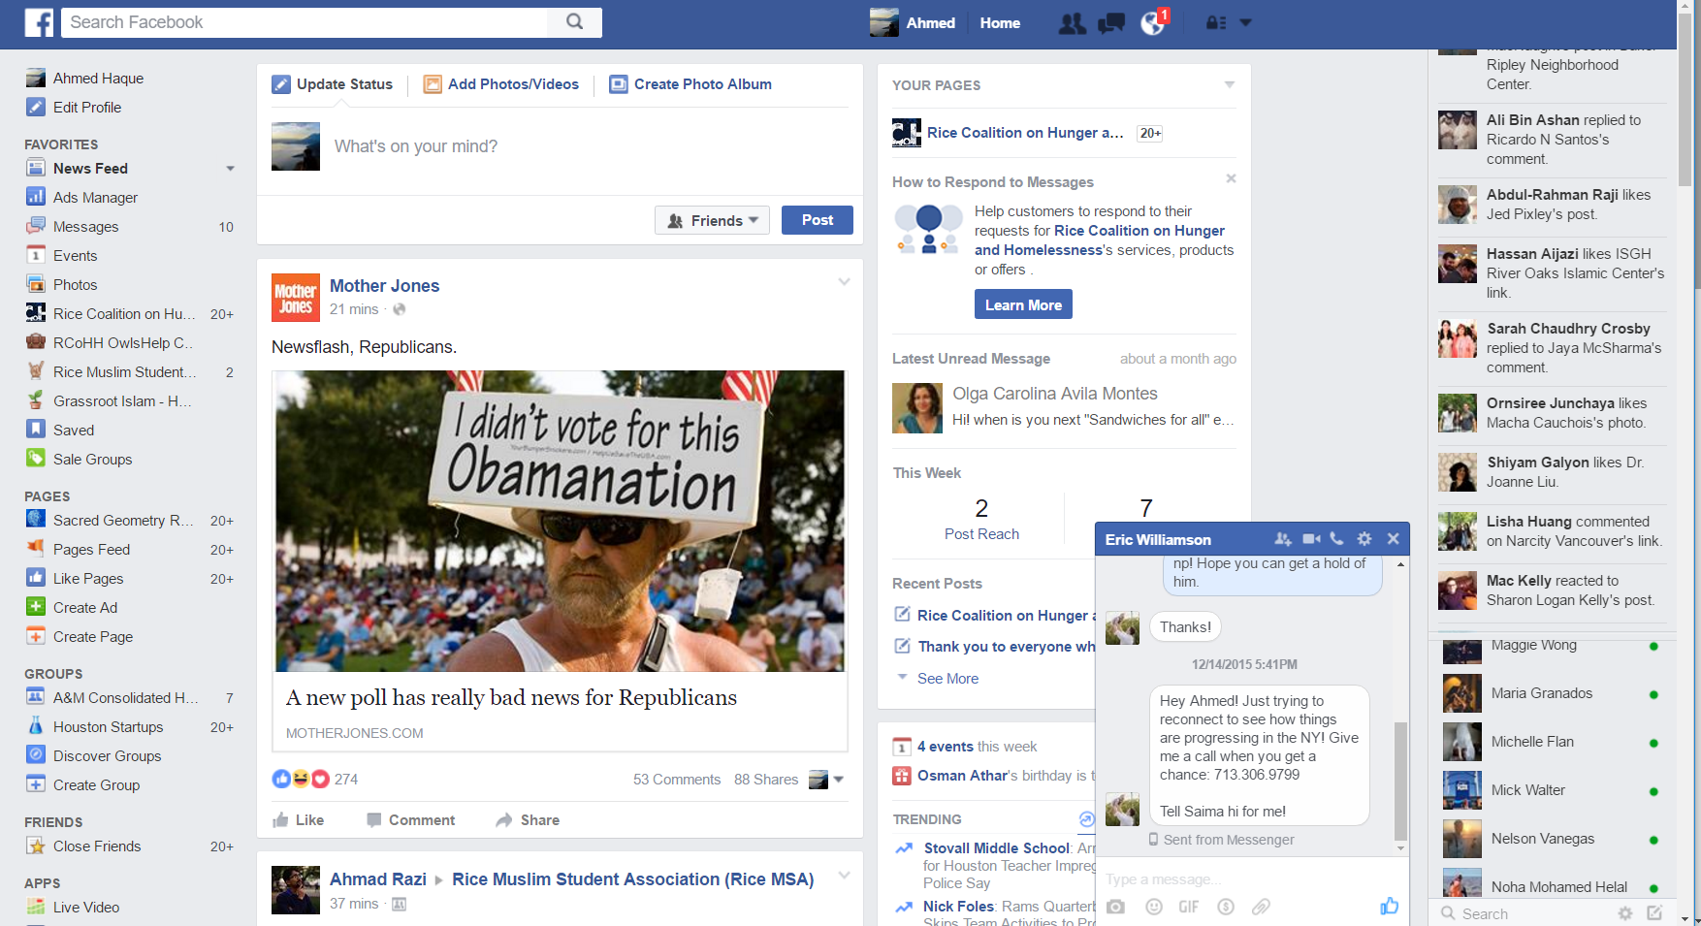
Facebook’s UI Complexities
Facebook’s website buzzes with interactive options, live-updating data, and tightly interacting elements. This poses a challenge to simple DOM manipulation strategies.

Slide 11
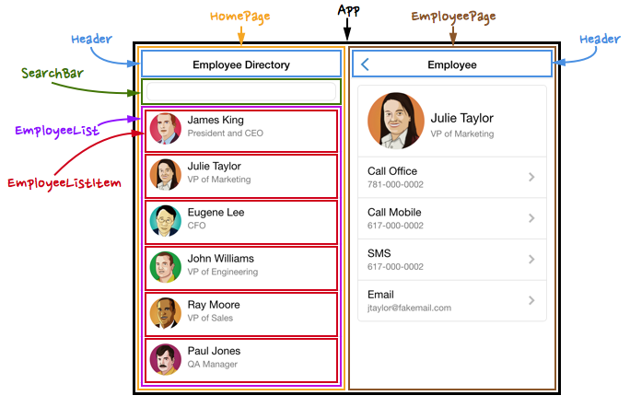
The Concept of Components
Using React, UI elements are broken down into re-usable sub-components.
Each sub-component behaves in a way that it is fully contained

Slide 12
Power of Components!
By separating elements out into components...
Layout and Logic are kept bundled together in a self-contained package.
Components can easily be re-used in various points in the application without needing to be re-coded.
Components can be more easily tested. (i.e. having one re-usable component means only one UI element needs to be tested).
For complex applications each of these can be critical in finding bugs and saving time.

Slide 13
Data Shifting Applications

Slide 14
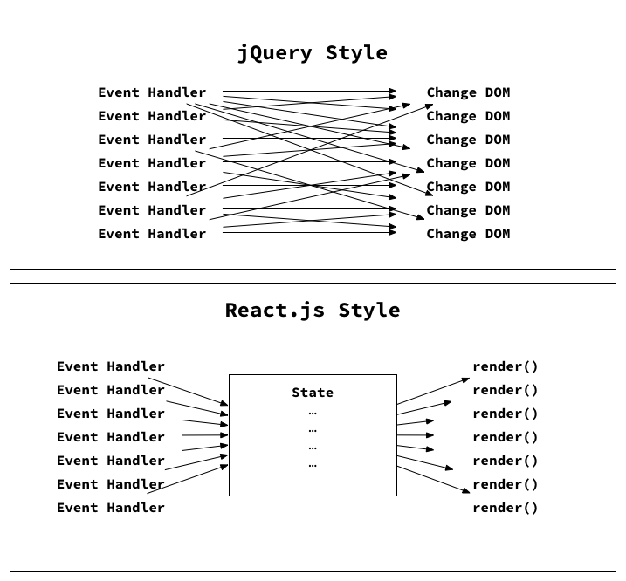
Why Can’t I jQuery Everything?
Jquery
Without an organization structure, code quickly become a series of erratic DOM Manipulations
React
In contrast, React utilizes a state or Virtual DOM that acts as a middle man with pre-defined rules for how each component will behave.

Slide 15
Rapid Data Changes: Option #1 –jQuery
Data-Driven Events
DOM
Article Comments
Users Signed on
Weather Forecast
Newsfeed of articles
Messages Sent
Constantly manipulating DOM is slow.

Slide 16
Rapid Data Changes: Option #2 - React
Data-Driven Events
DOM
Article Comments
Virtual DOM
Users Signed on
Weather Forecast
Newsfeed of articles
Messages Sent
Virtual DOM serves as intermediary

Slide 17
Digging into Docs

Slide 18
Documentation Immersion
With your partner(s)…
Answer each of the questions slacked out to you.
Really try on this activity!

Slide 19
Component Refresher

Slide 20
A Moment to Ponder…
Instead of separating “layout and logic”, React JS uses what alternative paradigm?

Slide 21
A Moment to Ponder…
Instead of separating “layout and logic”, React JS uses what alternative paradigm?
Components*!
* If you only learn one thing from our lessons on React it should be this.

Slide 22
A Moment to Ponder…
What exactly are components again?

Slide 23
Power of Components!
By separating elements out into components...
Layout and Logic are kept bundled together in a self-contained package.
Components can easily be re-used in various points in the application without needing to be re-coded.
Components can be more easily tested. (i.e. having one re-usable component means only one UI element needs to be tested).
For complex applications each of these can be critical in finding bugs and saving time.
Power of Components!

Slide 24
A Moment to Ponder…
What method do we use to create a
new component?

Slide 25
A Moment to Ponder…
What method do we use to create a
new component?
var ClassName* = React.createClass()
* Remember that React components must be capitalized

Slide 26
A Moment to Ponder…
What method do we use to
render our components to the DOM?

Slide 27
A Moment to Ponder…
What method do we use to
render our components to the DOM?
ReactDOM.render()*
* Note that you will only be rendering a single component into the DOM. Every other component will be a child to that component.

Slide 28
A Moment to Ponder…
New Question:
Every component must contain which method?

Slide 29
A Moment to Ponder…
New Question:
Every component must contain which method?
render: function() { }*
* Our render function will define what our component will look like. It will be in JSX syntax

Slide 30
A Moment to Ponder…
New Question:
How do we deploy a component in our JSX?

Slide 31
A Moment to Ponder…
New Question:
How do we deploy a component in our JSX?
<ComponentName />

Slide 32
A Moment to Ponder…
New Question:
How would we deploy a component inside of another component?

Slide 33
A Moment to Ponder…
New Question:
How would we deploy a component inside of another component?
<ParentComponent>
<ComponentName />
</ParentComponent>

Slide 34
JSX Gotcha’s

Slide 35
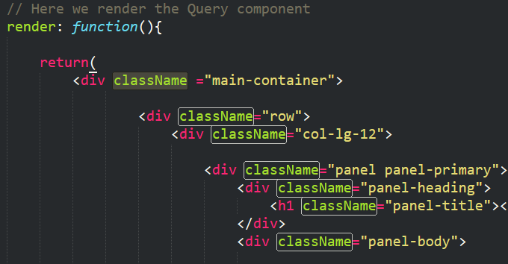
Incorporating Classes
It turns out…
You can incorporate classes into JSX
You just need to call them “className”
This is because “class” is a reserved keyword in Javascript

Slide 36
Incorporating Styles
It also turns out…
You can incorporate CSS styles into JSX
You just need to ditch the hyphen and camelcase the property.
Ex: font-size → fontSize

Slide 37
Component Architecting

Slide 38
Parent-Child Relationships
App.js
App.js
Header.js
Header.js
Search.js
Query.js
Search.js
Query.js
Results.js
Results.js
First step in building React applications is determining the component hierarchy.

Slide 39
States and Props

Slide 40
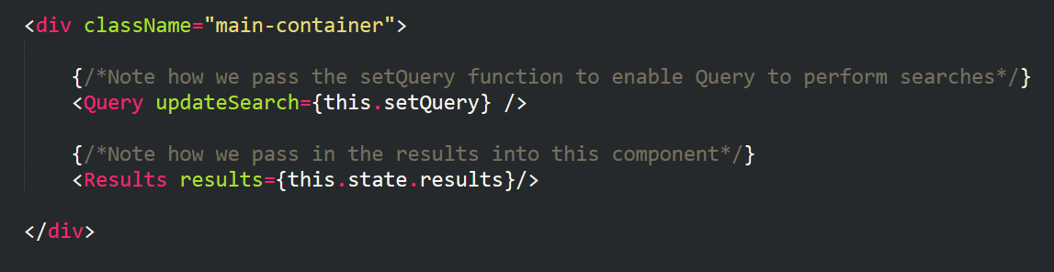
Passing State from Parent to Child
Parents can pass data (states and props) or methods to children. (It’s a bit trickier to send it to parents).

Slide 41
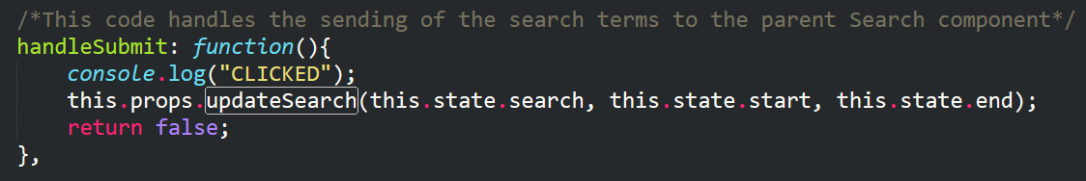
Children Inherit Props
When children inherit the data or method it ALWAYS comes in the form of a prop.
Props can be specifically referenced using this.props.propName syntax.

Slide 42
Props vs States: What’s the Difference?
States:
Mutable (i.e. changeable with UI).
States can be changed using this.setState({})
Props:
Immutable (i.e. unchangeable).
Props are static elements. They may be static properties or static methods.

Slide 43

A Moment to Ponder…
React.JS has a strong preference for passing state from parents to children…
What is the implication of this?

Slide 44
Unidirectional Data Flow

Slide 45
Unidirectional Data Flow
React.JS has a strong preference for unidirectional data flow.
This means that the variables that get manipulated are controlled by parents.
Parents are then responsible for divvying the data (and state changes) to the children.
Child A
GrandChild A
Great GrandChild A
Parent
Child B
GrandChild B
Great GrandChild B

Slide 46
Unidirectional Data Flow
Child A
GrandChild A
Great GrandChild A
Parent
Child B
GrandChild B
Great GrandChild B
“Oh Hey! My GrandChild A just changed colors”

Slide 47
Unidirectional Data Flow
Child A
GrandChild A
Great GrandChild A
Parent
Child B
GrandChild B
Great GrandChild B
“I’ll let the others know if needed….”

Slide 48
Unidirectional Data Flow
This approach is meant to create a level of manageability when it comes to data flow and UI changes.
Child A
GrandChild A
Great GrandChild A
Parent
Child B
GrandChild B
Great GrandChild B

Slide 49
Time to Code!

