Slide 1
Bitwise Pattern Generator
By: Andrew Brain

Slide 2
Live Demo

Slide 3
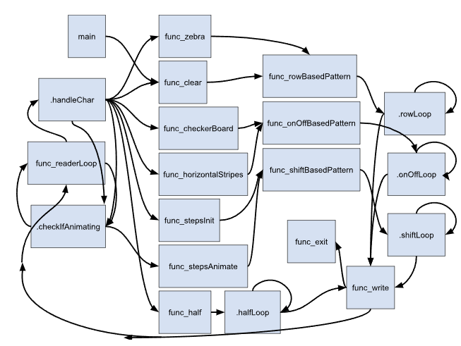
Branch Diagram

Slide 4
Buffer Layout and Addressing Math

Slide 5
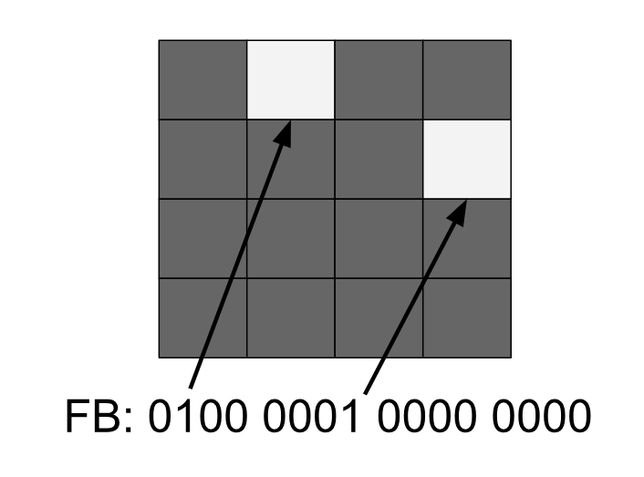
Frame Buffer Layout
48x48 Grid: 2304 bits (288 bytes), bit-packed frame buffer where every bit represents an individual pixel.
The frame buffer can be thought of as being
48, 6-byte-wide rows. Each 6 bytes represent
a row with the MSB representing the leftmost
pixel and the LSB representing the rightmost
pixel.

Slide 6
Index Math in terms of Bytes
ARM’s load and store instructions are based on bytes, meaning our frame buffer can be thought of as a 288 long array with a byte corresponding to 8 pixels being held in each index.
Arr = {byte0, byte1, byte2, byte3, byte4, byte5, byte6, byte7, …}
byteIndex = (row * 6) + byteCol (row : 0-47, byteCol: 0-5)
memoryAddress = byteIndex + frameBufferMemoryAddress

Slide 7
One Performance Choice

Slide 8
Bitwise Operations Done on Rows not on Bytes/Bits
Branch, store, and load instructions are a drag on performance, so reducing branches and loads can boost performance.
We can remove load instructions drag by having bitwise operations not require loading from framebuffer.
Efficiency : # bits written / # bits able to be written.
Doing a bit-by-bit traversal would mean a 1.5% usage of bitmask and 2304 iterations/branches.
Doing a byte-by-byte traversal would mean a 12.5% usage of bitmask and 288 iterations/branches.
Doing a full row traversal (48 bits) would mean a 75% usage of bitmask and 48 iterations/branches.
If we are clever enough to write all 64 bits of the bitmask we only would need to do 36 iterations/branches.

Slide 9
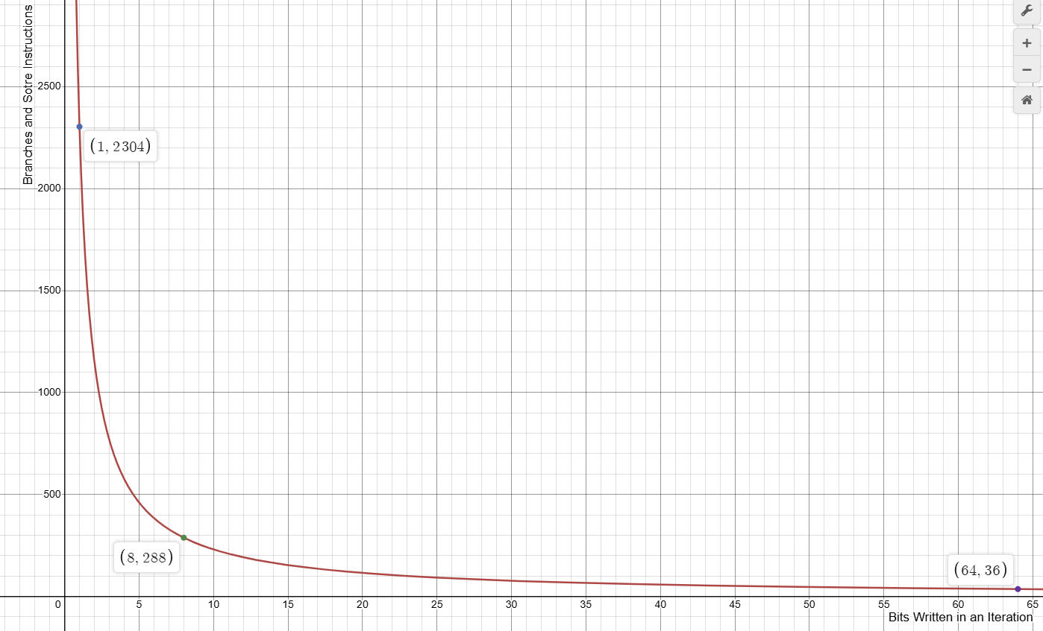

Slide 10

Example
Zebra Pattern:
01010101 01010101
01010101 01010101
01010101 01010101
01010101 01010101
In Frame Buffer: 64 bits can all be done in one iteration/store-instruction.
0101010101010101010101010101010101010101010101010101010101010101

Slide 11
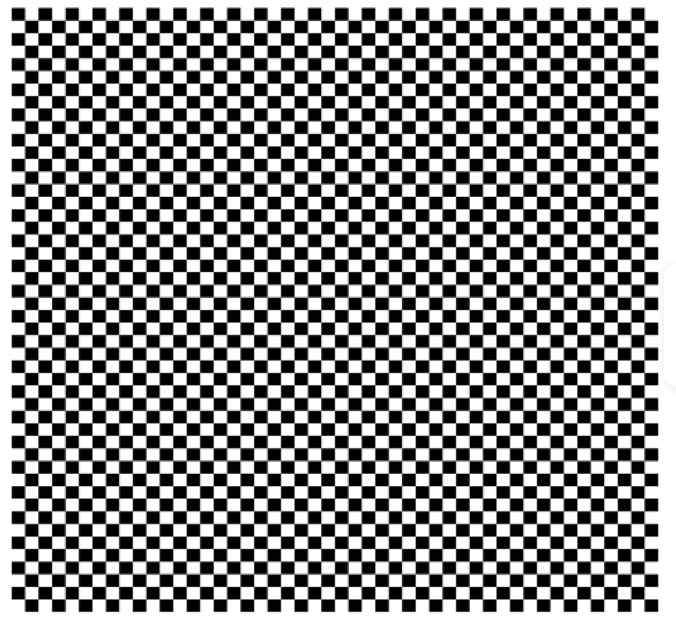
Example
Checkerboard Pattern:
01010101 01010101
10101010 10101010
01010101 01010101
1010101 010101010
In Frame Buffer:
0101010101010101101010101010101001010101010101011010101010101010

Slide 12
One Challenge

Slide 13
GUI?
Difficulty:
Current System: x86 architecture running an Ubuntu VM
Emulator: QEMU User Mode
QEMU User Mode doesn’t emulate the entire system, only CPU actions, meaning to draw a GUI using only ARM would require either moving to QEMU System Mode, using a library to act as a middle man between the emulation and the OS’s display, or switching to an ARM architecture.
None of these sounded like great options.

Slide 14
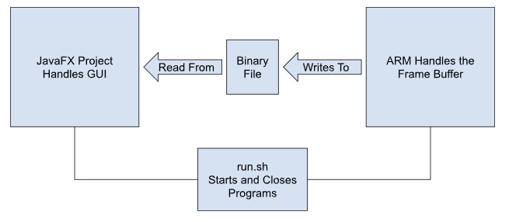
Solution

