Slide 1

Understanding MIDI: The Language of Music
Introduction to MIDI Technology

Slide 2
The Importance of MIDI
Tool for musicians and producers.
Developed in the early 1980s.
Aimed to standardize music production hardware and ensure compatibility with various devices.

Slide 3
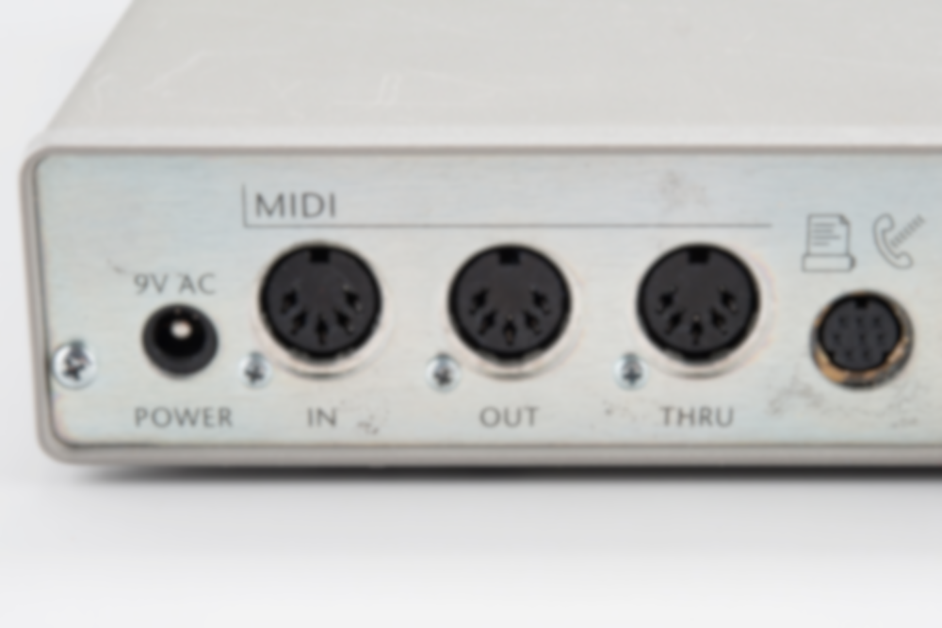
MIDI Communication
MIDI enables communication between computers, musical instruments, and other hardware.
MIDI processes binary data at up to 31,250 bits per second and supports 128 different musical notes.
MIDI ports include MIDI IN, MIDI OUT, and MIDI THRU.
MIDI IN receives external signals.
MIDI OUT sends signals.
MIDI THRU transfers signals from one external element to another.

Slide 4
Applications of MIDI
It allows for track composition and editing, including timbre, intensity, pitch, velocity adjustments, and effects like vibrato.
Live Performances: It enables real-time control

Slide 5
Thank you
Author1: André de Azevedo Barata - up201907705@edu.fe.up.pt
Author1: Marija Jodic- up202202484@edu.fe.up.pt
Professor: António Sá Pinto – asapinto@fe.up.pu
Course: Multimedia Systems

