Slide 1

Productionising Machine Learning models
Andrew Booth
26/02/2019

Slide 2
Introduction

Slide 3
Two parts to this talk
Project case study
How to productionise ML
Energy industry project
Data science
Productionised model
Deploying ML models to the Cloud
Azure Functions
Demo

Slide 4
Introduction
Senior Data Scientist at Elastacloud
Worked there for 2.5 years before which worked as a Research Associate at University of Nottingham
Love R and Python but mostly using Python currently

Slide 5
Elastacloud
Cloud Architecture and Data Science consultancy
Founded 8 years ago working predominantly with Microsoft Azure
Offices in London, Nottingham and Almeria

Slide 6





Who we work with

Slide 7
We work a lot with Microsoft technology
But we are not a Microsoft company
This talk focuses on Microsoft products but I will try and suggest some alternatives

Slide 8
Productionisation
An important part of what we do, and the favourite thing about my job, is ‘productionising’ machine learning models
But what exactly does this mean and how do we do it?
I’ll answer this question with a real example from one of our projects and also show you how you can do it

Slide 9
Productionisation
What do we actually do with a machine learning model once it is trained?
We could simply save it on our laptop and run it manually each time we want some predictions from new data
But this is inefficient and can only be accessed by one person

Slide 10
Project case study

Slide 11
Case study
Customer in the energy generation industry
Energy is traded on different markets
Generators and suppliers are obligated to pay something called the Balancing Services Use of System (BSUoS) charge which the National Grid, the system operator, levies to recoup the cost of balancing the system

Slide 12
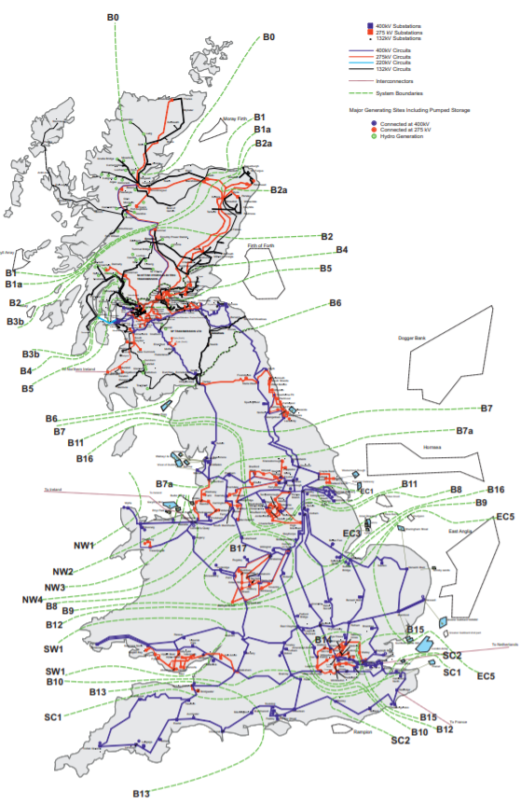
Balancing the grid
National Grid must ensure that the supply of electricity matches the demand
The place where electricity is generated is not necessarily near to where it is required
Particularly relevant for wind
Lots generated in Scotland
Needed in England
Constraints
When we have constraints the National Grid must take balancing actions, which may include paying generators to either stop or start generating

Slide 13
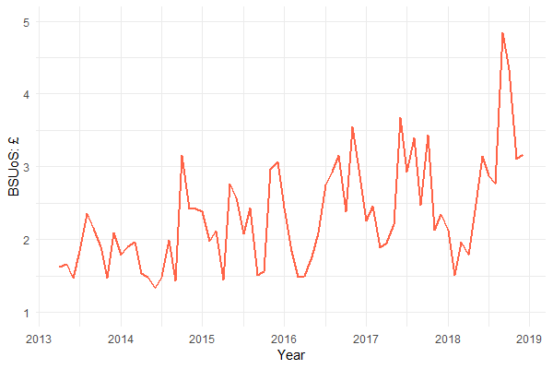
BSUoS
Charged on a half-hourly £/MWh basis
Normal is around £2 - £3 but can go as high as £6, £10, £20 with a record high of £47
Average BSUoS has been increasing year on year

Slide 14
Project summary
Our customer are particularly exposed to BSUoS. Their power plant has a capacity of approx. 4000 MW
Can we predict BSUoS one and two business days ahead for each of the 96 half-hourly settlement periods
Requirements
Identify as many BSUoS spikes as possible (> £5)
Predict better than the National Grid
Forecasts available to traders before 09:30 every day

Slide 15
Data
Model was trained using data related to the energy industry in the UK provided by the customer
Wind generation forecasts
Demand forecasts
Imbalance forecast
Availability forecasts
Patterns in the data

Slide 16
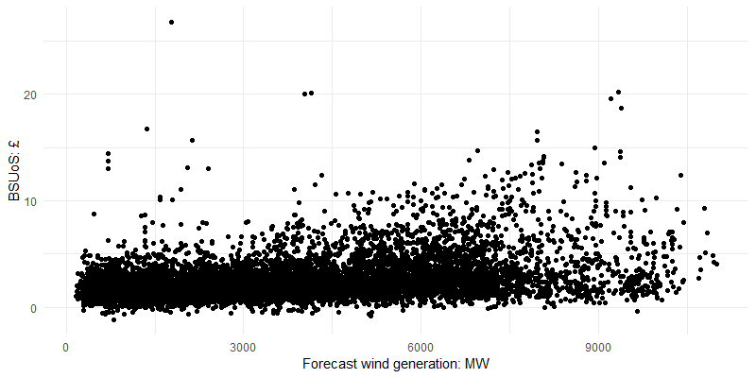
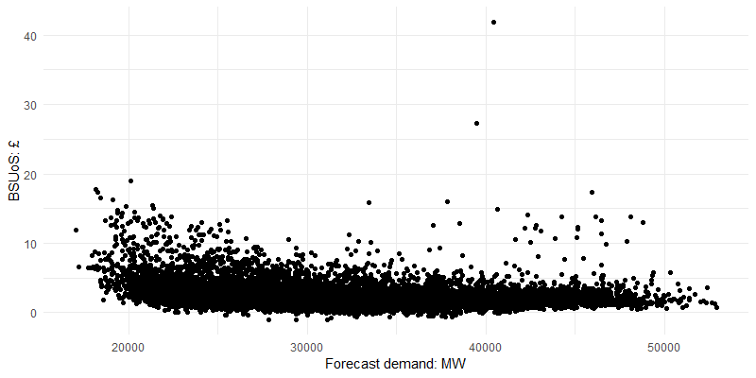
Positive correlation between forecast wind and BSUoS
Negative correlation between forecast demand and BSUoS

Slide 17
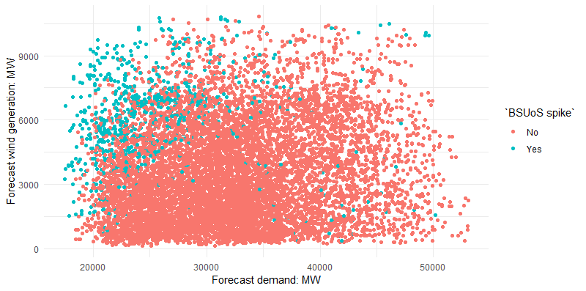
When do we get BSUoS spikes?

Slide 18
Results
Developed the model working closely with the customer
Business and data understanding
Communication is a key to success in Data Science projects
Regression model
Random Forest
sklearn
Meets the performance requirements
Iterative development
We are still working on it

Slide 19
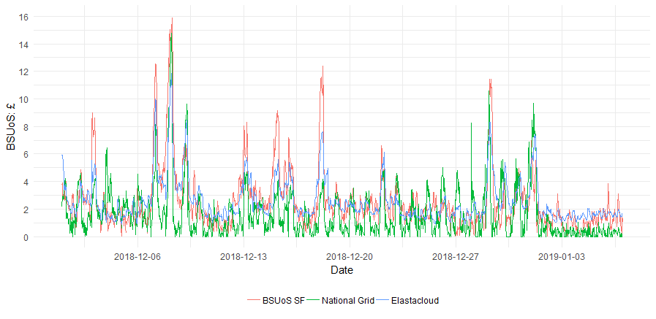
Predictions so far
Elastacloud’s forecast, at the settlement period frequency, is better than National Grid’s 72% of the time
When BSUoS SF exceeds £5 this increases to 84% of the time

Slide 20
Next steps
Asked Elastacloud to build a system that would provide the forecasts to them so they could access and display to their traders via their own systems
We had to productionise it, but the model is only a small part of the whole
Where Data Science meets Data Engineering

Slide 21
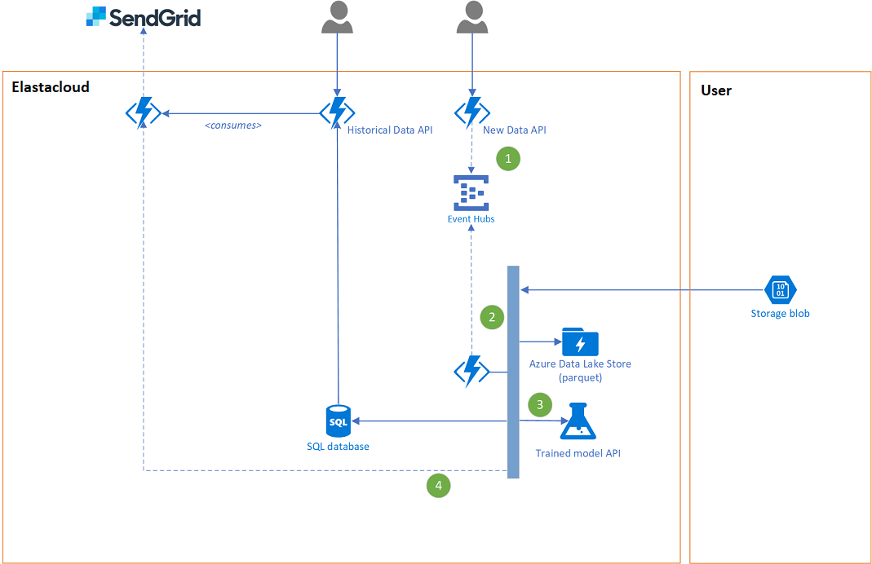
The solution

Slide 22
Machine learning model as an API
Application Programming Interface (API)
Allows our model and associated code written in Python to interact with software written in other languages
Where does the model run?
In the Cloud
Lots of solutions

Slide 23




In Microsoft Azure
Kubernetes
Azure ML
R and Python
Container instances
Azure ML
R and Python
Azure Functions
Serverless
Python only
Similar to AWS Lambdas
Databricks
Spark
Python, Scala, R
Also available on AWS

Slide 24
How to productionise a machine learning model

Slide 25
Azure functions
Code running in the Cloud
Consumption plan
1,000,000 free executions per month
400,000 Gb-s free per month
Requires a storage account, which is not free but very cheap
Python SDK (preview)

Slide 26
Demo
Productionisation of a Machine Learning model to perform sentiment analysis on reviews or comments
Trained a simple classifier on popular IMDB movie review data set
Multinomial Naïve Bayes
Performance not so important for this demo but had a 80% accuracy on the test set
Saved the model and tfidf vectorizer as separate .pkl files
Could have used a pipeline

Slide 27
Demo
https://www.kaggle.com/utathya/imdb-review-dataset

Slide 28
What we need to deploy to Azure
Azure account
Python 3.6
Azure command line tool
Azure Functions Core Tools
Visual Studio Code IDE

Slide 29
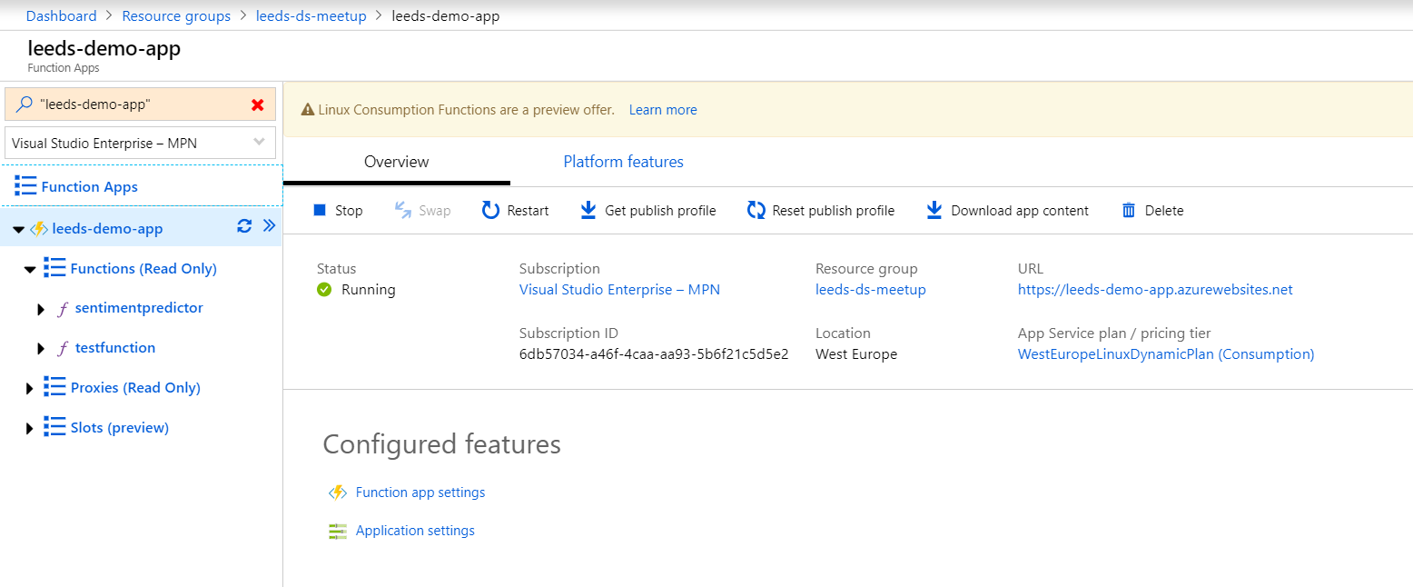
Azure Function Apps

