Slide 3
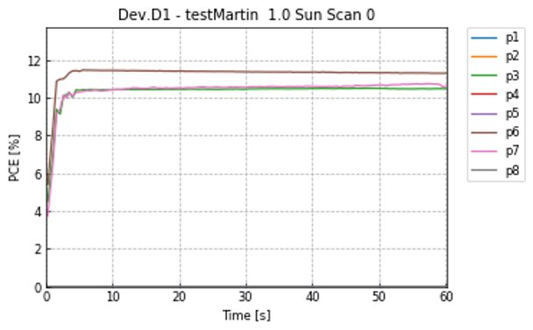




Slide 4
Next Steps
fine tune scan rate
wire up new chips to samtec connector
develop code to allow for collection of 8 pixels of data
improve mppt algorithm to be faster and more accurate
stress test setup for long time

