Slide 1
Previous Cost Breakdown
New Cost Breakdown
Product | Unit Price | Quantity | Total Price
arduino uno | 10 | 4 | 40
ina219 | 10 | 32 | 320
mcp475 | 5 | 32 | 160
miscelaneous | 100 | 1 | 100
Tca9548 | 10 | 8 | 80
litos connector | 10 | 1 | 10
pcb | 30 | 1 | 30
Product | Unit Price | Quantity | Total Price
4.7kΩ | 0.004 | 8 | 0.032
100nF | 0.012 | 64 | 0.768
10uF | 0.029 | 32 | 0.928
MCP4725A0T-E/CH | 0.848 | 8 | 6.784
MCP4725A1T-E/CH | 1.552 | 8 | 12.416
MCP4725A2T-E/CH | 2.327 | 8 | 18.616
MCP4725A3T-E/CH | 2.806 | 8 | 22.448
MCP1702T-3302E/CB | 0.531 | 4 | 2.124
FPC1 | 0.671 | 4 | 2.684
INA219BIDCNT | 2.11 | 32 | 67.52
10Ω | 0.024 | 32 | 0.768
ARDUINO_NANO | 5 | 4 | 20
Pre tax cost for 4 device system: $740
Pre tax cost for 4 device system: $155

Slide 2
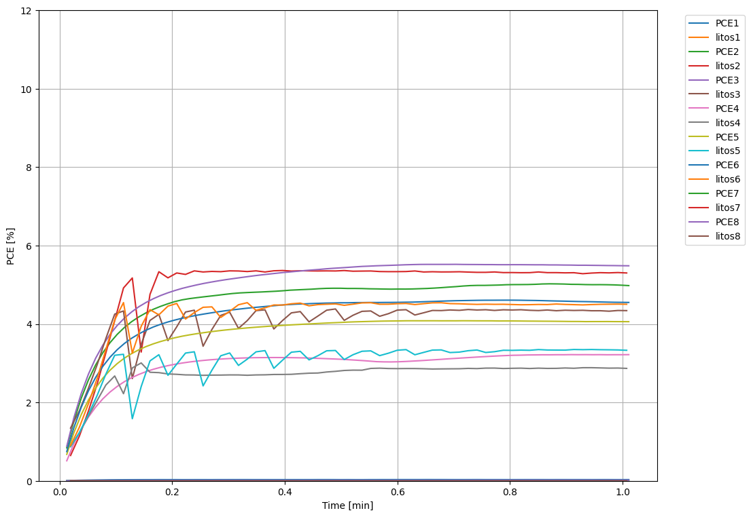
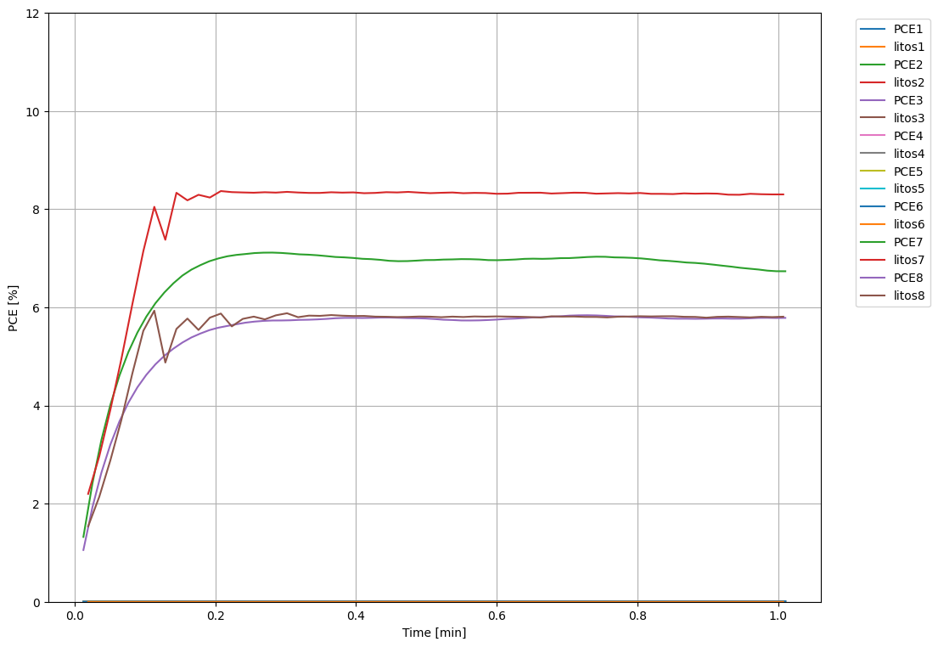
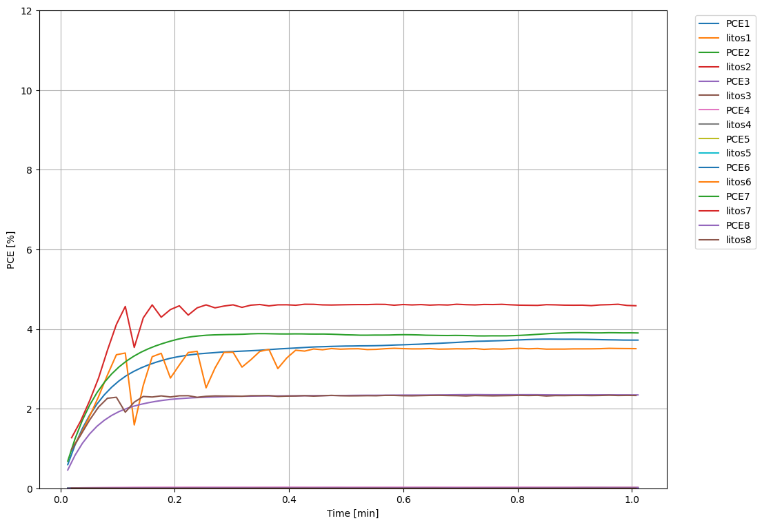
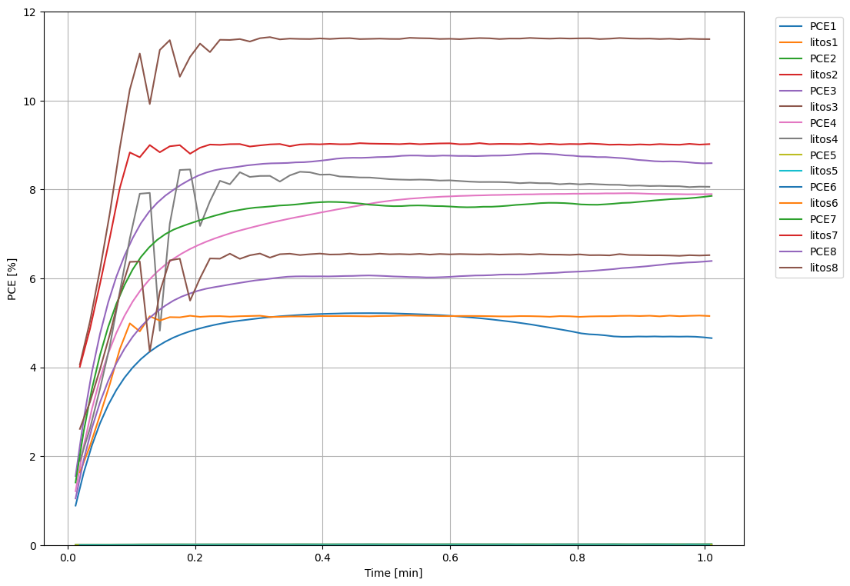
PCE abs diff:
0.554%
PCE avg error:
9.10%

