Slide 1
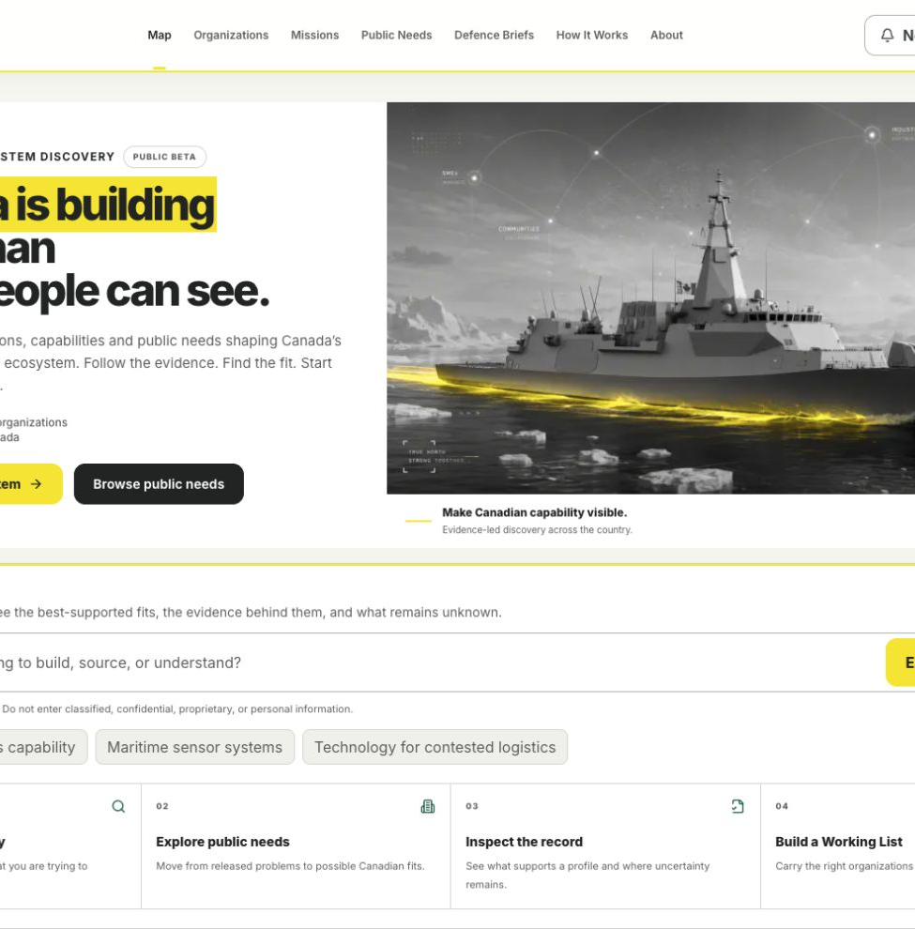
EVIDENCE-LED ECOSYSTEM DISCOVERY
Canada is building
more than most
people can see.
True North Map makes Canadian defence and dual-use capability easier to find, understand and connect.
MAKE CANADIAN CAPABILITY VISIBLE.
PUBLIC BETA
TRUENORTHMAP.CA
01
Notes:
Open with the visibility problem. True North Map is a discovery and decision-support layer, not a company directory with better styling.
[Sources]
- https://truenorthmap.ca/
- Local screenshot: content/launch/broader-public-beta-2026-08/screenshots/homepage-desktop.png
- True North Map Project Overview, reviewed 2026-07-31
[/Sources]

Slide 2
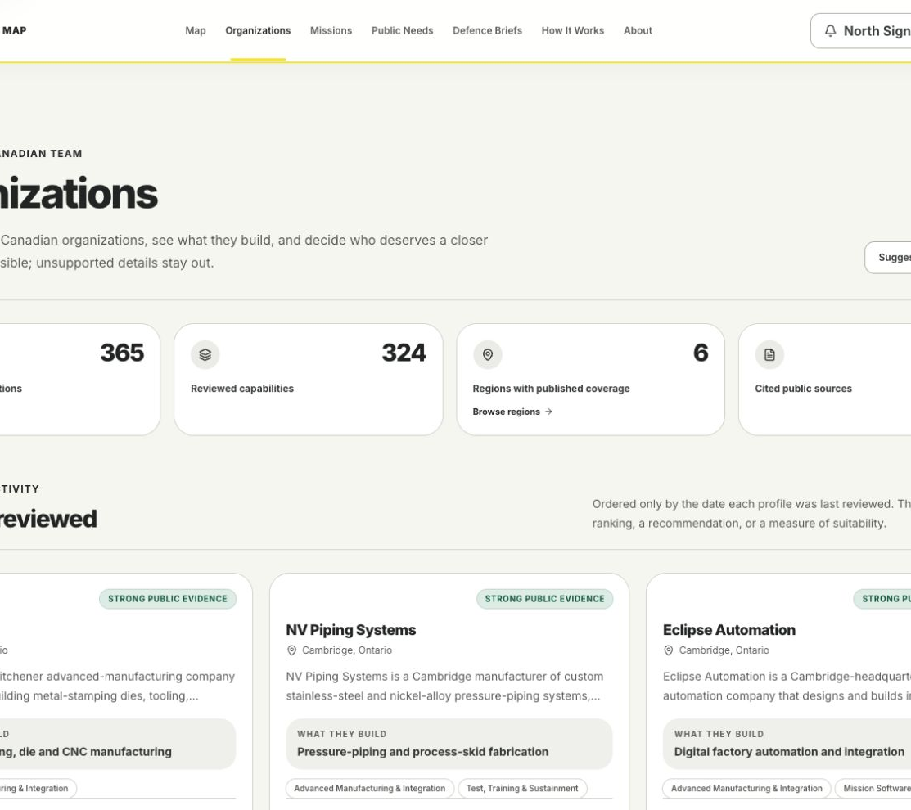
THE PROBLEM
Visibility breaks down before the work begins.
Canadian capability is spread across company pages, program lists, regional networks, technical language and public releases.
Find
the organizations and technologies that matter.
Understand
why they may fit a mission or released public need.
Act
with the evidence, limits and next step in view.
TRUENORTHMAP.CA
02
Notes:
Frame the product around the work the user is trying to complete. The organization corpus matters because it supports a more useful decision path.
[Sources]
- https://truenorthmap.ca/organizations
- Local screenshot: content/launch/broader-public-beta-2026-08/screenshots/organizations-desktop.png
- True North Map Project Overview, reviewed 2026-07-31
[/Sources]

Slide 3
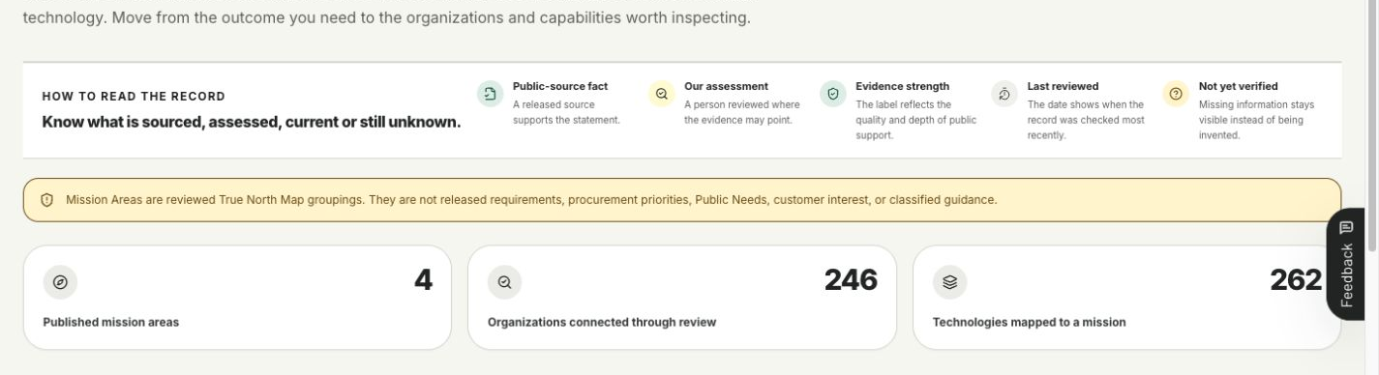
A MISSION-LED ENTRY POINT
Start with the mission, not a company list.
Mission Areas turn a practical operating problem into a reviewed landscape of organizations, technologies and released Public Needs.
A reviewed assessment layer, not a claim of customer demand.
TRUENORTHMAP.CA
03
Notes:
Explain the distinction between Mission Areas and Public Needs. Mission Areas organize reviewed capability relationships. Public Needs are grounded in released public sources.
[Sources]
- https://truenorthmap.ca/missions
- Local screenshot: content/launch/broader-public-beta-2026-08/screenshots/missions-desktop.png
- True North Map Project Overview, Terms and language map, reviewed 2026-07-31
[/Sources]

Slide 4
THE INTELLIGENCE LAYER
Connect what exists to why it matters.
Each step keeps the record, the interpretation and the next action separate.
01
02
03
04
05
→
→
→
→
Mission
Technology
Public need
Evidence
Action
Start with the use case or operating problem.
See reviewed Canadian capability.
Follow a released, source-gated signal.
Inspect support, strength and visible gaps.
Build a Working List or start a conversation.
Sources create the public record. People review the interpretation. AI helps people explore, but it does not publish facts or make procurement decisions.
TRUENORTHMAP.CA
04
Notes:
Use this slide to show why the product is more than web scraping. Data enters a reviewed relationship model, and the public experience keeps evidence, assessment and action distinct.
[Sources]
- True North Map Project Overview, Evidence, review, and publication flow, reviewed 2026-07-31
- https://truenorthmap.ca/how-it-works
[/Sources]

Slide 5
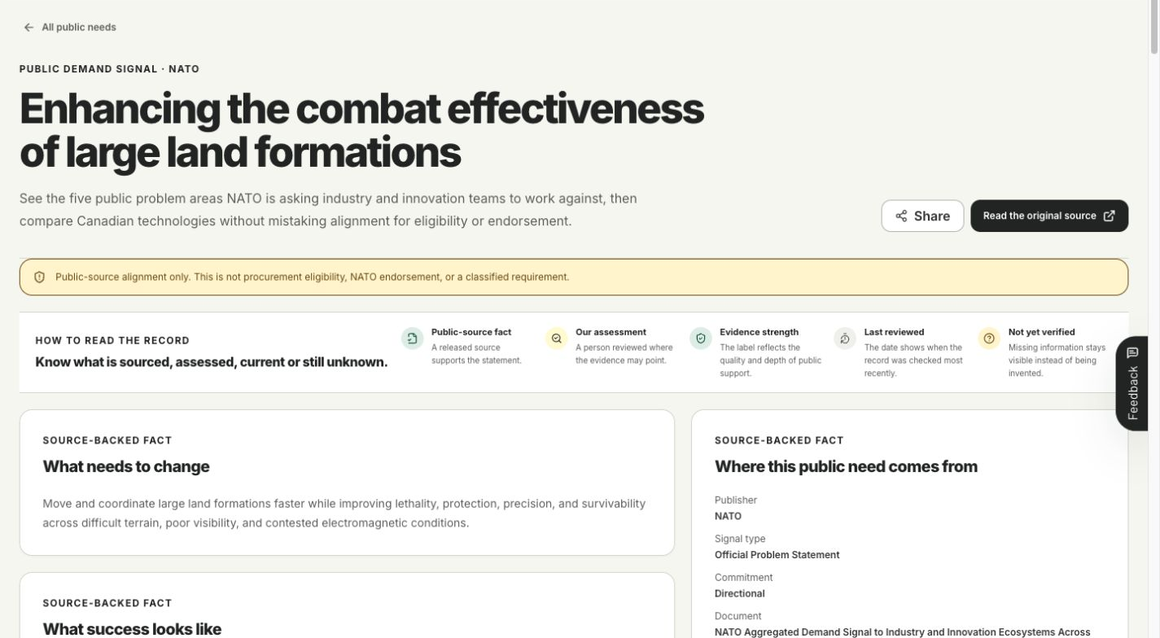
EVIDENCE AND GOVERNANCE
Every public connection stays reviewable.
01
Durable public source
Company, government, allied or program evidence.
02
Structured candidate
Facts, citations, confidence and gaps stay attached.
03
Private review
A person edits, accepts, defers or rejects the proposed change.
04
Explicit publication
Only the publish checkpoint changes the public record.
No agent, feed or model can publish autonomously.
TRUENORTHMAP.CA
05
Notes:
Describe the review-first publication boundary. Automation helps find and structure possible updates. Human review and a separate publish checkpoint remain mandatory.
[Sources]
- https://truenorthmap.ca/demand/land-formation-combat-effectiveness
- Local screenshot: content/launch/broader-public-beta-2026-08/screenshots/public-need-detail-desktop.png
- True North Map Project Overview, Evidence, review, and publication flow, reviewed 2026-07-31
[/Sources]

Slide 6
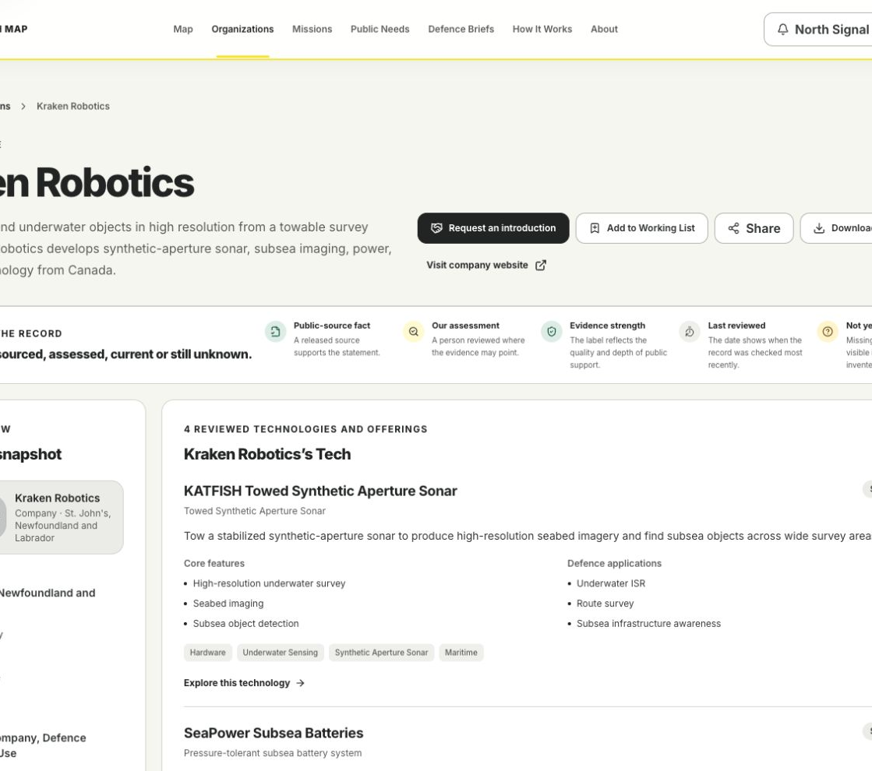
FROM DISCOVERY TO ACTION
Move into a better conversation.
Inspect
the organization, technology, evidence and current gaps.
Compare
possible relevance across Mission Areas and released Public Needs.
Carry
the right targets into a Working List, export or introduction request.
TRUENORTHMAP.CA
06
Notes:
The final value is not another profile page. It is a supported next move: compare, save, correct, share or ask for a relevant introduction.
[Sources]
- https://truenorthmap.ca/organizations/kraken-robotics
- Local screenshot: content/launch/broader-public-beta-2026-08/screenshots/organization-kraken-desktop.png
- True North Map Project Overview, Current product surface, reviewed 2026-07-31
[/Sources]

Slide 7

Try one real question
from your work.
MAKE CANADIAN
CAPABILITY VISIBLE.
Start with a capability, mission or public need you are trying to understand. Inspect the evidence, follow the fit and decide who may be worth speaking with next.
truenorthmap.ca
Independent project created and stewarded by Andrew Davies
07
Notes:
Close with one low-effort ask: try a real work question, then decide whether the record moves the user closer to a useful conversation.
[Sources]
- https://truenorthmap.ca/
- True North Map response guide, current broader public beta launch kit
[/Sources]

