Slide 1
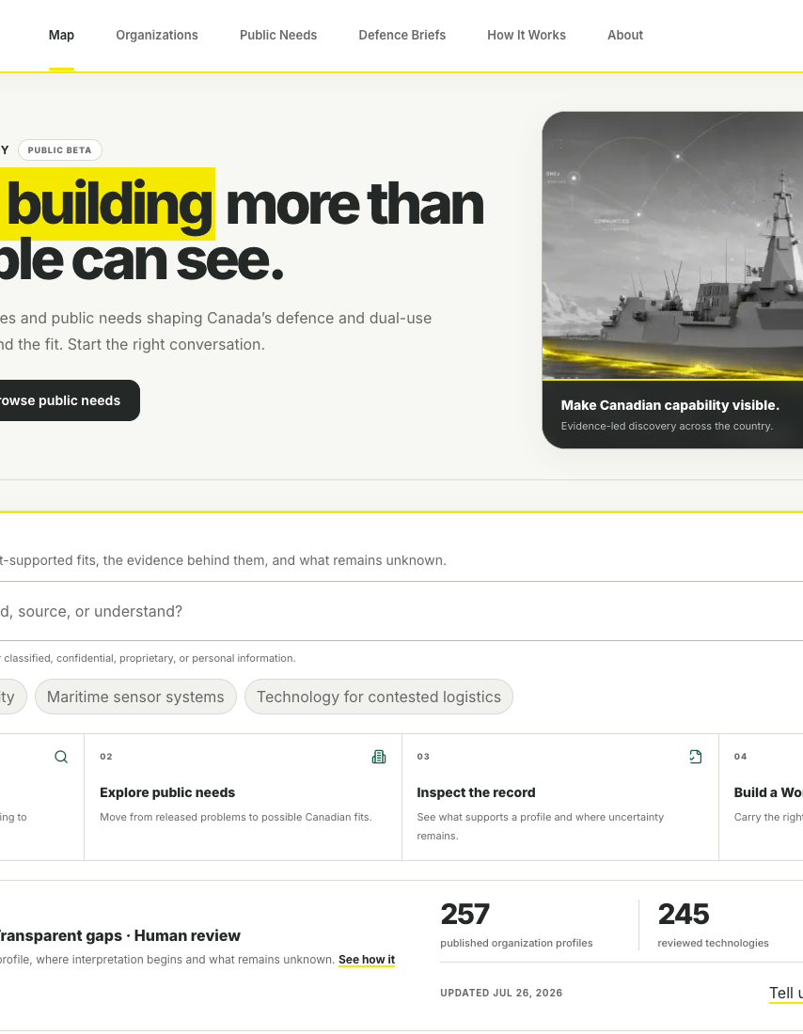
EVIDENCE-LED ECOSYSTEM DISCOVERY
Canada is building more
than most people can see.
True North Map makes Canadian defence and dual-use capability easier to find, understand and connect.
Make Canadian capability visible.
Notes:
[Sources]
- https://truenorthmap.ca
- True North Map Phase 2 homepage screenshot, captured 2026-07-26
[/Sources]

Slide 2
THE VISIBILITY GAP
Canadian capability is strong.
The shared picture is fragmented.
01
02
03
Scattered evidence
Slower discovery
Missed fit
Organizations, technologies, programs and public needs live across disconnected sources.
Teams spend time rebuilding the landscape before they can decide who is worth speaking with.
Relevant capability is harder to recognize when the evidence, need and organization are separated.
TRUE NORTH MAP | PARTNER OVERVIEW
02
Notes:
[Sources]
- True North Map founder positioning and About page, https://truenorthmap.ca/about
[/Sources]

Slide 3
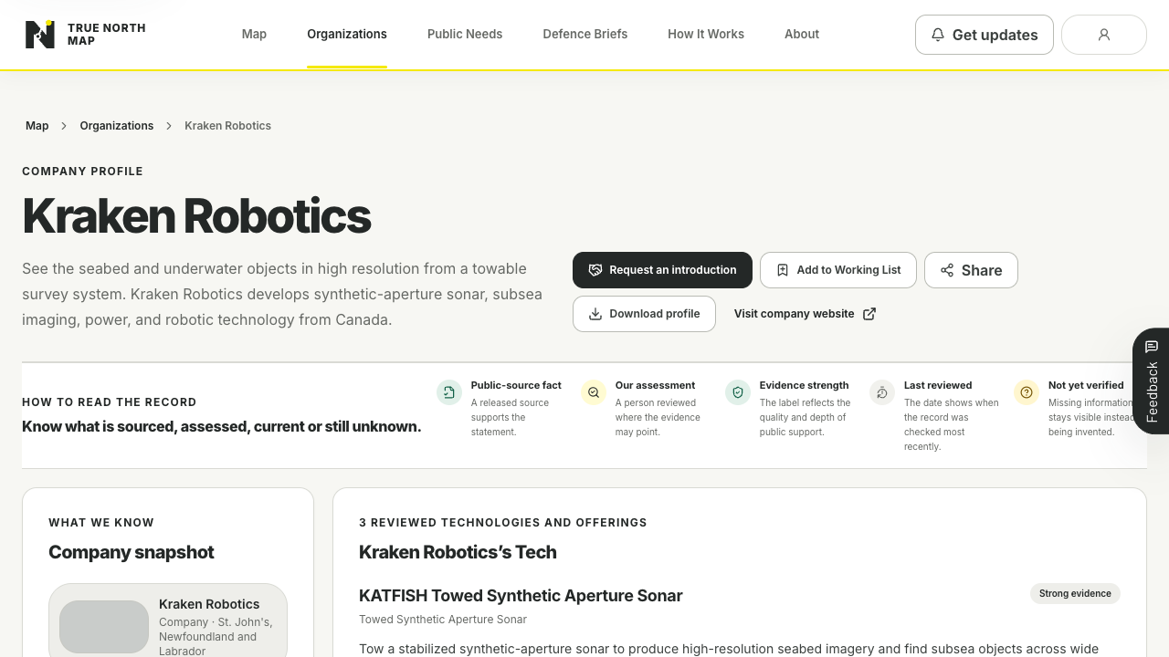
THE PRODUCT
Follow the evidence. Find the fit.
Start the right conversation.
1
Explore
Find companies, technologies and regions.
2
Inspect
Open the sources and visible gaps.
3
Connect
Save a Working List or start a conversation.
TRUE NORTH MAP | PARTNER OVERVIEW
03
Notes:
[Sources]
- https://truenorthmap.ca/how-it-works
- True North Map organization profile screenshot, captured 2026-07-26
[/Sources]

Slide 4
A REVIEWED PUBLIC RECORD
Evidence is the product boundary.
Sources create the public record. People review the interpretation. AI helps people explore, but it does not publish facts or make procurement decisions.
Reviewed public evidence
Transparent gaps
Human review
Profiles and technologies link to durable public sources.
Unknown, stale or incomplete information remains visible.
Research and suggested matches remain private until explicitly published.
Public-source relevance is not procurement eligibility, endorsement or classified demand.
Notes:
[Sources]
- https://truenorthmap.ca/methodology
- https://truenorthmap.ca/how-it-works
[/Sources]

Slide 5
CURRENT PUBLIC BETA
A live national discovery layer,
ready to learn in public.
257
245
383
30
published organization profiles
reviewed technologies
cited public sources
released public needs
The corpus continues to grow through the established research, evidence and human-review workflow. Coverage gaps are published honestly rather than padded.
Public Beta
Free to browse, search, inspect and share.
TRUE NORTH MAP | PARTNER OVERVIEW
05
Notes:
[Sources]
- https://truenorthmap.ca, live production counts read 2026-07-26
[/Sources]

Slide 6
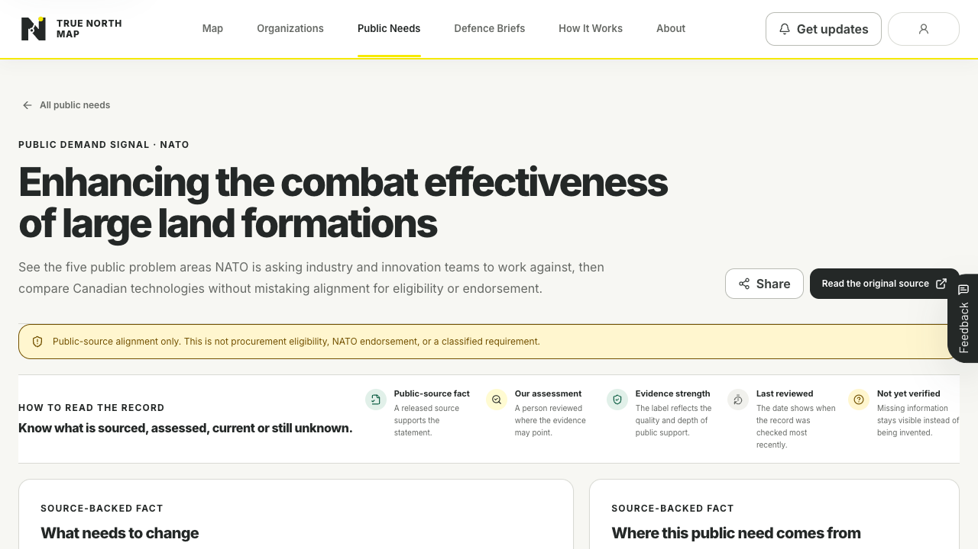
WAYS TO USE IT
Start with a real question.
01
Find a Canadian supplier or partner
02
Map technology to a released public need
03
Understand a regional capability landscape
04
Build a source-backed Working List
Try one real search
Tell us where the evidence, result or next step falls short. That is the most useful feedback.
05
Correct, claim or add a public profile
TRUE NORTH MAP | PARTNER OVERVIEW
06
Notes:
[Sources]
- https://truenorthmap.ca/demand
- True North Map Public Need screenshot, captured 2026-07-26
[/Sources]

Slide 7
INDEPENDENT PROJECT BY ANDREW DAVIES
Make Canadian
capability visible.
Explore the map. Follow the evidence. Find the organizations worth speaking with next.
truenorthmap.ca
Evidence-led ecosystem discovery
Notes:
[Sources]
- https://truenorthmap.ca
- https://truenorthmap.ca/about
[/Sources]

