Slide 1

WreckingNet: Neural approach for the classification of audio signals in construction sites
Neural Networks Project A.Y 2018/2019
Alessandro Maccagno 1653200
Andrea Mastropietro 1652886
Umberto Mazziotta 1647818

Slide 2
Structure
Introduction
Dataset and Data Processing
Architecture
Experiment
Results
Future Work
WreckingNet: Neural approach for the classification of audio signals
in construction sites
Pagina <number>

Slide 3
Structure
Introduction
Dataset and Data Preprocessing
Architecture
Experiment
Results
Future Work
WreckingNet: Neural approach for the classification of audio signals
in construction sites
Pagina <number>

Slide 4
Introduction
Perform classification of vehicles and tools in construction sites
Neural approach
  Combination of two CNNs (raw data and spectrogram)
Working on real data
  Provided by Professor Yongcheol Lee from Louisiana State University
Based on the work of Li et al. that performed environmental sound classification with a neural approach
High classification accuracy (~98%)
WreckingNet: Neural approach for the classification of audio signals
in construction sites
Pagina <number>

Slide 5
Structure
Introduction
Dataset and Data Processing
Architecture
Experiment
Results
Future Work
WreckingNet: Neural approach for the classification of audio signals
in construction sites
Pagina <number>

Slide 6
Dataset (1/2)
Provided by Prof. Yongcheol Lee of LSU
Live recording of construction event sounds
  Tools and machines performing a certain action
Real world data
  Difficulties arise: noise and low quality recordings
Large number of classes (~20)
WreckingNet: Neural approach for the classification of audio signals
in construction sites
Pagina <number>

Slide 7


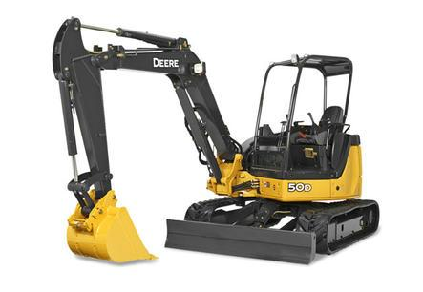
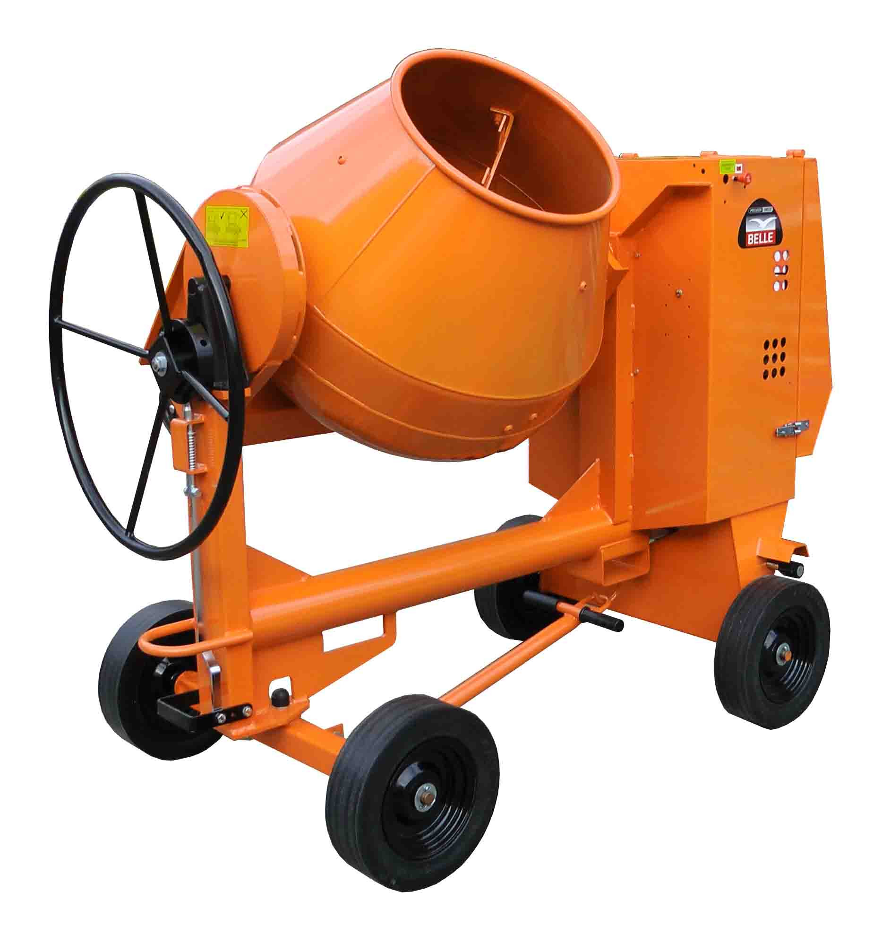
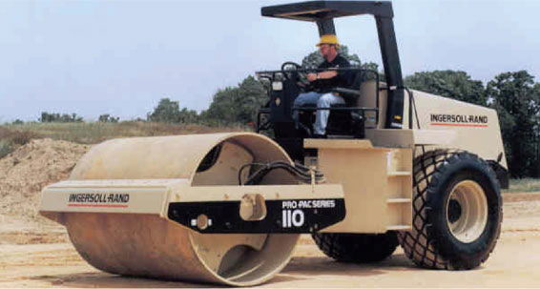
Dataset (2/2)
5 classes selected:
Excavator Cat 320E
Excavator Hitachi 50U
Backhoe JD50D Compact
Concrete Mixer
Compactor Ingersoll Rand
WreckingNet: Neural approach for the classification of audio signals
in construction sites
Pagina <number>

Slide 8
Dataset Preprocessing (1/)
Each track segmented in two fixed length partitions
  70% of the track for training, 30% for test
Each partition split into smaller fragments of 30ms
  15ms overlap
Training/Testing partition done before splitting
  Done to avoid the model to be tested on samples on which it was trained due to the overlap
Use pickle module to serialize data into files
  No need to regenerate components from audio files
  Noticeable reduction of the time required to obtain the dataset
  Noticeable reduction of the size of the data
WreckingNet: Neural approach for the classification of audio signals
in construction sites
Pagina <number>

Slide 9
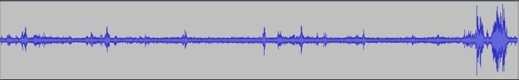
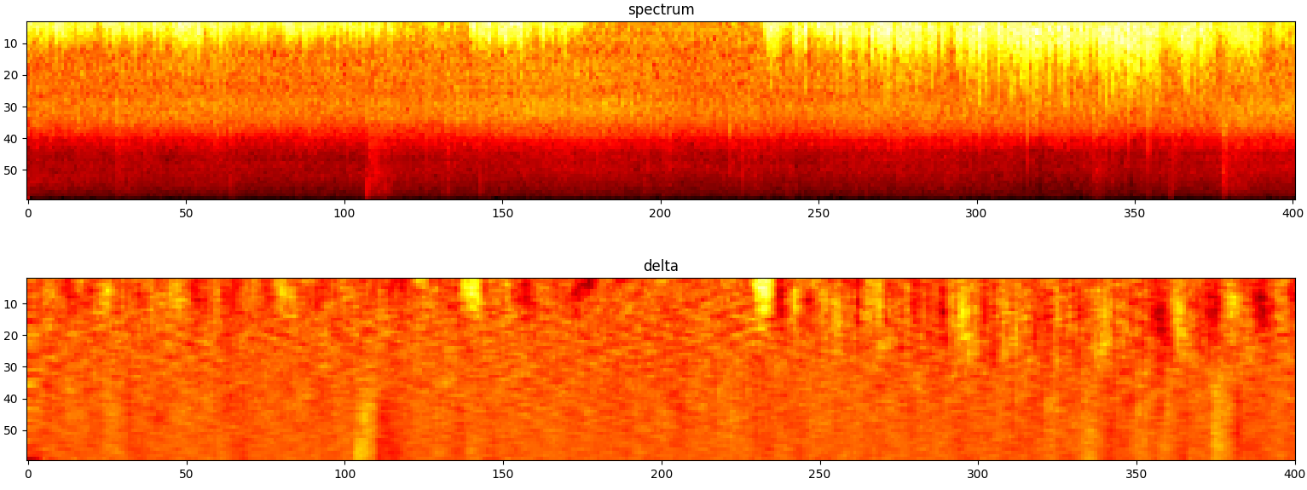
Data Preprocessing(2/)
We use 2 types of information:
Raw data
  Waveform of the audio
  Value of the wave of each instant is in the interval [-1.0, 1.0]
Spectral data
  Log-scale mel-spectrogram of the audio
  First-order time derivative of the mel-spectrogram
  60 mel bands
Waveform
Mel spectrogram and delta
Titolo Presentazione
Pagina <number>

Slide 10
Structure
Introduction
Dataset and Data Processing
Architecture
Experiment
Results
Future Work
WreckingNet: Neural approach for the classification of audio signals
in construction sites
Pagina <number>

Slide 11
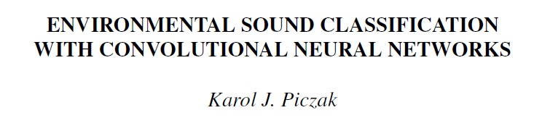
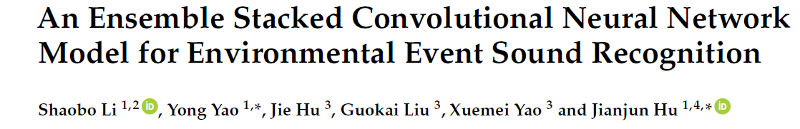
Architecture (1/)
An implementation from Li, Liu, 2*(Yao, Hu) and Piczak
Use two different neural networks
Each neural network makes use of a different type of data
Unify the results using Dempster-Shafer theory to improve results
Titolo Presentazione
Pagina <number>

Slide 12
Architecture (2/) - RawNet
Uses the waveform of the audio fragment
Optimizer: AdamOptimizer with a learning rate of 5⁻⁴
Titolo Presentazione
Pagina <number>

Slide 13
Architecture (3/) - SpectroNet
Uses the spectrograms of the audio fragment
Optimizer: AdamOptimizer with a learning rate of 5⁻⁴
Titolo Presentazione
Pagina <number>

Slide 14
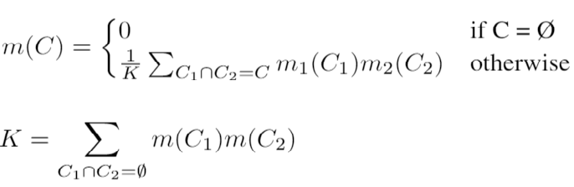
Architecture (4/) – DSE Module
Implements Dempster’s rule of combination:
Classes are mutually exclusive
Each network outputs a class probability distribution via its softmax layer
The probability that a segment belongs to a single class is equal to the normalized product of the two networks probabilities
Titolo Presentazione
Pagina <number>

